Slide 1

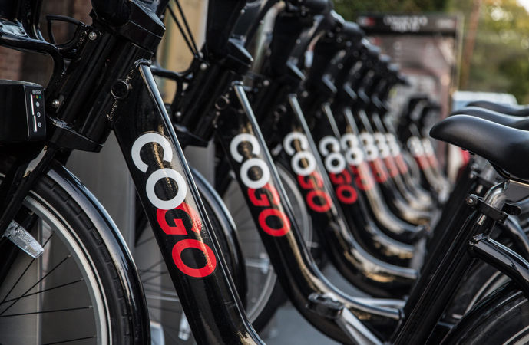
Bike Sharing Data (COGO bike) -Exploratory Data Analysis
Team -03
Project 1: Exploratory Data Analysis (EDA)
Class: DATS 6101- Intro to Data Science

Slide 2



OUR TEAM
Vishesh Bhati
Amjad Altuwayjiri
Suzhe Li
1
Bike Sharing Data (COGO bike) -Exploratory Data Analysis
Team-03

Slide 3
Why Bike sharing system?
While this system has many benefits, it also presents operators with a number of challenges, such as the best way to estimate demand. The data contains multiple features to explore which helped us to learn about the business and how to use analytics for the same.
Problem Statement
How can the CoGo bike-sharing company boost their profit margins by implementing particular adjustments, such as increasing or removing specific bike kinds, growing its business in a specific location, or lowering or raising the cost of bike share?
2
Bike Sharing Data (COGO bike) -Exploratory Data Analysis
Team-03

Slide 4
Source of Dataset
We found the data on CoGo website. They have made the CoGo's trip data available for public use.
This data is provided according to the CoGo Data License Agreement.
Features in the dataset
Rider ID
Bike Type
Start Time and Date
Stop Time and Date
Start Station Name
End Station Name
Station ID
Station Lat/Long
User Type
3
Bike Sharing Data (COGO bike) -Exploratory Data Analysis
Team-03

Slide 5





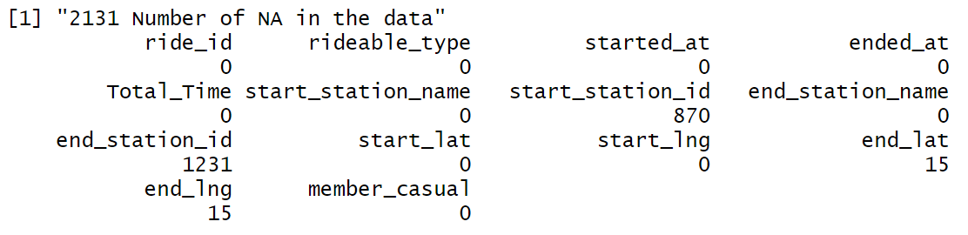
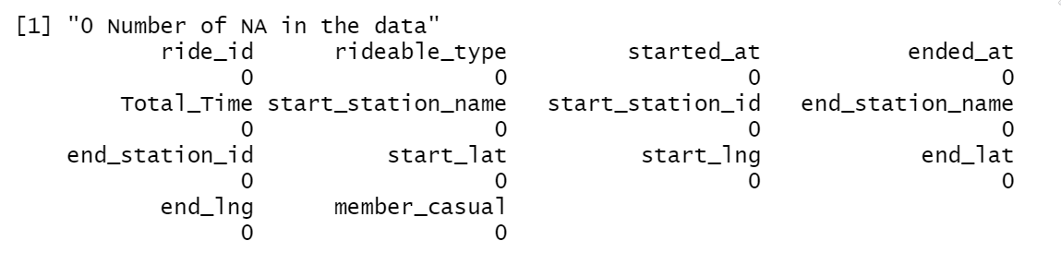
Missing Data
CSV file import
Select Columns
Find Nulls
Remove Nulls
Judgement call
Post removing the nulls we found, most of NA’s were contained in the columns start_station_id and end_station_id. However, since the name of the station was present we didn’t delete the rows. For further investigation, we subset the NA values to track any pattern.
4
Bike Sharing Data (COGO bike) -Exploratory Data Analysis
Team-03

Slide 6
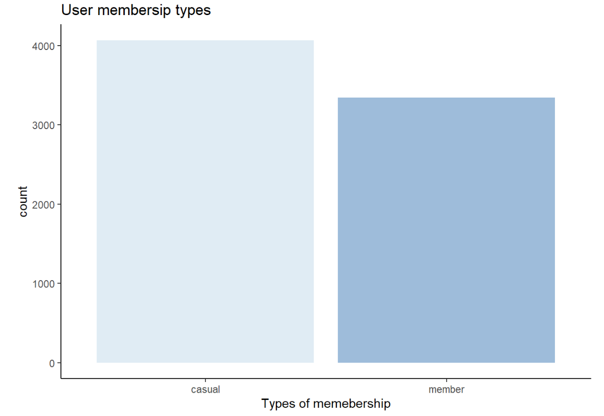
EDA: User’s membership type
Total users- 7,416
Casual users- 4,069
Annual member- 3347
Causal user’s single trip cost $2.25 per 30 min*
Annual membership trip cost $85 a year*
Findings:
There are more causal users than annual membership users, which is 4069 - 3347 = 722
* Electric bike price is $0.15 more than Classic bike for casual users and $0.10 more for annual users
5
Bike Sharing Data (COGO bike) -Exploratory Data Analysis
Team-03

Slide 7
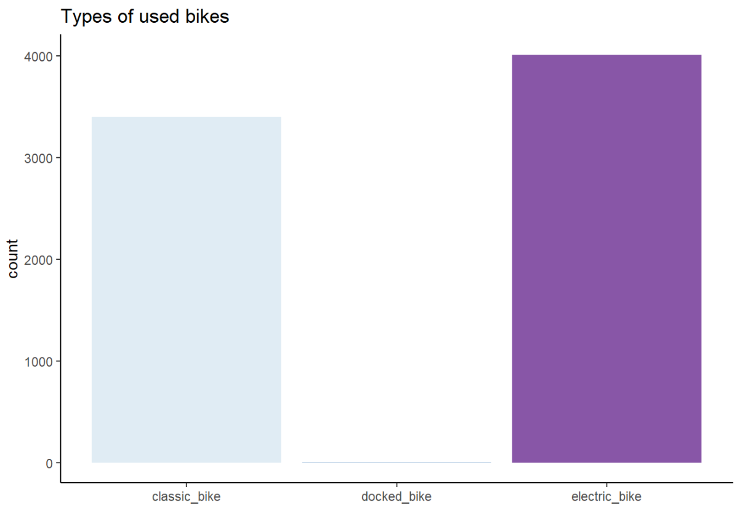
EDA: Most frequent bike type used
Total bike types- 3
Classic bike- 3,401
Electric bike- 4,012
Docked bike- 3
Electric bike price is $0.15 more than Classic bike for casual users
Electric bike price $0.10 more than Classic bike for annual membership users
Findings:
There are very few users of Docked bike and Electric bike is used the most
Electric bike is used more than the Classic bike
6
Bike Sharing Data (COGO bike) -Exploratory Data Analysis
Team-03

Slide 8
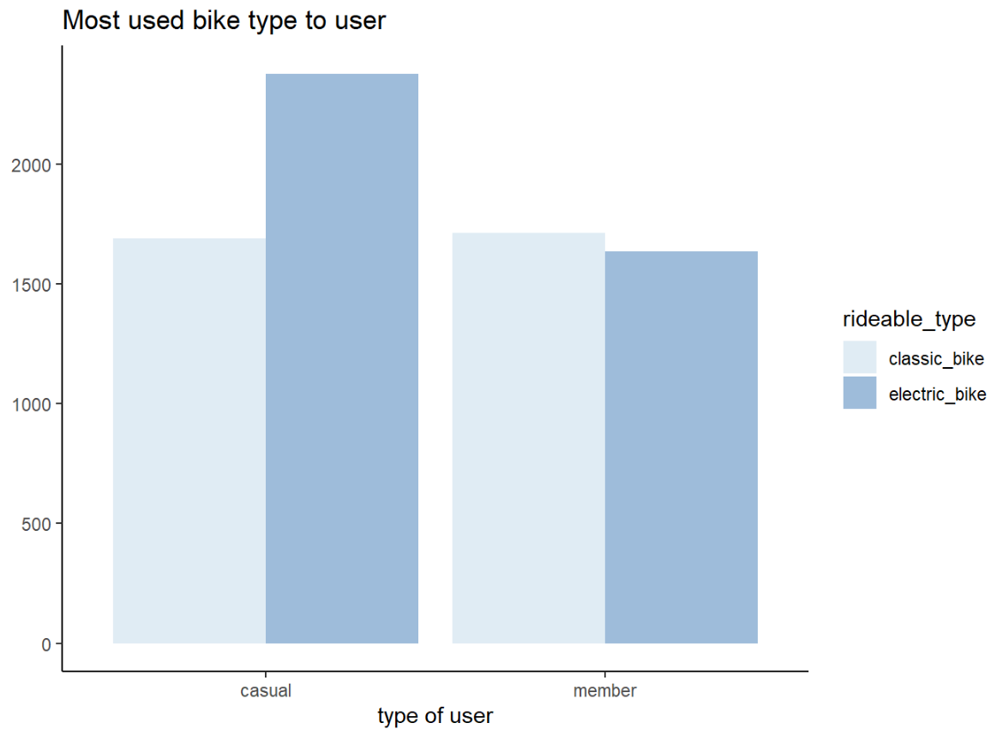
EDA: Casual vs Annual member bike preference
Casual users using Classic bike- 1689
Casual users using Electric bike- 2377
Annual members using Classic bike- 1712
Annual members using Electric bike- 1635
Findings:
Casual members prefer electric bikes over classic bikes- around 680 users
No significant difference in annual member’s bike preference
7
Bike Sharing Data (COGO bike) -Exploratory Data Analysis
Team-03

Slide 9
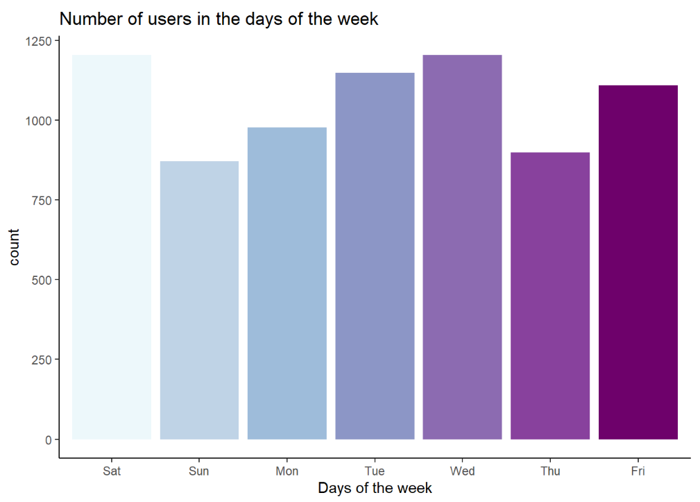
EDA: Number of users per day
Number of users per day:
Wednesday- 1,205
Saturday- 1,204
Tuesday- 1,149
Friday- 1,110
Monday- 978
Thursday- 899
Sunday- 871
Findings:
Saturdays and Wednesdays have the most number of users and Sundays have least.
8
Bike Sharing Data (COGO bike) -Exploratory Data Analysis
Team-03

Slide 10
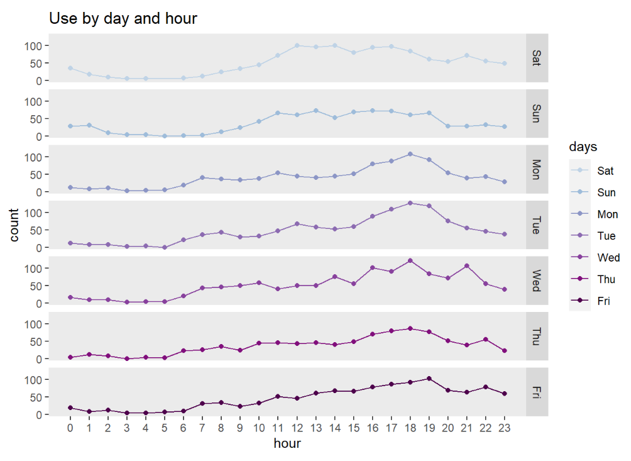
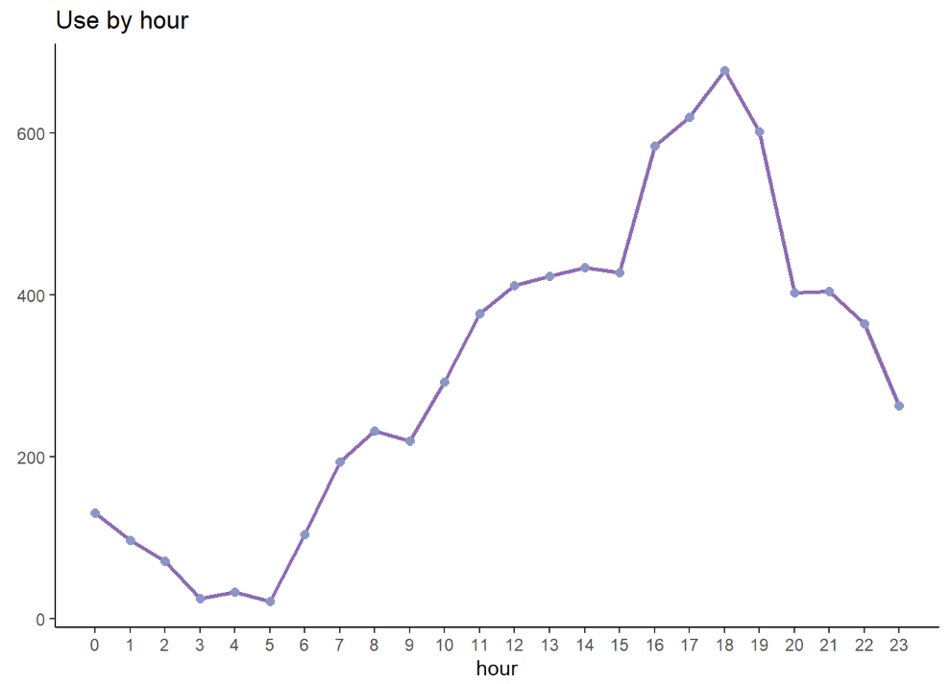
EDA: Highest-lowest time of use of the day
Findings: During the weekend hours, the rush hour starts at 9:00 am while on the weekdays it starts earlier at 6:00 am. Also, on most of the weekdays, the line does not drop unt il 9:00 pm but it drops a little earlier during the weekends at 8:00 pm.
Findings: The peak hours of August is between 3:00 pm to 7:30 pm with above 400 users.
9
Bike Sharing Data (COGO bike) -Exploratory Data Analysis
Team-03

Slide 11
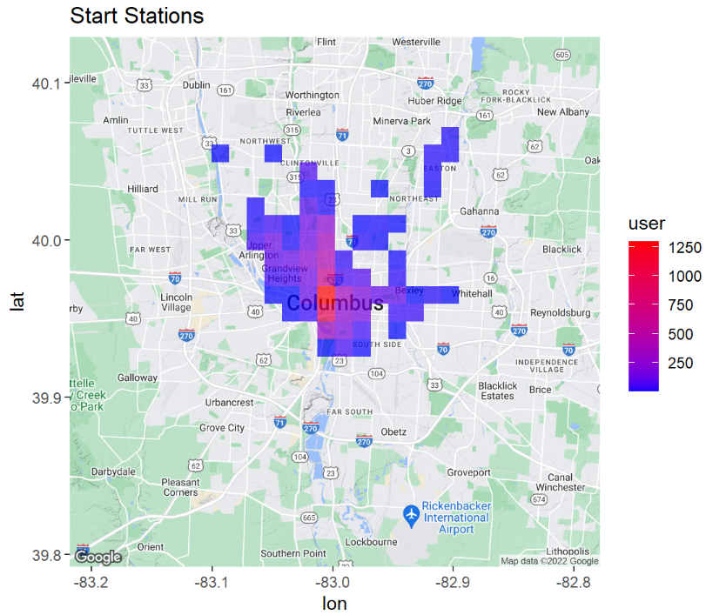
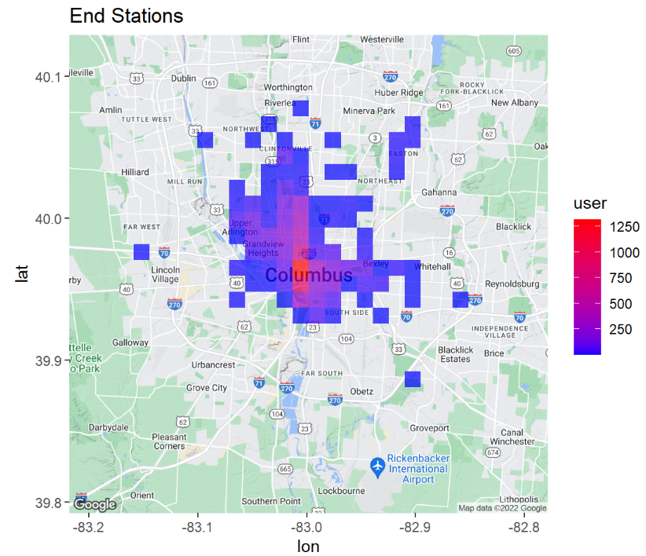
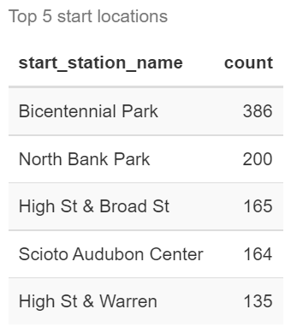
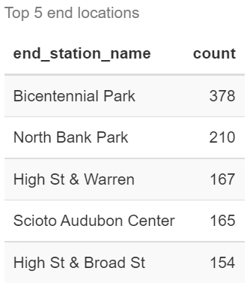
EDA: Top Stations
Findings:
Top stations:
Bicentennial Park
North Bank Park
High St & Broad St
Scioto Audubon Center
High St & Warren
10
Bike Sharing Data (COGO bike) -Exploratory Data Analysis
Team-03

Slide 12
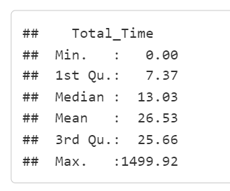
EDA: Summary Statistics Total time
11
Bike Sharing Data (COGO bike) -Exploratory Data Analysis
Team-03

Slide 13
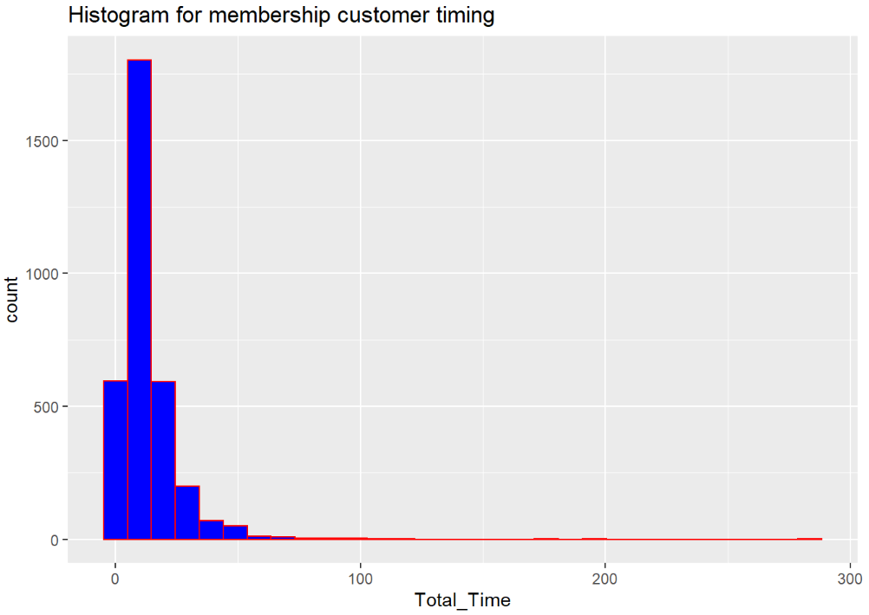
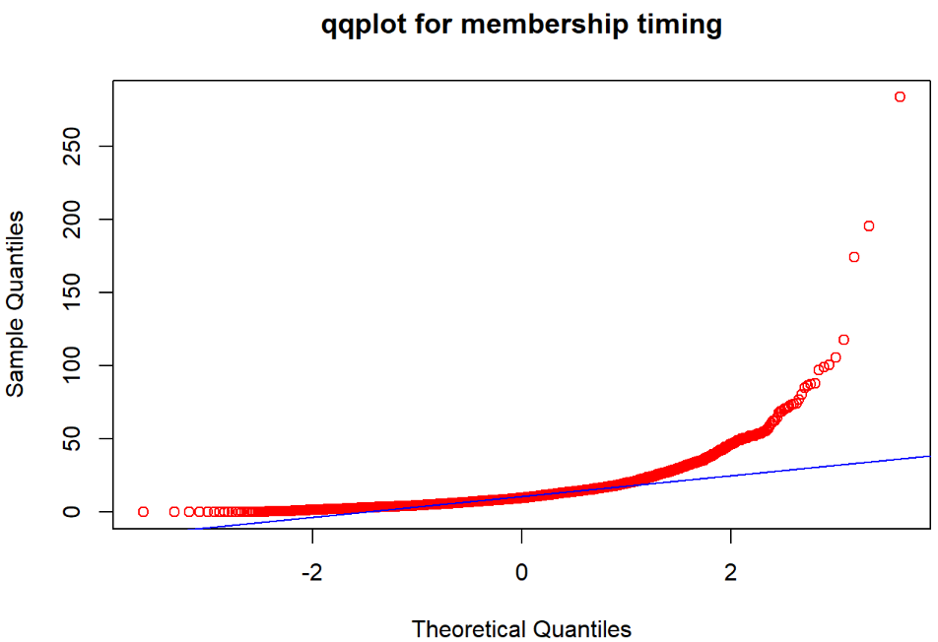
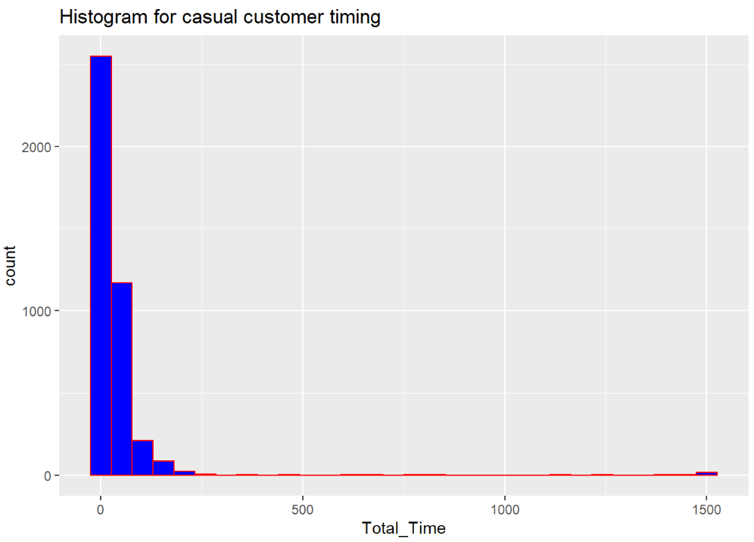
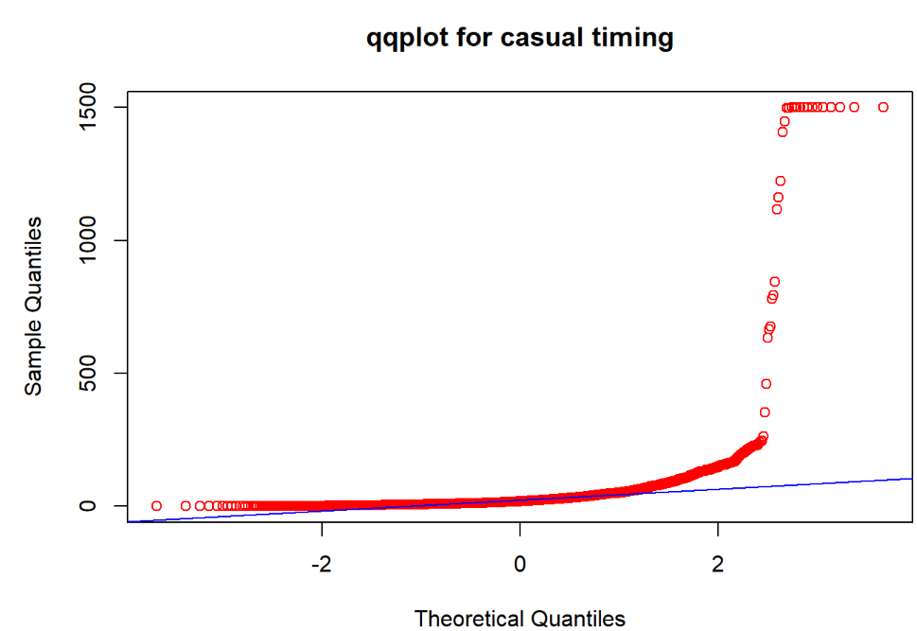
EDA: Casual vs Annual member above boundary time
Step 2
Step 1
Subset the data
(member and casual)
Built an histogram and qqplot
Boundary time:
Casual user: 30 mins
Annual member: 45 mins
Histogram is right skewed, not much data is distributed in the extreme right tail
qqplot data lying on the qqline, which are normally distributed
Finding:
Extreme max values are occasional so we must delete the outliers for further testing
12
Bike Sharing Data (COGO bike) -Exploratory Data Analysis
Team-03

Slide 14
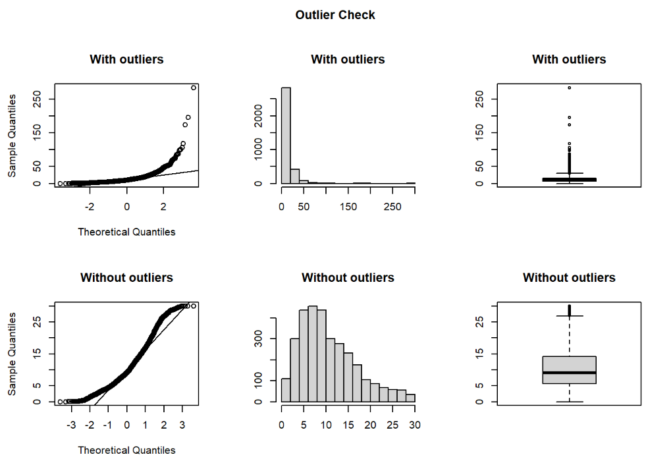
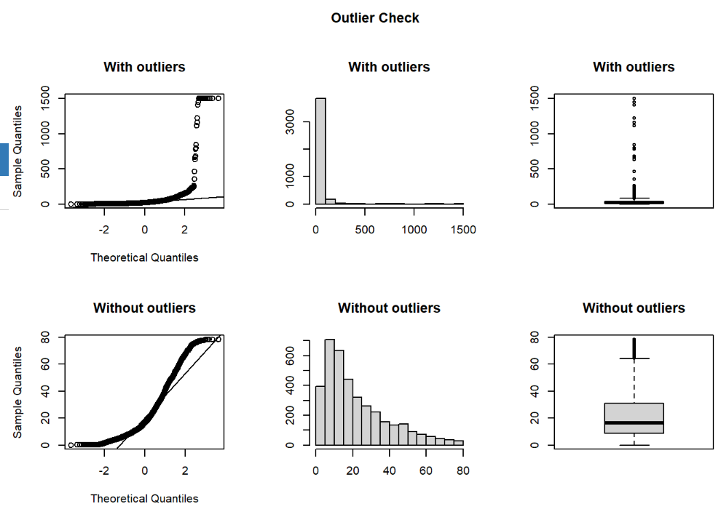
EDA: Casual vs Annual member above boundary time
Comparison of data with and without outliers
Annual membership
Casual users
13
Bike Sharing Data (COGO bike) -Exploratory Data Analysis
Team-03

Slide 15
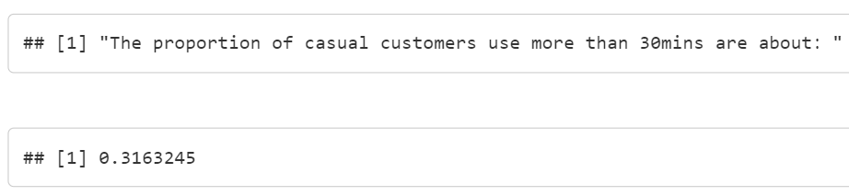
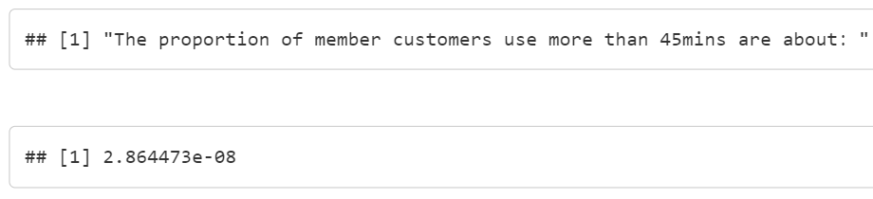
EDA: Casual vs Annual member above boundary time
Step 3
Casual customers using bikes over 30 mins – 31%
Annual members using bikes over 45 mins- negligible
Finding:
casual customers tend to go above boundary time in comparison to annual members
To further test our assumption that casual customer always use more time than member, we need to test average time of casual > average time of member user
pnorm
14
Bike Sharing Data (COGO bike) -Exploratory Data Analysis
Team-03

Slide 16
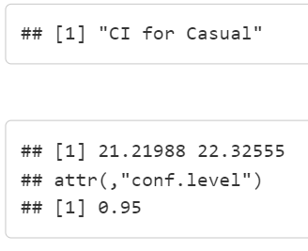
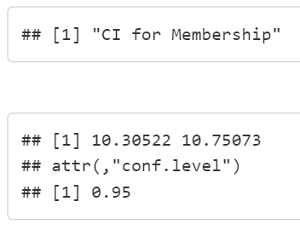
EDA: Casual vs Annual member above boundary time
Step 3
Casual customers CI at 95%: 21.21 - 22.3
Annual members CI at 95%: 10.30 – 10.75
Finding:
No overlap in CI
Time interval of member < Time interval of the casual users
t-test
15
Bike Sharing Data (COGO bike) -Exploratory Data Analysis
Team-03

Slide 17
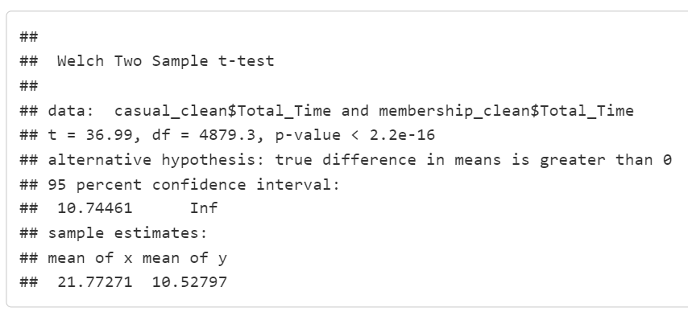
EDA: Casual vs Annual member above boundary time
Step 5
Null Hypothesis H0: average riding time of membership <= average riding time of casual customers
we set our significance level as 5%
p-value- 2.2e-16
Finding:
p-value is extremely small
We can reject null hypothesis
t-test
16
Bike Sharing Data (COGO bike) -Exploratory Data Analysis
Team-03

Slide 18
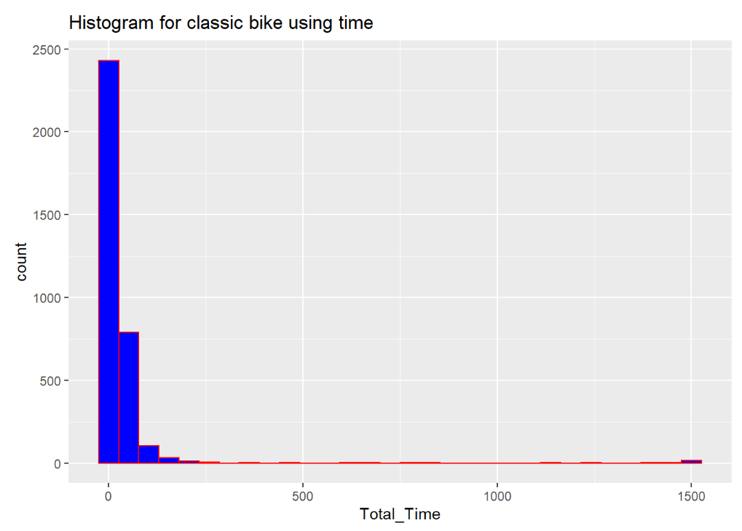
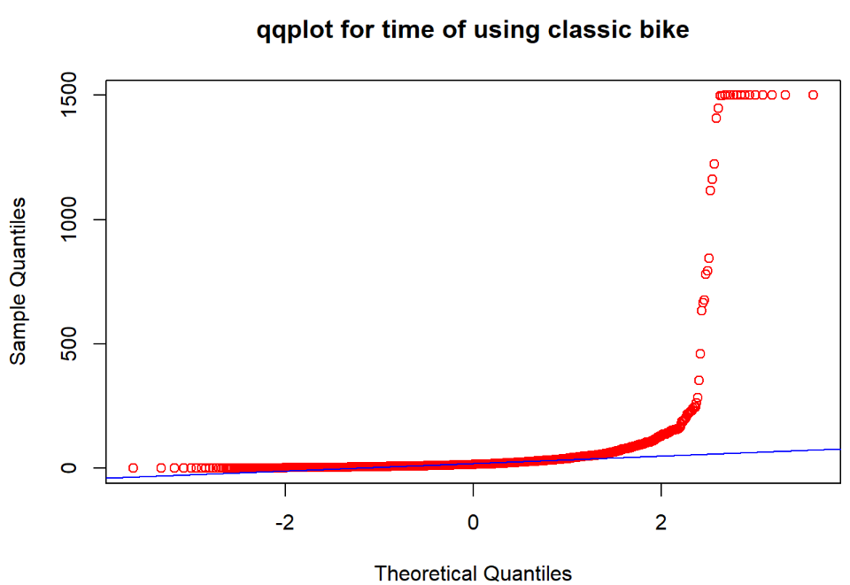
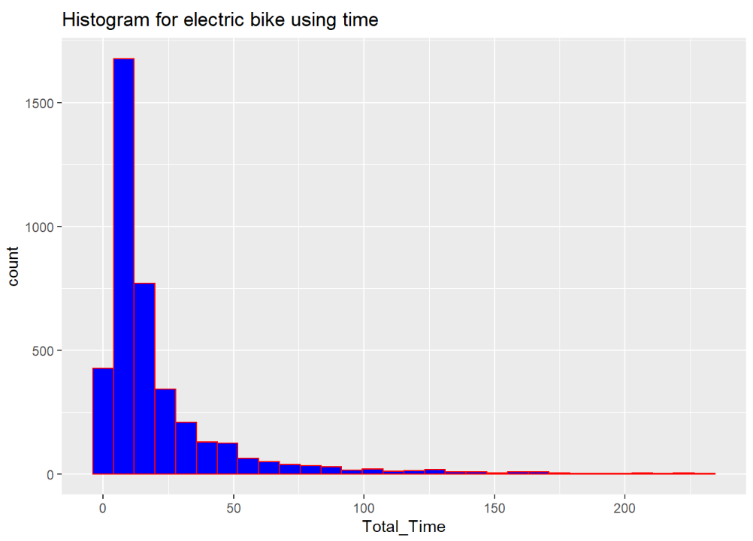
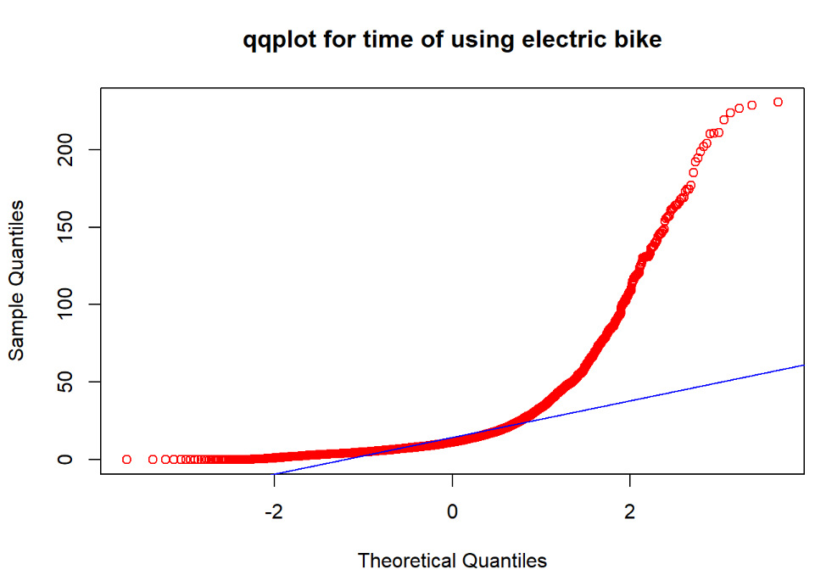
EDA: Bike type ride time comparison
Step 2
Step 1
Subset the data
(member and casual)
Built an histogram and qqplot
Histogram is right skewed, not much data distributed in the extreme right tail
qqplot data lying on the qqline, which are normally distributed
Conclusion:
Extreme max values are occasional so we must delete the outliers for further testing
17
Bike Sharing Data (COGO bike) -Exploratory Data Analysis
Team-03

Slide 19
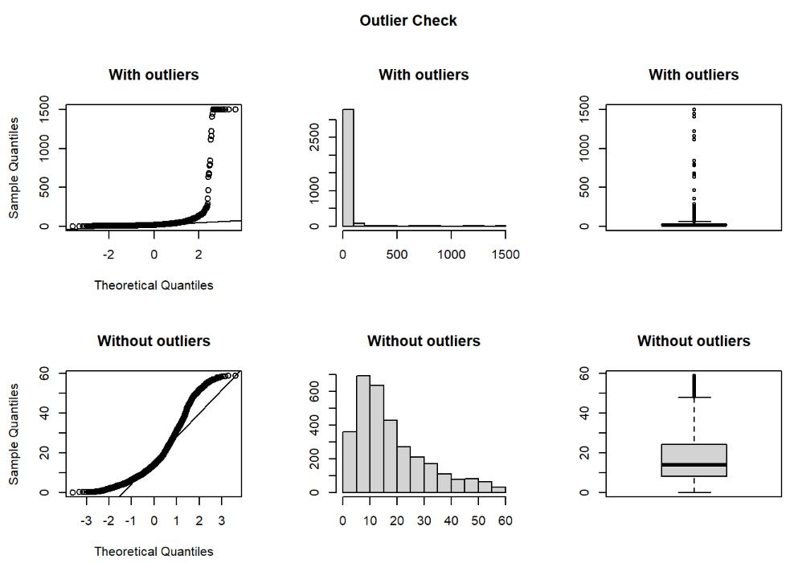
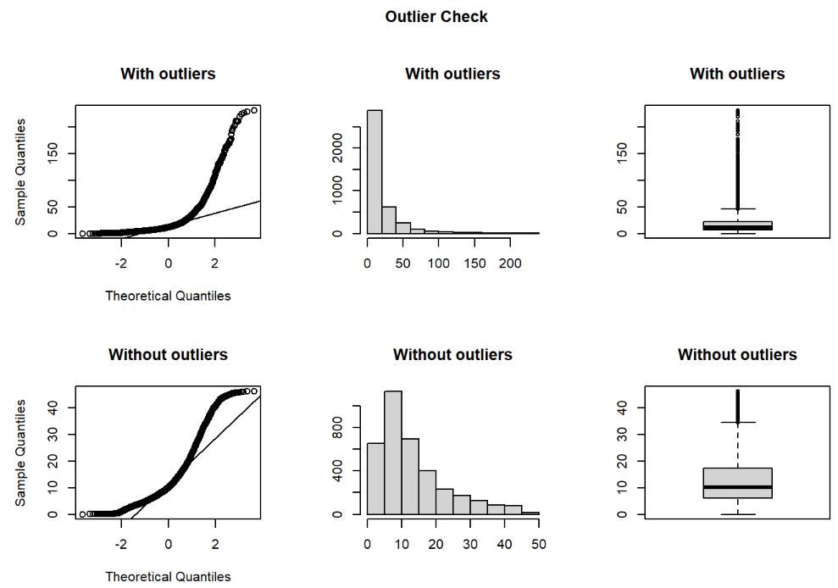
EDA: Bike type ride time comparison
Comparison of data with and without outliers
Classic Bike
Electric Bike
18
Bike Sharing Data (COGO bike) -Exploratory Data Analysis
Team-03

Slide 20
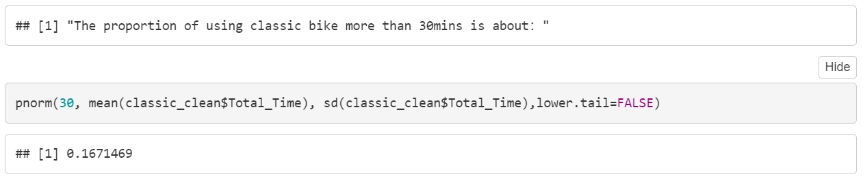
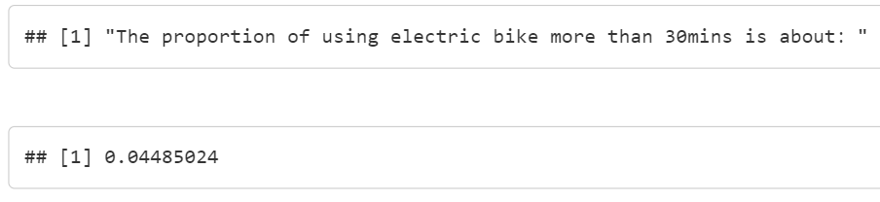
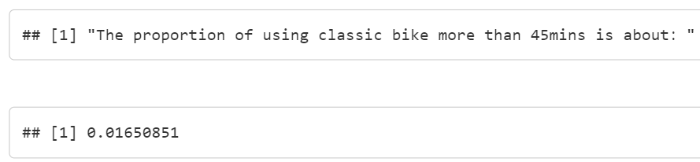
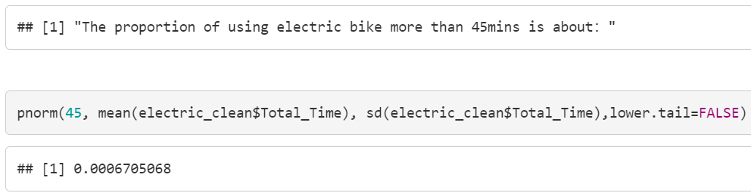
EDA: Bike type ride time comparison
Step 3
Classic bikes used over 30 mins – 16%
Electric bikes used over 30 mins – 4%
Classic bikes used over 45 mins- 1.6%
Electric bikes used over 45 mins- negligible
Finding:
For both 30 and 45 mins time boundary classic bike is used the most
To further test our assumption that Classic bike is used more than electric bike, we need to test if the average time for both are the same
pnorm
19
Bike Sharing Data (COGO bike) -Exploratory Data Analysis
Team-03

Slide 21
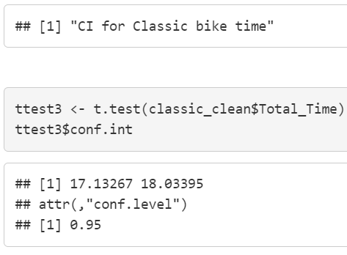

EDA: Bike type ride time comparison
Step 4
Classic bike CI at 95%: 17.13 - 18.03
Electric bike CI at 95%: 12.81 – 13.46
Finding:
No overlap in CI
Time interval of Electric bike < Time interval of Classic bike
t-test
20
Bike Sharing Data (COGO bike) -Exploratory Data Analysis
Team-03

Slide 22
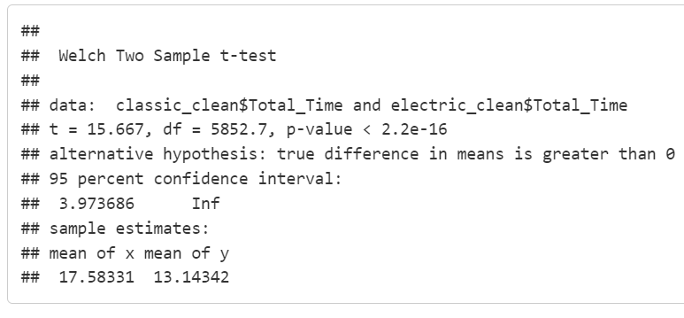
EDA: Bike type ride time comparison
Step 5
Null Hypothesis H0: Classic bike ride time <= the Electric bike ride time
we set our significance level as 5%
p-value- 2.2e-10
Finding:
p-value is extremely small
We can reject the null hypothesis
t-test
21
Bike Sharing Data (COGO bike) -Exploratory Data Analysis
Team-03

Slide 23
Conclusion and Recommendation
Sno. | Conclusion | Recommendation
1 | Casual users- 4,069; Annual members- 3,347; Difference is 722 | Company should focus more on casual users
2 | Electric bike users- 4012 ; Classis bike users- 3401; Docked bike users- 3 | Since there are only a few users using the docked bike. We recommend that the company should stop investing in the docked bikes and should use its money and inventory for Electric bike
3 | Casual members prefer electric bikes over classic bikes- around 680 users; no significant difference in annual member’s bike preference | Even though Electric bikes are expensive, casual members prefer them. This again brings to our last conclusion that the company should invest in Electric bikes more
4 | Saturdays and Wednesdays have the most number of users and Sunday has least | Company can do the bike and station maintenance work on Sundays
5 | During the weekend hours, the rush hour starts at 9:00 am while on the weekdays it starts earlier at 6:00 am. Also, on most of the weekdays, the line does not drop until 9:00 pm but it drops a little earlier during the weekends at 8:00 pm | Since, people use less bikes post 9:00 pm so company can start the bike and station maintenance post 9:00 pm on Sunday
6 | The peak hours of August is between 3:00 pm to 7:30 pm with above 400 users | Since these are the busiest hours; the price can be increased for these hours and can be reduced for Sundays and the other days when the bike is less used
7 | Top 5 stations: Bicentennial Park; North Bank Park; High St & Broad St; Scioto Audubon Center; High St & Warren | The company can invest more in these stations and can increase the number of bikes. Also, the company can increase the price for the users of these stations and looking at the pattern in the future can reduce or maintain the price
8 | Casual customers using bikes over 30 mins – 29% Casual customers CI at 95%: 21.21 - 22.2 | The company can increase their profit margin by slightly increasing the boundary price for casual customers because casual customers may be more accepting of the price increment Company can even reduce the boundary time to 20 mins to increase the profit
9 | Classic bikes used over 30 mins – 16% Classic bike CI at 95%: 17.13 - 18.03 Electric bike CI at 95%: 12.81 – 13.46 Electric bikes used over 30 mins – 4% | Classic bike price can be increased for over 30 mins by a slight margin Even though electric bikes are used most people don’t use them for over 30 mins. So Electric bike inventory can be increased but their price margin over 30 mins can be reduced
22
Bike Sharing Data (COGO bike) -Exploratory Data Analysis
Team-03

Slide 24
Conclusion and Recommendation
Sno. | Conclusion | Recommendation
1 | Casual users- 4,069; Annual members- 3,347; Difference is 722 | Company should focus more on casual users
2 | Electric bike users- 4012 ; Classis bike users- 3401; Docked bike users- 3 | Since there are only a few users using the docked bike. We recommend that the company should stop investing in the docked bikes and should use its money and inventory for Electric bike
3 | Casual members prefer electric bikes over classic bikes- around 680 users; no significant difference in annual member’s bike preference | Even though Electric bikes are expensive, casual members prefer them. This again brings to our last conclusion that the company should invest in Electric bikes more
4 | Saturdays and Wednesdays have the most number of users and Sunday has least | Company can do the bike and station maintenance work on Sundays
5 | During the weekend hours, the rush hour starts at 9:00 am while on the weekdays it starts earlier at 6:00 am. Also, on most of the weekdays, the line does not drop until 9:00 pm but it drops a little earlier during the weekends at 8:00 pm | Since, people use less bikes post 9:00 pm so company can start the bike and station maintenance post 9:00 pm on Sunday
6 | The peak hours of August is between 3:00 pm to 7:30 pm with above 400 users | Since these are the busiest hours; the price can be increased for these hours and can be reduced for Sundays and the other days when the bike is less used
7 | Top 5 stations: Bicentennial Park; North Bank Park; High St & Broad St; Scioto Audubon Center; High St & Warren | The company can invest more in these stations and can increase the number of bikes. Also, the company can increase the price for the users of these stations and looking at the pattern in the future can reduce or maintain the price
8 | Casual customers using bikes over 30 mins – 29% Casual customers CI at 95%: 21.21 - 22.2 | The company can increase their profit margin by slightly increasing the boundary price for casual customers because casual customers may be more accepting of the price increment Company can even reduce the boundary time to 20 mins to increase the profit
9 | Classic bikes used over 30 mins – 16% Classic bike CI at 95%: 17.13 - 18.03 Electric bike CI at 95%: 12.81 – 13.46 Electric bikes used over 30 mins – 4% | Classic bike price can be increased for over 30 mins by a slight margin Even though electric bikes are used most people don’t use them for over 30 mins. So Electric bike inventory can be increased but their price margin over 30 mins can be reduced
22
Bike Sharing Data (COGO bike) -Exploratory Data Analysis
Team-03

