Slide 1

Classification of Human Activities using Smartphone Sensors through Machine Learning and Neural Network Algorithms

Slide 2

I. Introduction
Human activity recognition using smartphones is a growing area of research with potential applications in health monitoring, sleep observation, and fitness tracking
Notes:
What is the project about
So this project is about a data that is collected from you smartphone or could be electronic watch and by applying machine learning and NN algorithems we can detect what type of activity your doing at the moment!
What is its importance
The importance of this project come from.. If we could track your daily activity we could tell you about your fitness and how much exercises you do, or monitor your sleeping and hell you about your sleeping happit

Slide 3
II. Dataset
0
Uploading Data
. UCI Human Activity Recognition with Smartphones dataset that collected accelerometer and gyroscope data from a Samsung Galaxy S II smartphone
. Contains 10,299 instances of 6 different activities performed by 30 subjects and 561 different features
Analyze Columns
Feature reduction
Notes:
The dataset come from "…" don’t ask me about that! So from the two sencesrs they got those two features xyz and xyz, then they done feature engineering by doing mean, coefficient and all that they created 561 columns. The data has more than 10 thousands rows from 30 subjects

Slide 4
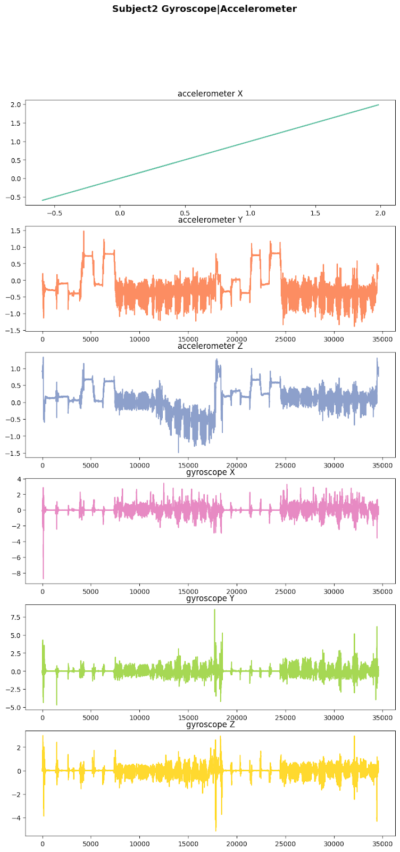
II. Dataset
UCI Human Activity Recognition with Smartphones dataset. Collected accelerometer and gyroscope data from a Samsung Galaxy S II smartphone
Uploading Data
Analyze Columns
Feature reduction
Notes:
This is a graph of the main dataset the .. two main features the xyz, xyz! And me and you we can tell that this part probably sitting, maybe standing or laying and this part is walking, maybe going on the stairs or something!

Slide 5
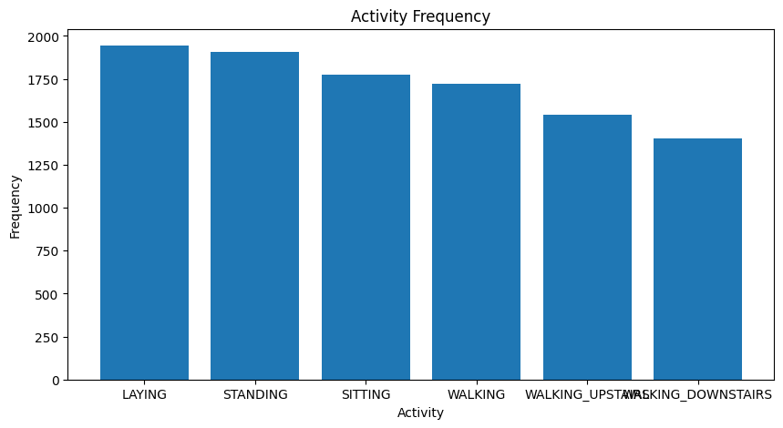
II. Dataset
UCI Human Activity Recognition with Smartphones dataset. Collected accelerometer and gyroscope data from a Samsung Galaxy S II smartphone
Uploading Data
The distribtion of 6 activities
Analyze Columns
Feature reduction
Notes:
So these are the type of activities we're trying to predict. They are six "…" and as we can see in the graph the distribution of these activities are pretty good that we're not having imbalanced data

Slide 6
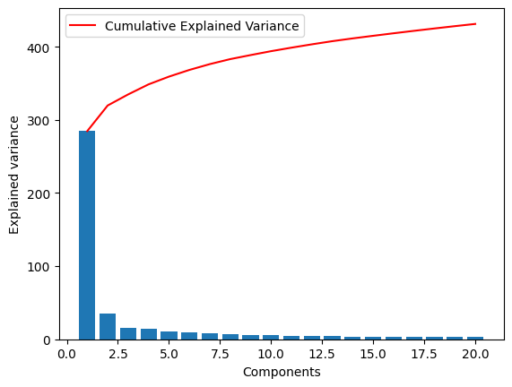
II. Dataset
UCI Human Activity Recognition with Smartphones dataset. Collected accelerometer and gyroscope data from a Samsung Galaxy S II smartphone
PCA key components' cumulative EV
Uploading Data
Analyze Columns
Feature reduction
Notes:
After drawing graphs, separating independent X and dependent y, we scaled X variables into 0 and 1. Finishing this process of basic preprocessing, we built a PCA model and drew a graph about correlation among key components and y targets. From this graph, we can see the cumulative explained variance are over 400 and it soothmly changes after components equals 20.

Slide 7
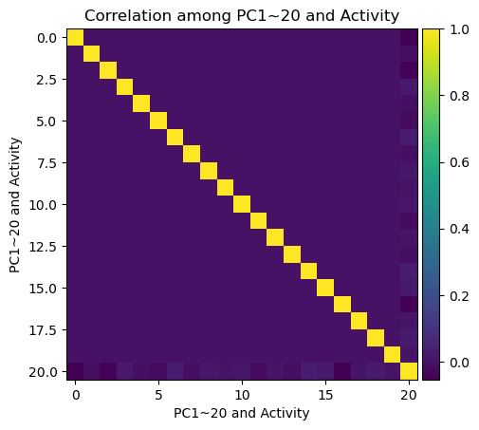
II. Dataset
UCI Human Activity Recognition with Smartphones dataset. Collected accelerometer and gyroscope data from a Samsung Galaxy S II smartphone
Correlation matrix
Uploading Data
Analyze Columns
Feature reduction
Notes:
This is correlation matrix among key components and y target. Some have medium correlation with each other but some' correlation is weak.

Slide 8
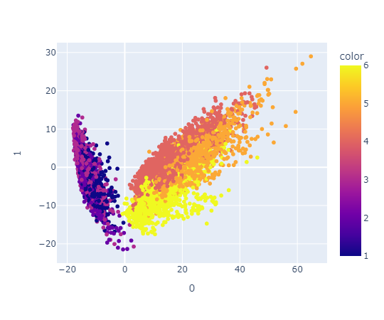
II. Dataset
UCI Human Activity Recognition with Smartphones dataset. Collected accelerometer and gyroscope data from a Samsung Galaxy S II smartphone
Uploading Data
The distribtion of the first two components
Analyze Columns
Feature reduction
Notes:
We chose the first two key components and show their activities by colors. And the distribution of these two components are shown as this graph. As we can see, it also linearly separable.

Slide 9
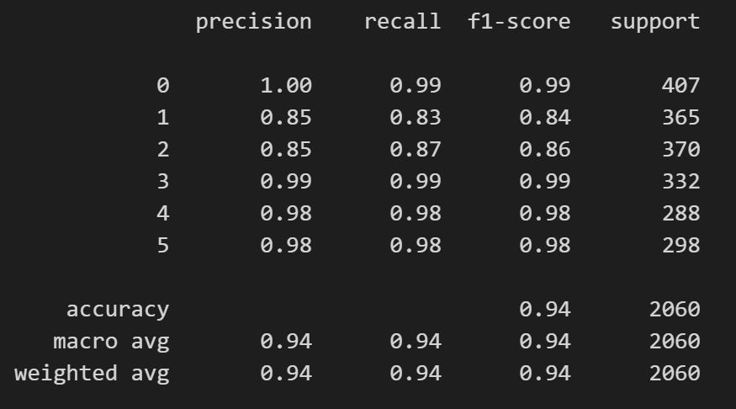
III. Machine Learning Algorithms
MLP
LVQ
SVM
Notes:
So we're doing three models MLP, LVQ, and SVM. And in analysing the MLP model it got 94% accurcy and did well in most of the parts precision, recall, f1score

Slide 10
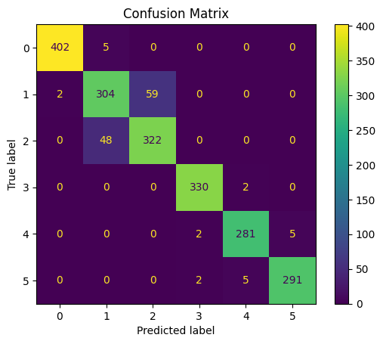
MLP
LVQ
SVM
III. Machine Learning Algorithms
Notes:
The confusion matrix shows us that the model did pretty good in predicting most of the classes. However it got a little confused in 1 and 2 that is standing and sitting. It got 59 standing activities as sitting and the same with sitting, t got 48 sitting to be predicted as standing

Slide 11
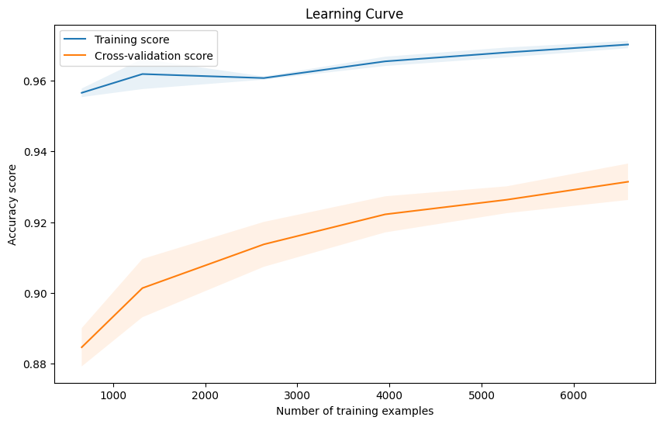
MLP
LVQ
SVM
III. Machine Learning Algorithms
Notes:
However when we plotted the learning curve we

Slide 12
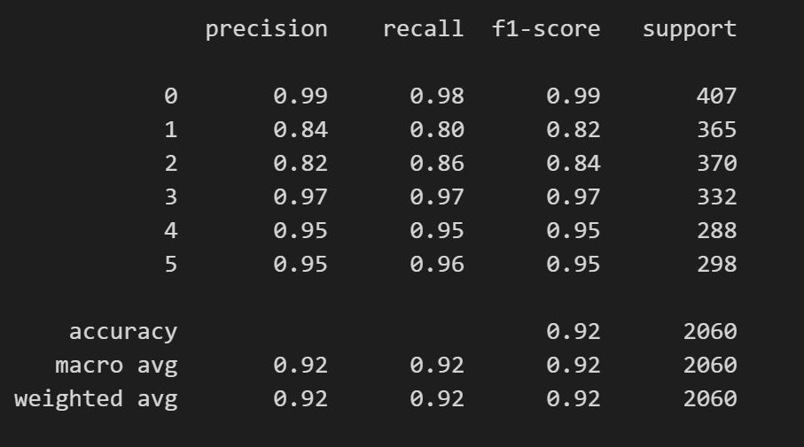
MLP
LVQ
SVM
III. Machine Learning Algorithms

Slide 13

MLP
LVQ
SVM
III. Machine Learning Algorithms

Slide 14
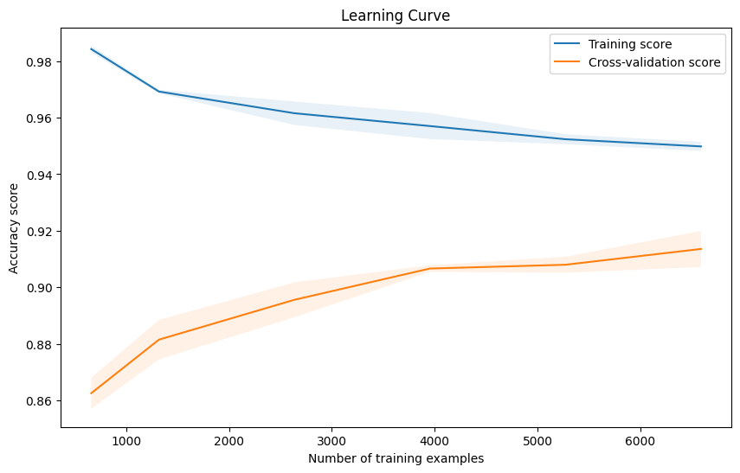
MLP
LVQ
SVM
III. Machine Learning Algorithms

Slide 15
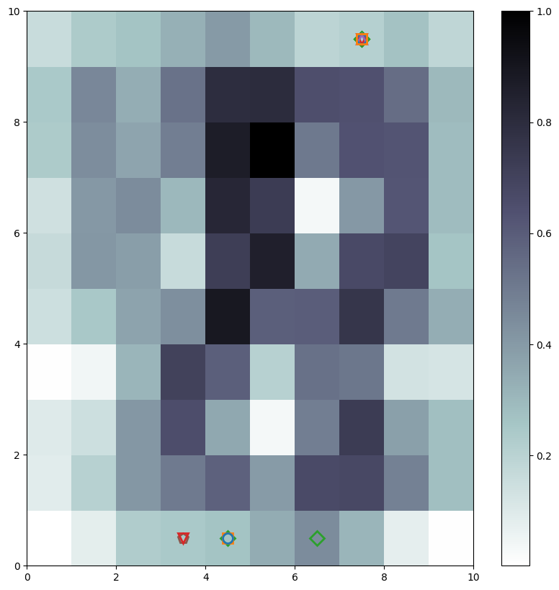
MLP
LVQ
SVM
III. Machine Learning Algorithms

Slide 16
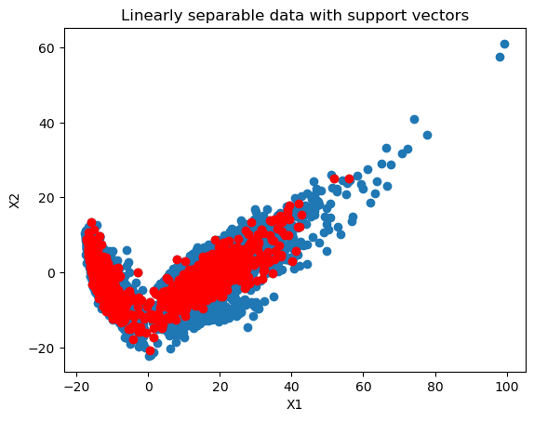
III. Machine Learning Algorithms
MLP
LVQ
SVM
Finding support vectors
Notes:
We built SVM model and tried to find the support vectors. The red dots are support vectors we found. As you can see, there are too many. And I will discuss it later.

Slide 17
III. Machine Learning Algorithms
MLP
LVQ
SVM
As we can see, the data can be linearly separable.
So setting SVM kernel to 'linear'.
Algorithm | Accuracy | Precision | Recall | F1-score | K-fold validation
SVM | 90.92% | 0.9114 | 0.9112 | 0.9111 | 0.9092

Slide 18
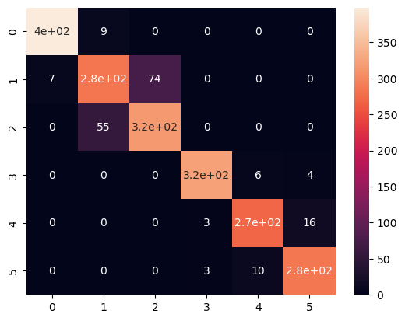
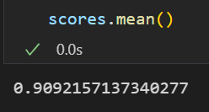
MLP
LVQ
SVM
III. Machine Learning Algorithms
Correlation Matrix of SVM
K-fold validation:

Slide 19
III. Machine Learning Algorithms
MLP
LVQ
SVM
It is overfitting, so we see so many red dots.
Two ways solving this problem:
Soft margin
Early stop

Slide 20
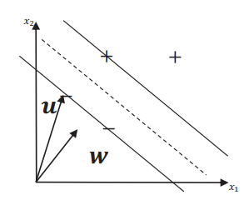
III. Machine Learning Algorithms
MLP
LVQ
SVM
Adopting soft margin
That means the width is larger and
it can tolerate more errors.
So all of the regulaztion parameters C we set
are smaller than 50.
Width

Slide 21
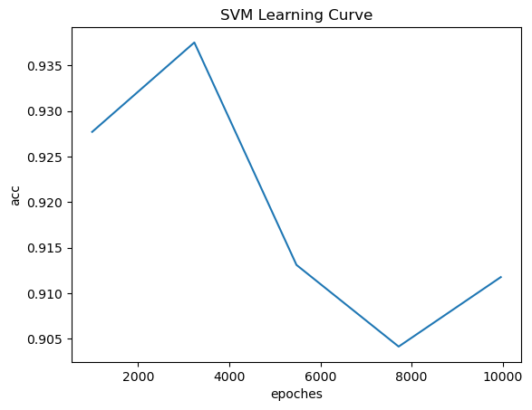
MLP
LVQ
SVM
III. Machine Learning Algorithms
As we can see, the acc will decrease if training epoches are too many. It is overfitting, so we tried early stopping to control this problem.
Notes:
From this learning curve, we can see the acc will decrease if training epoches are too many. It is overfitting, so we tried early stopping to control this problem. So, I did artificial neural network with customizing early stop stepping. The codes are shown.

Slide 22
III. Machine Learning Algorithms
MLP
LVQ
SVM
Early Stop
By customizing early stopping, and
setting training epoches to be 42, the loss is 0.
Notes:
By customizing early stopping, and setting training epoches to be 42, the loss is 0. That is because the early stopping monitors the loss rather than the accuracy.

Slide 23
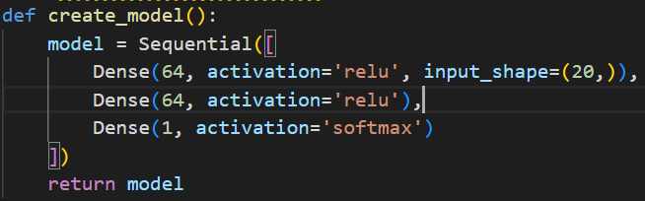
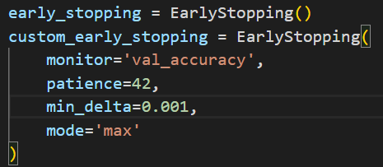
III. Machine Learning Algorithms
MLP
LVQ
SVM
Early Stop
Notes:
We create a sequential model in Keras, using activation functions 're linear unit' and 'softmax'. And we also customized the early stopping setting.

Slide 24

III. Machine Learning Algorithms
MLP
LVQ
SVM
Optimization
We optimize our SVM model, using grid search and Bayes search. Both of the accuracy are improve from 0.90 to 0.93, by choosing regulation parameter to be 42 and kernel to be rbf.
Original SVM | SVM with grid search | SVM with Bayes search
0.91 | 0.93 | 0.93
Notes:
We take two hyperparameters optimization methods, grid-search and Bayes search to improve SVM model's performance. Both of the accuracy are improve from 0.90 to 0.93.

Slide 25

V. Result
MLP achieved highest accuracy of 94% , then LVQ 92%, and SVM 91%.
Expand the dataset to include a wider range of individuals with different health records to further validate the effectiveness of this approach
Human activities can be accurately classified using accelerometer and gyroscope

Slide 26
Thank you
Amjad Altuwayjiri & Yongxin Luo

