Slide 1
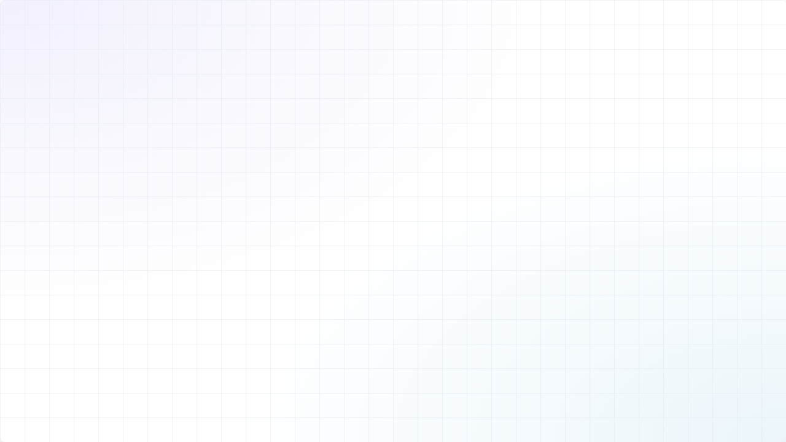
Planify
Developing a Smart Planning Tool
Benjamin | Muhammed | Gift | Wei | Pham

Slide 2

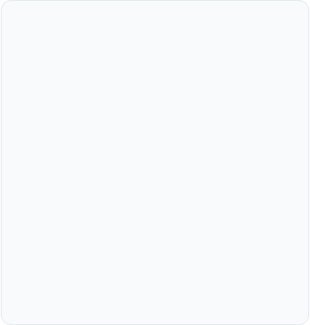
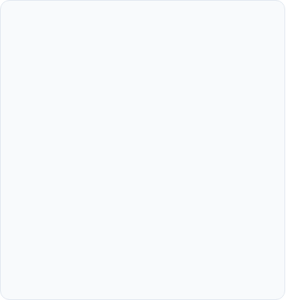
Importance
Work about Work
Project Failure
Frustrated Employees
83%​
60%
34%
Searching & Organizing
Projects on time & within budget
Believe their work isn’t effective because of managing processes

Slide 3
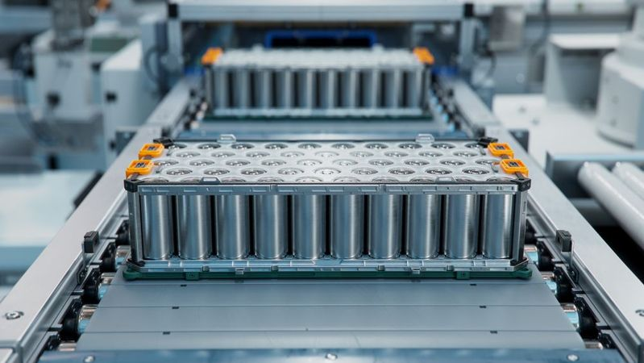
Own Problem
Analysis Department
Fast feedback from taskforce team
Prototype - Production
Full Investigation
Mechanical tests
Chemical tests
Thermal tests
…
Fast task distribution is required

Slide 4
Approach
 | Monday | Tuesday | Wednesday | Thursday | Friday
8:00-12:00 | ✅ | ❌ | ❌ | ✅ | ❌
13:00-17:00 | ❌ | ❌ | ✅ | ❌ | ✅
Person A
Responsible for Task A
Task
Subtask
 | Monday | Tuesday | Wednesday | Thursday | Friday
8:00-12:00 | ❌ | ❌ | ✅ | ❌ | ✅
13:00-17:00 | ✅ | ❌ | ❌ | ❌ | ❌
Person B
Responsible for Task B

Slide 5
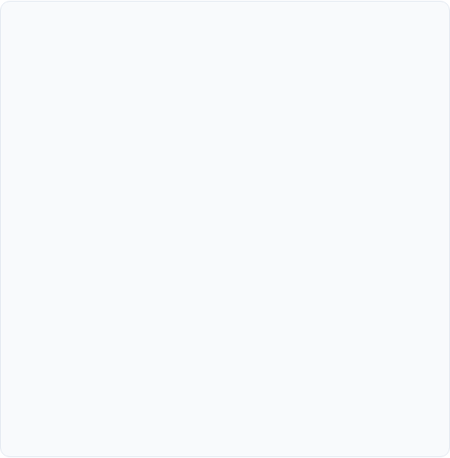
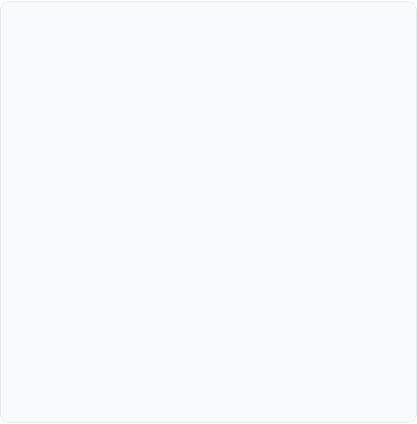
Our Project
Included Features
Planned Features
•
Smart schedule planning
•
Direct integrations with e.g. Microsoft Outlook
•
Simple UI
•
Additional manual editing of assigned tasks
•
AI-generated sample schedule data
•
Additional reasoning of assignment

Slide 6
Why Planify matters
•⁠ ⁠Eliminates manual scheduling grind •⁠ ⁠Faster time to plan •⁠ ⁠⁠Respects real constraints / Scales with team complexity •⁠ ⁠⁠Deadline-driven
•⁠ ⁠⁠Reduces overallocation & burnout
•⁠⁠⁠ Foundation for smarter Product Management tooling

Slide 7
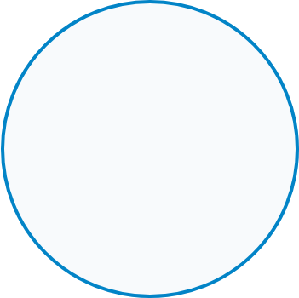
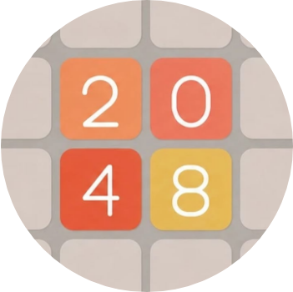
Example Use Case Execution
Demo

Slide 8
Questions?
Thank you for your time.
Planify.

