Slide 1
Apelo
E-Channeling Platform

Slide 2
Introduction
An Echanneling website which allows users to book appointments
Allows admins to manage all the functions related to doctors, patients, schedules and appointments
Interactive , minimalistic and userfriendly website

Slide 3

Front-end
Implemented using
REACT JS FRAMEWORK
02 logins for users and
admins

Slide 4

Back-end
Implemented using INTELLIJ – IDEA developer tool
Spring-Boot Application using REST
Programming Language : Java
Dependencies : Spring data JPA
MySQL Driver
Spring Web

Slide 5
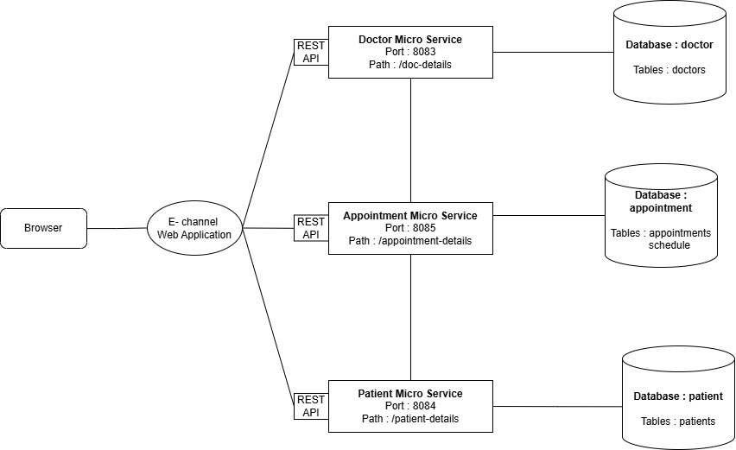
Micro Service Architecture

Slide 6
Thank You !

