Slide 1
CLUSTERING

Slide 2
Clustering Agenda
Definition of Clustering
Existing clustering methods
Clustering examples
Clustering demonstration using R

Slide 3
Definition
Clustering can be considered the most important unsupervised learning technique; so, as every other problem of this kind, it deals with finding a structure in a collection of unlabeled data.
Unsupervised: no information is provided to the algorithm on which data points belong to which clusters
Clustering is “the process of organizing objects into groups whose members are similar in some way”.
A cluster is therefore a collection of objects which are “similar” between them and are “dissimilar” to the objects belonging to other clusters.

Slide 4



Definition

Slide 5
Why and Where to use Clustering?
Why?
Simplifications
Pattern detection
Useful in data concept construction
Unsupervised learning process
Where?
Data mining
Information retrieval
text mining
Web analysis
marketing
medical diagnostic

Slide 6
Which method to use?
Type of attributes in data
Scalability to larger dataset
Ability to work with irregular data
Time cost
complexity
Data order dependency
Result presentation

Slide 7
Major Existing clustering methods
Distance-based
Hierarchical
Probabilistic

Slide 8
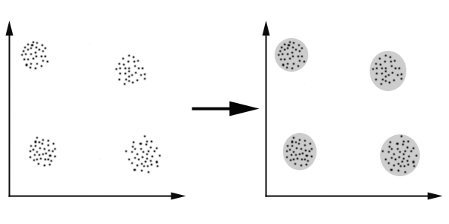
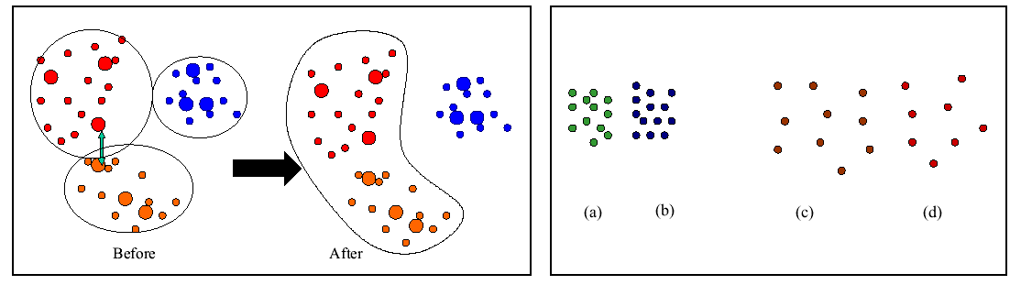
Distance Based Method
In this case we easily identify the 4 clusters into which the data can be divided; the similarity criterion is distance: two or more objects belong to the same cluster if they are “close” according to a given distance. This is called distance-based clustering.

Slide 9
Hierarchical clustering
Agglomerative (bottom up)
Start with 1 point (singleton)
Recursively add two or more appropriate clusters
Stop when k number of clusters is achieved.
Divisive (top down)
Start with a big cluster
Recursively divide into smaller clusters
Stop when k number of clusters is achieved.

Slide 10
Probabilistic clustering
Data are picked from mixture of probability distribution.
Use the mean, variance of each distribution as parameters for cluster
Single cluster membership

Slide 11
K-means Clustering Algorithm
It accepts the number of clusters to group data into, and the dataset to cluster as input values.
It then creates the first K initial clusters (K= number of clusters needed) from the dataset by choosing K rows of data randomly from the dataset. For Example, if there are 10,000 rows of data in the dataset and 3 clusters need to be formed, then the first K=3 initial clusters will be created by selecting 3 records randomly from the dataset as the initial clusters. Each of the 3 initial clusters formed will have just one row of data.
The K-Means algorithm calculates the Arithmetic Mean of each cluster formed in the dataset.
The Arithmetic Mean of a cluster is the mean of all the individual records in the cluster. In each of the first K initial clusters, their is only one record.
The Arithmetic Mean of a cluster with one record is the set of values that make up that record.
For Example if the dataset we are discussing is a set of Height, Weight and Age measurements for students in a University, where a record P in the dataset S is represented by a Height, Weight and Age measurement, then P = {Age, Height, Weight).
Then a record containing the measurements of a student John, would be represented as John = {20, 170, 80} where John's Age = 20 years, Height = 1.70 metres and Weight = 80 Pounds.
Since there is only one record in each initial cluster then the Arithmetic Mean of a cluster with only the record for John as a member = {20, 170, 80}.
Next, K-Means assigns each record in the dataset to only one of the initial clusters. Each record is assigned to the nearest cluster (the cluster which it is most similar to) using a measure of distance or similarity like the Euclidean Distance Measure or Manhattan/City-Block Distance Measure.

Slide 12
K-means Clustering Algorithm
K-Means re-assigns each record in the dataset to the most similar cluster and re-calculates the arithmetic mean of all the clusters in the dataset. The arithmetic mean of a cluster is the arithmetic mean of all the records in that cluster.
For Example, if a cluster contains two records where the record of the set of measurements for John = {20, 170, 80} and Henry = {30, 160, 120}, then the arithmetic mean P_{mean} is represented as P_{mean}= {Age_{mean}, Height_{mean}, Weight_{mean}). Age_{mean}= (20 + 30)/2, Height_{mean}= (170 + 160)/2 and Weight_{mean}= (80 + 120)/2. The arithmetic mean of this cluster = {25, 165, 100}. This new arithmetic mean becomes the center of this new cluster. Following the same procedure, new cluster centers are formed for all the existing clusters.
7. K-Means re-assigns each record in the dataset to only one of the new clusters formed. A record or data point is assigned to the nearest cluster (the cluster which it is most similar to) using a measure of distance or similarity
8. The preceding steps are repeated until stable clusters are formed and the K-Means clustering procedure is completed. Stable clusters are formed when new iterations or repetitions of the K-Means clustering algorithm does not create new clusters as the cluster center or Arithmetic Mean of each cluster formed is the same as the old cluster center. There are different techniques for determining when a stable cluster is formed or when the k-means clustering algorithm procedure is completed.

Slide 13
Case: K-means Clustering to identify similar grouping in data containing auto insurance policy records
Adam, an Analytics consultant works with First Auto Insurance Company. His manager gave him data having policy level and loss amount related details of a group of customers. He asked him to “identify” the distinct groups by using some suitable Clustering technique. Adam has no knowledge of running a clustering analysis.
Now suppose, he approaches you and request for your help to complete the assignment. Lets help Adam in solving the problem.

Slide 14
Case: K-means Clustering analysis
In due course of helping Romanov to complete his task, we will walk him through following steps:
Variable categorization (e.g. Numeric, Categorical, Discrete, Continuous etc.)
Importing data
Insurance_Dataset_Clustering_Analysis.xlsx
Selecting the variables
Deciding on the number of clusters to be created
Running the analysis
Interpreting the results

