Slide 1
CLIENT DEMO · AUGUST 2026
145
AI Skill Analyser
skills in the KB
356
Graph RAG–Based HR Recruitment Platform
graph nodes
1 351
Hire on evidence, not keywords. Upload a resume, get a ranked, explainable shortlist in seconds.
relationships
138
Explainable AI matching
Knowledge graph
Enterprise ready
automated tests
AI Skill Analyser · Graph RAG HR Recruitment Platform
01
Notes:
Open with the promise: every resume becomes structured, comparable, explainable evidence. The numbers on the right are from the live demo dataset shipped with the platform.

Slide 2
AGENDA
What we will cover in the next 30 minutes
Five parts: the problem we set out to solve, the goal, how the platform works, a live walkthrough, and the impact.
01
The problem
Where hiring loses time, money and good candidates
02
Goal & end state
What we committed to build and what success looks like
03
The solution
Graph RAG architecture, scoring model, security
04
Live walkthrough
The working product, screen by screen
05
Impact & next steps
Value, rollout plan and roadmap
AI Skill Analyser · Graph RAG HR Recruitment Platform
02
Notes:
Set expectations: roughly 10 minutes of context, 15 minutes of live product, 5 minutes of next steps.

Slide 3
THE PROBLEM · 01
Where the hiring funnel actually loses time
An illustrative funnel for a single technical role. Replace the volumes with your own and the shape stays the same.
250
12.5 hrs
40
12
1
resumes received
per open technical role
manual reading
at ~3 minutes per resume
shortlisted
ranked by whoever read them
interviewed
after a second manual pass
hired
4–8 weeks after the first resume arrived
THE PART NOBODY BUDGETS FOR
AND THE QUALITY COST
— 12.5 hours of reading before a single conversation happens
— 20 roles a quarter is roughly 250 hours, about 1.5 FTE-months of pure screening
— Every re-read starts from zero nothing from the last search is reusable
— Fatigue sets in resume 200 is not read like resume 2
— Two recruiters, two shortlists ranking is not reproducible
— The strongest candidate may simply never be opened
Illustrative model — the demo uses your volumes during the workshop.
AI Skill Analyser · Graph RAG HR Recruitment Platform
03
Notes:
Ask the client for their real numbers here: resumes per role, roles per quarter, minutes per resume. The arithmetic is deliberately simple so they can challenge it.

Slide 4
THE PROBLEM · 02
Six pain points we heard from HR and hiring managers
Every one of these is a direct requirement in the platform we built.
PAIN 01
Manual screening does not scale
Headcount grows linearly with applications. Hiring freezes when recruiters go on leave.
PAIN 02
The same skill, ten spellings
K8s, Kubernetes, kubernetes, K8's, EKS — a keyword filter treats them as five different things.
PAIN 03
Keyword ATS filters strings, not meaning
A Django expert is invisible to a 'Python' filter if the word Python never appears.
PAIN 04
Scoring is inconsistent
Every recruiter weighs experience, certifications and projects differently, and never the same way twice.
PAIN 05
Good candidates stay buried
Past applicants are never revisited. The same role is sourced from scratch every time.
PAIN 06
No defensible audit trail
'Why was this candidate rejected?' has no answer that survives a compliance review.
AI Skill Analyser · Graph RAG HR Recruitment Platform
04
Notes:
Pause here and ask which two hurt the most. Whichever they pick, point forward to the slide that answers it: normalization for spelling, Graph RAG for meaning, the scoring model for consistency, the audit log for compliance.

Slide 5
THE PROBLEM · 03
Why keyword search quietly loses your best candidates
Four failures we can reproduce on demand in any keyword-based ATS.
WHAT THE FILTER DOES
WHAT IS ACTUALLY NEEDED
Search "Kubernetes"
Misses K8s, EKS, AKS, "container orchestration" — the candidate is filtered out on spelling.
One canonical skill
every synonym resolves to the same node
A hierarchy
Search "Python"
Matches a resume that mentions Python once under Interests, and ranks it beside an eight-year Python engineer.
Django is a child of Python, EC2 of AWS
Evidence
Reads any number near the word "years" instead of computing real, de-overlapped employment intervals.
the sentence in the resume that proves the skill
Filter "5+ years"
A weighted score
skills, semantics, experience, certs, projects
Related skills
Django, Flask and Pandas never roll up to Python. AWS never rolls up from EC2, S3 and Lambda.
An explanation
the graph path that produced the ranking
AI Skill Analyser · Graph RAG HR Recruitment Platform
05
Notes:
This slide is the bridge into Graph RAG. The right-hand column is literally the feature list of the platform.

Slide 6
THE PROBLEM · 04
What the status quo costs the business
Five risks that compound every quarter the process stays manual.
SPEED
Time-to-shortlist
Days of reading before the first interview. The best candidates accept another offer while the pile is being read.
MONEY
Cost per hire
Screening hours are the largest hidden line item, and they scale with volume rather than with hires.
QUALITY
Wrong shortlists
Ranking depends on who read the resume and when. Strong profiles are missed, weak ones advance.
REUSE
A dead database
Thousands of parsed resumes sit unused because nothing makes them searchable by capability.
RISK
No audit trail
No reproducible reason for a rejection, which is exactly what regulators and candidates ask for.
The bottleneck is not a lack of candidates. It is the absence of a machine-readable, comparable representation of what each candidate can actually do.
AI Skill Analyser · Graph RAG HR Recruitment Platform
06
Notes:
Land the reframe: this is a data structure problem, not a headcount problem. That is what the knowledge graph fixes.

Slide 7
THE GOAL · 05
What we set out to build
One objective, five measurable commitments.
PROJECT GOAL
Turn every resume into structured, comparable, explainable evidence — and rank candidates against any role in seconds.
G1
Ingest anything
PDF, DOC, DOCX and TXT at batch scale, with OCR fallback for scanned resumes and checksum-based duplicate detection.
G2
One shared vocabulary
Every extracted phrase normalized against an authoritative Skills Knowledge Base you own and can replace.
G3
Connect the evidence
Candidates, skills, technologies, companies, certifications, projects and job roles in one traversable graph.
G4
Rank, and justify it
A weighted score you can tune per role, with the component breakdown and graph path behind every number.
G5
Make it usable
Plain-English search, dashboards, exportable reports and role-based access for the whole hiring team.
STATUS
All five are built, tested and demonstrated in the walkthrough that follows.
AI Skill Analyser · Graph RAG HR Recruitment Platform
07
Notes:
These five goals map one-to-one onto the five product areas shown in the walkthrough.

Slide 8
THE END GOAL · 06
What success looks like once this is live
The target state we are demonstrating today, and the metrics that prove it.
✓
Every resume is searchable seconds after upload
NORTH-STAR METRICS
Parsing, normalization, embedding and graph insertion happen in one pipeline — no overnight batch.
Time to shortlist
✓
The organisation shares one definition of a skill
days → minutes
Recruiters, hiring managers and reports all resolve to the same taxonomy node.
Screening hours per role
12.5 → under 1
✓
Shortlists take minutes, not days
Describe the role, run the match, review a ranked list with evidence attached.
Candidates actually reviewed
100% of the pool
✓
No black-box decisions
Ranking consistency
Every score carries its breakdown, matched and missing skills, strengths and gaps.
identical inputs, identical result
The talent graph compounds
Decisions with an audit trail
✓
100%
Each resume makes future searches better; past applicants resurface automatically for new roles.
AI Skill Analyser · Graph RAG HR Recruitment Platform
08
Notes:
This is the slide to return to at the end. Everything in the walkthrough should be traceable back to one of these outcomes.

Slide 9
THE SOLUTION · 07
AI Skill Analyser at a glance
Six capabilities, one pipeline, one graph — delivered as a single deployable platform.
Resume intelligence
Multi-engine parsing with OCR fallback. Personal details, work history, education, projects, certifications and skills extracted with the evidence sentence kept.
Skills Knowledge Base
145 skills across 57 categories with synonyms, parent/child hierarchy, related technologies and job-role mappings. Owned by you as a CSV.
Knowledge graph
9 node types and 12 relationship types linking candidates to everything they have used, held, built and studied.
Explainable matching
Weighted scoring across skills, semantics, experience, certifications and projects, with the graph path behind every point awarded.
Natural-language search
Ask in plain English across hybrid, semantic, keyword, graph and skill modes, and get a RAG-generated answer with citations.
Reports & governance
Dashboards, skill-gap analysis, PDF/CSV/Excel exports, role-based access and a complete audit trail.
AI Skill Analyser · Graph RAG HR Recruitment Platform
09
Notes:
One line per tile. Do not go deep here — each one gets its own screen in the walkthrough.

Slide 10
THE SOLUTION · 08
Why Graph RAG, and not keyword or vector search alone
Vector search understands language. A graph understands structure. Recruiting needs both.
Keyword / ATS
Vector-only AI
Graph RAG · ours
String matching
Embedding similarity
Graph + vectors + rules
Handles synonyms (K8s = Kubernetes)
No
Yes
Yes
Understands hierarchy (Django rolls up to Python)
No
No
Yes
Keeps evidence for each claim
Partial
No
Yes
Explains why a candidate ranked where they did
No
No
Yes
Handles phrasing never seen before
No
Yes
Yes
Auditable for compliance
Weak
Weak
Full
AI Skill Analyser · Graph RAG HR Recruitment Platform
10
Notes:
The honest version of this slide: vector search alone gets you fuzzy recall but no reasons. The graph is what makes the answer defensible.

Slide 11
THE SOLUTION · 09
How it works: resume to ranked shortlist in six steps
One pipeline runs on upload. Everything downstream — search, matching, reports — reads from its output.
STEP 1
STEP 2
STEP 3
STEP 4
STEP 5
STEP 6
Ingest
Extract
Normalize
Build graph
Embed
Retrieve & rank
pdfplumber → PyMuPDF → python-docx → OCR fallback. Checksums catch duplicates.
Personal details, work history, education, projects, certifications, skill mentions.
Every phrase resolved to the Skills KB with match type, confidence and evidence.
Candidate linked to skills, companies, projects, certifications and roles.
Profile, resume chunks and skill text vectorised for cosine search.
Query parsed, expanded through the graph, fused with vectors, scored, explained.
WHAT MAKES THIS PIPELINE DIFFERENT
— Provenance is kept every skill carries its match type, confidence and source sentence
— Experience is computed merged, de-overlapped employment intervals, not a regex on 'years'
— Re-uploads are safe checksum duplicate detection instead of a second candidate record
— Every AI dependency has an offline fallback no model downloads, no API keys, no GPU required
AI Skill Analyser · Graph RAG HR Recruitment Platform
11
Notes:
Emphasise step 3. Normalization is the step that makes every later number comparable across candidates.

Slide 12
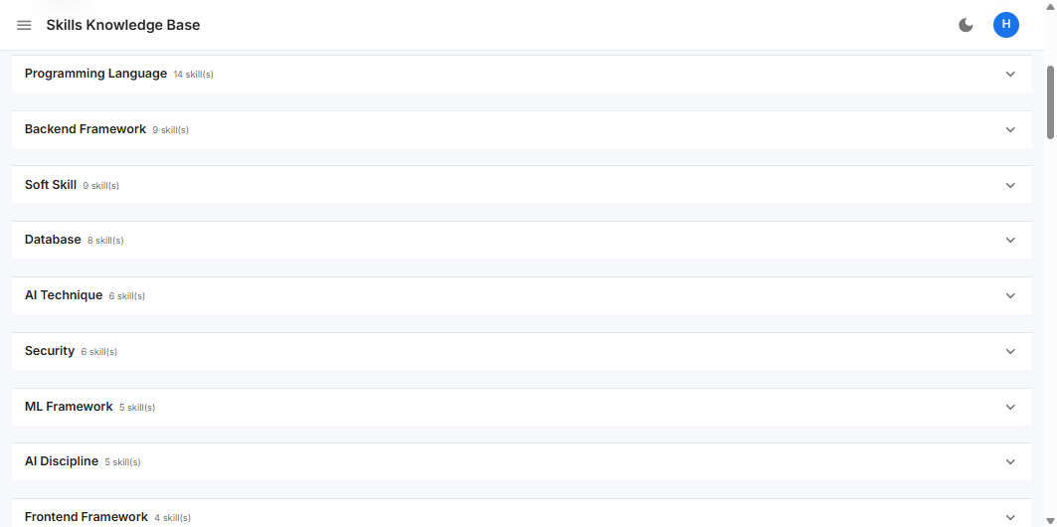
THE SOLUTION · 10
The Skills Knowledge Base is your source of truth
A CSV you own, version and replace. Swap the file, re-import, and the whole platform speaks your vocabulary.
ONE ROW PER SKILL
skill_id · skill_name · category · parent_skill · related_skills · technology_stack · job_role · experience_level · skill_synonyms · skill_description
HOW A RAW PHRASE IS RESOLVED
1 Exact
Node.js → nodejs
confidence 1.00
2 Synonym
K8s → Kubernetes
confidence 0.95
Skills page — taxonomy browser with category grouping and CSV re-import
3 Fuzzy
Kubernetess → Kubernetes
confidence ~0.80
4 Graph
Django → Python (parent)
confidence 0.50–0.85
AI Skill Analyser · Graph RAG HR Recruitment Platform
12
Notes:
Key ownership message: the client is not locked into our taxonomy. They upload their own CSV from the Skills page and re-import.

Slide 13
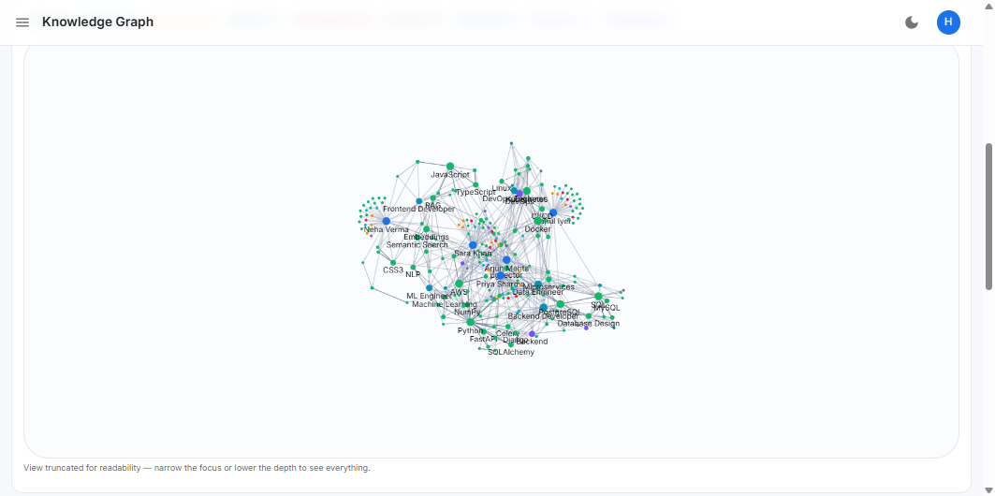
THE SOLUTION · 11
The knowledge graph model
Nine node types and twelve relationship types. This is what turns isolated resumes into a connected talent asset.
NODES
Candidate
Skill
Category
Technology
JobRole
Company
Project
Certification
Education
RELATIONSHIPS
HAS_SKILL
WORKED_AT
USED_SKILL
COMPLETED
HOLDS
STUDIED_AT
Live knowledge graph from the five demo resumes
A PATH THE MATCHER ACTUALLY WALKED
BELONGS_TO
PART_OF
RELATED_TO
AWS —[PARENT_OF]→ EC2 (w=0.7) · AWS —[RELATED_TO]→ Terraform (w=0.6)
PARENT_OF
DEPENDS_ON
REQUIRED_FOR
AI Skill Analyser · Graph RAG HR Recruitment Platform
13
Notes:
The demo dataset is only five resumes and already produces 356 nodes and 1,351 relationships. Point out that density is the source of the recall advantage.

Slide 14
THE SOLUTION · 12
The scoring model, in full
No hidden weights. The formula, the credit ladder and the bands are all visible and tunable per role.
overall = 0.40 · skill + 0.20 · semantic + 0.20 · experience + 0.10 · certification + 0.10 · project
SKILL CREDIT DEGRADES WITH MATCH QUALITY
RECOMMENDATION BANDS
Exact match
1.00
Highly Recommended
85 – 100
Synonym match
0.95
Recommended
70 – 84
Fuzzy match
~0.80
Consider
55 – 69
Related / parent / child
0.55 – 0.85
Not Recommended
below 55
Graph-only inference
0.50
A missing mandatory skill caps the candidate regardless of everything else.
AI Skill Analyser · Graph RAG HR Recruitment Platform
14
Notes:
Defaults are 40/20/20/10/10 and every weight is a slider on the Skill Match page, so a role can be re-weighted live in the demo.

Slide 15
THE SOLUTION · 13
System architecture
A conventional, well-separated service architecture — nothing exotic to operate.
Client
React 18 SPA · TypeScript · Material UI · TanStack Query · Recharts · force-directed graph canvas
API
FastAPI · JWT auth with refresh · RBAC dependencies · rate limiting · OpenAPI docs · structured errors
Services
Resume processing · candidates · matching · search · graph · reports · dashboards · audit
AI & Graph
Parsers · entity extraction · skill taxonomy · embeddings · vector store · Graph RAG retriever · reasoning
Data
PostgreSQL + pgvector · Redis · Neo4j or NetworkX · Celery workers · encrypted file storage
Every heavy dependency degrades gracefully: no FAISS → NumPy, no Neo4j → NetworkX, no model download → deterministic embeddings, no API key → template reasoning.
AI Skill Analyser · Graph RAG HR Recruitment Platform
15
Notes:
The fallback line matters for procurement: the platform runs air-gapped with no external AI calls if required.

Slide 16
THE SOLUTION · 14
Technology stack
Mainstream, supportable technology your team can hire for and operate.
Frontend
Backend
AI / ML
Data & Ops
React 18 + TypeScript
Python 3.11 + FastAPI
spaCy entity extraction
PostgreSQL 15 + pgvector
Vite build tooling
SQLAlchemy 2 ORM
Sentence Transformers
Redis cache and queue
Material UI design system
Alembic migrations
pgvector / FAISS / NumPy
Neo4j graph database
TanStack Query
Pydantic v2 contracts
NetworkX + Neo4j
Docker Compose
Recharts + force graph
Celery + Redis workers
Graph RAG retriever
138 automated tests
Light and dark themes
Structured logging
Template or OpenAI reasoning
Ruff + MyPy quality gates
AI Skill Analyser · Graph RAG HR Recruitment Platform
16
Notes:
No proprietary lock-in. Everything here is open source and deployable in the client's own cloud.

Slide 17
THE SOLUTION · 15
Security, access control and governance
Built for an enterprise HR function handling personal data.
Authentication
JWT access and refresh tokens, bcrypt password hashing, session listing and revocation, password reset flow.
Authorisation
A permission matrix enforced as API dependencies, so the UI and the API can never drift apart.
Audit
Every login, upload, edit, status change and export recorded with actor, target and timestamp.
Data protection
Optional Fernet encryption of stored resumes, soft delete, checksum de-duplication, configurable retention.
Hardening
Rate limiting, strict schema validation, structured error handling, API docs disabled in production.
Data residency
Runs entirely inside your infrastructure. With offline models, no candidate data leaves the network.
HR Admin
Recruiter
Hiring Manager
Everything, including users, audit and the Skills KB
Upload, edit candidates, match, search, report
Read candidates, match, search, report
AI Skill Analyser · Graph RAG HR Recruitment Platform
17
Notes:
Three seeded roles ship with the platform; the permission matrix is configuration, so more roles are additive.

Slide 18
PART 04
Live product walkthrough
Eleven screens from the running platform — every screenshot on the following slides is the real application, not a mockup.
AI Skill Analyser · Graph RAG HR Recruitment Platform
18
Notes:
Switch to the live app here if the room has network access; the slides are the fallback.

Slide 19
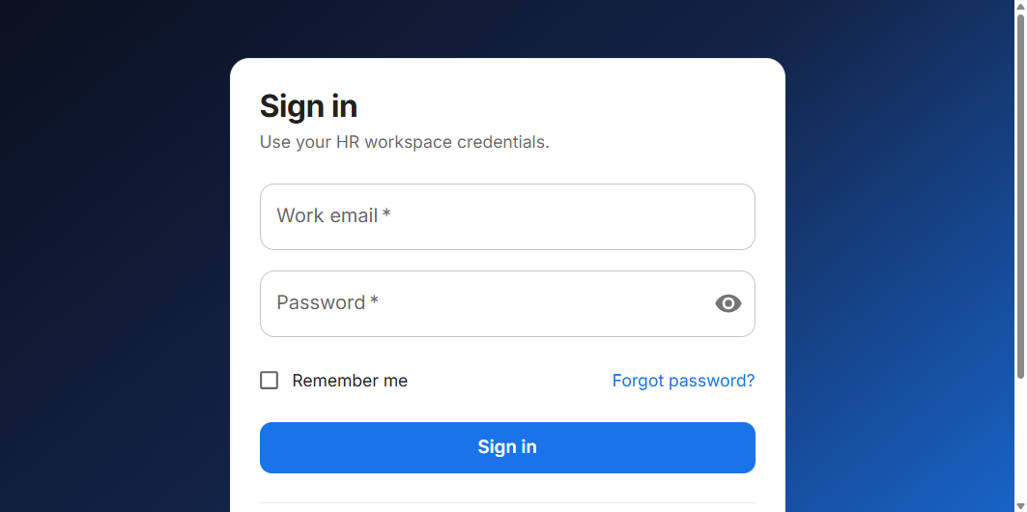
WALKTHROUGH · 01
Secure, role-aware access
JWT authentication with refresh tokens, remember-me sessions and a self-service password reset.
IN THIS VIEW
› Three seeded roles HR Admin, Recruiter, Hiring Manager
› Navigation and actions adapt to the signed-in user's permissions
› Active sessions are visible and revocable from Settings
› Every sign-in is written to the audit log
Sign-in — the platform is permission-aware from the first screen
AI Skill Analyser · Graph RAG HR Recruitment Platform
19

Slide 20
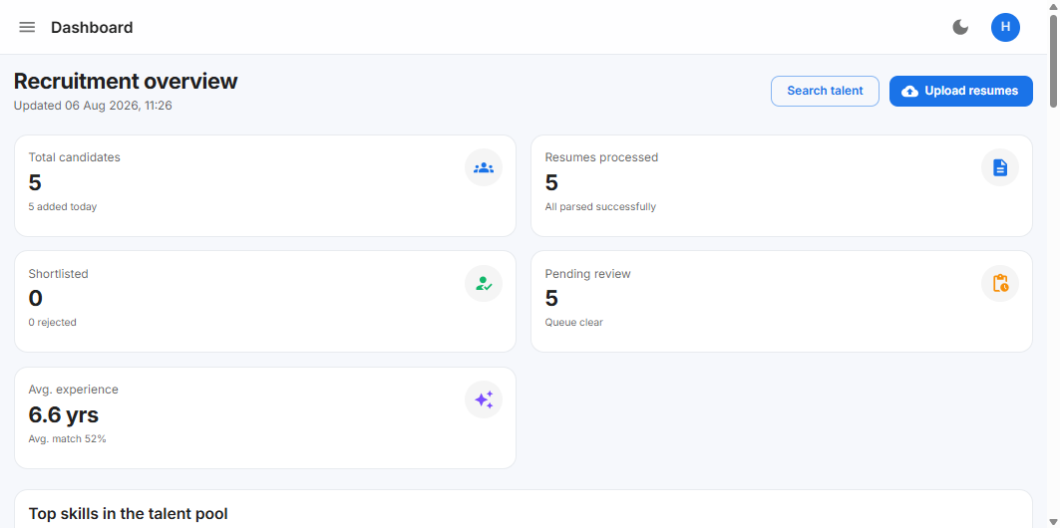
WALKTHROUGH · 02
Dashboard: the state of the pipeline at a glance
Live counts, parse health, average experience and match quality the moment resumes land.
IN THIS VIEW
› Candidates, resumes processed, shortlisted and pending review
› Average experience and average match score across the pool
› Top skills and technologies in the talent pool, charted
› Recent activity feed and AI-generated recommendations
Dashboard — recruitment overview with live KPIs
AI Skill Analyser · Graph RAG HR Recruitment Platform
20

Slide 21
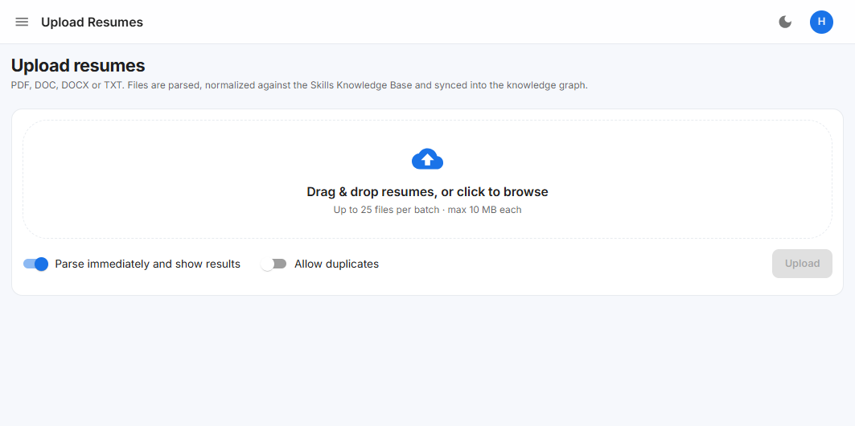
WALKTHROUGH · 03
Upload: drag, drop, done
Batch upload up to 25 resumes at a time. Parsing, normalization, embedding and graph insertion run automatically.
IN THIS VIEW
› PDF, DOC, DOCX and TXT OCR fallback for scanned documents
› Per-file result: extracted name, skills found, parse time, warnings
› Duplicate detection by checksum — no accidental double records
› Runs inline or on Celery workers for large batches
Upload — batch ingestion with per-file parse feedback
AI Skill Analyser · Graph RAG HR Recruitment Platform
21

Slide 22
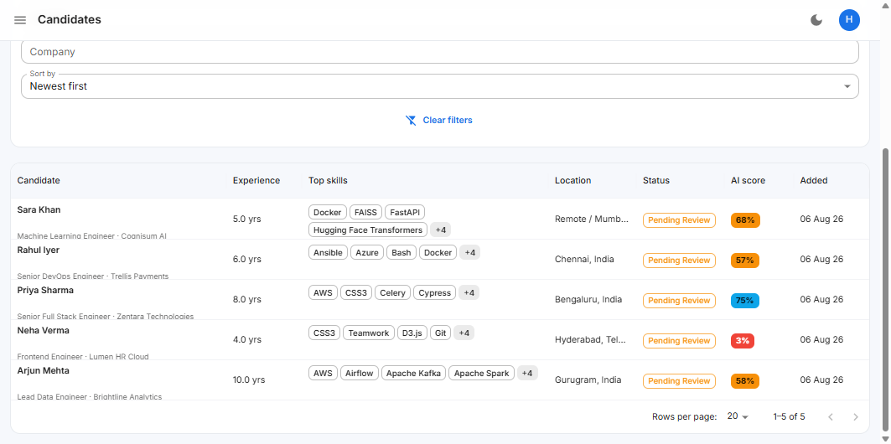
WALKTHROUGH · 04
Candidates: one searchable, filterable talent pool
Server-side pagination over the whole database, with the filters recruiters actually ask for.
IN THIS VIEW
› Filter by skill, status, minimum experience, location and company
› Top skills and AI score shown inline for fast triage
› Status workflow: pending review, shortlisted, rejected, hired
› One-click CSV export of the filtered set
Candidate list — filters, inline skills and AI score
AI Skill Analyser · Graph RAG HR Recruitment Platform
22

Slide 23
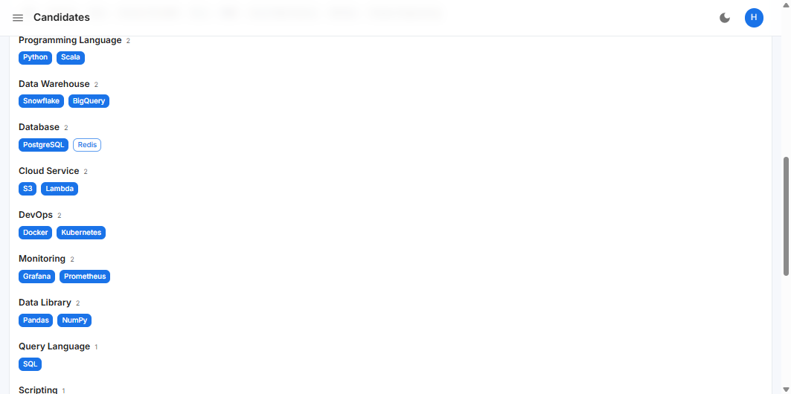
WALKTHROUGH · 05
Candidate profile: normalized skills with evidence
Raw resume phrases resolved into the taxonomy, grouped by category, each one traceable back to the source text.
IN THIS VIEW
› Skills grouped by category, not a flat keyword cloud
› Match type and confidence retained for every skill
› Timeline, education, projects, certifications and recruiter notes
› Similar candidates and the candidate's own subgraph, one tab away
Candidate profile — skills normalized against the Knowledge Base
AI Skill Analyser · Graph RAG HR Recruitment Platform
23

Slide 24
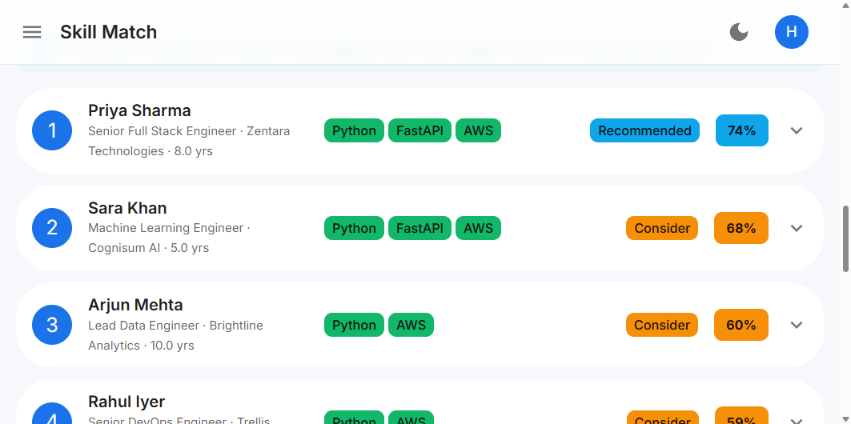
WALKTHROUGH · 06
AI skill match: a ranked shortlist in under a second
Describe the role, run the match, and get every candidate scored, banded and ordered.
IN THIS VIEW
› Required, mandatory and preferred skills, plus certifications
› Live weight sliders — re-rank for a role in real time
› Recommendation bands: Highly Recommended → Not Recommended
› This run evaluated the pool in 98 ms
Skill Match — ranked candidates with matched skills and score bands
AI Skill Analyser · Graph RAG HR Recruitment Platform
24

Slide 25
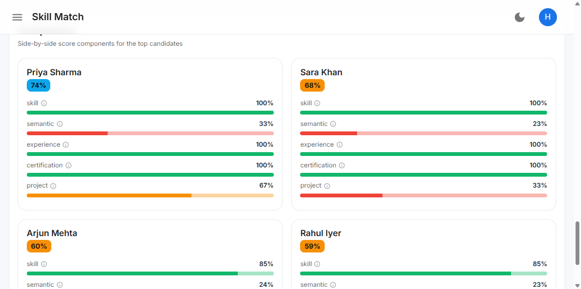
WALKTHROUGH · 07
Every score decomposes into five components
Side-by-side comparison shows exactly where each candidate gained and lost points.
IN THIS VIEW
› Skill, semantic, experience, certification and project shown separately
› Compare the top candidates on the same axes, at a glance
› Change a weight and the whole comparison recalculates
› The same numbers are available through the API for your own reporting
Score comparison — component breakdown per candidate
AI Skill Analyser · Graph RAG HR Recruitment Platform
25

Slide 26
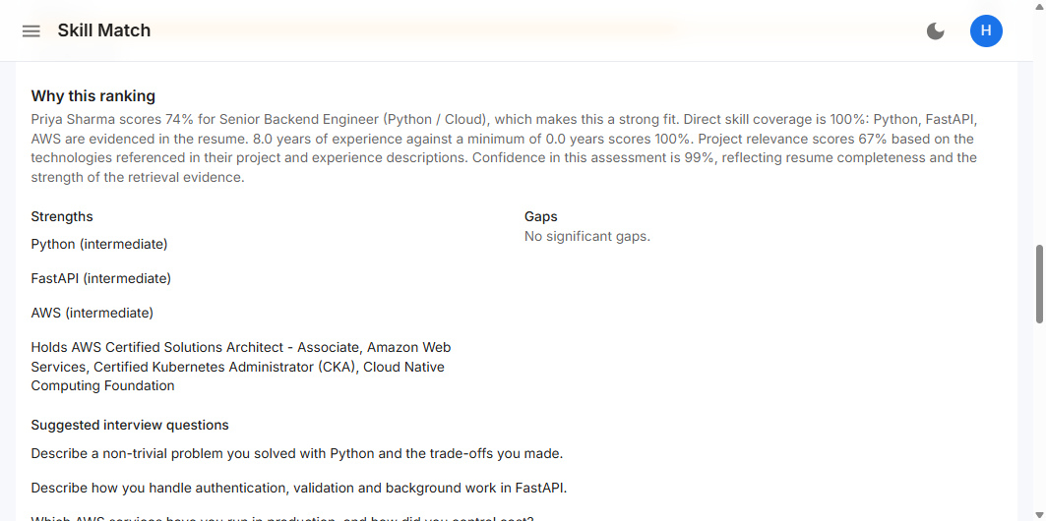
WALKTHROUGH · 08
"Why this ranking?" — answered on every candidate
A written justification, the strengths, the gaps and interview questions generated from the evidence.
IN THIS VIEW
› Plain-language explanation of how the score was reached
› Strengths with proficiency, and gaps stated explicitly
› Certifications credited by name
› Suggested interview questions targeted at this candidate
Explainability panel — narrative, strengths, gaps and interview questions
AI Skill Analyser · Graph RAG HR Recruitment Platform
26

Slide 27
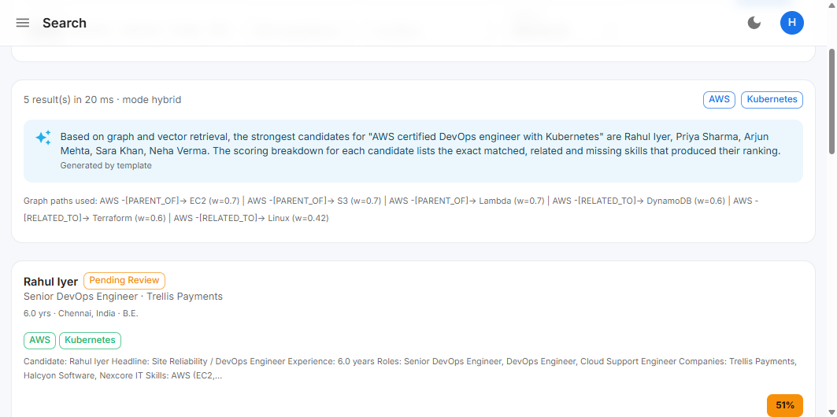
WALKTHROUGH · 09
Search in plain English, answered by the graph
The query is parsed into skills and constraints, expanded through the graph, then fused with vector hits.
IN THIS VIEW
› Five modes hybrid, semantic, keyword, graph and skill
› A RAG-generated answer summarising the strongest candidates
› The graph paths used are printed with their weights
› This query returned in 20 ms
Search — natural-language query with a RAG answer and graph citations
AI Skill Analyser · Graph RAG HR Recruitment Platform
27

Slide 28
WALKTHROUGH · 10
The knowledge graph, explorable
The asset that grows with every resume: an interactive map of who knows what, and how it all connects.
IN THIS VIEW
› 356 nodes and 1 351 relationships from just five demo resumes
› Focus on a skill, set traversal depth, expand any node
› Rebuild on demand; NetworkX in-process or Neo4j for scale
› Powers similar-candidate discovery and skill expansion
Knowledge graph explorer — force-directed view of the live graph
AI Skill Analyser · Graph RAG HR Recruitment Platform
28

Slide 29
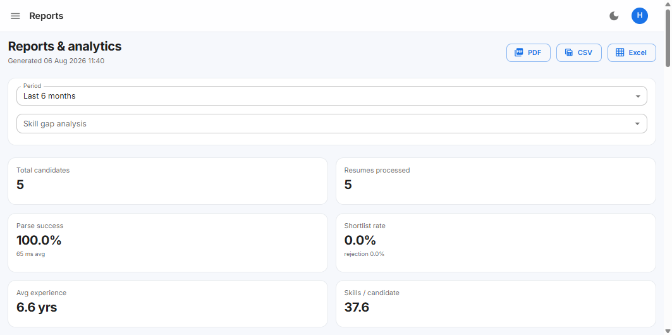
WALKTHROUGH · 11
Reports that prove what the pipeline is doing
Operational KPIs, skill-gap analysis and exports for the numbers your leadership already tracks.
IN THIS VIEW
› Parse success rate, average parse time and shortlist rate
› Hiring trends, skill distribution and gap analysis by period
› Export to PDF, CSV or Excel in one click
› Full audit trail available to HR Admins
Reports — KPIs, trends and exportable analytics
AI Skill Analyser · Graph RAG HR Recruitment Platform
29

Slide 30
IMPACT & NEXT STEPS · 16
What changes on day one, and where we go next
The platform is built, tested and running. The remaining work is your data and your rollout.
TODAY
WITH AI SKILL ANALYSER
PROPOSED NEXT STEPS
Screening a role
Week 1
12.5 hours of reading
Minutes, over the entire pool
Load your Skills CSV and a sample of 200 real resumes
Ranking
Week 2
Depends who read it
Same inputs, same result, every time
Calibrate weights with your recruiters on two live roles
Justification
Week 3
A recruiter's recollection
Score breakdown plus graph evidence
Deploy to your cloud, connect SSO, import history
Past applicants
Week 4
Effectively lost
Resurface automatically for new roles
Pilot with one hiring team, measure time-to-shortlist
The platform is complete and demonstrable today — 138 automated tests, Docker deployment, and full documentation.
Ready for your data
AI Skill Analyser · Graph RAG HR Recruitment Platform
30
Notes:
Close by asking for two things: their Skills CSV and 200 anonymised resumes. That is everything needed to run the same demo on their own data next week.

