Slide 1
Music Player Web Interface
Amlan : 23BAI1247
Ankit: 23BAI1379
Kanishq: 23BAI1379
GitHub Link: https://github.com/Amlan131/music-master

Slide 2
Introduction
A web-based music player interface designed using Bootstrap 5, ReactJS, Axios, Spotify Web API and Spotify Playback API
Key Features: Hero Bar Display, Music Controls, Dynamic Content Area, Fast Search, No Page Refresh
Programming Languages and Frameworks used:
HTML5: Structuring the webpage
CSS3: Custom styling
Bootstrap 5: Responsive design and components
Bootstrap Icons: Icon integration
ReactJS: Entire Web Handling
React-router: Switching dynamically between sections

Slide 3
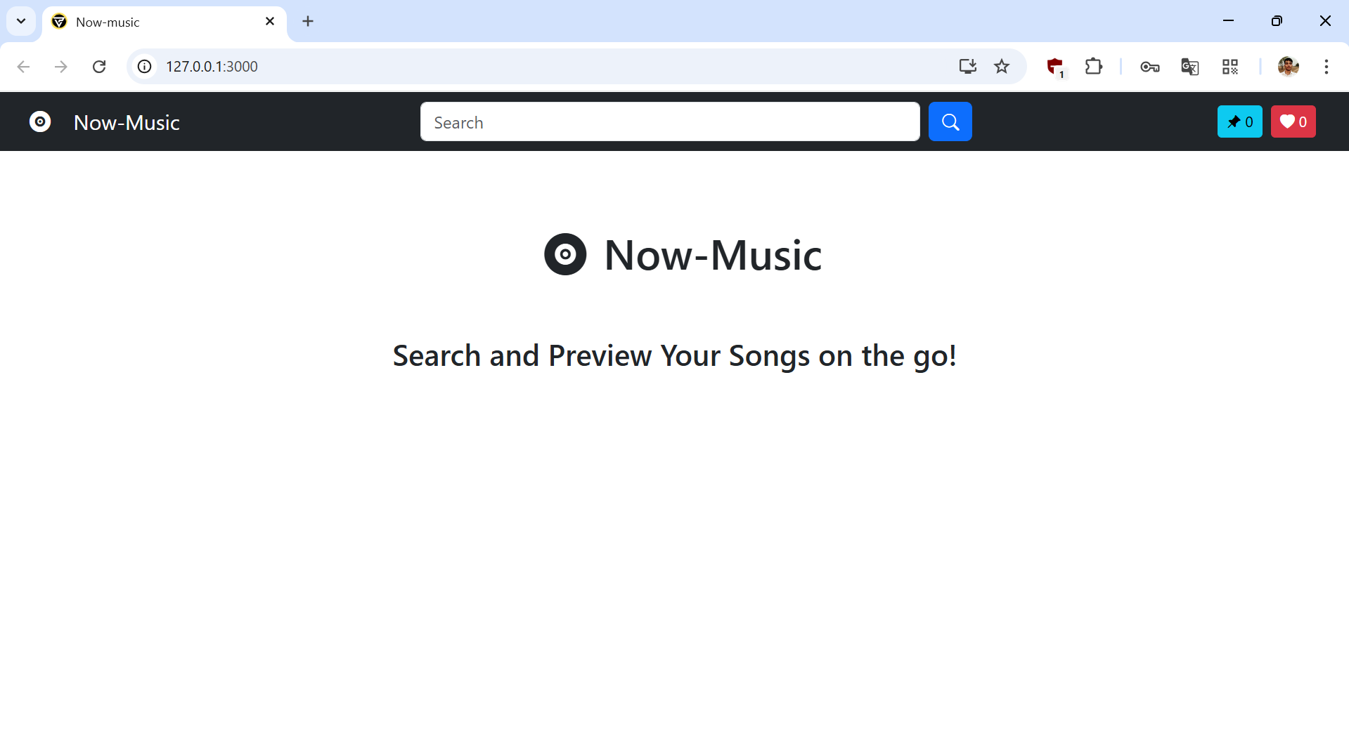

Slide 4
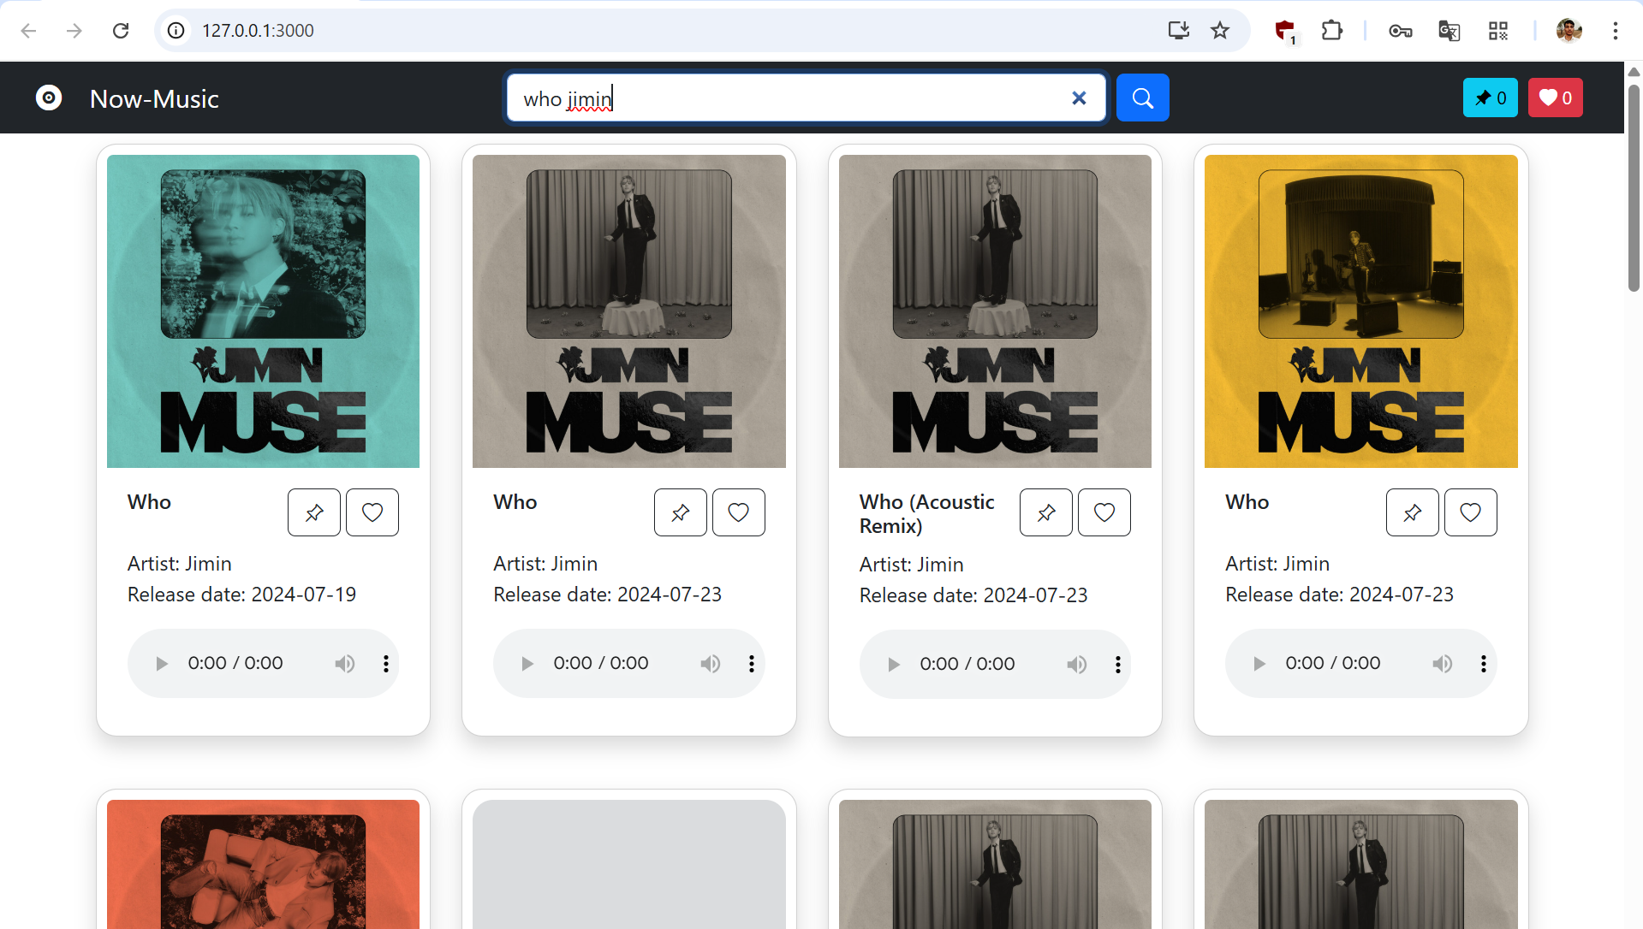

Slide 5
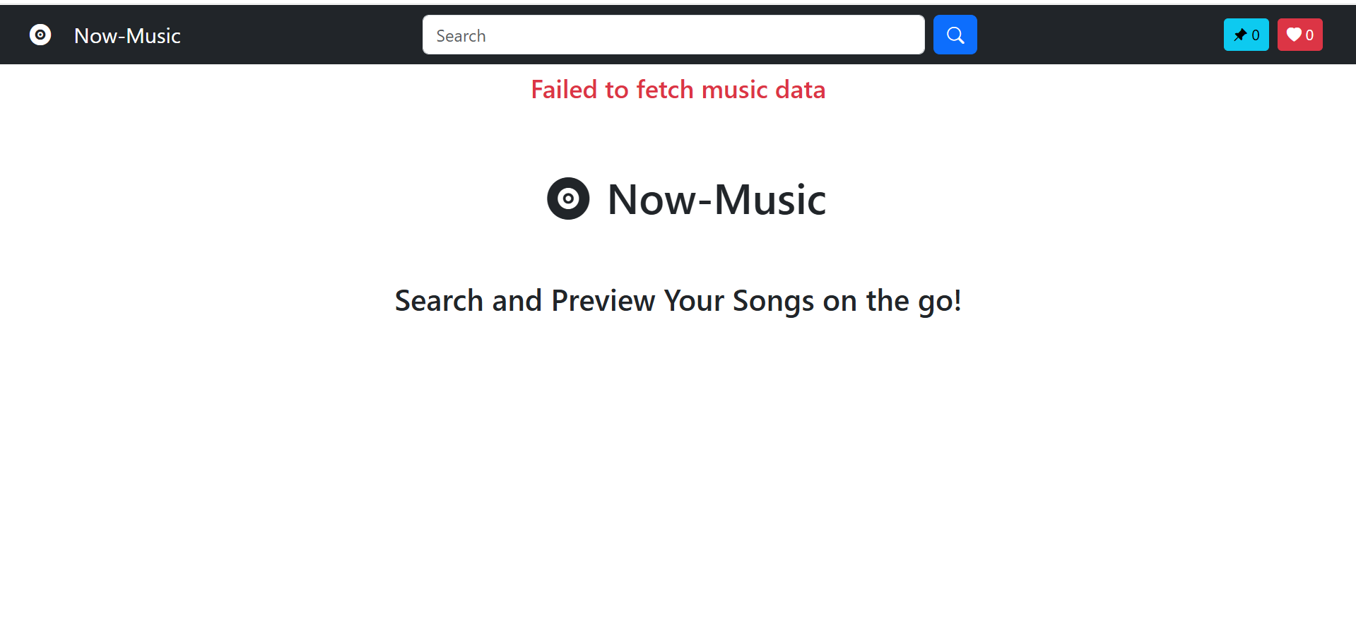

Slide 6
Main Content & Enhancements
Page Layout
Hero Bar: Handles Searches and navigation
Pinned: Displays pinned songs
Liked: Show songs in liked section
Body: Changes Dynamically with content refresh displaying required info as needed
Main Content Area Design
Displays core music-related content (song details, album covers, artist information).
Utilizes flex-grow to take up remaining space for a clean, responsive layout.
Future Enhancements:
To add Fallback for preview using free API like YouTube/SoundCloud
Improved card structuring and refreshed design consistency

Slide 7
Code
import "./App.css";
import { useContext, useEffect, useState } from "react";
import Card from "./components/Card";
import CreatePlaylist from "./components/CreatePlaylist";
import { initializePlaylist } from "./initialize";
import Navbar from "./components/Navbar";
import { MusicContext } from "./Context";
function App() {
const [keyword, setKeyword] = useState("");
const [message, setMessage] = useState("");
const [tracks, setTracks] = useState([]);
const [token, setToken] = useState(null);
const musicContext = useContext(MusicContext);
const isLoading = musicContext.isLoading;
const setIsLoading = musicContext.setIsLoading;
const setLikedMusic = musicContext.setLikedMusic;
const setpinnedMusic = musicContext.setPinnedMusic;
const resultOffset = musicContext.resultOffset;
const setResultOffset = musicContext.setResultOffset;

Slide 8
Code
const fetchMusicData = async () => {
setTracks([]);
window.scrollTo(0, 0);
setIsLoading(true);
try {
const response = await fetch(
`https://api.spotify.com/v1/search?q=${keyword}&type=track&offset=${resultOffset}`,
{
headers: {
Authorization: `Bearer ${token}`,
},
}
);
if (!response.ok) {
throw new Error("Failed to fetch music data");
}
const jsonData = await response.json();
setTracks(jsonData.tracks.items);
} catch (error) {
setMessage(error.message);

Slide 9
Code
} finally {
setIsLoading(false);
}
};
const handleKeyPress = (event) => {
if (event.key === "Enter") {
setResultOffset(0);
fetchMusicData();
}
};
useEffect(() => {
initializePlaylist();
// current client credentials will be deleted in few days
const fetchToken = async () => {
try {
const response = await fetch("https://accounts.spotify.com/api/token", {
method: "POST",
headers: {
"Content-Type": "application/x-www-form-urlencoded",
},

Slide 10
Code
body: "grant_type=client_credentials&client_id=16317c8f4e7448bca45baf267eacdb24&client_secret=d6f9afb20d174828a8483adc6817e262",
});
if (!response.ok) {
throw new Error("Failed to fetch token");
}
const jsonData = await response.json();
setToken(jsonData.access_token);
} catch (error) {
setMessage(error.message);
} finally {
setIsLoading(false);
}
};
fetchToken();
setLikedMusic(JSON.parse(localStorage.getItem("likedMusic")));
setpinnedMusic(JSON.parse(localStorage.getItem("pinnedMusic")));
}, [setIsLoading, setLikedMusic, setpinnedMusic]);

Slide 11
Code
return (
<>
<Navbar
keyword={keyword}
setKeyword={setKeyword}
handleKeyPress={handleKeyPress}
fetchMusicData={fetchMusicData}
/>
<div className="container">
<div className={`row ${isLoading ? "" : "d-none"}`}>
<div className="col-12 py-5 text-center">
<div
className="spinner-border"
style={{ width: "3rem", height: "3rem" }}
role="status"
>
<span className="visually-hidden">Loading...</span>
</div>
</div>
</div>
<div className="row">
{tracks.map((element) => {

Slide 12
Code
return <Card key={element.id} element={element} />;
})}
</div>
<div className="row" hidden={tracks.length === 0}>
<div className="col">
<button
onClick={() => {
setResultOffset((previous) => previous - 20);
fetchMusicData();
}}
className="btn btn-outline-success w-100"
disabled={resultOffset === 0}
>
Previous Next Page: {resultOffset / 20}
</button>
</div>
<div className="col">
<button
onClick={() => {
setResultOffset((previous) => previous + 20);
fetchMusicData();
}}
className="btn btn-outline-success w-100"
>

Slide 13
Code
Next Page: {resultOffset / 20 + 2}
</button>
</div>
</div>
<div className="row">
<div className="col">
<h4 className="text-center text-danger py-2">{message}</h4>
</div>
</div>
<div className="row">
<div className="col-12 py-5 text-center">
<h1>
<i class="bi bi-vinyl-fill mx-3"></i>
Now-Music
</h1>
<h3 className="py-5">Search and Preview Your Songs on the go!</h3>
</div>
</div>
</div>
<div
className="modal fade position-absolute"
id="exampleModal"
tabIndex={-1}
aria-labelledby="exampleModalLabel"
aria-hidden="true"

Slide 14
Code
>
<CreatePlaylist />
</div>
</>
);
}
export default App;

