Slide 1
Employee Management System
Ama Mensah-Dwumfua
Project Demonstration

Slide 2
Problem and Solution
Problem:
Businesses need a simple way to manage employee information and track attendance.
Solution:
The Employee Management System helps managers add employees, track attendance, and generate reports easily.

Slide 3
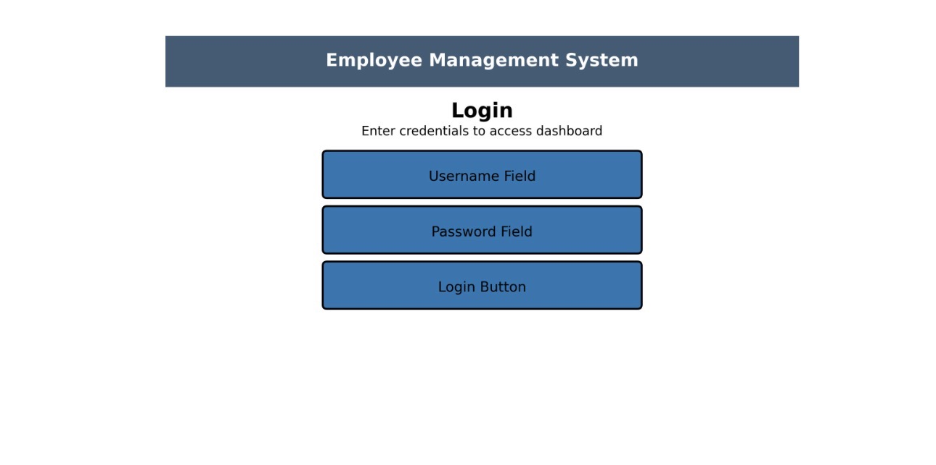
Login Screen
Users enter their username and password to access the system dashboard.

Slide 4
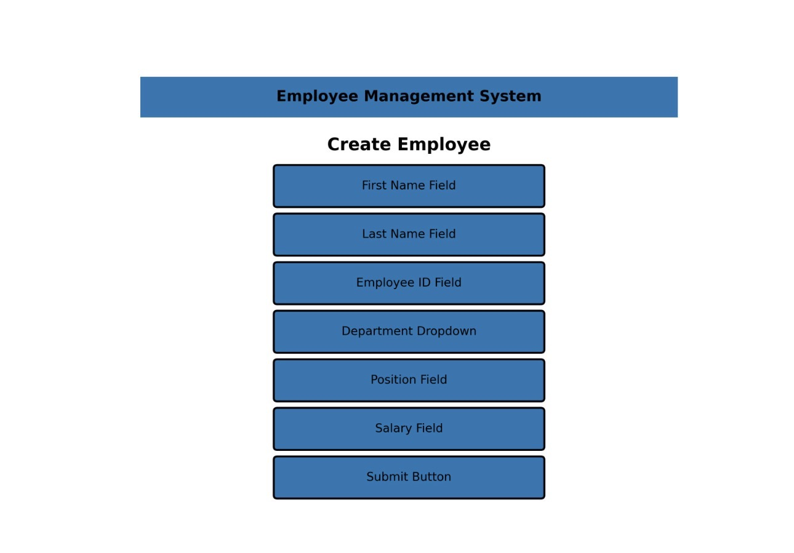
Create Employee Screen
Managers can add new employees by entering their information such as name, ID, department, and salary.

Slide 5
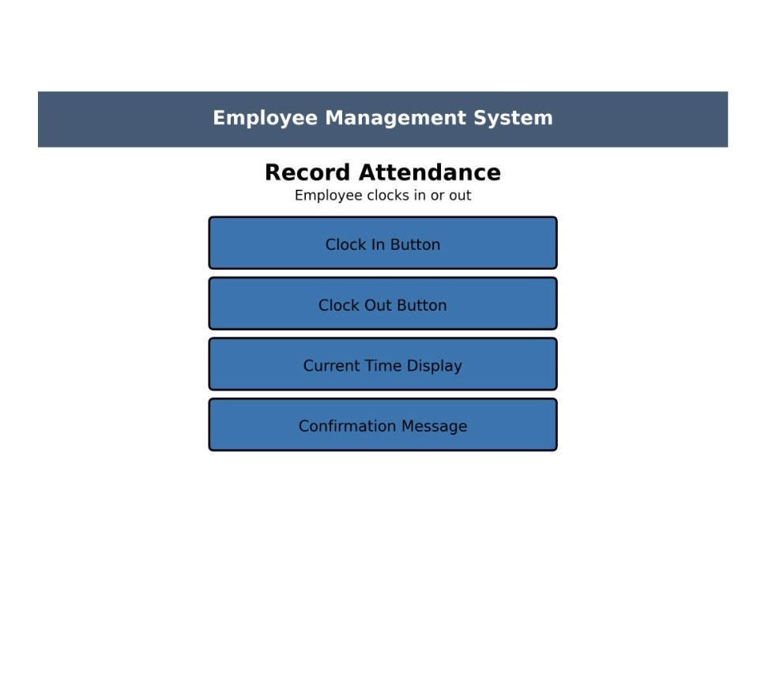
Record Attendance Screen
Employees can clock in and clock out. The system records the time and confirms the action.

Slide 6
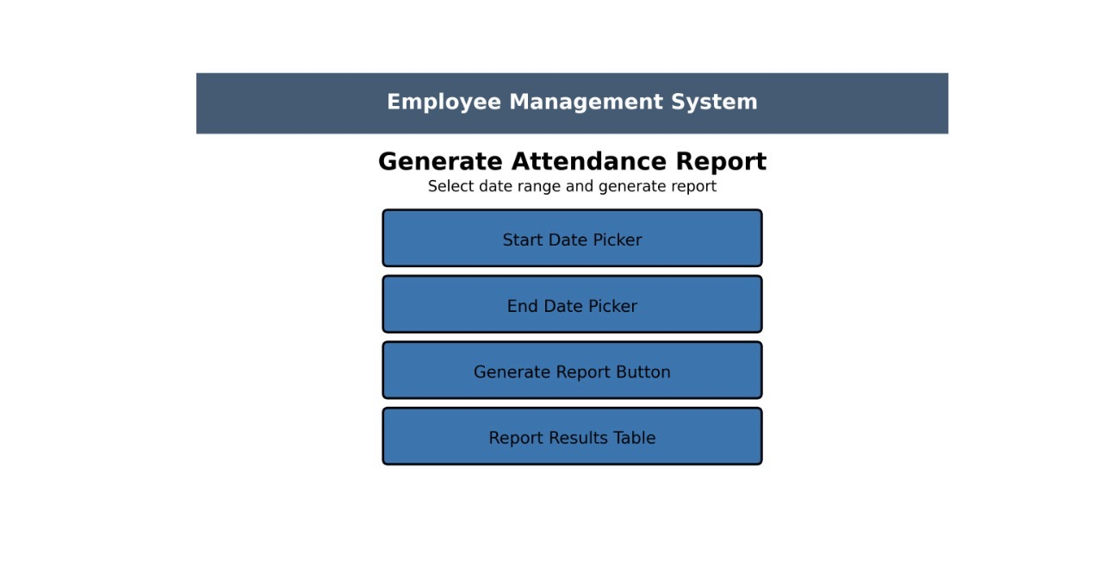
Generate Attendance Report Screen
Managers select a date range and generate reports showing employee work hours and attendance data.

Slide 7
Future Improvements
Future improvements for the system include:
• Improving the reporting features
• Adding more employee management tools
• Enhancing the user interface design
• Improving database functionality

