Slide 1
Generalizable RL for Neighborhood Battery Control
CityLearn Challenge 2023 · Track 3 (RL Competition)
Erik Dyer · Ammaar Alam · Grace Sun
COS 435 / ECE 433 — Spring 2026
Problem: control a shared neighborhood battery across 3 buildings with solar PV and stochastic demand. Each hour the policy emits a per-building continuous action in [−1, +1] to jointly reduce cost, carbon, peak, discomfort, and outage risk.
CityLearn 2023 Track-3 · Title + problem 1 / 7
Notes:
We control a neighborhood-scale battery storage system across three buildings with solar generation and stochastic electricity demand. At each hour, the agent outputs a continuous action in [-1, +1] per building — negative discharges, positive charges — to optimize a composite score across cost, carbon, peak demand, discomfort, and thermal resilience.

Slide 2
Why it matters
Buildings are a first-order decarbonization lever
• Buildings ≈ 28% of global CO₂ emissions (IEA)
• Distributed storage + PV is a key grid-decarbonization lever — shifts peak, absorbs renewables.
• CityLearn Challenge 2023 — realistic, standardized benchmark for multi-building coordination.
• Better battery coordination → lower peak loads, cheaper bills, less carbon. Real-world stakes.
CityLearn 2023 Track-3 · Why it matters 2 / 7
Notes:
Better battery coordination directly translates to lower peak loads, cheaper bills, and less carbon — real-world stakes. The CityLearn benchmark gives us a controlled testbed to study RL for a problem where rule-based and MPC methods currently dominate.

Slide 3
Why it is hard
Naive approaches fail for concrete, measurable reasons
• Non-stationary demand + weather — distribution shifts across seasons and hours.
• Partial observability — no perfect load forecast, imperfect thermal state.
• Multi-building coordination, long horizons — credit assignment is brutal.
• Reward specification is not given — competition ships an evaluation rule, not a training signal.
• Naive RBC = 1.02 on public_dev — strong non-RL baseline. Exploitable structure, little adaptivity.
CityLearn 2023 Track-3 · Why it is hard 3 / 7
Notes:
Rule-based control does a reasonable job because the domain has exploitable structure, but it cannot adapt to unusual conditions. RL promises better generalization, but training is unstable across seeds, reward misspecification dominates early results, and the long-horizon credit assignment is brutal. A naive single-seed PPO run looks better than RBC but regresses on held-out splits.

Slide 4
Prior work + our differentiator
Track 3 is already solved if the metric is leaderboard rank
• CityLearn 2023 winner: CHESCA — 0.562 public / 0.565 private (hierarchical optimization, not RL).
• Most leaderboard entries are rule-based or MPC variants — RL is under-represented.
• Our contribution: a systematic ablation, not a new algorithm.
• 2 algorithms × 2 control topologies × 3 reward variants
• Multi-seed runs (n = 3–10) with 95% CI error bars
• Cross-split generalization: public_dev → phase_2 (3b) → phase_3 (6b held-out)
CityLearn 2023 Track-3 · Prior work + differentiator 4 / 7
Notes:
Track 3 has already been solved if the metric is leaderboard rank — CHESCA won with hierarchical optimization. Nobody has done a clean comparison of RL architectures and rewards with seeded error bars, though. That's the gap we fill. We don't claim to beat CHESCA; we claim to map which design choices matter for RL practitioners who come next.

Slide 5
Approach — architecture + algorithms
Two control topologies, two RL algorithms
• Centralized: one controller observes all 3 buildings, emits a 3-vector action. Wired for exactly 3 buildings.
• Shared-DTDE: one policy network, per-building observation windows, decentralized rollout with shared parameters — size-agnostic.
• PPO — on-policy, clipped surrogate objective. From-scratch for DTDE; Stable-Baselines-3 for centralized.
• SAC — off-policy, entropy-regularized. Custom for both topologies.
• Only shared-DTDE transfers to the 6-building phase_3 held-out cluster — a centralized policy's input/output shapes are fundamentally non-portable.
CityLearn 2023 Track-3 · Approach — architecture 5 / 7
Notes:
We implemented PPO from scratch on a shared policy net with per-building embeddings for the DTDE variants, and used Stable-Baselines-3 for centralized PPO. SAC is custom for both topologies. The centralized architecture gets full joint-action credit assignment; the DTDE version is the only one that transfers to the 6-building phase-3 held-out split — centralized policies are fundamentally non-portable there.

Slide 6
Approach — reward design
Train on the same thing the competition scores on
Variant | What it is | Why
reward_v0 (baseline) | CityLearn's built-in default (negative net-consumption proxy). | Sanity baseline; the training signal does not match the competition scoring rule.
reward_v1 | 8-term weighted penalty mirroring the official 2023 scoring weights: 0.30·comfort + 0.15·outage_comfort + 0.15·outage_unserved + 0.10·carbon + 0.075·{ramping, load_factor, daily_peak, all_time_peak} | Train on the same thing the competition scores on.
reward_v2 | reward_v1 + 0.05·|ΔSoC| + 0.05·1[sign_flip] | Battery smoothness penalties — discourages bang-bang charge/discharge; empirically improves cross-split generalization.
Reward-variant ablation axis run on SAC-central only (compute-bound). SoC = battery state of charge; sign_flip indicator penalizes charge→discharge reversal between consecutive steps.
CityLearn 2023 Track-3 · Reward design 6 / 7
Notes:
Instead of inventing weights, reward_v1 literally mirrors the 8-term weighted penalty the competition uses to score submissions, so the agent is trained directly on the objective it's evaluated on. reward_v2 adds two battery-behavior terms that penalize SoC swings and charge-discharge sign flips between consecutive steps. Without them, SAC learns bang-bang policies that are locally optimal on public_dev but brittle on held-out splits; with them, the policy is steadier and generalizes better. The reward-ablation axis is run only on SAC-central — we didn't have compute to matched-ablate PPO.

Slide 7
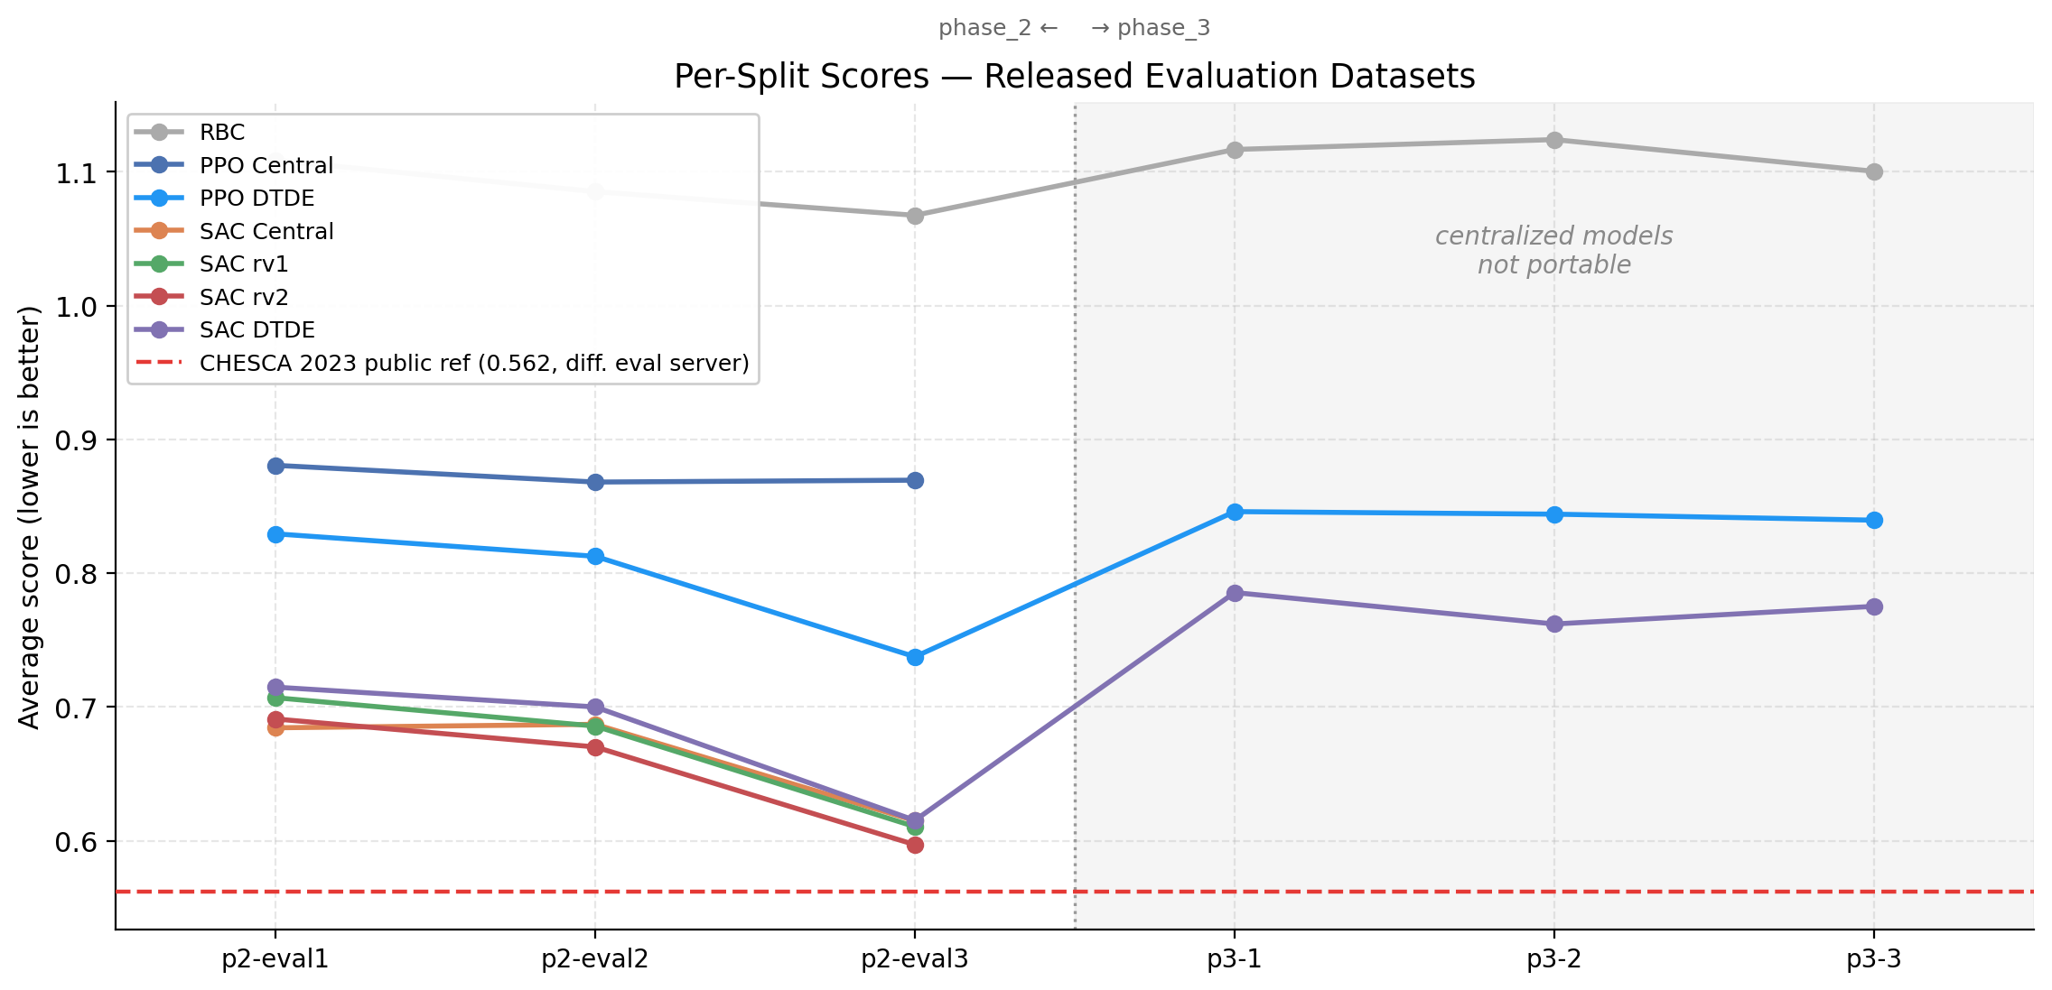
Results + limitations
Held-out average_score (↓ better) across 6 released evaluation datasets
phase_2 (3 buildings, held-out)
RBC: 1.087
PPO central: 0.873
PPO DTDE: 0.793
SAC central reward_v2: 0.653 (best)
SAC DTDE: 0.677
CHESCA public ref: 0.562
phase_3 (6 buildings, held-out — portable only)
RBC: 1.114
PPO DTDE: 0.843
SAC DTDE: 0.774 (best)
Takeaway: shared-DTDE is the only architecture that transfers to a different building count; centralized SAC reward_v2 is the best within-size variant. CHESCA's 0.562 is benchmark context (different eval server), not a head-to-head number.
CityLearn 2023 Track-3 · Results + limitations 7 / 7
Notes:
The headline panel is the held-out phase_2_online_eval split — same 3-building setup as training but weather and demand the agent has never seen. RBC sits at 1.09, PPO central at 0.87, PPO-DTDE at 0.79, and SAC variants cluster at 0.65-0.68. The dashed line at 0.562 is CHESCA's 2023 public-leaderboard score — benchmark context, not a head-to-head number, because CHESCA was scored on the original competition server we cannot re-run.
The harder test is phase_3 — held-out AND a different 6-building cluster, not the 3 we trained on. Only the shared-DTDE variants can execute here: a centralized policy's input and output layers are wired for exactly 3 buildings, so feeding it a 6-building observation is a shape mismatch, not a degradation. SAC-DTDE generalizes best at 0.774, PPO-DTDE at 0.843. This is our cleanest architectural claim: if deployment might see a different building count than training, choose shared-DTDE.
Limitations: single public_dev tuning split was used to select reward variants (overfitting risk); compute-bound so we capped PPO-DTDE and SAC-DTDE at 10 and 3 seeds respectively; reward-variant ablation was run only on SAC-central, not on PPO-central. CHESCA's line is reference, not a competitive bar we're claiming to have cleared.

