Slide 1
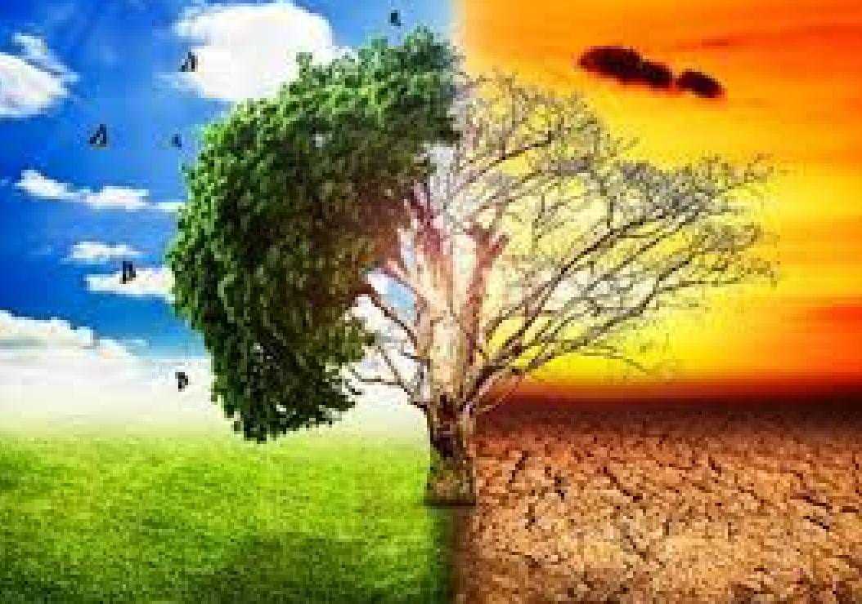
NASA APP SPACE CHALLENGE 2024
TOPIC : TELL US A CLIMATE STORY
GROUP MEMBERS
ALYAN NASEEM
AMMAD ALI
RAMEEZ MALLICK
KASHIF HASSAN
ASAD ALI

Slide 2
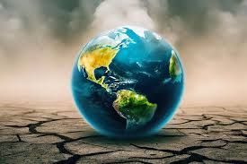
THE CLIMATE CHANGE
Climate Change Cause: Air Pollution
Rising Temperatures, Melting Ice.
Harms Humans, Animals, Plants.

Slide 3
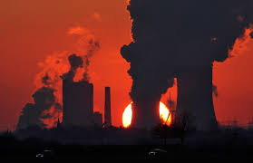
WHAT ARE THE MAIN CAUSES
Point 1: Human Activities
Fossil Fuel Burning.
Point 2: Contributing Factors
Deforestation, Industrial Emissions.
Point 3: Natural Factors
Volcanic Eruptions.

Slide 4

HOW IT AFFECT THE WEATHER
Point 1: Extreme Weather
Heatwaves, Droughts, Floods.
Point 2: Unpredictable Patterns
Heavy Rainfall, Strong Storms.
Point 3: Severe Consequences
Harsher Winters, Hurricanes.

Slide 5
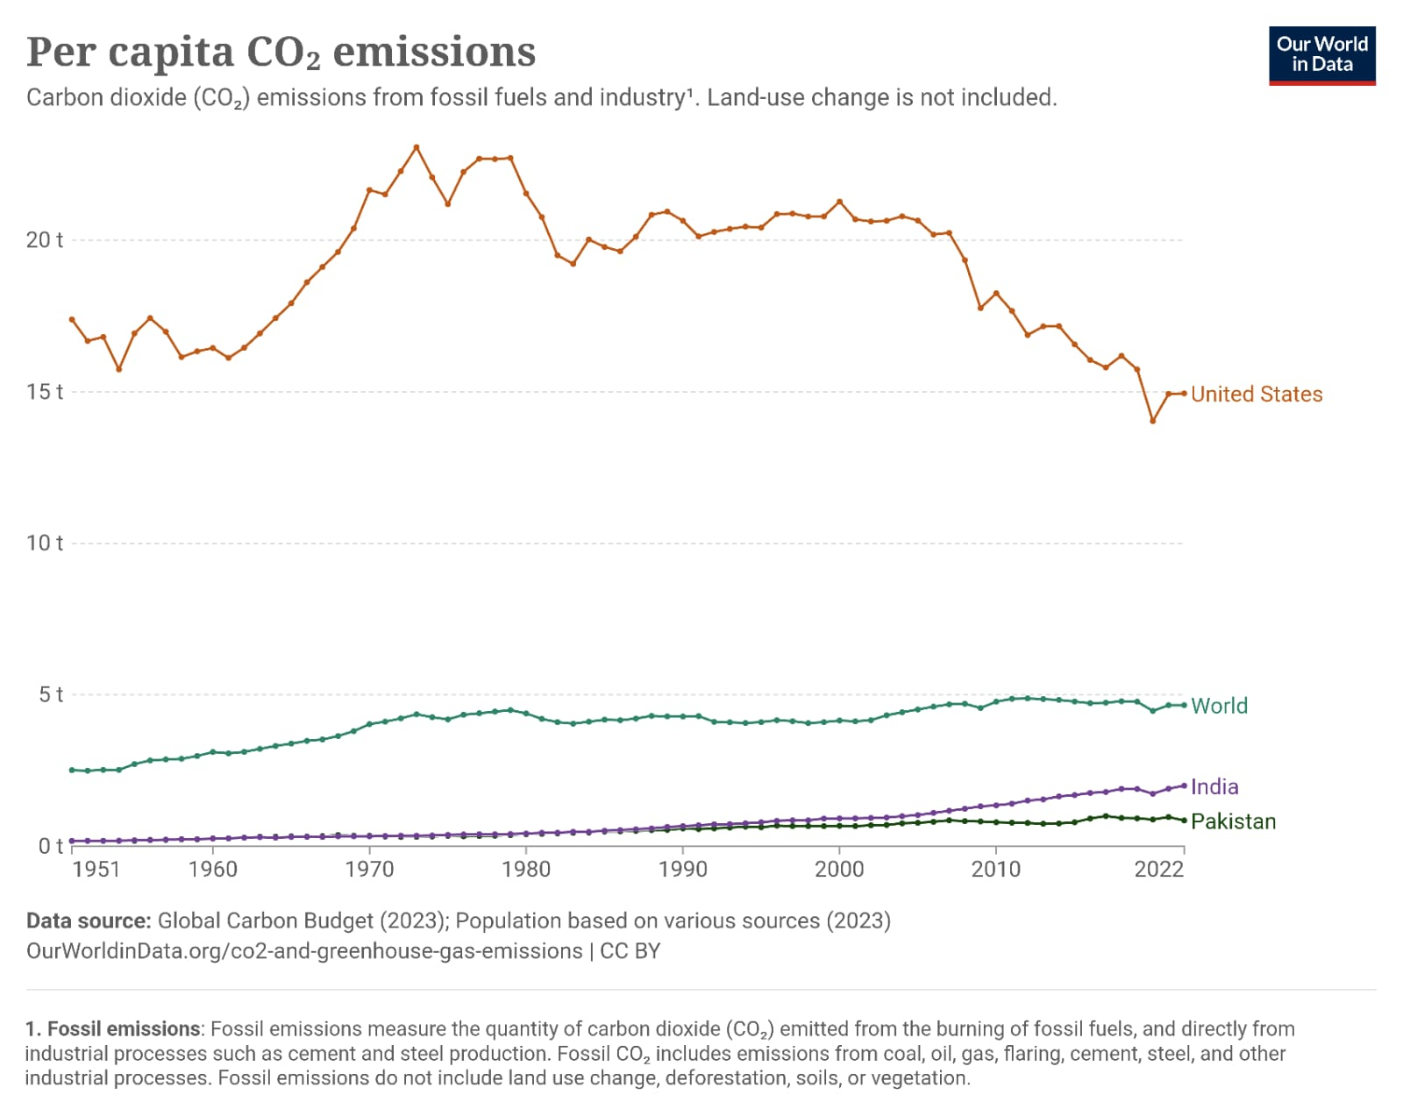

Slide 6

CLIMATE CHANGE IMPACT ON PAKISTAN
Point 1: Vulnerability
Pakistan among top 20 climate-vulnerable countries.
Point 2: Industry Impact
Agriculture & textiles affected by climate change.
Point 3: Water Scarcity
Water-intensive industries face severe consequences.

Slide 7
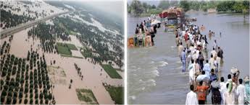
MIGRATION
Point 1: Migration Crisis
Human, animal migration.
Point 2: Ecosystem Disruption
Food chains collapse.
Point 3: Global Instability
Food insecurity, wars.

Slide 8
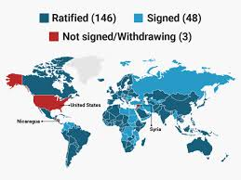
THE PARIS ACCORD 2016
Point 1: CO2 Reduction
Pledge 30% Less.
Point 2: Tree Plantation
Billion Tree Goal.
Point 3: Water Mismanagement
Lack of Storage

Slide 9
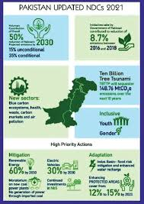
PARIS ACCORD AND PAKSITAN
Point 1: CO2 Reduction
Reduce 300% Emissions.
Point 2: Billion Tree
Plantation Initiative.
Point 3: Water Crisis
Mismanagement, Waste.

Slide 10

TOGETHER FOR A BETTER TOMORROW
Point 1: Change Now
Avoid climate crisis.
Point 2: Plant-Based Diet
Reduce methane emissions.
Point 3: Sustainable Living
Limit, relearn habits.

Slide 11


