Slide 1
Code mania_2025 Brain in
Presented by
: A.Spoorthy(24D41A6610)
A.Sathwika(24D41A6608)
A spoorthi(24D41A6614)
C.Harini(24D41A6648)
AIML-A

Slide 2
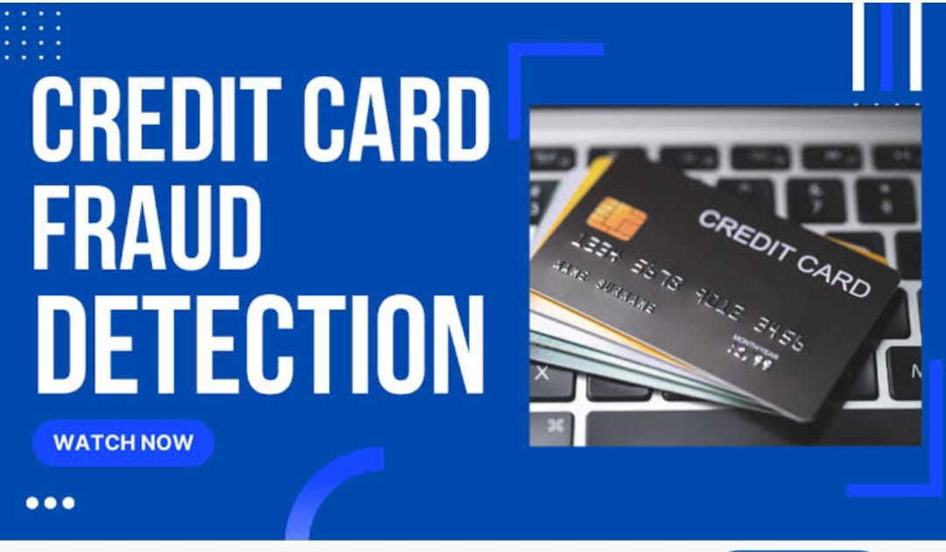
Credit card fraud detection
What is Credit Card Fraud?
The unauthorized use of credit card information to make purchases or withdraw funds.
Often carried out through theft, hacking, phishing, or skimming.
Why is Detection Important?
Credit card fraud causes billions in global losses each year.
Protects consumers and financial institutions from financial harm.
Helps maintain trust in online transactions and banking systems.
Real-World Impact:
According to [latest data], global credit card fraud losses exceeded [$X billion] in [year].
Increasing trend due to the rise in digital and online payments.
Would you like me to turn this into a slide with visuals and design, or continue with the next slide?

Slide 3
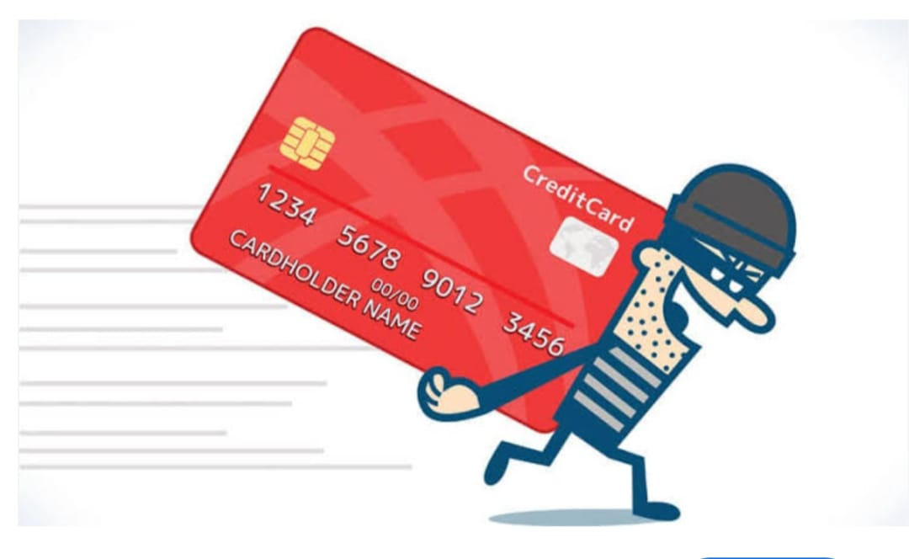
Types of credit card fraud
Rule-Based Detection
Uses manually defined rules (e.g., flagging large transactions in unusual locations).
Easy to implement, but limited in adaptability.
Anomaly Detection
Detects transactions that deviate significantly from a user's normal behavior.
Unsupervised learning techniques often used.
Supervised Machine Learning
Trained on labeled datasets (fraud vs. legitimate).
Common algorithms: Logistic Regression, Random Forest, SVM, XGBoost.
Deep Learning Models
Uses neural networks (e.g., CNNs, LSTMs) to detect complex patterns in transactional data.
More effective on large datasets with hidden fraud patterns.
Hybrid Approaches
Combines multiple methods (e.g., rule-based + machine learning) to improve accuracy and reduce false positives.

Slide 4
Machine learning approch
Here's a concise slide on the Machine Learning Approach for Credit Card Fraud Detection:
Slide Title: Machine Learning Approach
Data Collection
Gather transactional data (features like amount, time, location).
Data Preprocessing
Handle missing values
Normalize data
Deal with imbalanced classes (e.g., using SMOTE or undersampling)
Feature Selection
Identify key indicators of fraud (e.g., unusual spending patterns)
Model Training
Apply ML algorithms:
Logistic Regression
Decision Trees
Random Forest
XGBoost
Model Evaluation
Use metrics like:
Precision, Recall, F1-Score
Confusion Matrix
ROC-AUC Curve
Deployment
Integrate the model into real-time systems for live fraud detection
Would you like help creating a diagram for this workflow or move to the next topic?

Slide 5
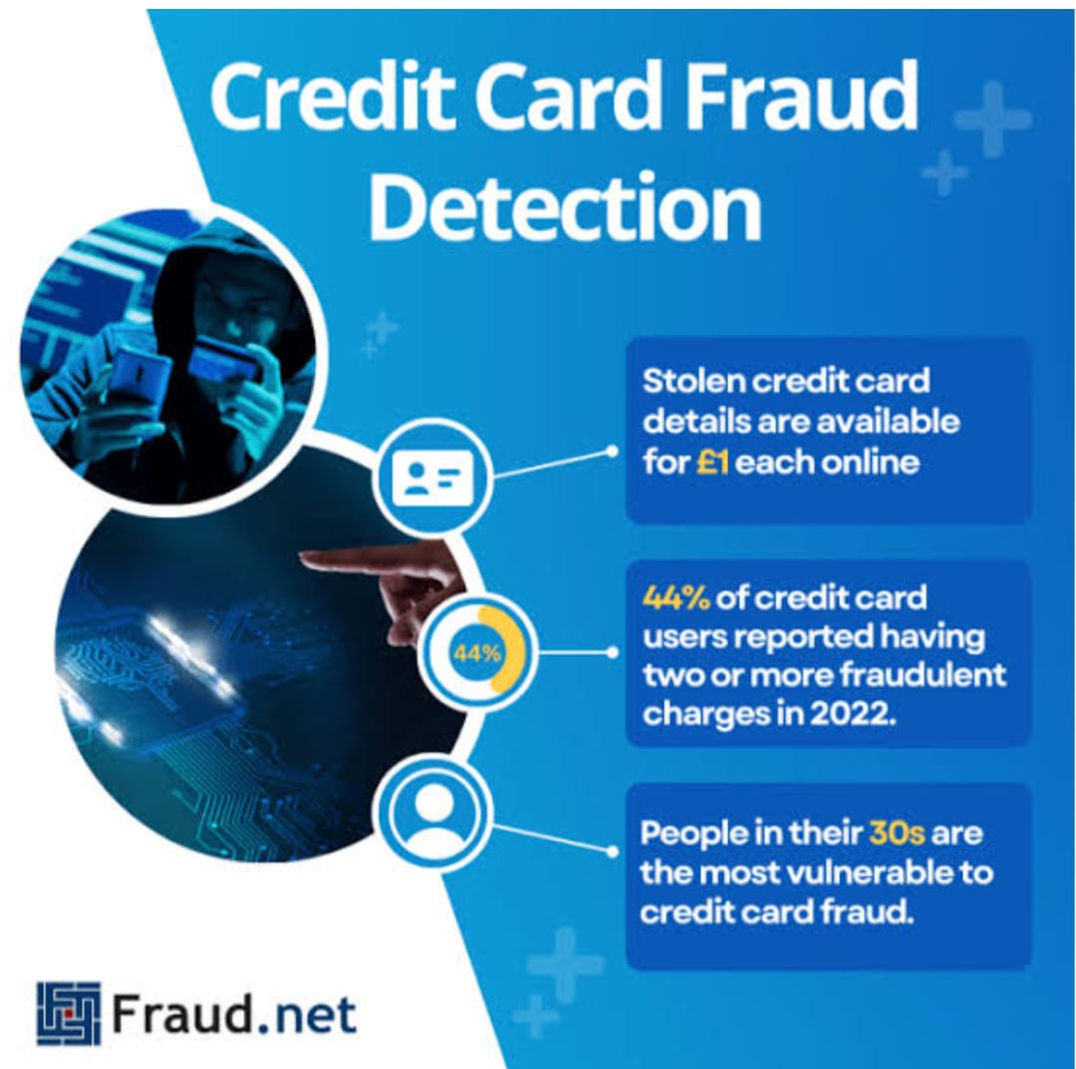
Implementations
Tools Used
Python, Scikit-learn, Pandas, NumPy, Matplotlib
Dataset
Kaggle Credit Card Fraud Detection Dataset
Contains 284,807 transactions with 492 fraud cases
Steps
Load and clean data
Handle class imbalance (e.g., SMOTE)
Train ML model (e.g., Random Forest)
Evaluate using ROC curve & confusion matrix
Result
Achieved high recall and precision
Model detects fraud with good accuracy
Would you like to add code snippets or visuals to this slide?

Slide 6
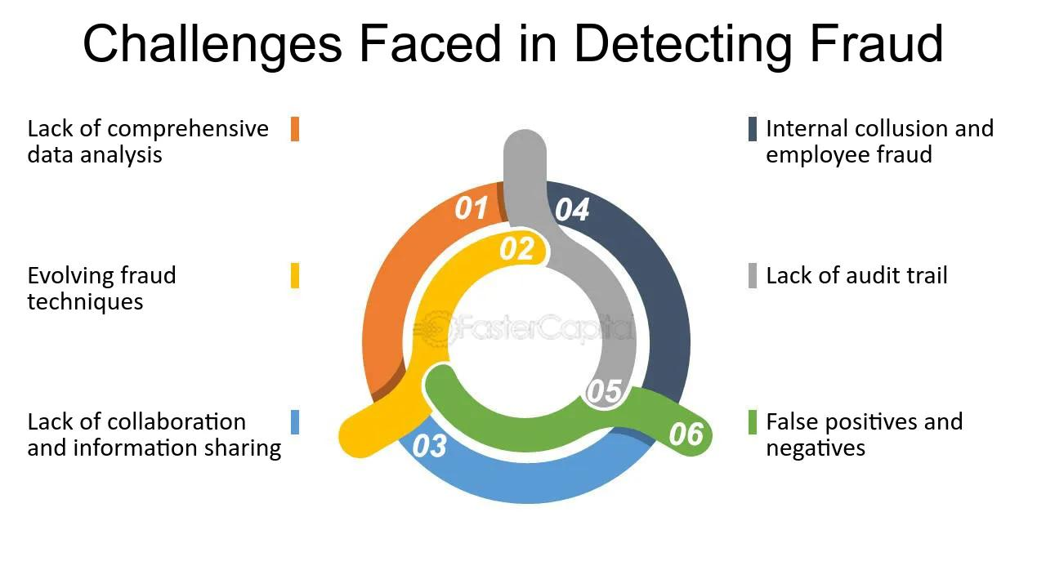
Challenge s in credit Card fraud detection

Slide 7
Conclusion
Slide Title: Future Scope
Real-Time Detection
Faster models to stop fraud instantly.
AI & Deep Learning
Smarter models for better pattern recognition.
Blockchain Technology
Secure and transparent transaction tracking.
Behavioral Biometrics
Using typing speed, mouse movements for fraud checks.
Continuous Learning
Models that update as fraud techniques

Slide 8
Thank you

