Slide 1

Australia’s total Greenhouse Gas Emissions 1990-2016
DATA VISUALISATION

Slide 2
About the Project
Greenhouse gases are gases in the atmosphere that absorb and emit infrared or heat radiation, thus trapping heat in the lower atmosphere.
We are going to understand and visualize data that contain Australia’s total Greenhouse Gas emissions (of CO2-equivalent) between the years 1990 and 2016. Also contain the list of all the Greenhouse gasses present in our atmosphere and their attributes.
What GWP means?
Global warming potential (GWP) is the heat absorbed by any greenhouse gas in the atmosphere, as a multiple of the heat that would be absorbed by the same mass of carbon dioxide (CO. 2). GWP is 1 for CO. 2. For other gases it depends on the gas and the time frame.
You calculate the carbon dioxide equivalent of a quantity of F gas by multiplying the mass of the gas, by the gas' global warming potential (GWP).

Slide 3
Green House gasses
Greenhouse gasses in Atmosphere and their 100-year Global Warming Potential (GWP).As we can see that the various gases have been displayed in cluster of circles . We can easily identify the and compare various gases that made a huge impact on atmosphere . As we can observe from the visualization that Sf6 made a huge impact in global warming.

Slide 4
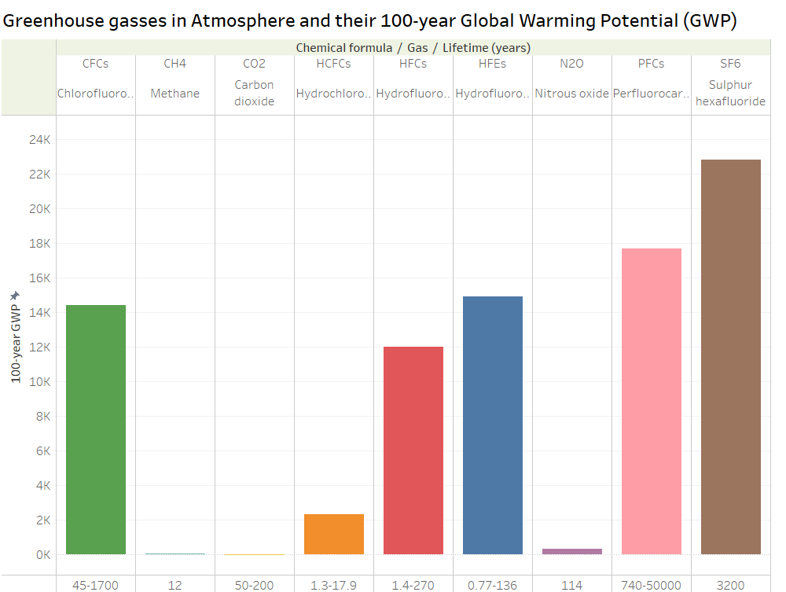
The GWP chart of the Australian gasses in Atmosphere

Slide 5
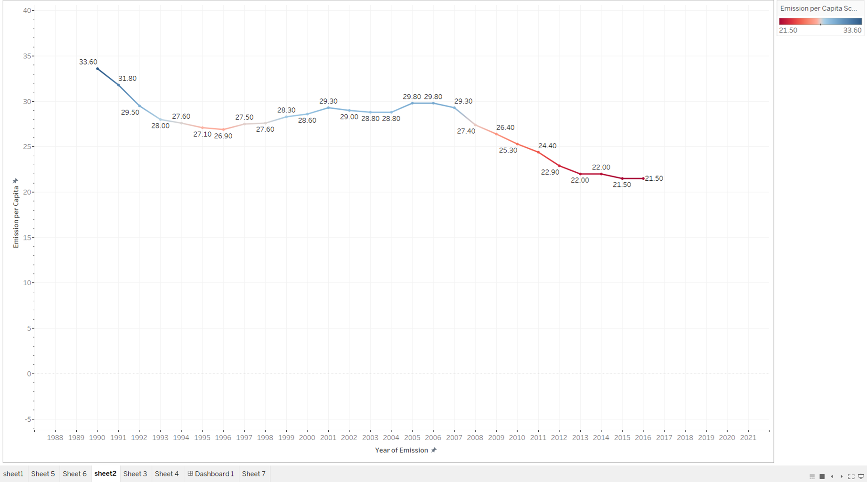
Emissions Per Capita (1990 – 2016)

Slide 6
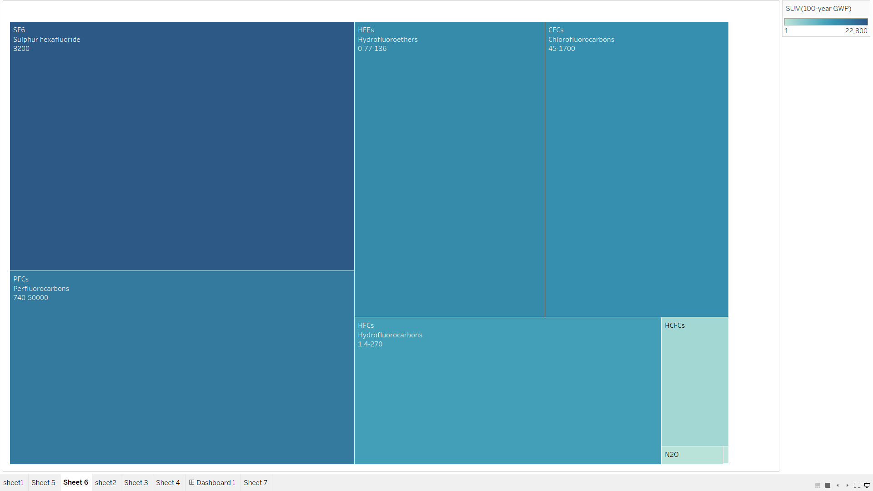
All Carbons in the Australian atmosphere

Slide 7
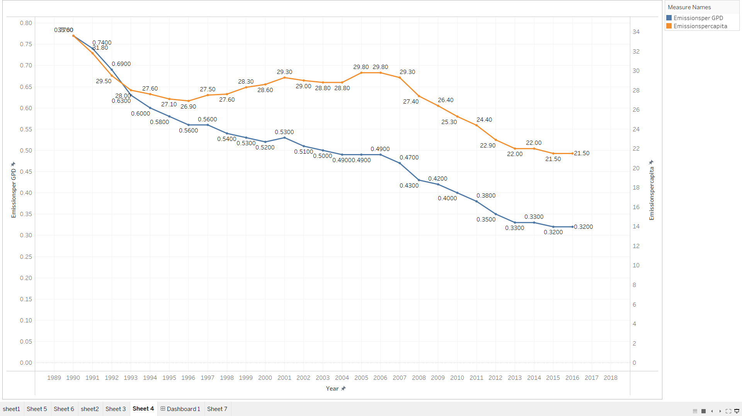
GPD Emissions per Year (1990 – 2016)

Slide 8
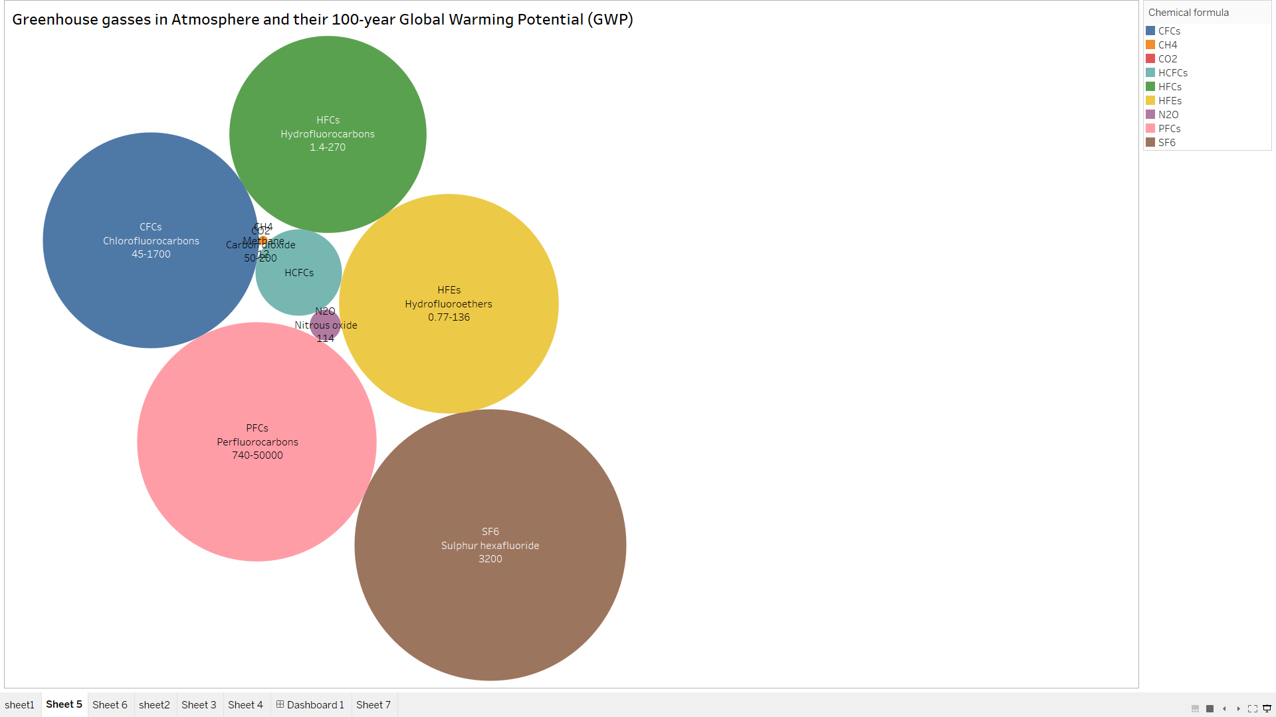

Slide 9
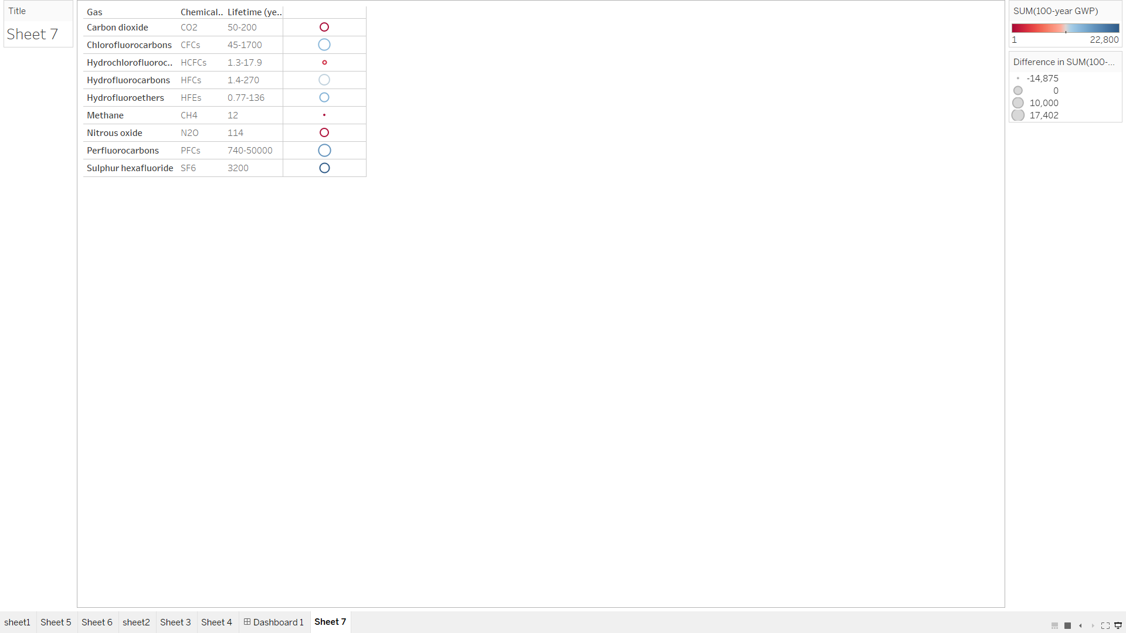
Australia's total GHG Emissions (CO2e) from 1990 to 2016

Slide 10
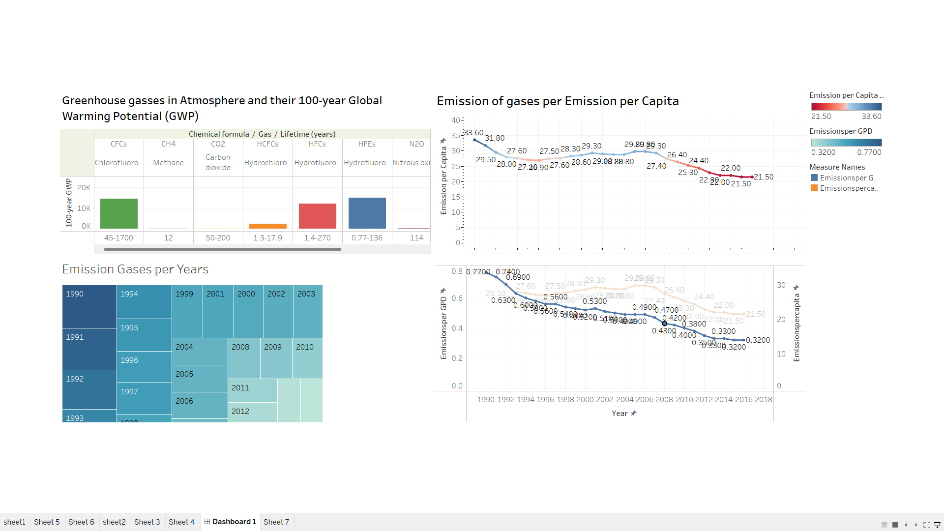

Slide 11
Observations
We observed that Greenhouse gasses in Atmosphere and their 100-year Global Warming Potential (GWP).As we can see that the various gases have been displayed in cluster of circles . We can easily identify the and compare various gases that made a huge impact on atmosphere . As we can observe from the visualization that Sf6 made a huge impact in global warming.

