Slide 1
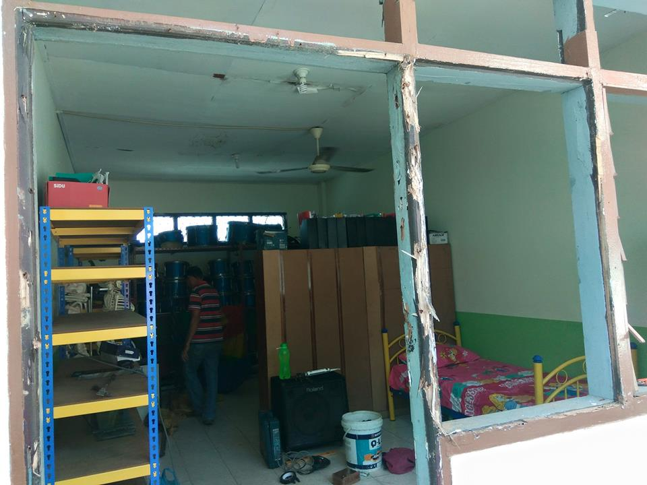
BEFORE
KUSEN ALUMINIUM BATAM Hub : 0823-8756-9098(Tsel)

Slide 2
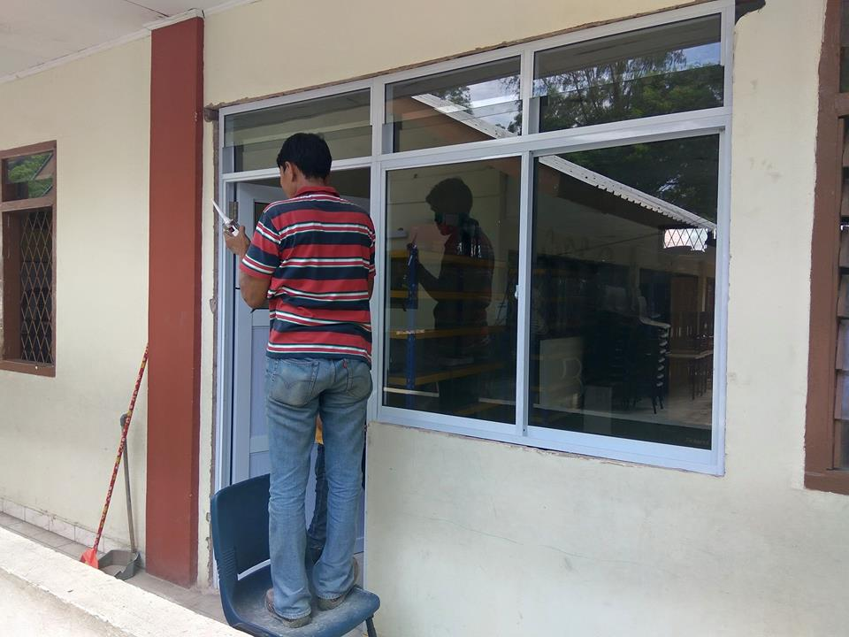
AFTER
KUSEN ALUMINIUM BATAM Hub : 0823-8756-9098(Tsel)

Slide 3
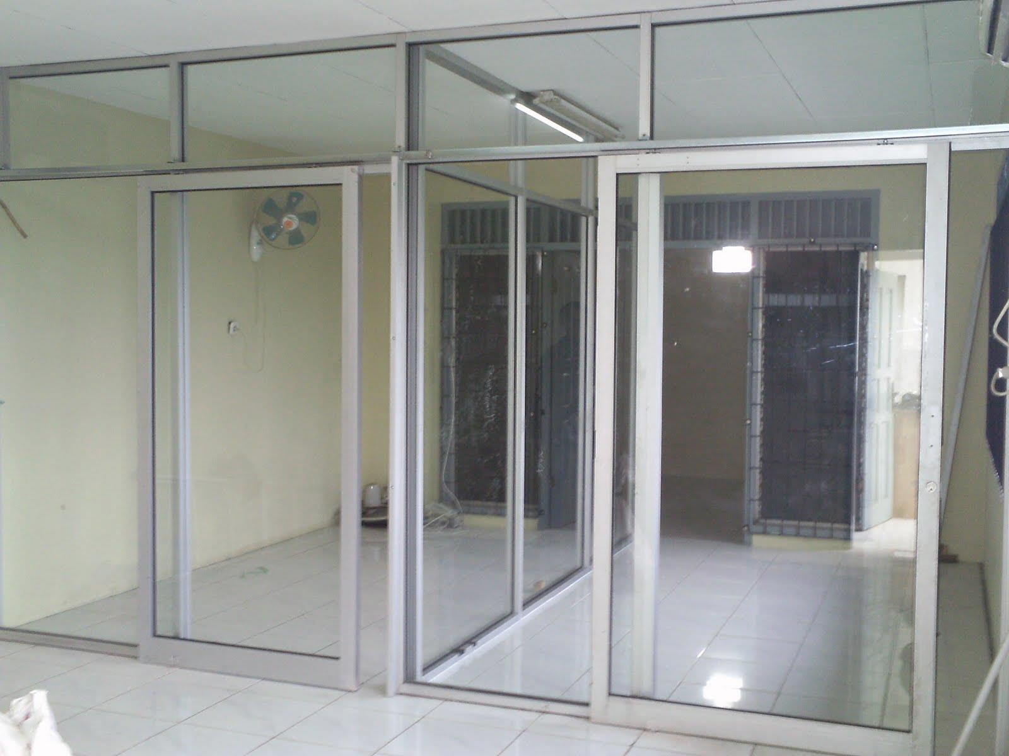
KUSEN ALUMINIUM BATAM Hub : 0823-8756-9098(Tsel)

Slide 4
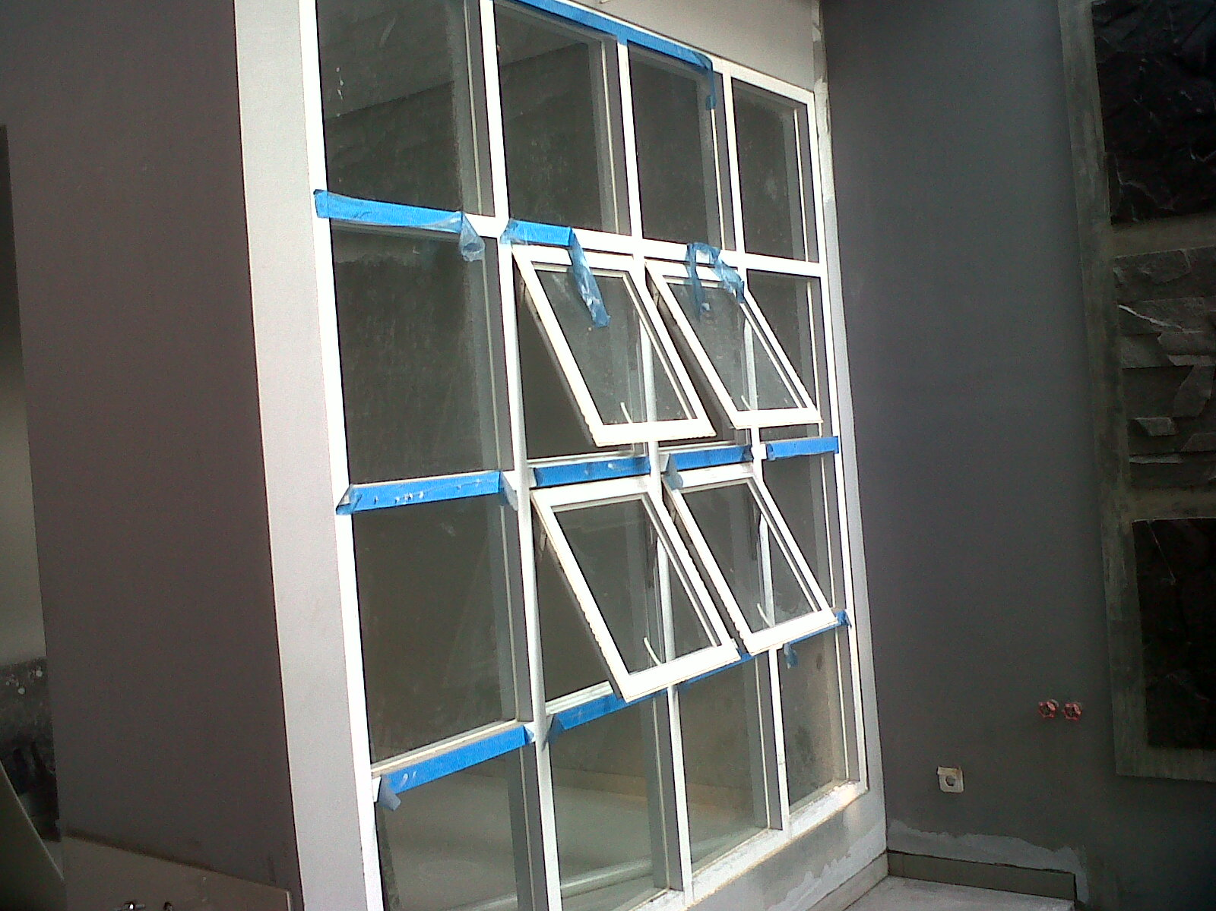
KUSEN ALUMINIUM BATAM Hub : 0823-8756-9098(Tsel)

Slide 5
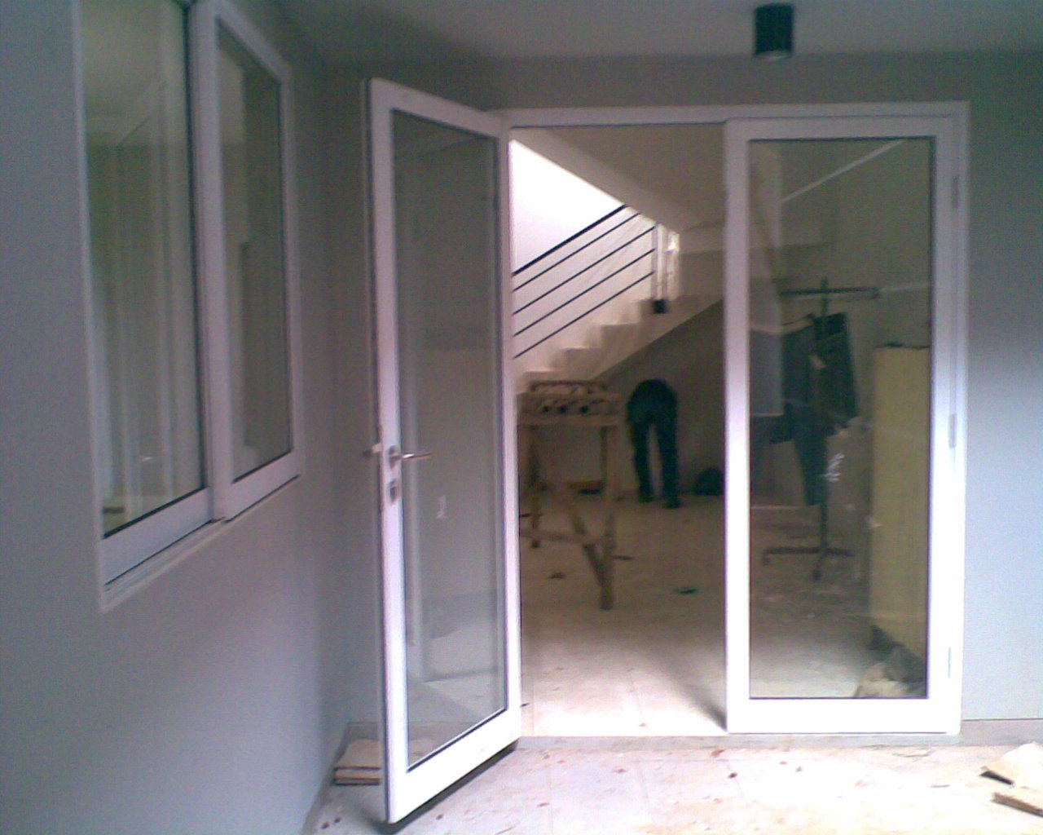
KUSEN ALUMINIUM BATAM Hub : 0823-8756-9098(t-sel)

