Slide 1
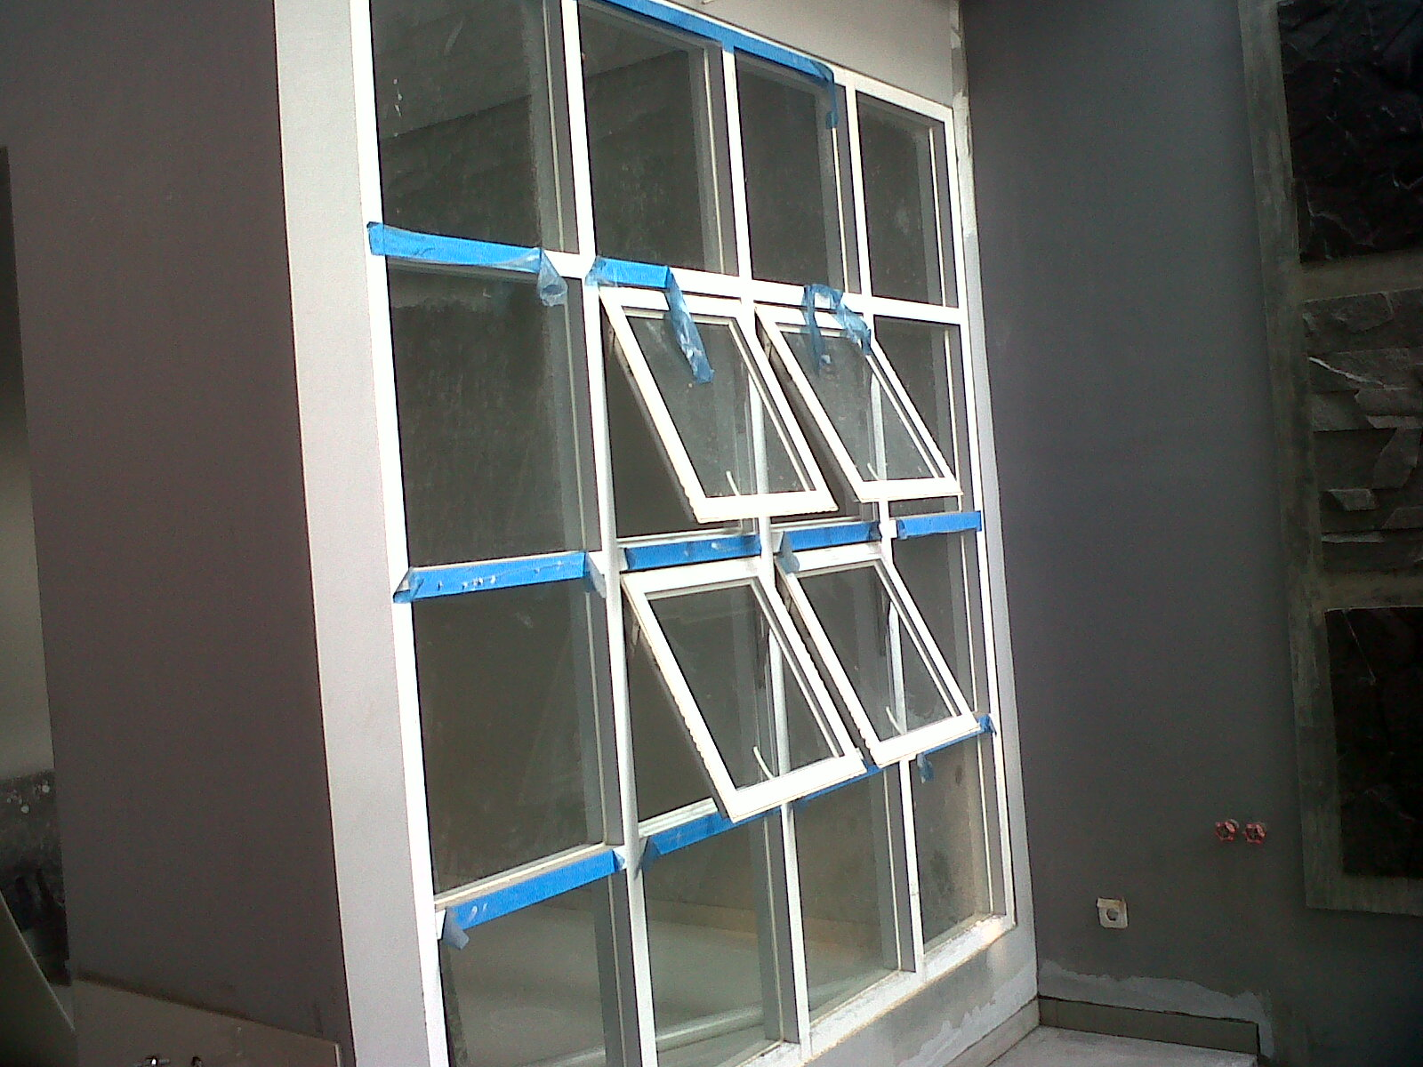
KUSEN ALUMINIUM BATAM Hub : 0823-8756-9098(Tsel)

Slide 2
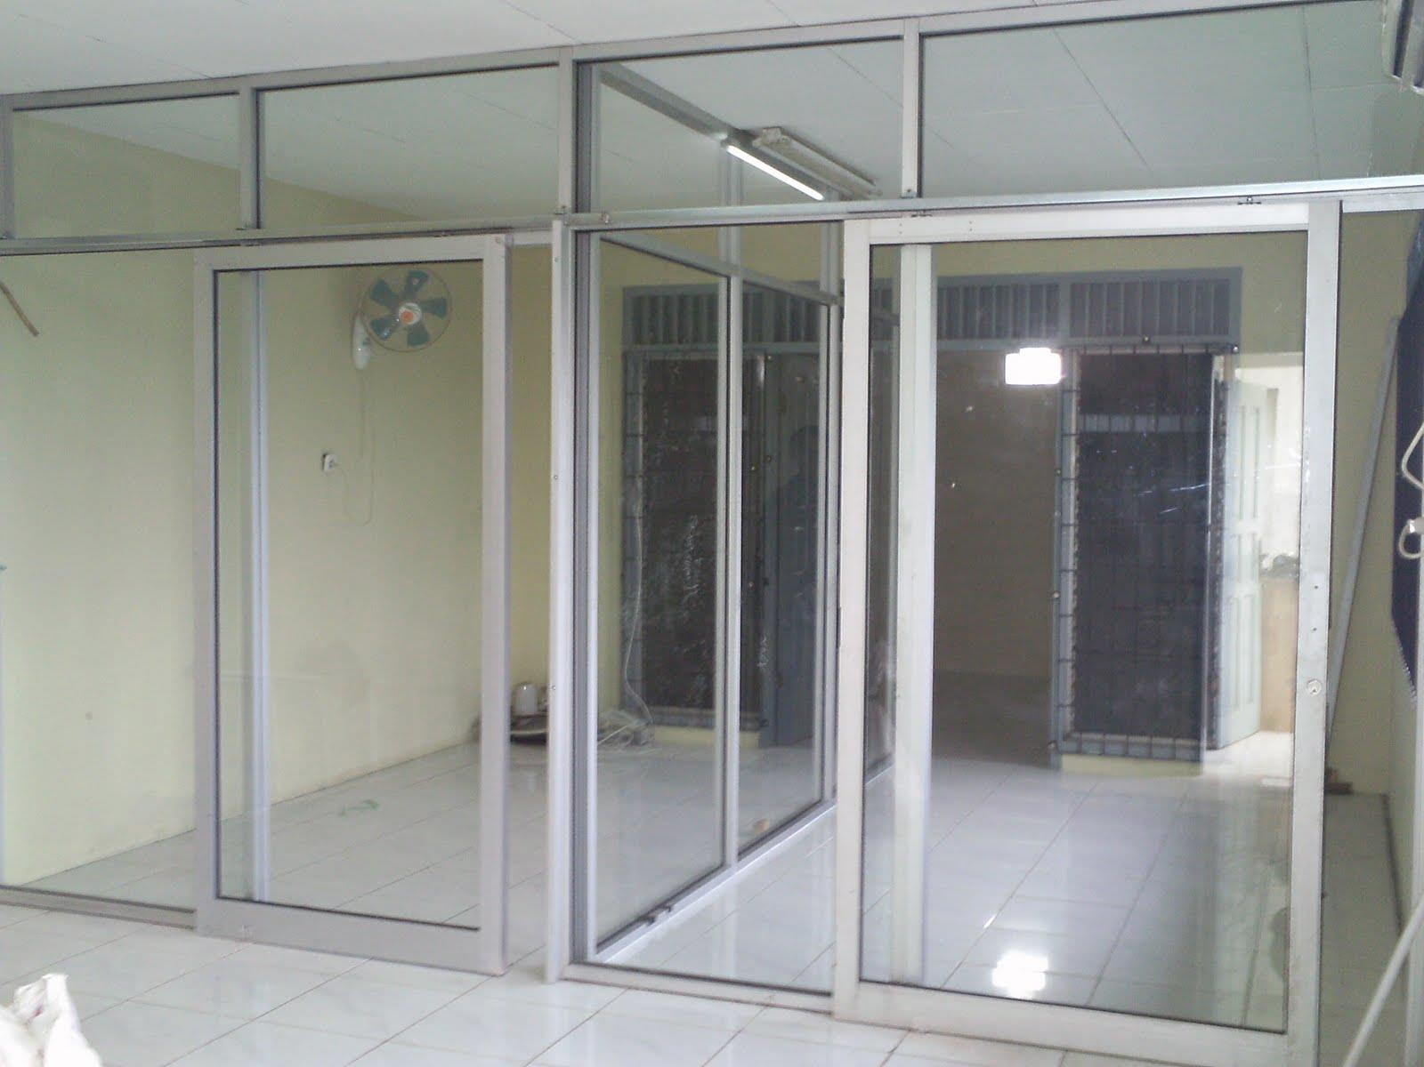
KUSEN ALUMINIUM BATAM Hub : 0823-8756-9098(Tsel)

Slide 3
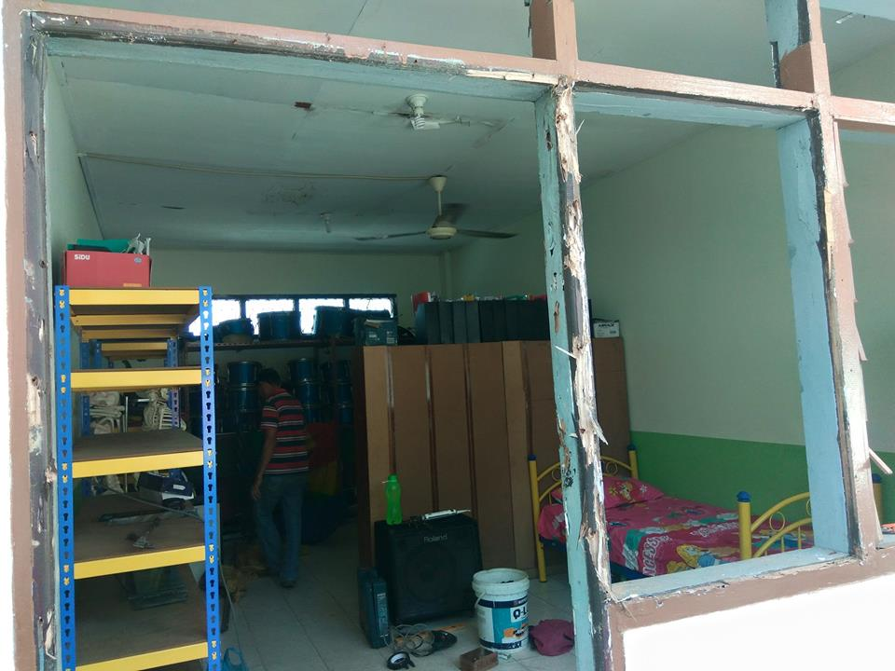
BEFORE
KUSEN ALUMINIUM BATAM Hub : 0823-8756-9098(Tsel)

Slide 4
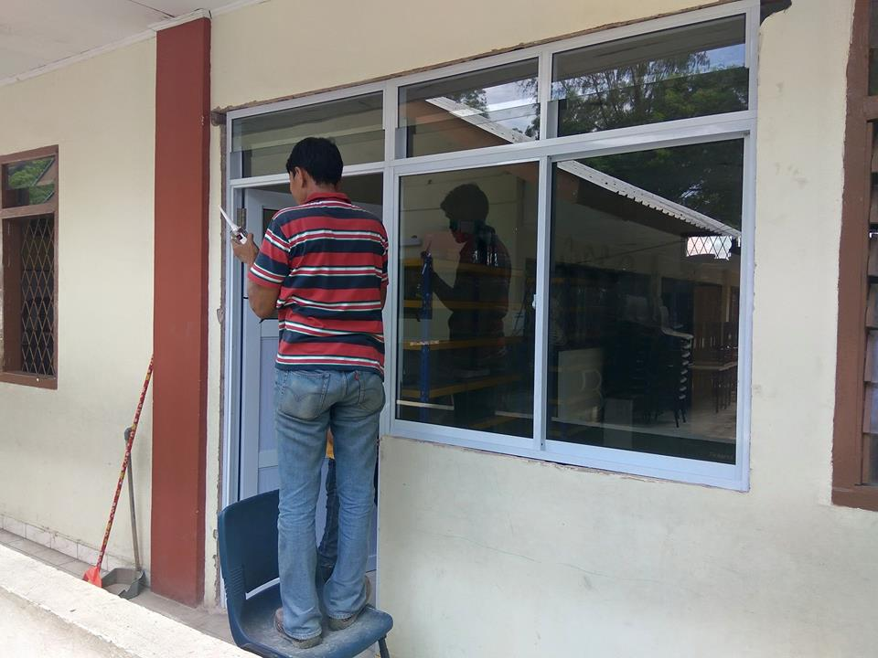
AFTER
KUSEN ALUMINIUM BATAM Hub : 0823-8756-9098(Tsel)

Slide 5
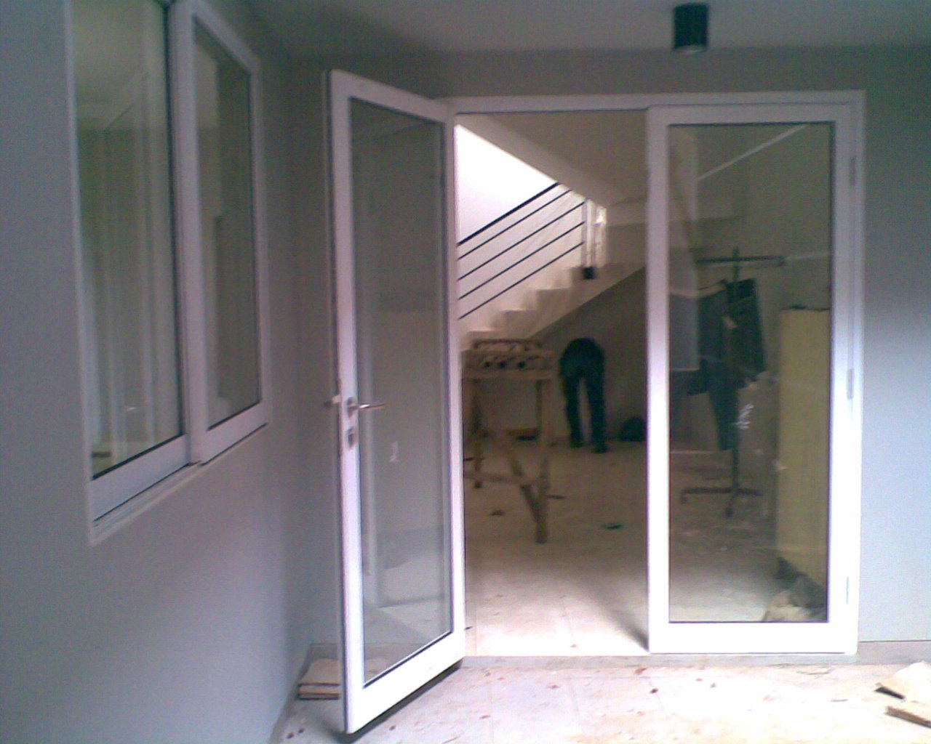
KUSEN ALUMINIUM BATAM Hub : 0823-8756-9098(t-sel)

