Slide 1
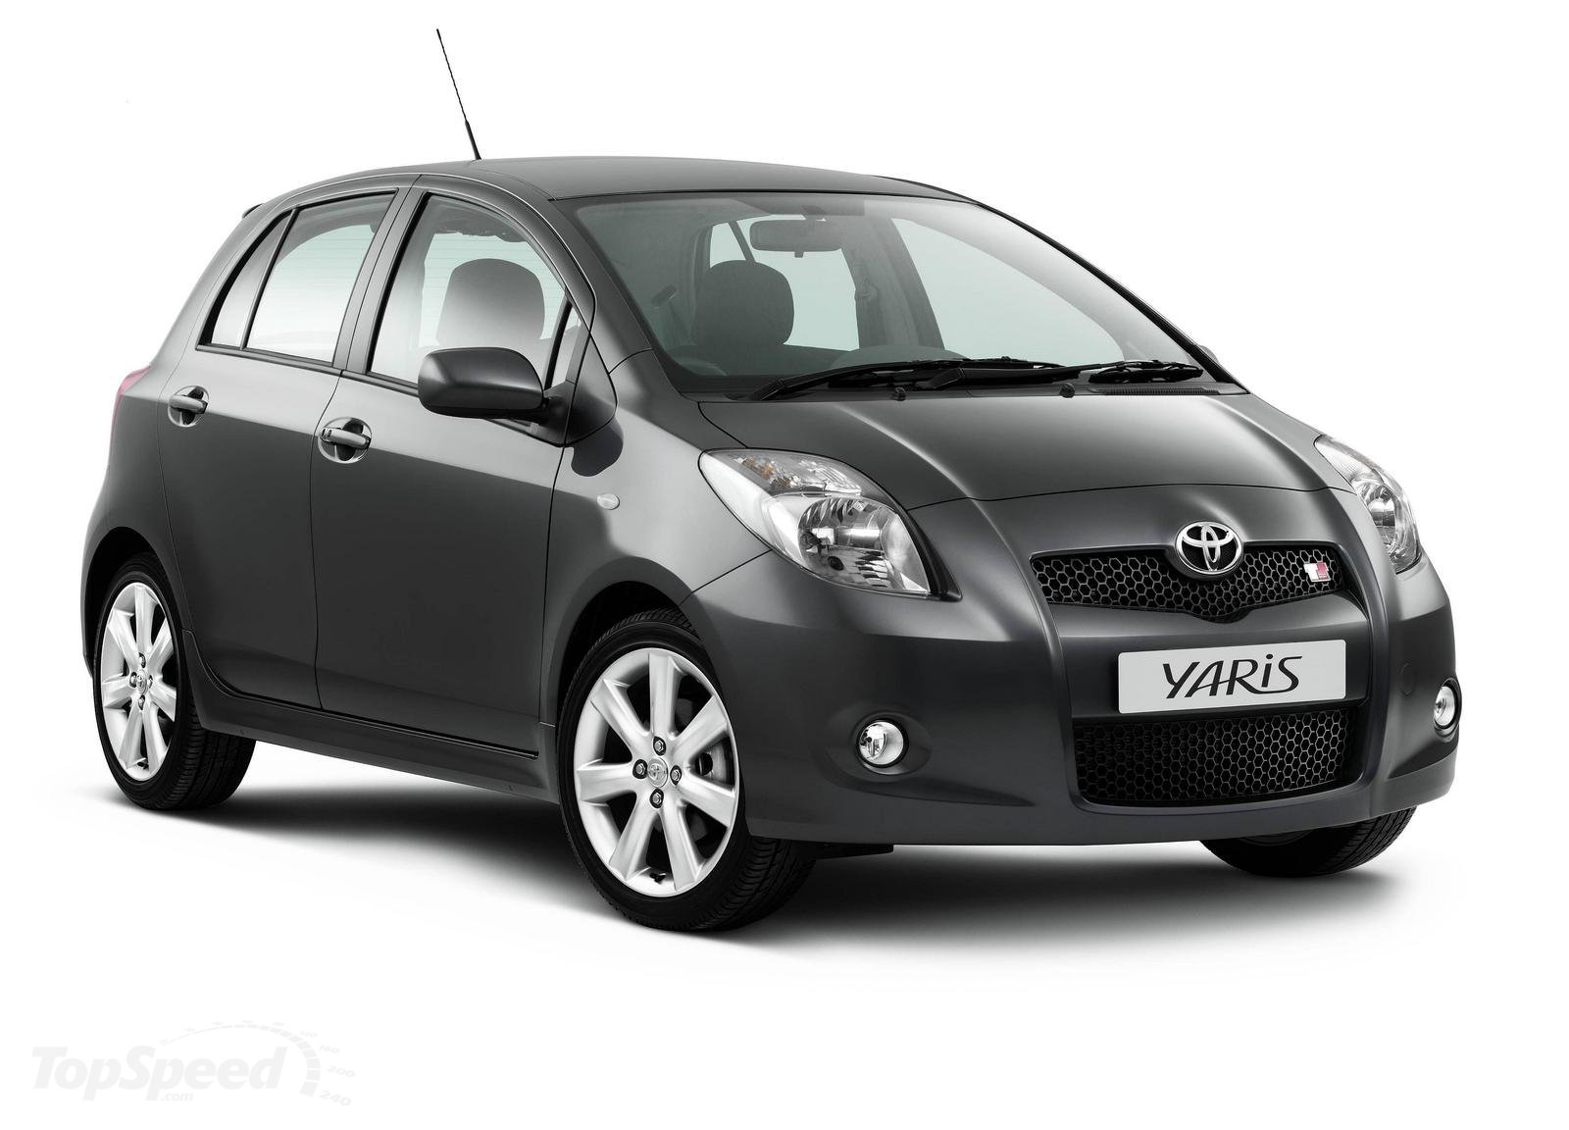
MARKETER YARIS BATAM HUB: 0821-7222-9423 (Tsel)

Slide 2
MARKETER YARIS BATAM HUB: 0821-7222-9423 (Tsel)

