Slide 1
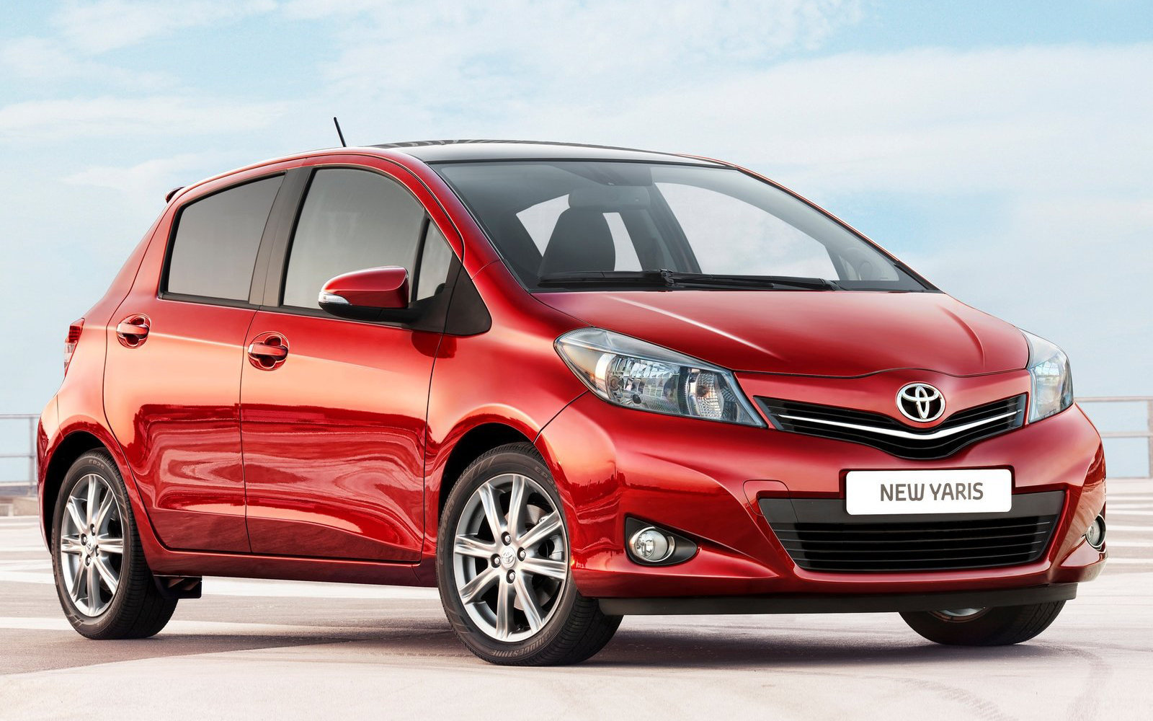
MARKETER YARIS BATAM HUB : 0821-7222-9423 (Tsel)

Slide 2

MARKETER YARIS BATAM HUB : 0821-7222-9423 (Tsel)

Slide 3
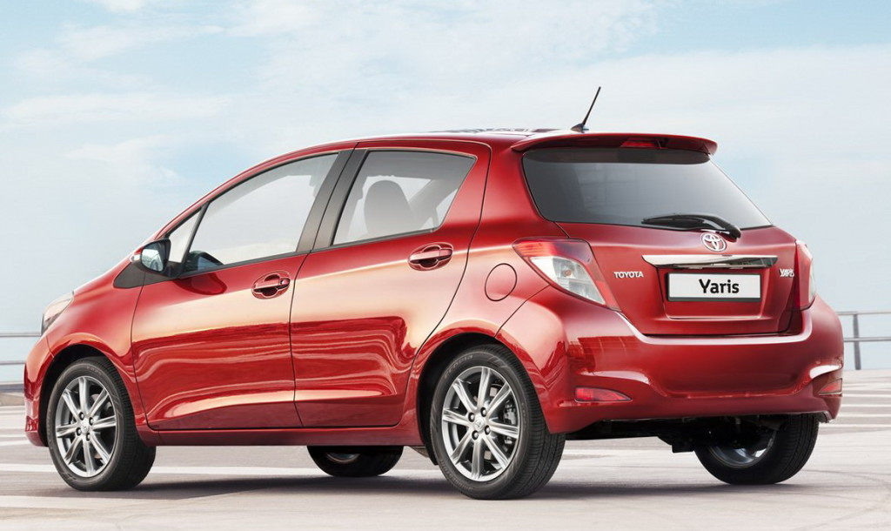
MARKETER YARIS BATAM HUB : 0821-7222-9423 (Tsel)

