Slide 1
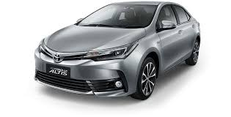
MARKETER TOYOTA BATAM HUB: 0821-7222-9423 (Tsel)

Slide 2
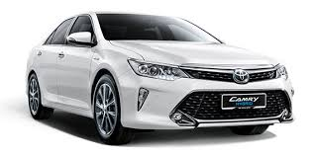
MARKETER TOYOTA BATAM HUB: 0821-7222-9423 (Tsel)

