Slide 1

SENTIMENT ANALYSIS Project
Advanced Topics in Computer Engineering
Supervised By: -
Assoc .Prof. Lamiaa Elrefaei
Group Members: -
Nada Mahmoud
Sabah Mohamed
Abdelrahman Elsayed
Fady Zarif
Ammar Ahmed

Slide 2
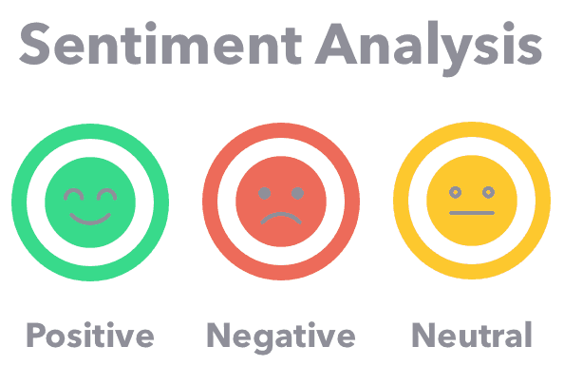
Sentiment analysis
Sentiment analysis is the process of analyzing pieces of writing to determine the emotional tone they carry, it is considered one of NLP techniques where your classifier is asked to determine if a phrase or group of words has a positive, negative, or neutral attitude.

Slide 3
Problem formulation
In our project, we are aiming to use different classification algorithms to determine the sentiment of text and predict the positive and negative reviews.
This is used in organizations for a variety of applications, including: -
Identifying brand awareness, and reputation.
Tracking consumer reception of new products or features.
Evaluating the success of a marketing campaign.

Slide 4
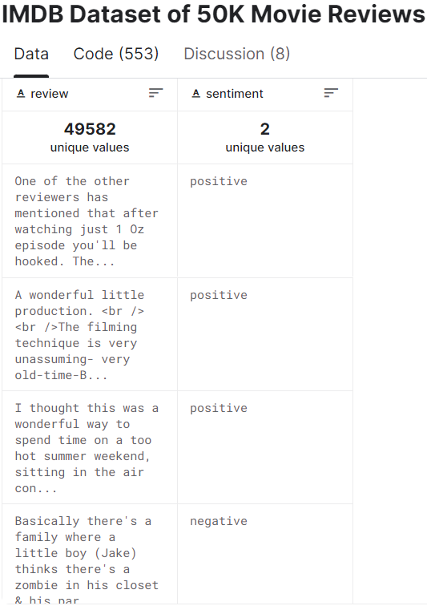
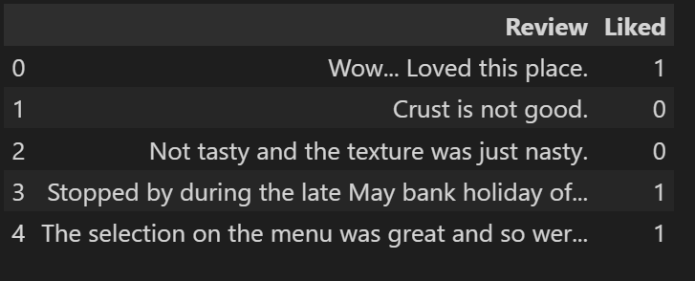
Datasets
We used the Internet Movie Database (IMDb) dataset consisting of nearly 50K movie reviews. The IMDb dataset classified into positive and negative movie review which is also known as binary sentiment analysis dataset.
Moreover, we applied our methodology on another dataset (Restaurant reviews).

Slide 5
TECHNICAL DISCUSSION
Main libraries used : -
Pandas: - is a python library used for analyzing, cleaning, exploring, and manipulating data.
NumPy: - is a Python library used for working with arrays. The library contains many mathematical, algebraic, and transformation functions.
NLTK: - is a leading platform for building Python programs to work with human language data. It provides many text processing libraries for classification, tokenization, stemming, tagging, parsing, and semantic reasoning.

Slide 6
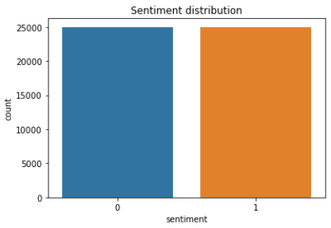
TECHNICAL DISCUSSION
Data Preprocessing : -
First, we started by checking the distribution of the IMDB dataset, as shown in the figure, this dataset has an equal ratio of positive to negative reviews, so we considered it balanced.
After that we checked for any duplicate records and found 418 duplicates, so we dropped them.

Slide 7
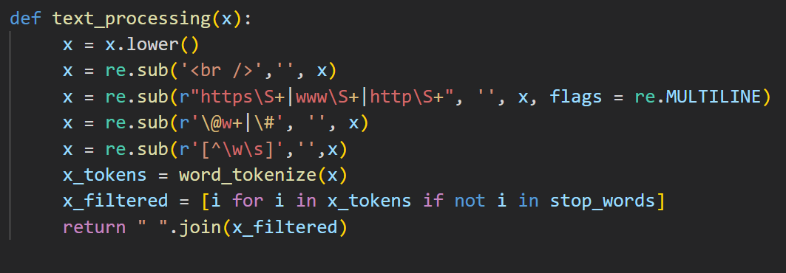
TECHNICAL DISCUSSION
Data Preprocessing : -
We created a text processing function , as shown in the figure , that will clean the reviews from URLs, hashtags, and unnecessary characters like punctuation or markup. Next, we tokenized the reviews and removed the stop words from sentence.
After that, we applied the text processing function for each record in the dataset.

Slide 8
TECHNICAL DISCUSSION
Data Preprocessing : -
Tokenization: - is a way of separating a piece of text into smaller units called tokens. Here, tokens can be either words, characters, or sub-words. Word Tokenization is the most used tokenization algorithm.
Stop words: - are the words which are generally filtered out before processing a textual data. These are the most common words in any language and does not add much information to the text. Examples of a few stop words in English are “the”, “a”, “an”, “so”, “what”.

Slide 9
TECHNICAL DISCUSSION
Data Preprocessing : -
Stemming: - is the process of reducing a word to its stem. This is important since the English language has several variants of a single term. The presence of these variances in a text corpus results in data redundancy when developing machine learning models. We used Porter’s Stemmer.
Porter’s Stemmer: - It is based on the idea that the suffixes in the English language are made up of a combination of smaller and simpler suffixes. This stemmer is known for its speed and simplicity, which we used in our processing

Slide 10
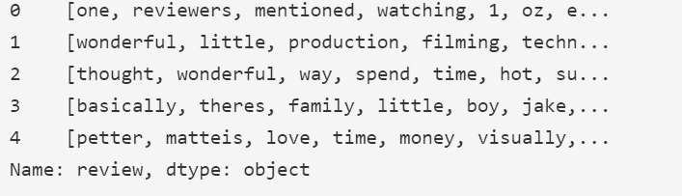
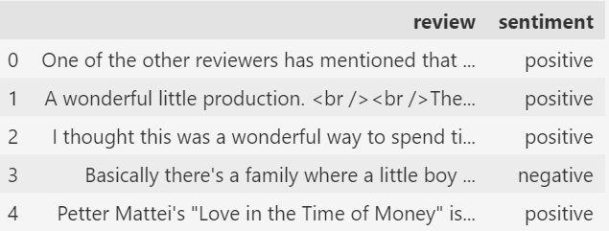
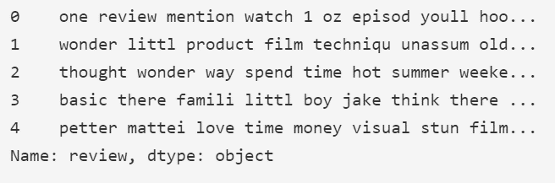
TECHNICAL DISCUSSION
Data Preprocessing : -
Dataset’s records before and after preprocessing
Fig. The first 5 records after tokenization and the removal of stop words
Fig. The first 5 records before any preprocessing
Fig. The first 5 records stemming

Slide 11
TECHNICAL DISCUSSION
Data Preprocessing : -
We decided to take 2 different approaches when dealing with the dataset. We will apply the same preprocessing mentioned above for both but for the final form or the features that will be the input of the classification model first we will try handling each review as a whole sentence, then we will try handling the reviews by extracting key words features.
First approach: - we take the preprocessed data and apply the TF-IDF vectorizer with maximum features set to 200.
Second approach: - we split the dataset into positive and negative reviews and used a counter to count the number of times each word was used in regards of negative and positive reviews to help identify the keywords then applied the TF-IDF.

Slide 12
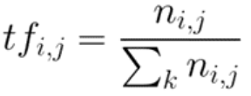
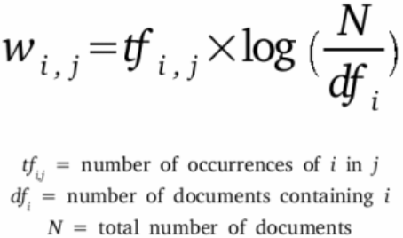
TECHNICAL DISCUSSION
Data Preprocessing : -
TF-IDF: - stands for Term frequency-inverse document frequency. It is a text vectorizer that transforms text into a vector form. It is a combination of term frequency and inverse document frequency. Term frequency is defined as the number of times a word i appears in a document j divided by the total number of words in the document.

Slide 13
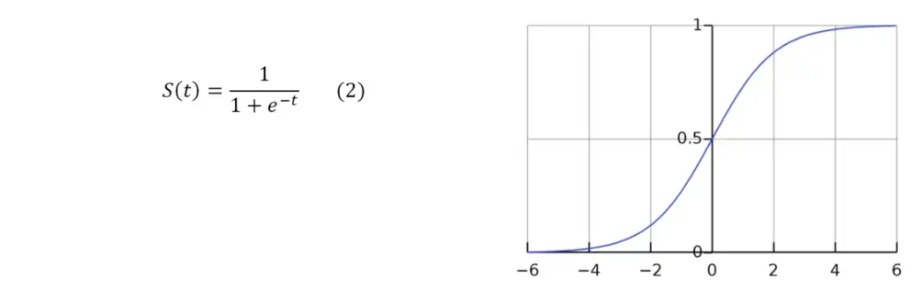
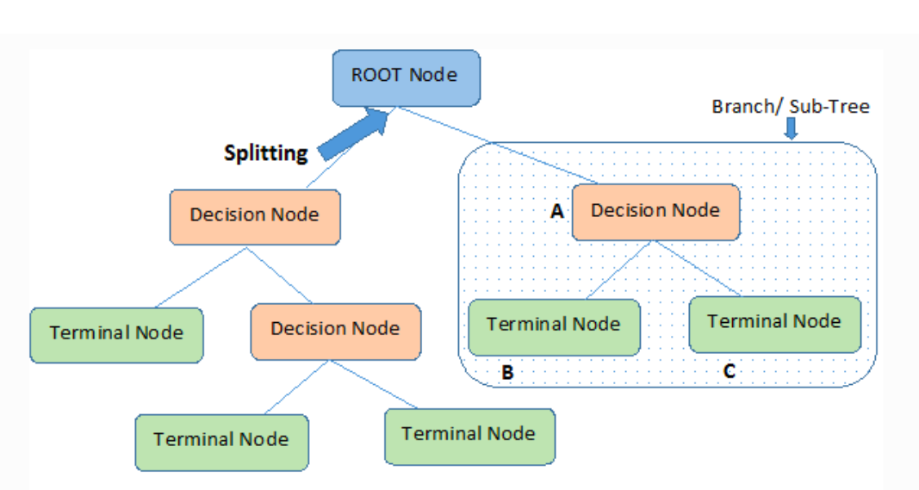

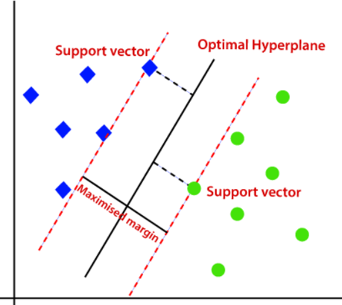
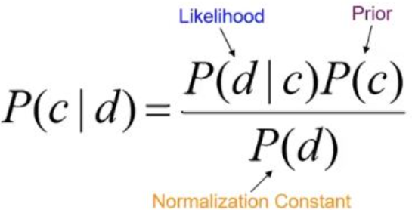
Classification models
Decision Tree Classifier
Logistic regression
Support Vector Machine
Naive Bayes classification

Slide 14
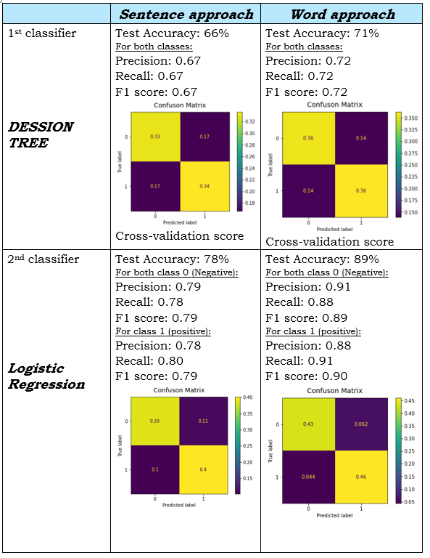
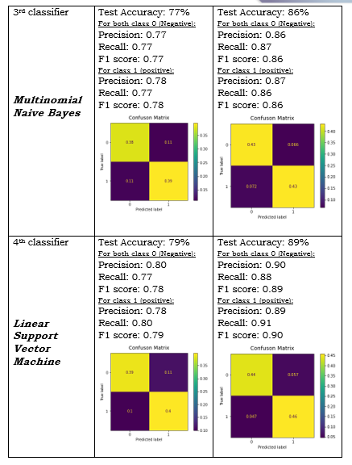
Results
IMDB Dataset

Slide 15
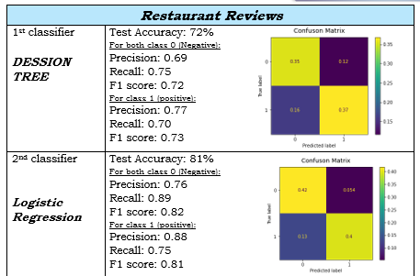
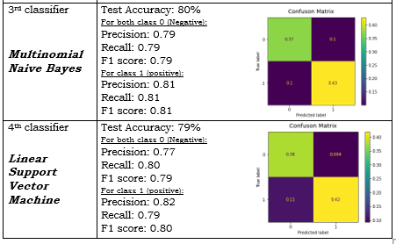
Results
Restaurant Review Dataset

Slide 16
DISSCUSION OF RESULTS
Comparing the results from the first data set we found that the word approach performed better over all the classification models.
Both the linear SVM and the logistic regression had an accuracy of 89% which is the highest accuracy from all our applied models across the datasets
The second dataset had lower scores compared to the word approach in the first dataset, this could be because it is significantly smaller in size.

Slide 17
Thank you

