Slide 1


Remote Monitoring System based on Nios ii and nodeMCU
By:
Ammar Reda

Slide 2
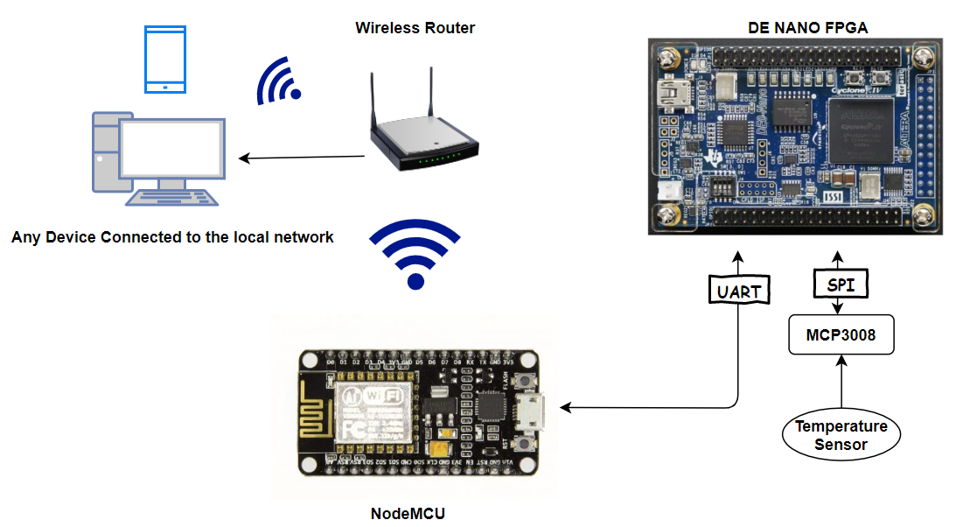
Block Diagram of the system

Slide 3
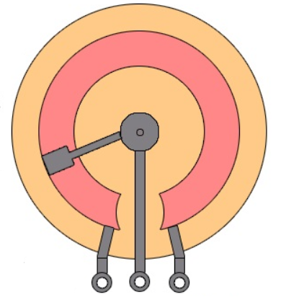

Block Diagram of the system
NodeMCU
TX RX GND
Nios ii System
TX RX SCLK
MISO
MOSI
SS_N
MCP3008 ADC
CH0 CH1
DE0-Nano FPGA
3v3
CLK DOUT DIN CS

Slide 4
Block Diagram of nios system
Nios II processor
Avalon interconnect fabric
Onchip
RAM
Jtag UART
Interval Timer
System ID
RS232 UART
SPI (3 wire serial)

Slide 5
Flow chart of nios ii program
Start
Sending start byte to the ADC
Sending the string to nodeMCU through UART, Character by character
Reading the two bytes received from the ADC
Convert the readings to the actual analog voltage value
Convert the reading to a string of fixed size

Slide 6
