Slide 1
AI CHATBOT
Presented by: ISHAQ AUWAL
Date: 27th, Jan, 2025

Slide 2
Introduction
Good Afternoon
Today, I will present a project idea called Smart School Assistant Chatbot, an AI-Powered tool designed to help students.

Slide 3
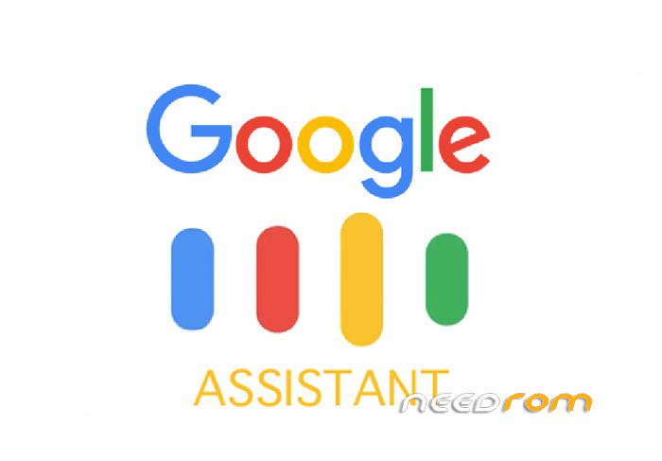

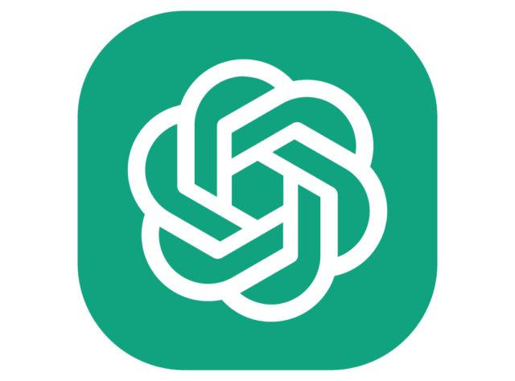
WHAT IS AN AI CHATBOT
A computer program that talks to people.
It answers questions and provides information automatically.
Examples: ChatGPT, Siri, Google Assistant

Slide 4
PROJECT CONCEPT
A Chatbot that helps student with:
  Exam Schedules
  Class timetables
  Subject explanations
  Motivational qoutes

Slide 5
WHY DO WE NEED IT
Saves time for students and teachers.
Makes learning easy and interactive.
Helps new students
Available anytime

Slide 6
HOW IT WORKS
Students asks a question.
Chatbot replies instantly
Example:
  Student: “When is our next exam?”
  Chatbot:” Your next exam is on Monday at 8:00 AM.”.
  Student: ”Explain Photosynthesis.”
  Chatbot: “Photosynthesis is how plants make food using sunlight.”

Slide 7
TOOLS TO BUILD IT
Simple version: Dialogflow, chatbot.com, frontend(NextJs) + backend( Javascript, Databases).
Advanced Version:”ChatGPT API, OpenAI models.

Slide 8
FUTURE IMPROVEMENTS
Voice responses .
Connect to school website.
More subjects.
Homework reminders

Slide 9
BENEFITS
Reduces teacher’s workload
Encourages independent learning
Makes information accessible
Promote use of technology in school

Slide 10
CONCLUSION
In conclusion, AI chatbots are changing how we interact with technology. By introducing a Smart School Assistant Chatbot, we can make learning more efficient and enjoyable for everyone.

