Slide 1
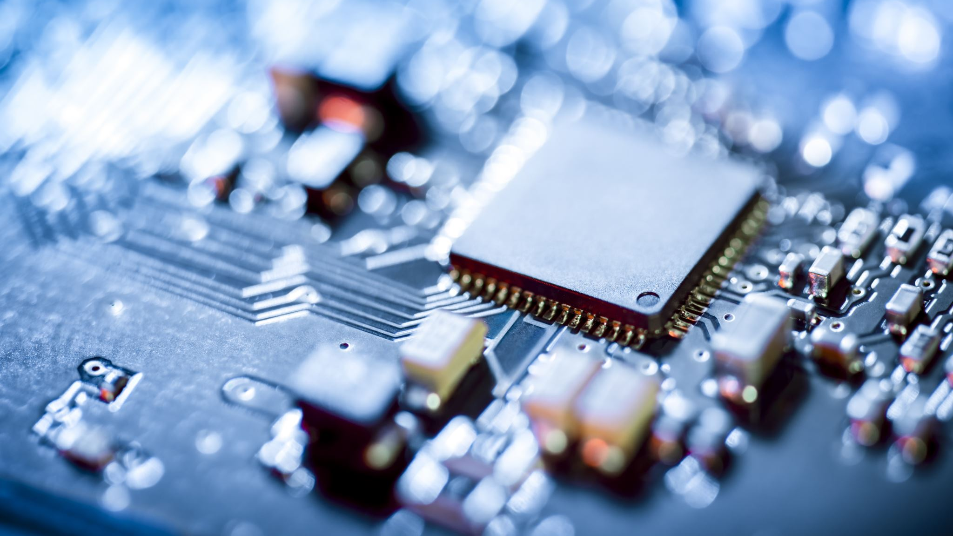
Ensure Sterilization
Assad Waleed Dadoush
Ammar Slahden Hobi
Mohammed Mousa Alshamrani
Instructor: Dr. Wassim Zouch

Slide 2
Outline
Introduction
Components
Simulation
Codes
Conclusion

Slide 3


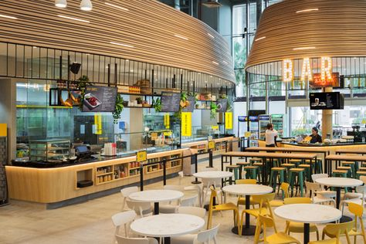
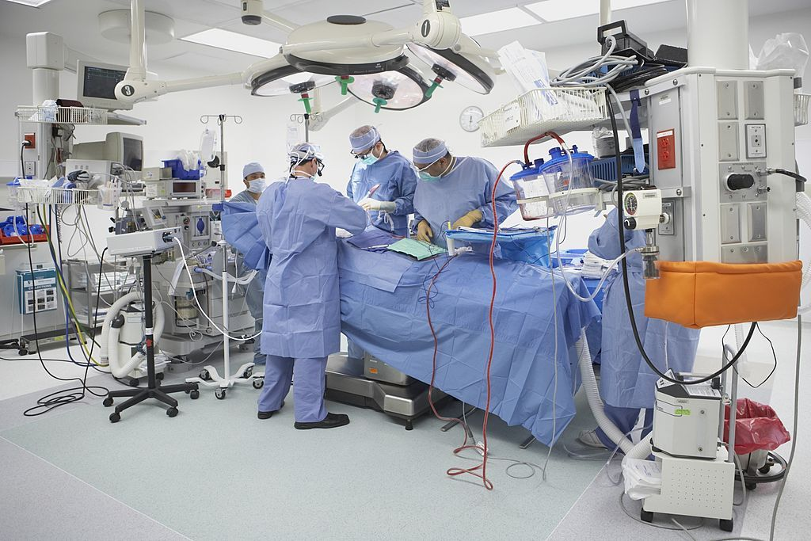
Introduction
In light of the ongoing COVID-19 pandemic and which has a great impact on our private lives
Our goal from our artifact is to reduce this impact and for natural life .
By stimulating an Idea that explain it in next slide

Slide 4


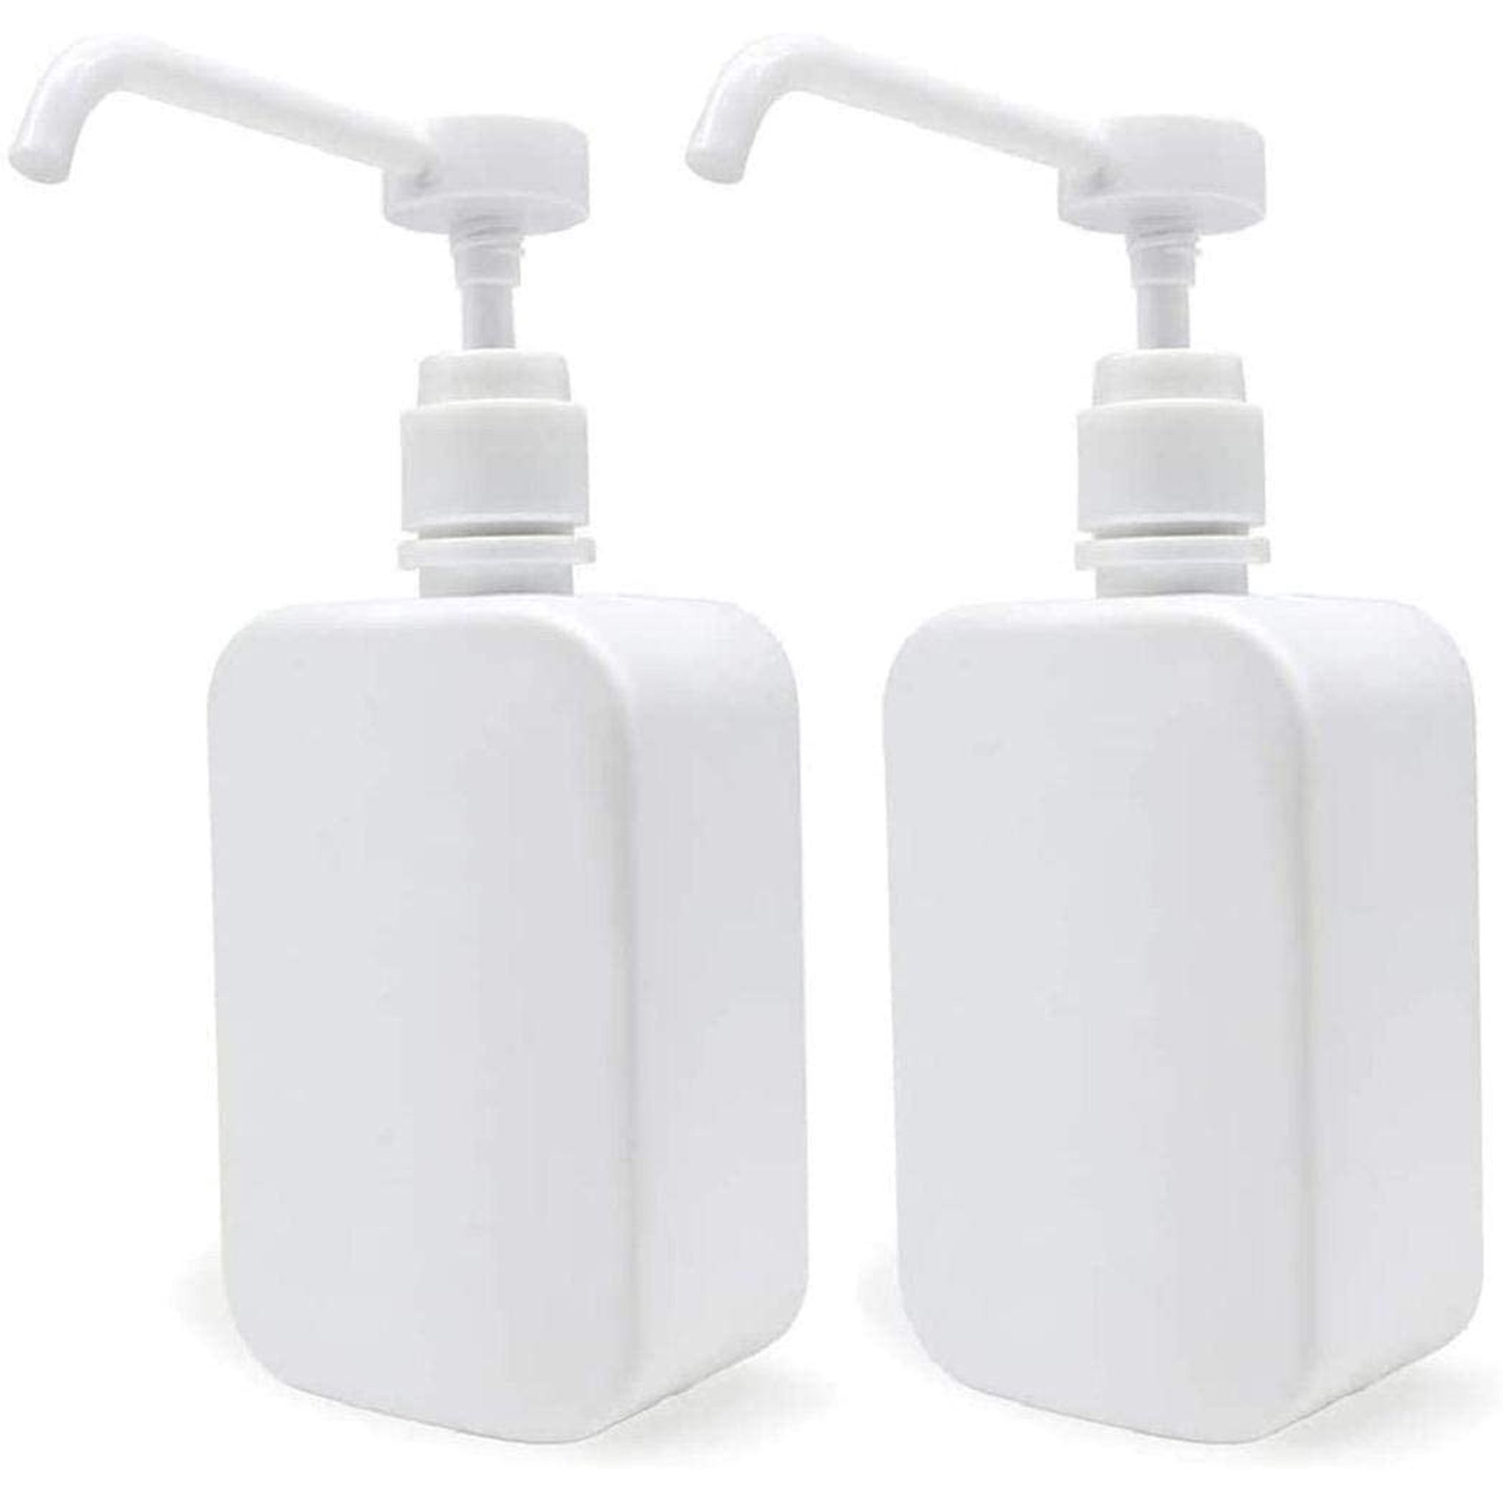
Basic Idea
2-Sensor on bottle sterilization
1-Sensor for Enter person
Sensor for enter Person
3-Warming system , when the time finishing

Slide 5
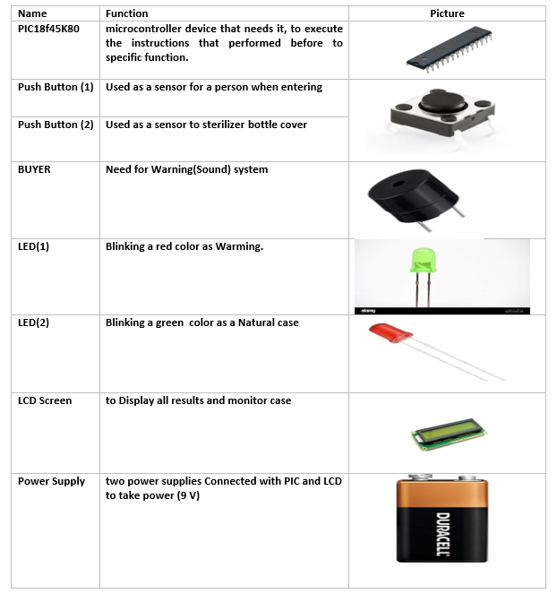
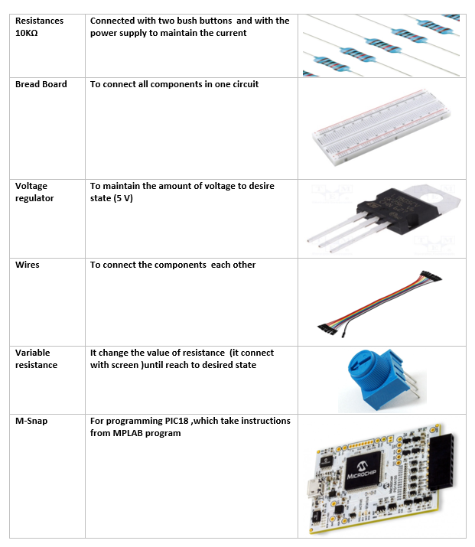
Components of the Artifact

Slide 6
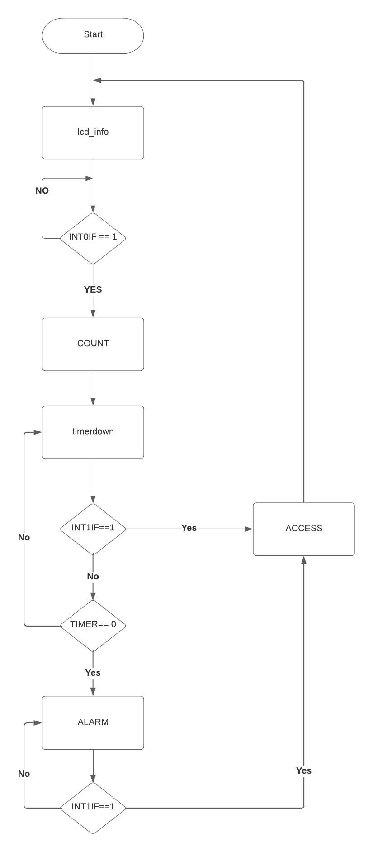
Flowchart

Slide 7
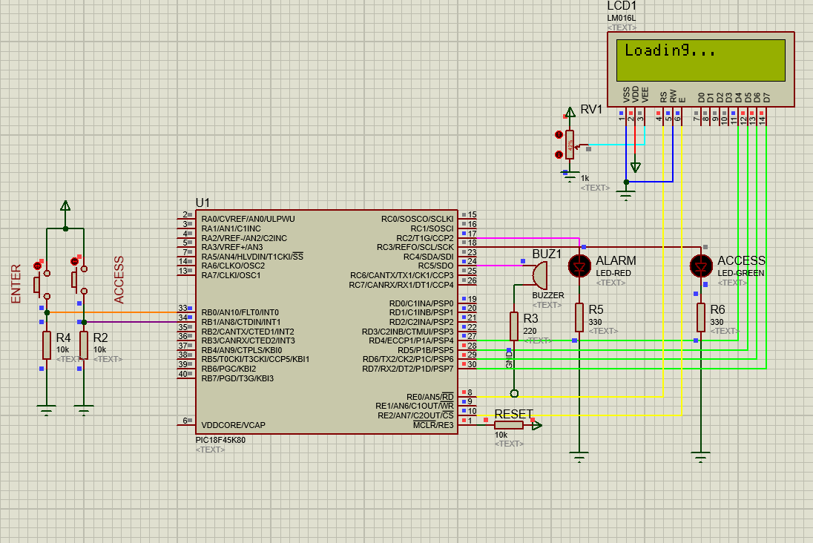
Simulation:
The First of all, whence device On ,the screen start loading

Slide 8
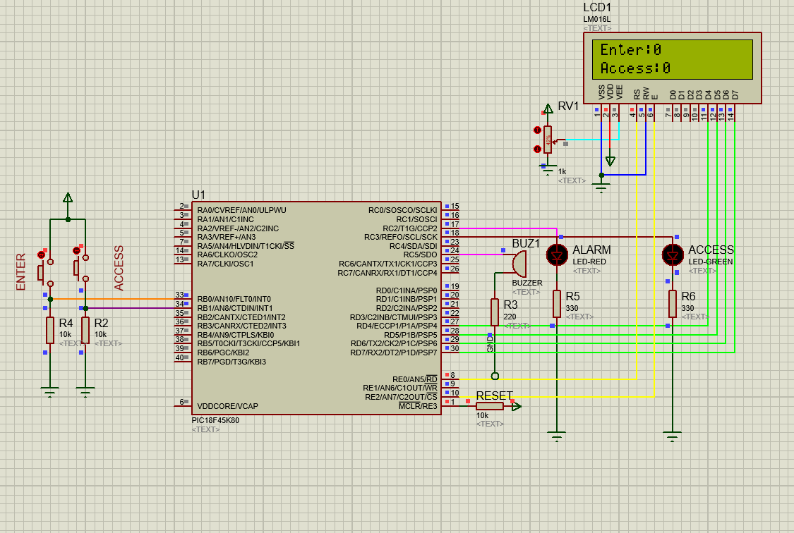
Then Screen will provide Number of Person their enter of the Area (One by one) and the number of whose used sterilizer bottle

Slide 9
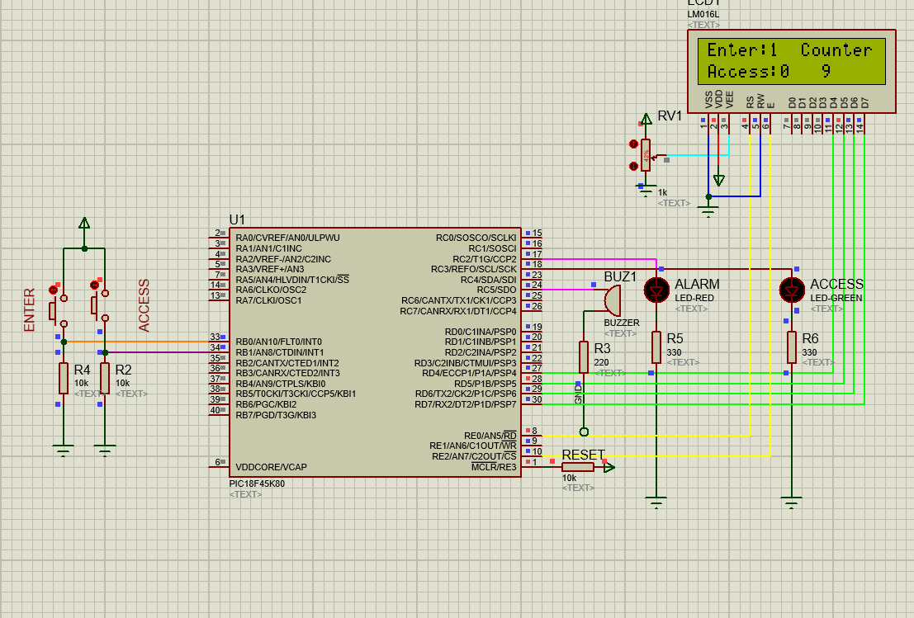
When the Person enter the hall, stimulated (by PB 0)the number of Enter will increment and start decrement counter (delay (10 s) des)

Slide 10
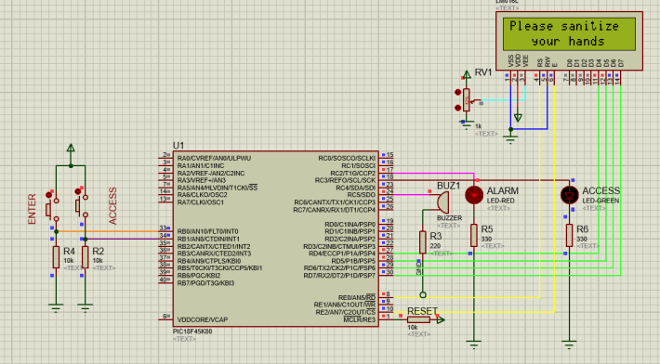
In case the person not used bottle of sterilization (PB1not Pressed ) ,the LCD screen will display “please sterilization your hand” in same time the buzzer start buzz and Blinking red LED as warming

Slide 11
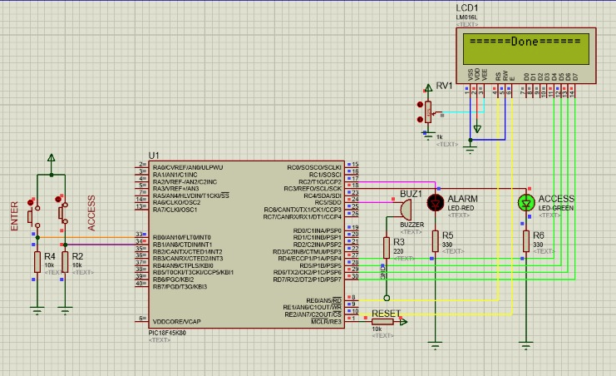
Once the person used Sterilization bottle (PB1 pressed)then LCD screen it print ==Done==
in same time Buzzer will cleared and Blinking one second green LED.

Slide 12
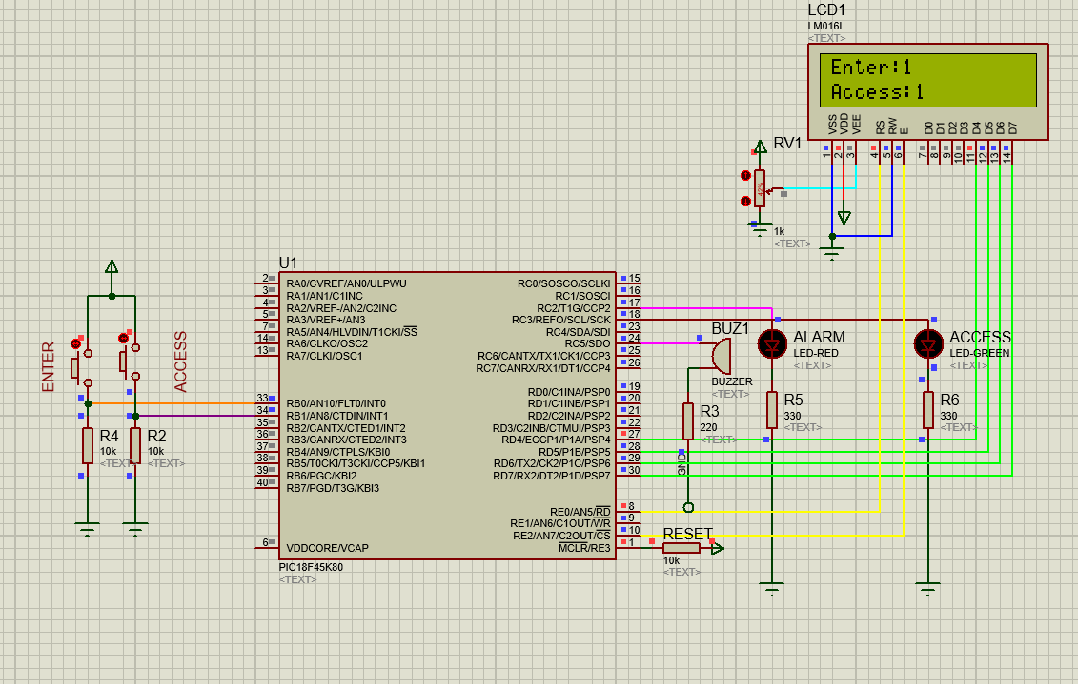
After that LCD display a static data about number of enter persons and whose used sterilization bottle ,and keeping in loop working like that

Slide 13

Code

Slide 14
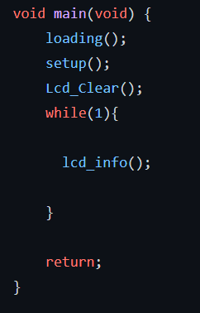
Main

Slide 15
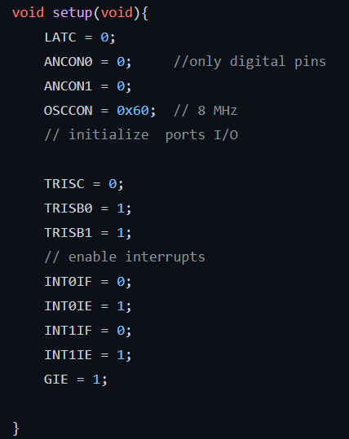
Configuration of
I/O & Interrupts & ADC

Slide 16
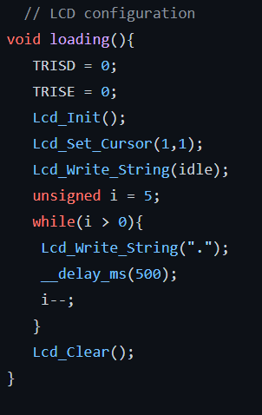
LCD Configuration

Slide 17
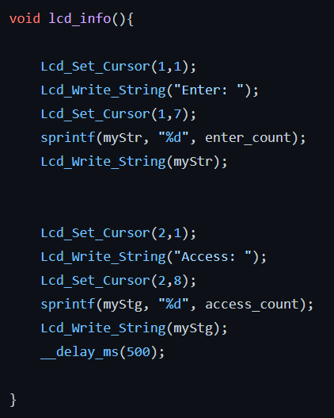
LCD Information

Slide 18
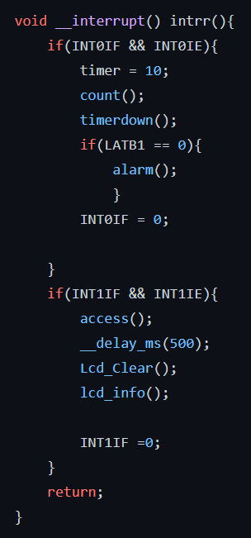
Interruptus checking

Slide 19
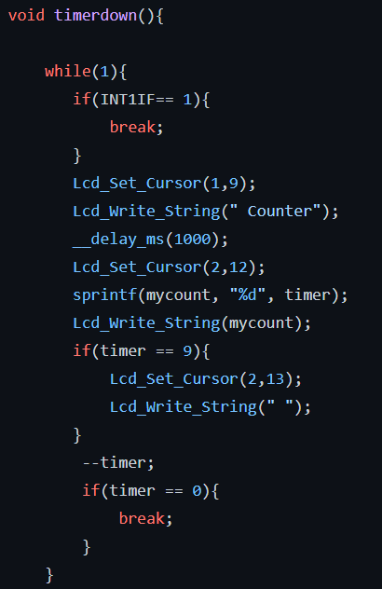
Counter code

Slide 20
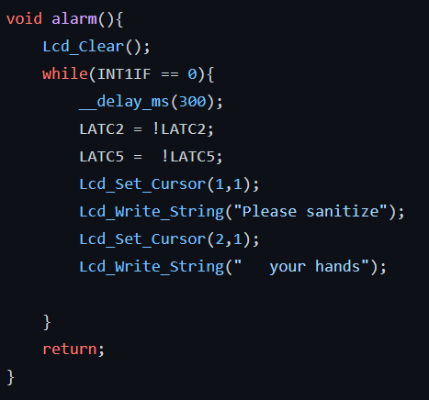
Alarm code

Slide 21
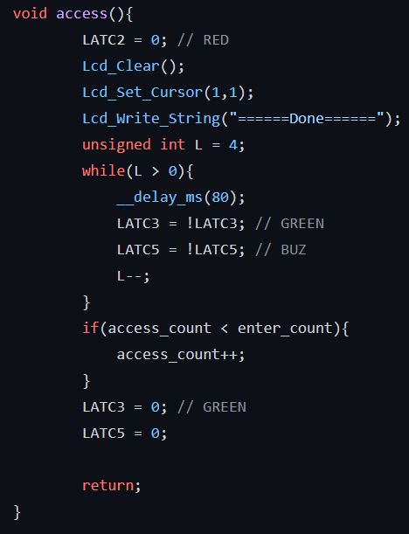
Access

Slide 22

Conclusion

Slide 23

Any Questions ?

