Slide 1

Encryption

Slide 2
What is encryption ?
Encryption is : the process of converting information or data into a code, especially to prevent unauthorized access

Slide 3
How does it work?
A massage in it original form(plain text) is encrypted into an unintelligible form (cipher text) by set of procedures known as encryption process and a variable called a key ; and the cipher text is decrypted into plain text using the key .

Slide 4
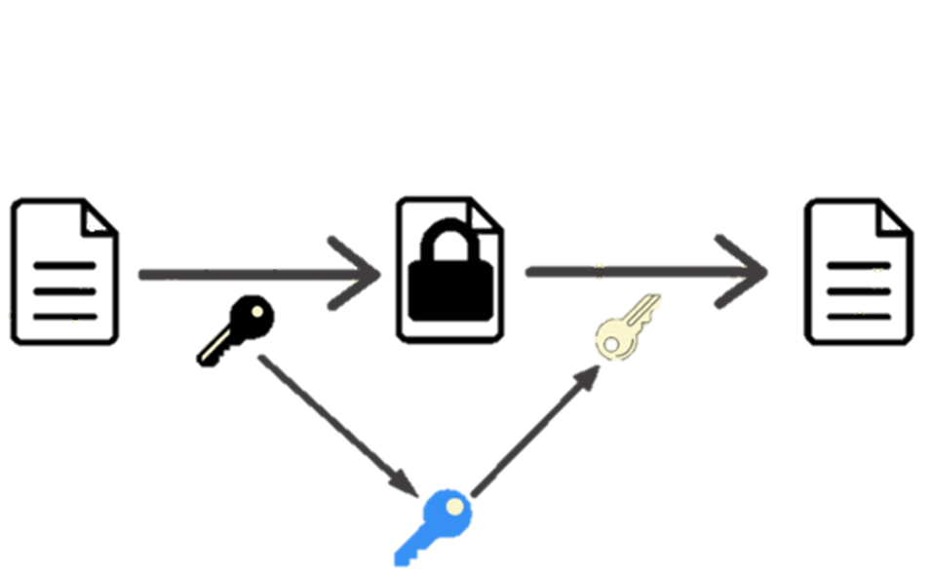
Encryption
Decryption
Plain text
Cipher text
Plain text
The Key

Slide 5
source
Google ////////// Edge
Ammar yasser

