Slide 1
COMPUTER MALFUNCTION EXPERT SYSTEM

Slide 2
IDEA
I proposed this issue
Because of ease and time saving for expert system to do it

Slide 3
About the system
1

Slide 4
The expert system analysis set of computer diagnostics
And malfunctions then determines what is the problem then propose the solution

Slide 5
System Input
System asks user set of questions
User answers with 0 for No or 1 for Yes
If 1 : it asks user how often it happens 0 -> 1

Slide 6
System output
What’s the problem and propose a solution.

Slide 7
Problems we face
Screen
Sometimes screen flickers or stutters and we have to decide the issue.
The first is from Screen
And the second is from the cable
Power Supply
Sometimes we hear a weird sound from it. Maybe from Dust Or fan malfunction
SYSTEM HAVE TO DETERMINE!

Slide 8
Expert Problems contained
I discussed the most popular computer malfunctions
Screen Issues
Sound Issues
HDD Issues
Power Supply Issues
PSU Issues

Slide 9
Rules and Scenarios
System takes an input from user foreach Problem as a input Rule
These input Rules has corresponding Rules contains input Facts and CF
System computes CF for each Problem and give the total CF

Slide 10
But A Hardware Issue have multi causes!
System computes each CF for each Problem then finds the most probable issue and propose a solution for the user

Slide 11
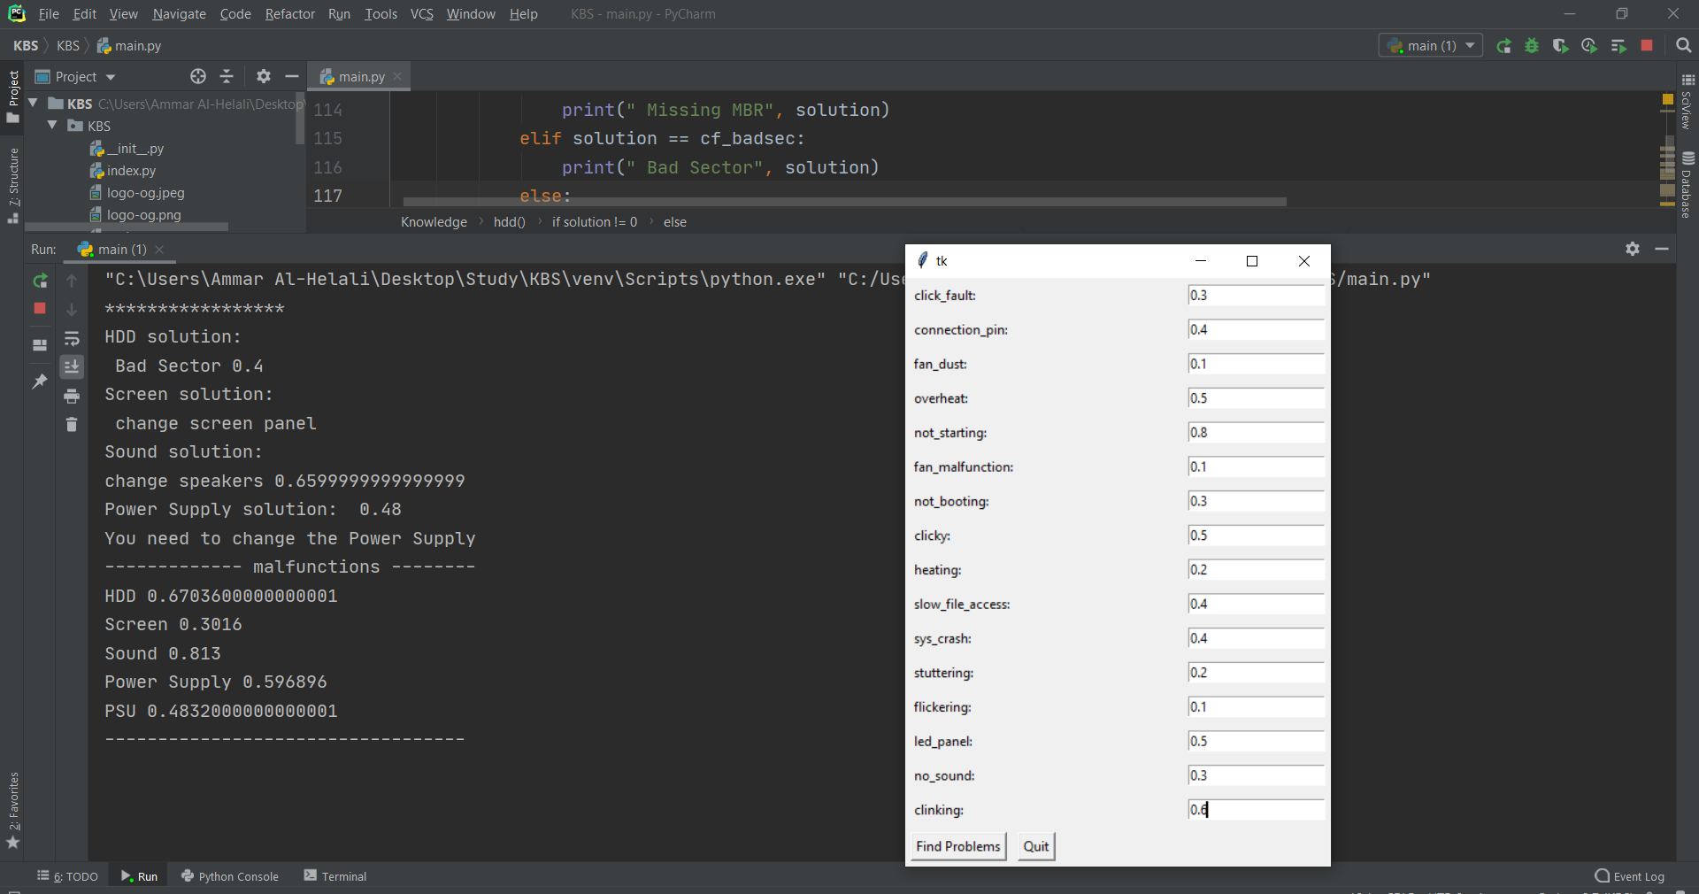
Example of Input : GUI

Slide 12
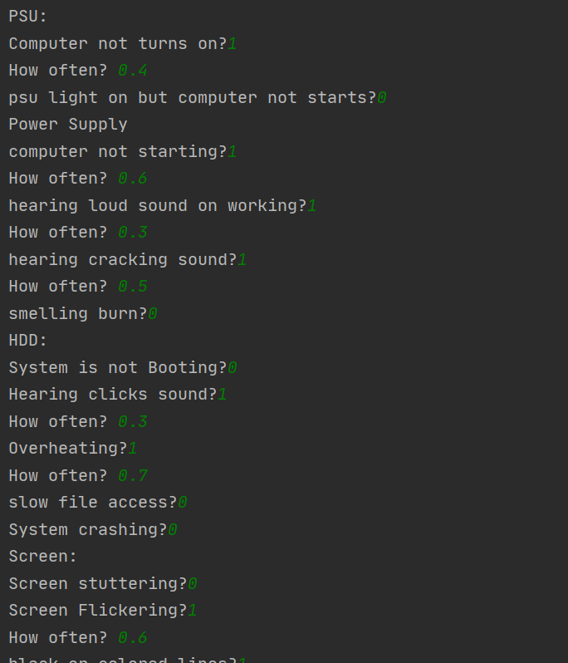
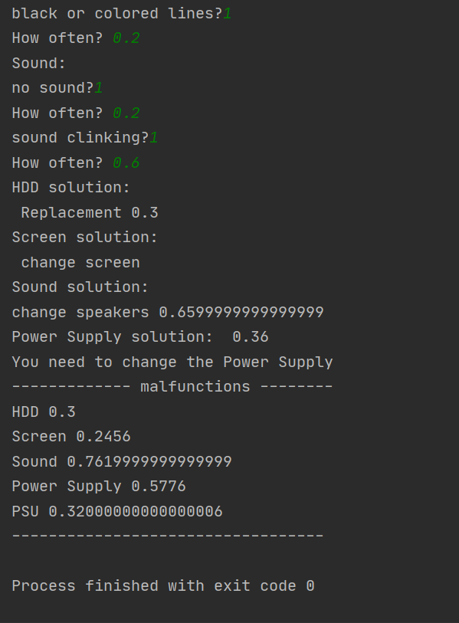
Example of Input : Console

Slide 13
SOURCES
GOOGLE .
As I am a CS student I had a good Strong Knowledge in Computer mechanism and Know about it’s hardware

Slide 14
THANKS!

