Slide 1

Free Lancing Website
Edwin George 22204005
Abdul Hadi Shah 22204007
Ammar Nagarji 22204011
Project Guide
Ms. Roshna Sangle

Slide 2
Contents
Introduction
Objectives
Scope
Features / Functionality
Project Outcomes
Technology Stack
Block Diagram if applicable

Slide 3
1. Introduction
Our freelancing website is designed to connect clients with developers in a simple and effective way. Clients can post project requests and developers can accept and complete them, allowing for efficient and streamlined collaboration.
The website offers a user-friendly interface with several pages to facilitate communication and project management. Clients can post detailed descriptions of their projects, including information about their businesses and deadlines. Developers can browse available job requests and select those that match their skills and interests.

Slide 4
Our website also includes a registration process that collects essential information from users, such as contact details, bio, skills, and languages. This allows for accurate matching of clients with developers and ensures that projects are completed to a high standard.
With our website, clients can enjoy easy access to a pool of talented developers and developers can find interesting projects that match their skills. Our goal is to create a platform that fosters mutually beneficial relationships between clients and developers, leading to successful project outcomes and continued collaboration.

Slide 5
2. Objectives
To provide a user-friendly and efficient platform for clients and developers to connect and collaborate. Our website aims to achieve the following objectives:
1. Provide a central platform for clients and developers to connect and collaborate on project requests.
2. Ensure transparency and fairness in the project bidding and selection process.
3. Streamline the communication process between clients and developers to ensure successful project completion.

Slide 6
4. Provide a user-friendly and intuitive interface that allows users to easily navigate and use the platform.
5. Foster a culture of professionalism and excellence by promoting timely and high-quality project delivery.
Overall, our project aims to provide a reliable and efficient platform that facilitates successful collaborations between clients and developers while promoting professionalism and quality work.

Slide 7
3. Scope
The project is developed to provide a platform for clients and developers to connect and collaborate efficiently. The website is applicable for a variety of projects, including website development, app development, software development, and other tech-related projects.
Our website is designed to be user-friendly and accessible to users with different levels of technical expertise. The sign-up process is straightforward, and users can easily browse available job requests or post their own projects.

Slide 8
The scope of our project is not limited to a particular industry or region. Our website is easily accessible to users, allowing for collaboration of diverse pool of talent.
Overall, our project's scope is to provide a reliable and efficient platform for clients and developers to connect and work together, regardless of their location or industry.

Slide 9
4. Feature /Functionality
Our freelancing website provides a range of features and functionality that make it easy for clients and developers to connect and work together. The key features include:
1. User registration and login: Users can create an account and log in to access the platform's full features.
2. Post a project: Clients can post project requests, including project name, details, and estimated deadline.
3. Browse jobs: Developers can browse available job requests based on their preferred programming language and communication language.

Slide 10
4. Skill and language selection: Users can select their skills and languages, which are displayed in their profile and used to match with suitable job requests.
5. User profiles: Users can create a detailed profile, including bio, skills, languages, and profile picture.
6. Search functionality: Users can search for job requests based on specific criteria, such as project name, programming language, or communication language.
Overall, our website's features and functionality are designed to provide a user-friendly and efficient platform for clients and developers to collaborate and complete projects successfully.

Slide 11
5. Outcome of Project
Streamlined and automated project management process
Increased flexibility and accessibility for both clients and freelancers
Secure and efficient payment transactions
Improved communication and collaboration between clients and freelancers
A centralized platform for showcasing freelancer skills and connecting with potential clients

Slide 12
6. Technology Stack
HTML
CSS
JavaScript
Django
SQLite (Django built-in)

Slide 13
User Interface
Web Server (Django)
Database Server
The user interface component is responsible for rendering the website's pages and user interactions. The web server component is powered by Django and handles user requests and responses. The database server component is responsible for storing and retrieving user and project data and is powered by SQLite.

Slide 14
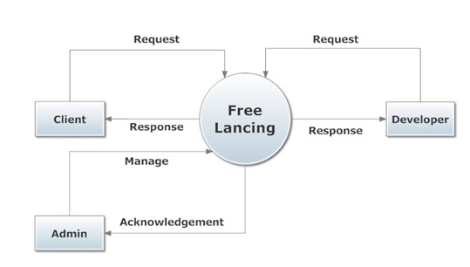

Slide 15
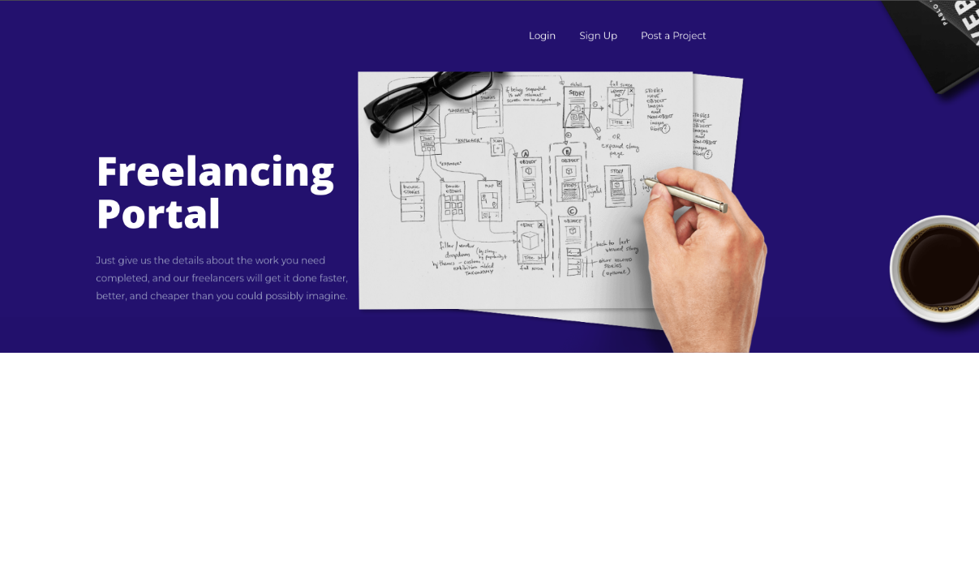

Slide 16
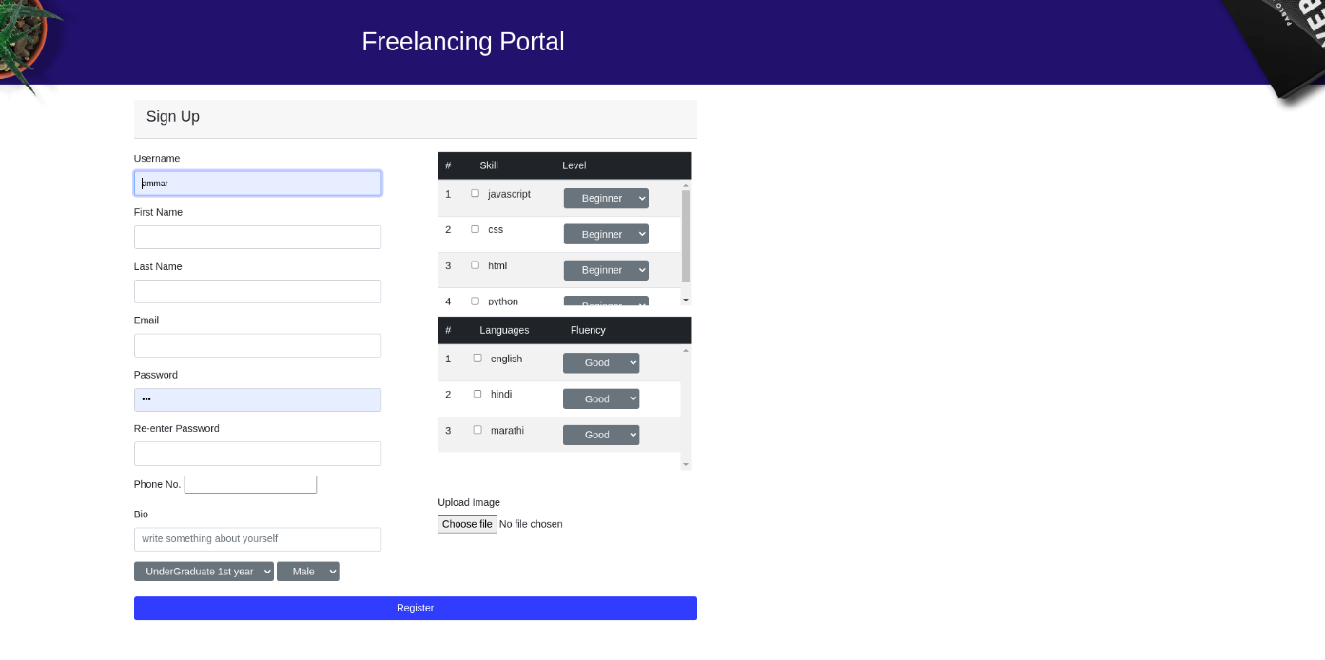

Slide 17


Slide 18
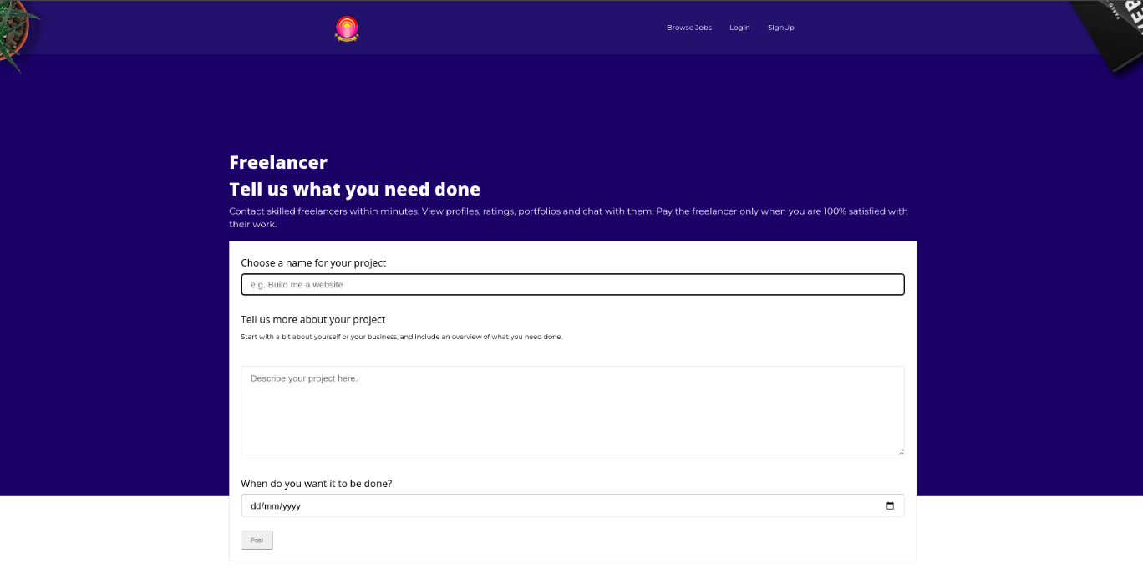

Slide 19
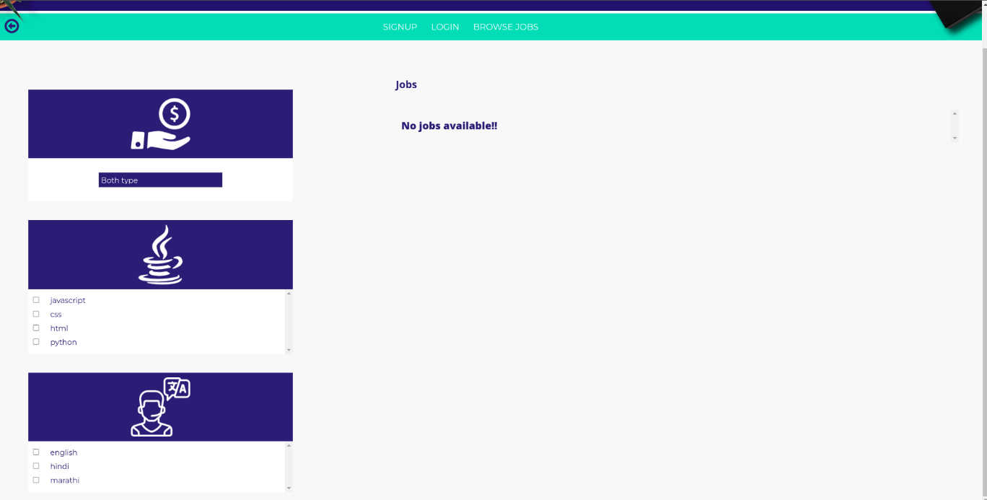

Slide 20
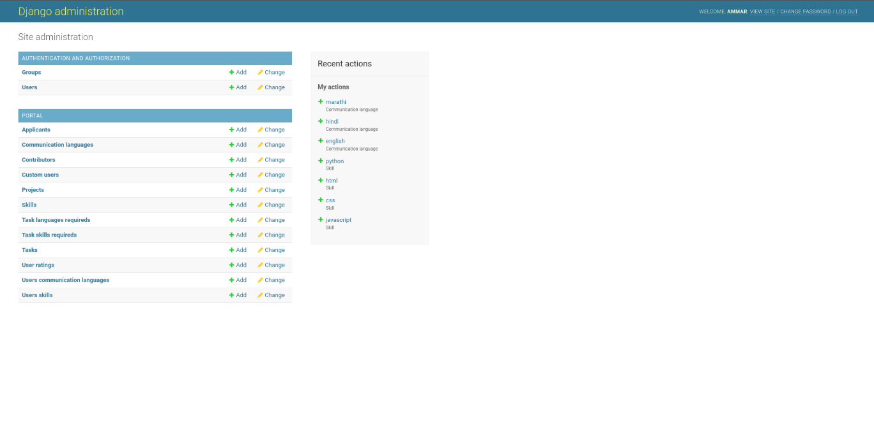

Slide 21
7. Conclusion
In conclusion, the suggested freelancing website aims to seamlessly and efficiently link clients and developers. The website accelerates the project creation and delivery process by offering a platform where clients can post their project requirements and developers may accept and finish them.
The user-friendly layout, comprehensive functionality, and emphasis on security, scalability, and SEO make the website a valuable and dependable platform for the freelancing community.

Slide 22
Thank You...!!

