Slide 1
News App
Ammar Atef Ahmed Mohamed ID#617278

Slide 2
Objectives

Slide 3
Provide Real-Time News – Deliver up-to-date news articles from multiple categories using the News API.
Enable Easy News Search – Allow users to quickly find articles on specific topics or keywords.
Enhance News Browsing Experience – Offer a clean, modern, and responsive UI using Jetpack Compose and Material
Support Offline Reading – Cache fetched news so users can access previously loaded articles without internet.
Personalized Content Access – Enable browsing by categories (e.g., Technology, Sports, Business) to suit user preferences.
Demonstrate MVVM Best Practices – Showcase clean architecture for better maintainability and scalability.

Slide 4
Target Audience / Beneficiaries
General Public – Anyone who wants a quick, easy way to read news from various sources.
Students – Particularly journalism and media students who need current news updates for study or projects.
Professionals – People who want to stay updated on industry news during breaks or commutes.
Researchers & Analysts – Individuals who track trends and updates in specific categories.
News Enthusiasts – Users who want a visually appealing, organized way to consume news daily.

Slide 5
App Project Structure

Slide 6
Project Structure Explanation
The project follows MVVM architecture and is organized into separate packages for better maintainability and scalability.

Slide 7
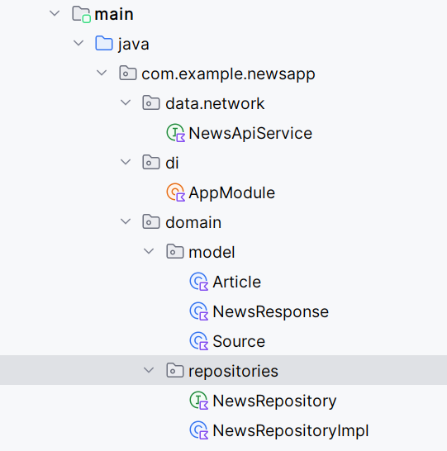

Slide 8
1. data.network
NewsApiService – Defines API endpoints using Retrofit for fetching news data from the News API.
2. di (Dependency Injection)
AppModule – Hilt module that provides app-wide dependencies such as Retrofit, repository instances, and other singletons.
3. domain
a) model
Article, NewsResponse, Source – Data models representing API response structures.
b) repositories
NewsRepository – Interface defining data operations.
NewsRepositoryImpl – Implements the repository, bridging API calls from data.network to the ViewModel.

Slide 9
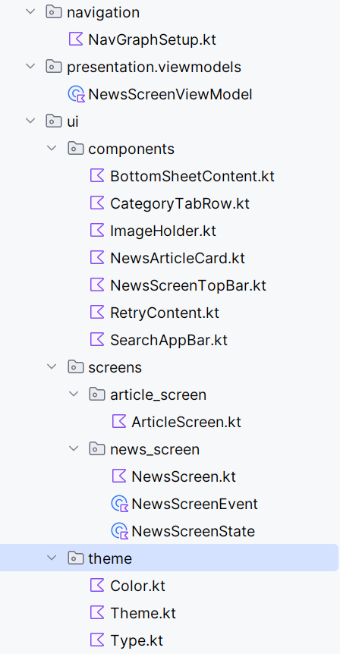

Slide 10
navigation
NavGraphSetup.kt – Defines navigation routes and graph for moving between screens in Jetpack Compose.
5. presentation.viewmodels
NewsScreenViewModel – Manages UI state, handles business logic, and interacts with the repository to fetch data.

Slide 11
6. ui
a) components
Reusable Jetpack Compose UI elements:
BottomSheetContent – UI for bottom sheet display.
CategoryTabRow – Tab layout for switching news categories.
ImageHolder – Handles image loading with Coil.
NewsArticleCard – Card layout for displaying a news item.
NewsScreenTopBar, SearchAppBar – App bars for navigation and search.
RetryContent – UI for error retry state.
b) screens
article_screen → ArticleScreen.kt – Displays details of a selected article.
news_screen → NewsScreen.kt, NewsScreenEvent, NewsScreenState – Main screen for browsing news with state and event handling.

Slide 12
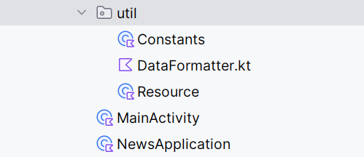
c) theme
Color.kt, Theme.kt, Type.kt – Defines app colors, typography, and theming for Material 3 design.

Slide 13
7. util
Constants – Stores static values like API keys, base URLs, and constants used across the app.
DataFormatter – Utility for formatting dates or text before display.
Resource – Wrapper class for handling success, error, and loading states in data fetching.
8. Root Files
MainActivity – The main entry point that initializes the Compose UI and sets up navigation.
NewsApplication – Application class for Hilt initialization and app-wide configurations.

Slide 14
Features / Modules Discussion

Slide 15
1. News Fetching Module
Purpose: Retrieves latest news articles from News API.
Implementation:
Uses NewsApiService with Retrofit and Gson Converter to fetch JSON data.
Data is mapped to Kotlin models (Article, NewsResponse, Source).
Results are cached for offline reading.

Slide 16
2. Search Module
Purpose: Allows users to search for news articles by keywords.
Implementation:
Search input handled by SearchAppBar UI component.
Query passed to ViewModel, which calls repository with updated search parameters.
Displays filtered results in NewsScreen.

Slide 17
3. Category Browsing Module
Purpose: Lets users browse news by categories (e.g., Technology, Sports, Business).
Implementation:
CategoryTabRow displays available categories.
Selecting a category triggers a ViewModel call to load category-specific articles.

Slide 18
4. Article Details Module
Purpose: Shows full article details when a news card is selected.
Implementation:
ArticleScreen displays title, description, image, and source link.
Navigation handled by NavGraphSetup.

Slide 19
5. Error & Retry Handling Module
Purpose: Ensures smooth user experience in case of API failure or no internet.
Implementation:
RetryContent component offers a retry button.
Resource class manages Loading, Success, and Error states.

Slide 20
6. UI & Theming Module
Purpose: Provides a consistent, modern UI experience using Material 3.
Implementation:
Theme defined in Color.kt, Theme.kt, and Type.kt.
Coil used in ImageHolder for efficient image loading.

Slide 21
Major Concepts

Slide 22
MVVM Architecture – Clear separation of concerns: UI (Compose screens), state/logic (ViewModels), and data (Repository).
Repository Pattern – NewsRepository/NewsRepositoryImpl abstracts data sources and business rules from the UI.
Jetpack Compose – Declarative UI with state-driven rendering; reusable components (cards, app bars, bottom sheet).
Unidirectional UI State + Events – NewsScreenState and NewsScreenEvent model screen state and user intents for predictable updates.
ViewModel – NewsScreenViewModel survives configuration changes, exposes state, and orchestrates data flow.
Navigation (Compose Navigation) – NavGraphSetup defines type-safe routes between list and article detail screens.
Dependency Injection (Hilt) – AppModule provides Retrofit, repository, and other singletons; improves testability and decoupling.
Retrofit Web Service + Gson – NewsApiService calls the News API and maps JSON to Kotlin models (Article, Source, NewsResponse).
Kotlin Coroutines – Asynchronous API calls and background work without blocking the main thread.
Resource Wrapping for Result States – Resource encapsulates Loading/Success/Error to drive UI accordingly (with RetryContent).

Slide 23
Error Handling & Retry UX – Graceful handling of failures with user-triggered retries and empty/error states.
Image Loading (Coil) – Efficient, lifecycle-aware image fetching and caching in Compose (ImageHolder).
Theming with Material 3 – Centralized color/typography/system UI for consistent look & feel (Theme, Color, Type).
Modular UI Composition – Reusable composables (e.g., NewsArticleCard, SearchAppBar, CategoryTabRow, BottomSheetContent) to keep screens lean.
Formatting & Utilities – Centralized constants and data formatting (Constants, DataFormatter) to reduce duplication.

Slide 24
Additional Dependencies

Slide 25
Navigation-Compose Enables seamless screen-to-screen navigation in a Jetpack Compose app.
Retrofit + Gson Converter For making HTTP requests to the News API and converting JSON responses into Kotlin objects.
Hilt (Dagger-Hilt) Dependency injection framework to manage object creation and lifecycle, with Compose navigation integration.
Coil-Compose Loads and caches images directly in Jetpack Compose UI components.
Accompanist Pager Adds horizontal paging/swiping functionality (used for category tabs).

Slide 26
Github link
https://github.com/AmmarAtef/News_app.git
https://github.com/AmmarAtef/News_app

Slide 27
Conclusion (SCI Connection)
Developing NewsApp taught me the value of structured thinking, as seen in the MVVM architecture, which reflects SCI’s principle of orderly thought leading to effective action. It also showed the importance of adaptability, where handling dynamic API data mirrors SCI’s teaching of maintaining stability amid constant change.

Slide 28
Thank you

