Slide 1
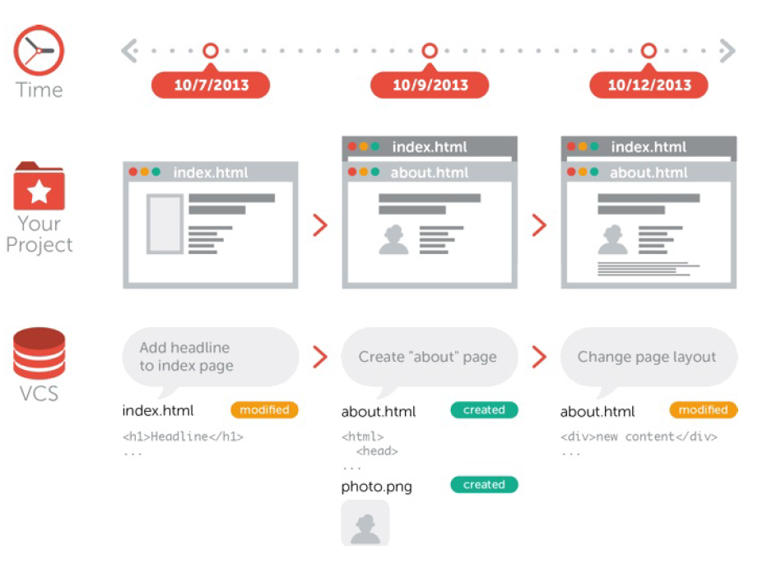
What is Version Control ? VCS ?
Version control is independent of the kind of project / technology / framework you‘re working with.

Slide 2
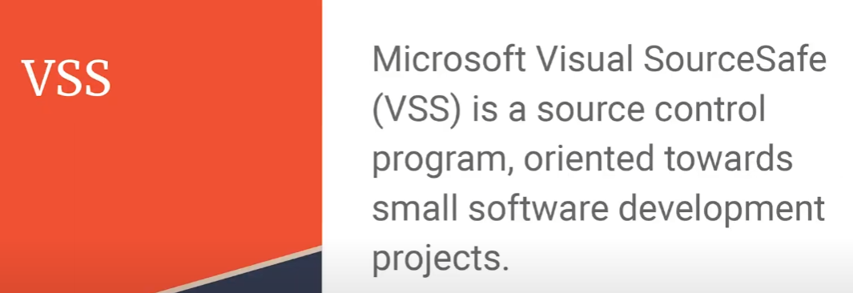
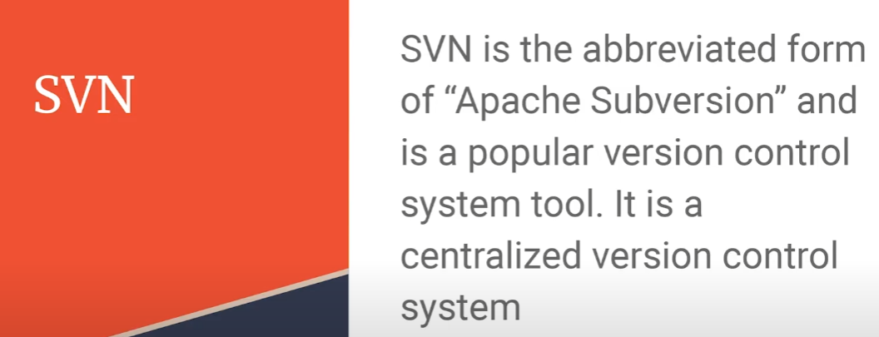
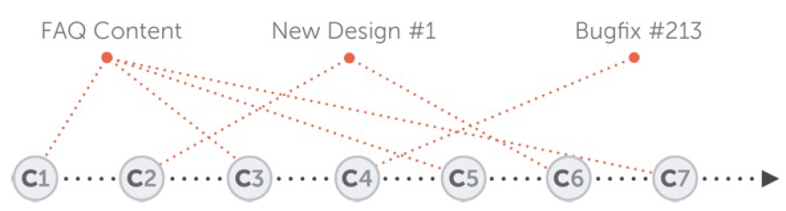
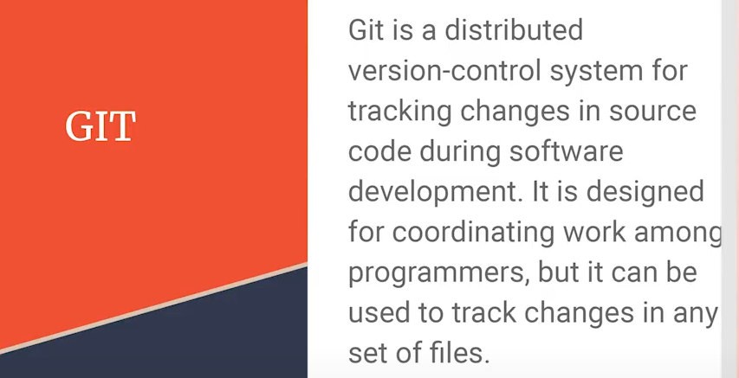
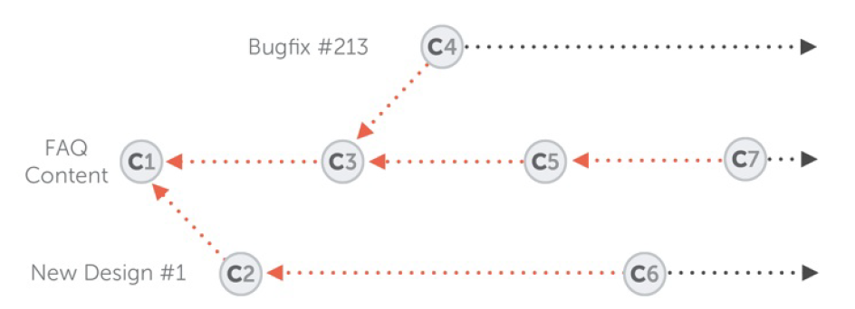
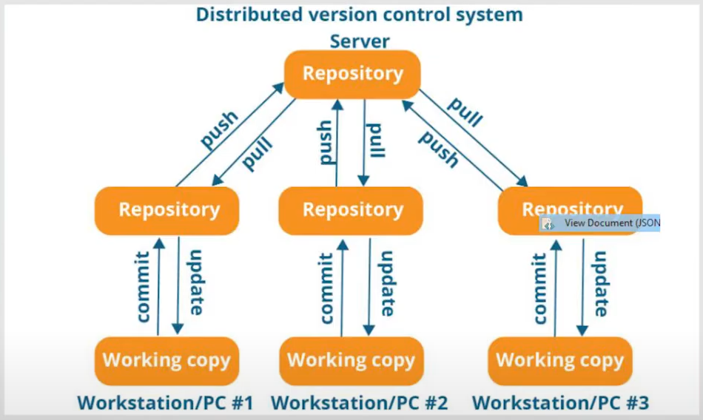
Different Version Control Systems
Why Version Control ?

Slide 3
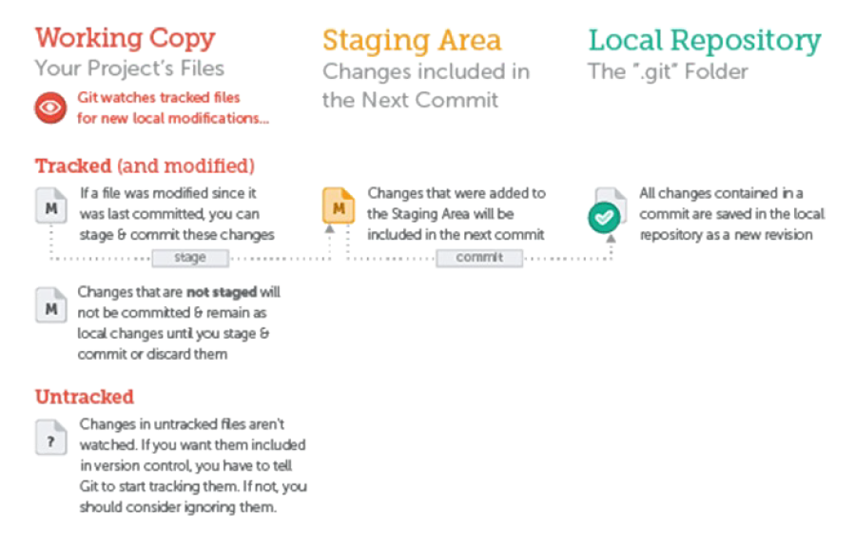
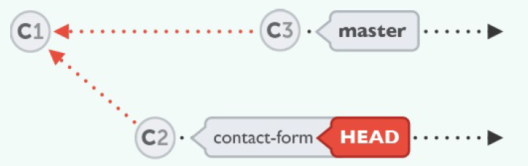
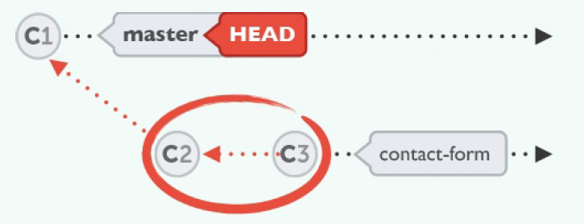
Git Commands
Initialize the directory as git repository
Basic Commands:
-> git init
-> git add –A OR
-> git add new-page.html index.html css/*
-> git commit -m “Initial commit”
Clone Remote Repository:
-> git clone https://github.com/gittower/git-crash-course.git
Status Commands:
-> git status
-> git log
Branch Commands:
-> git branch contact-form
-> git checkout contact-form
-> git checkout master
-> git merge contact-form
stage all files in directory
Commit changes in git repository
stage specific files

