Slide 1
Microservices
By,
Ammar

Slide 2
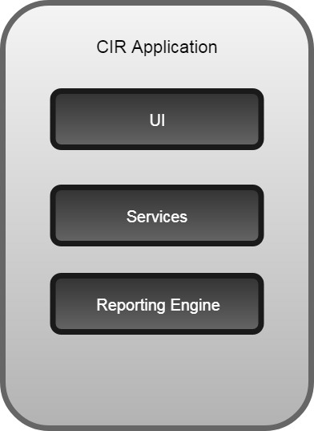
Before Microservice(Application Development Approach)
Traditionally, software developers created large, monolithic applications. The single monolith would encompass all the business activities for a single application.
e.g. IRCTC , Banking
CIR Application

Slide 3
Cons of the Monolithic Application
Because of single service failure the whole application will go down or will not work
Enhancement of business functionality required developers to make changes within the single application
Code conflict.

Slide 4
What is Microservice Architecture?
Microservice is a service-based application development methodology. In this methodology, big applications will be divided into smallest independent service units. By dividing the entire application as a collection of interconnected services, where each service will serve only one business need.
You can chose any of the technology for creating a microservice (e.g. Node js, Spring boot, Dot Net, Ruby etc.)

Slide 5

CIR Application(Microservice Approach)

Slide 6
Why should you use it?
Better Organization
Decoupled
Performance
Fewer Mistakes

Slide 7
Difference between Web service & Microservices
S.No | Web service | Microservice
1 | A web service is just a technology for providing services over "web" or HTTP. | A microservice is a software architecture, which can be implemented with web services.
2 | Web services cannot be individually deployable, Individually scalable, Individually monitored? | Microservice services can be individually deployable, Individually scalable , Individually monitored

Slide 8
12 Factors App
In order to achieve microservice architecture following factors needs to be consider
Codebase
Dependencies
Config
Backing Services
Build, Release, Run
Stateless Process
Port Binding
Concurrency
Disposability
Dev/Prod Parity
Logs
Admin Process

Slide 9
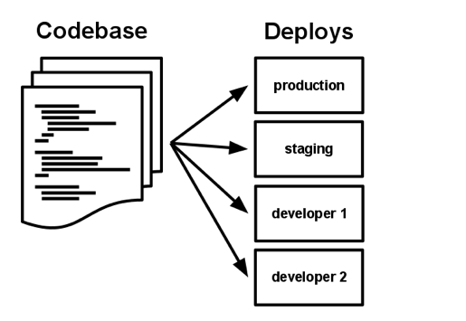
1. One codebase
One codebase tracked in version control, many deploys.
e.g. (Github , SVN etc.)

Slide 10

2.Dependencies
Explicitly declare and isolate dependencies
Code dependencies, like a database, or an image processing library,
Tools such as (Maven,Gradle)

Slide 11
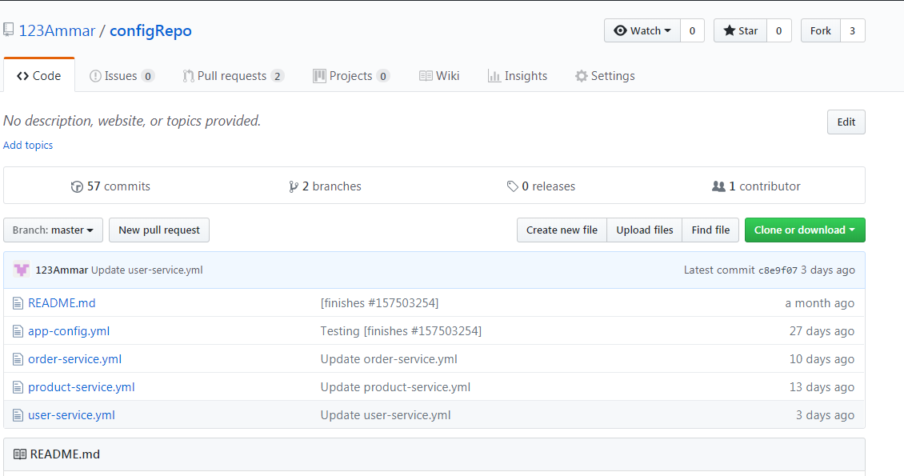
3.Config
Configuration is anything that may vary between different environments. Code is the stuff that doesn’t.

Slide 12

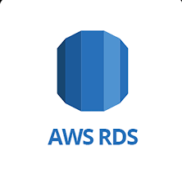
4.Backing Service
Treat backing services as attached resources
MySQL to RDS

Slide 13
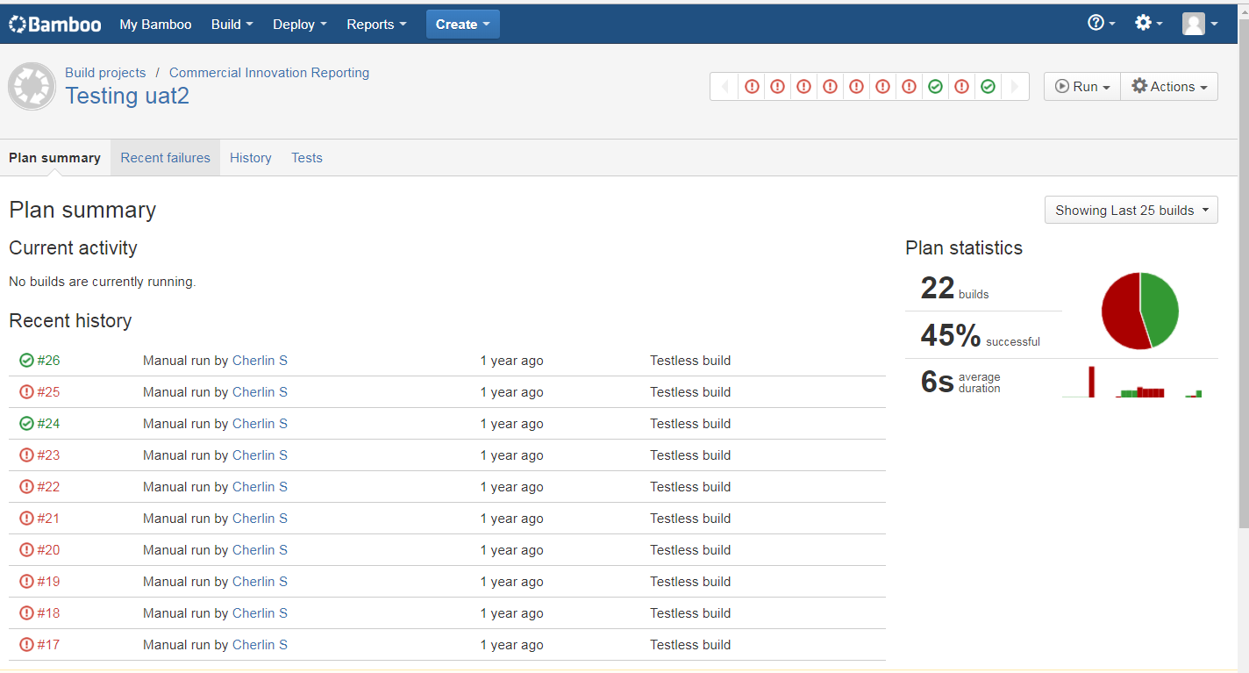
5.Build,Release,Run (Devops)
Strictly separate build and run stages
Tools (Jenkins, Bamboo) can be used in order to achieve this

Slide 14
6.Stateless Processes
Execute the app as one or more stateless processes
(eg: HTML,HTTP Protocol)
7.Port Binding
Export services via port binding (API)
Usually you get this for free because your application is already presenting itself through a web-server. But let’s say you have an API that’s used by both your customers in the outside world (untrusted) and your internal website (trusted). You might create a separate URL to your API that your website can use which doesn’t go through the same security (firewall and authentication), so it’s a bit faster for you than for untrusted clients.
Eg : Apigee, Mashery

Slide 15
8.Concurrency
Two or more events or existing at the same time.
Eg : Mail, SMS etc.
9.Disposability
Maximize robustness with fast startup and graceful shutdown
Tools used (PCF Autoscaling , AWS Autoscaling)

Slide 16
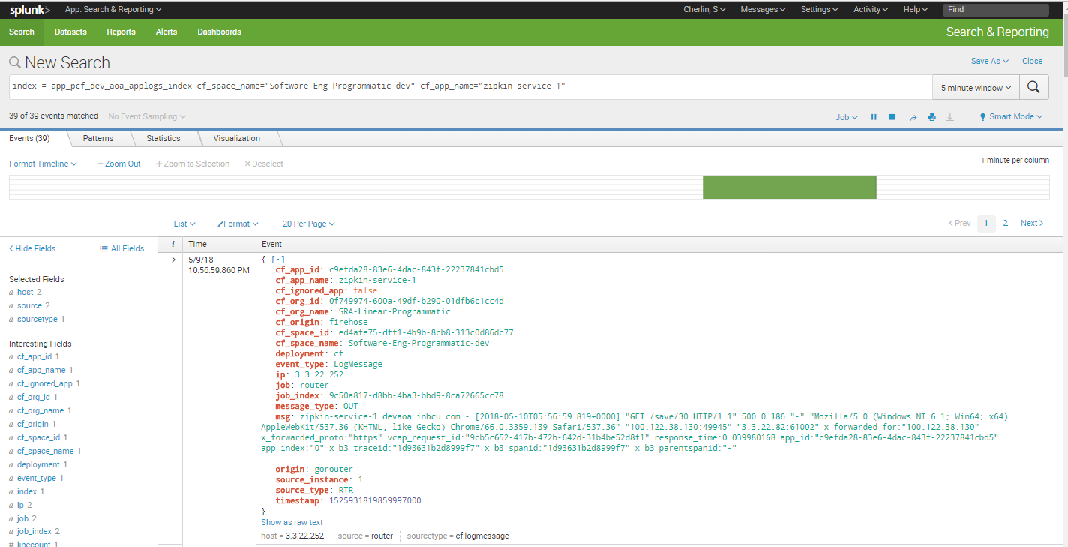
10.Logs
Treat logs as event streams
At the very least, you should be capturing errors and sending them to an error reporting service like New Relic or AppDynamics. You can take a more general approach and send your logs to a service like Splunk ,Storm.
Splunk Dashboard

Slide 17
11.Dev/Prod parity
Keep development, staging, and production as similar as possible
Vagrant to manage their own personal virtual server that’s configured just like production servers.
12.Admin Process
Run admin/management tasks as one-off processes
e.g. Data repair after deployment etc.

Slide 18
Demo

Slide 19
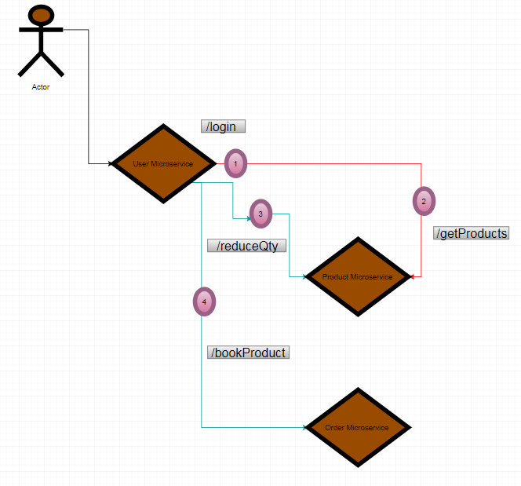
E-commerce Demo Application

Slide 20
Application Hosting
For Hosting the microservice application, we have used the PCF (Pivotal Cloud Foundry) it is PAAS
You can host your application using (AWS etc.)

Slide 21
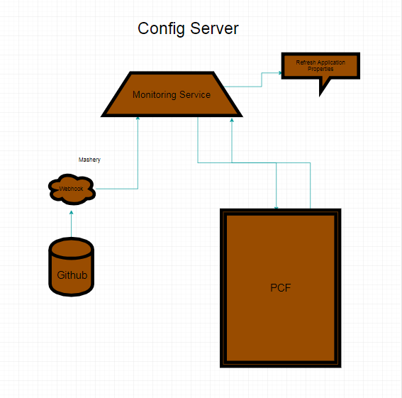
Factors Implemented in Ad sales
Config
PCF Service (Config server)
PCF config service
* Config Repo
* Webhook (Mashery -> Config server monitor application)
* Binding the application
Additional Service used for Microservice
1. Service Registry
Eureka
2. Circuit Breaker
Hystix

Slide 22
PROS AND CONS OF MICORSERVICE
Pros:
It is easier to build application with Multiple Technology
It is easier to deploy individual Microservice compared to a monolith.
It is easier to develop a Microservice for a specific task.
It is much easier to change the underlying implementation of a Microservice.
It is easier to scale a Microservice.
It is easier to debug any issues with a specific Microservice.
Cons:
It is very difficult to maintain multiple Microservices.
It is very difficult to maintain versioning among Microservices.
It is extremely difficult to find good architects for creating Microservice architecture in right way.

Slide 23
References
https://12factor.net/
https://thenewstack.io/from-monolith-to-microservices/
https://www.dragonspears.com/blog/migrating-to-microservice-architecture
https://github.com/rainboyan/spring-cloud-microservice-example.git
Demo Reference:
https://github.com/123Ammar/Microservice-demo.git

Slide 24
Questions?

