Slide 1
TopoFlow
Physics-Informed Deep Learning for Multi-Pollutant Air Quality Forecasting
Ammar Kheddar | 2025

Slide 2
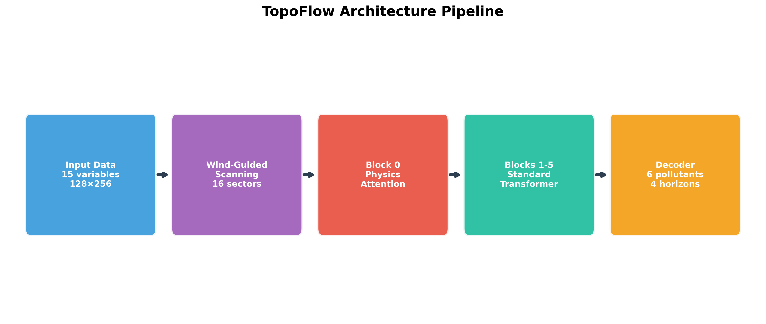
Methodology: Physics-Informed Innovations
🌬️ Wind-Guided Scanning
Patches reordered by wind direction (upwind→downwind)
16 pre-computed sectors | Captures atmospheric transport
🏔️ Elevation-Based Attention
Terrain-aware bias: bias = -α × ReLU(Δh/H)
Penalizes uphill transport | Learnable parameter α
🧪 Multi-Pollutant Modeling
6 species: PM2.5, PM10, SO₂, NO₂, CO, O₃
4 horizons: 12h, 24h, 48h, 96h
⚡ Large-Scale Training
800 AMD MI250X GPUs on LUMI
100 nodes × 8 GPUs | ~48 hours

Slide 3
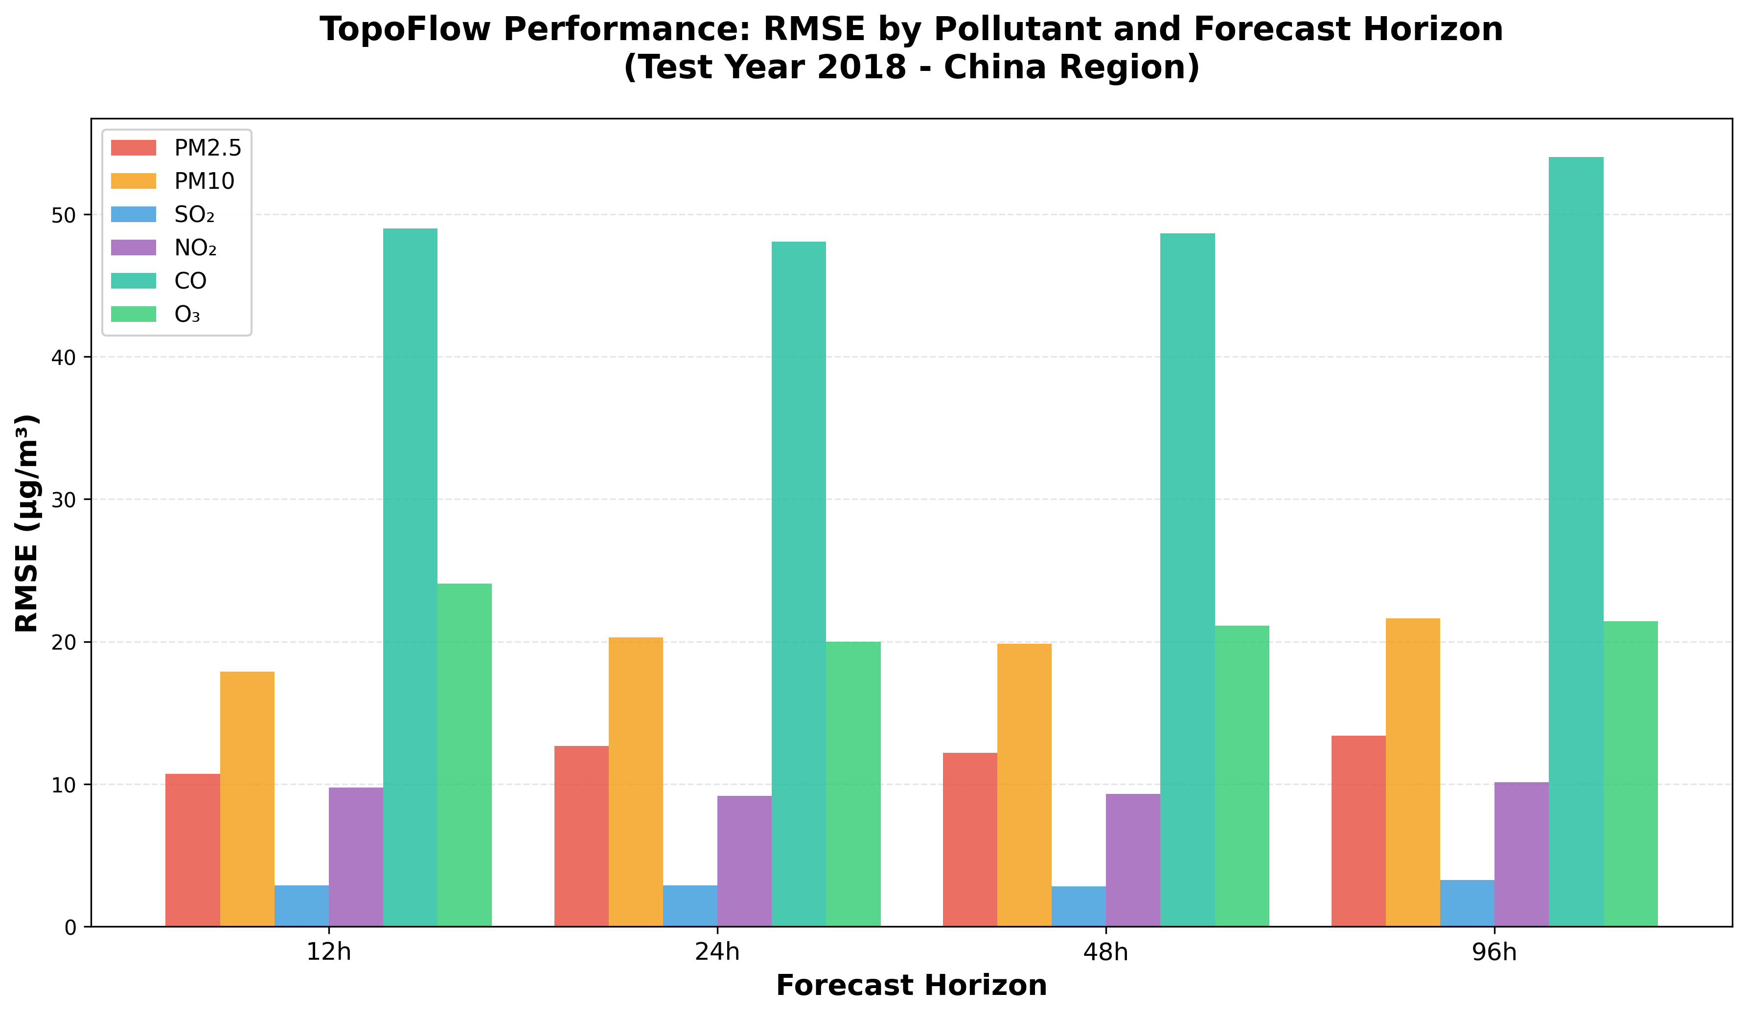
Results: Performance Metrics (Test Year 2018)

Slide 4
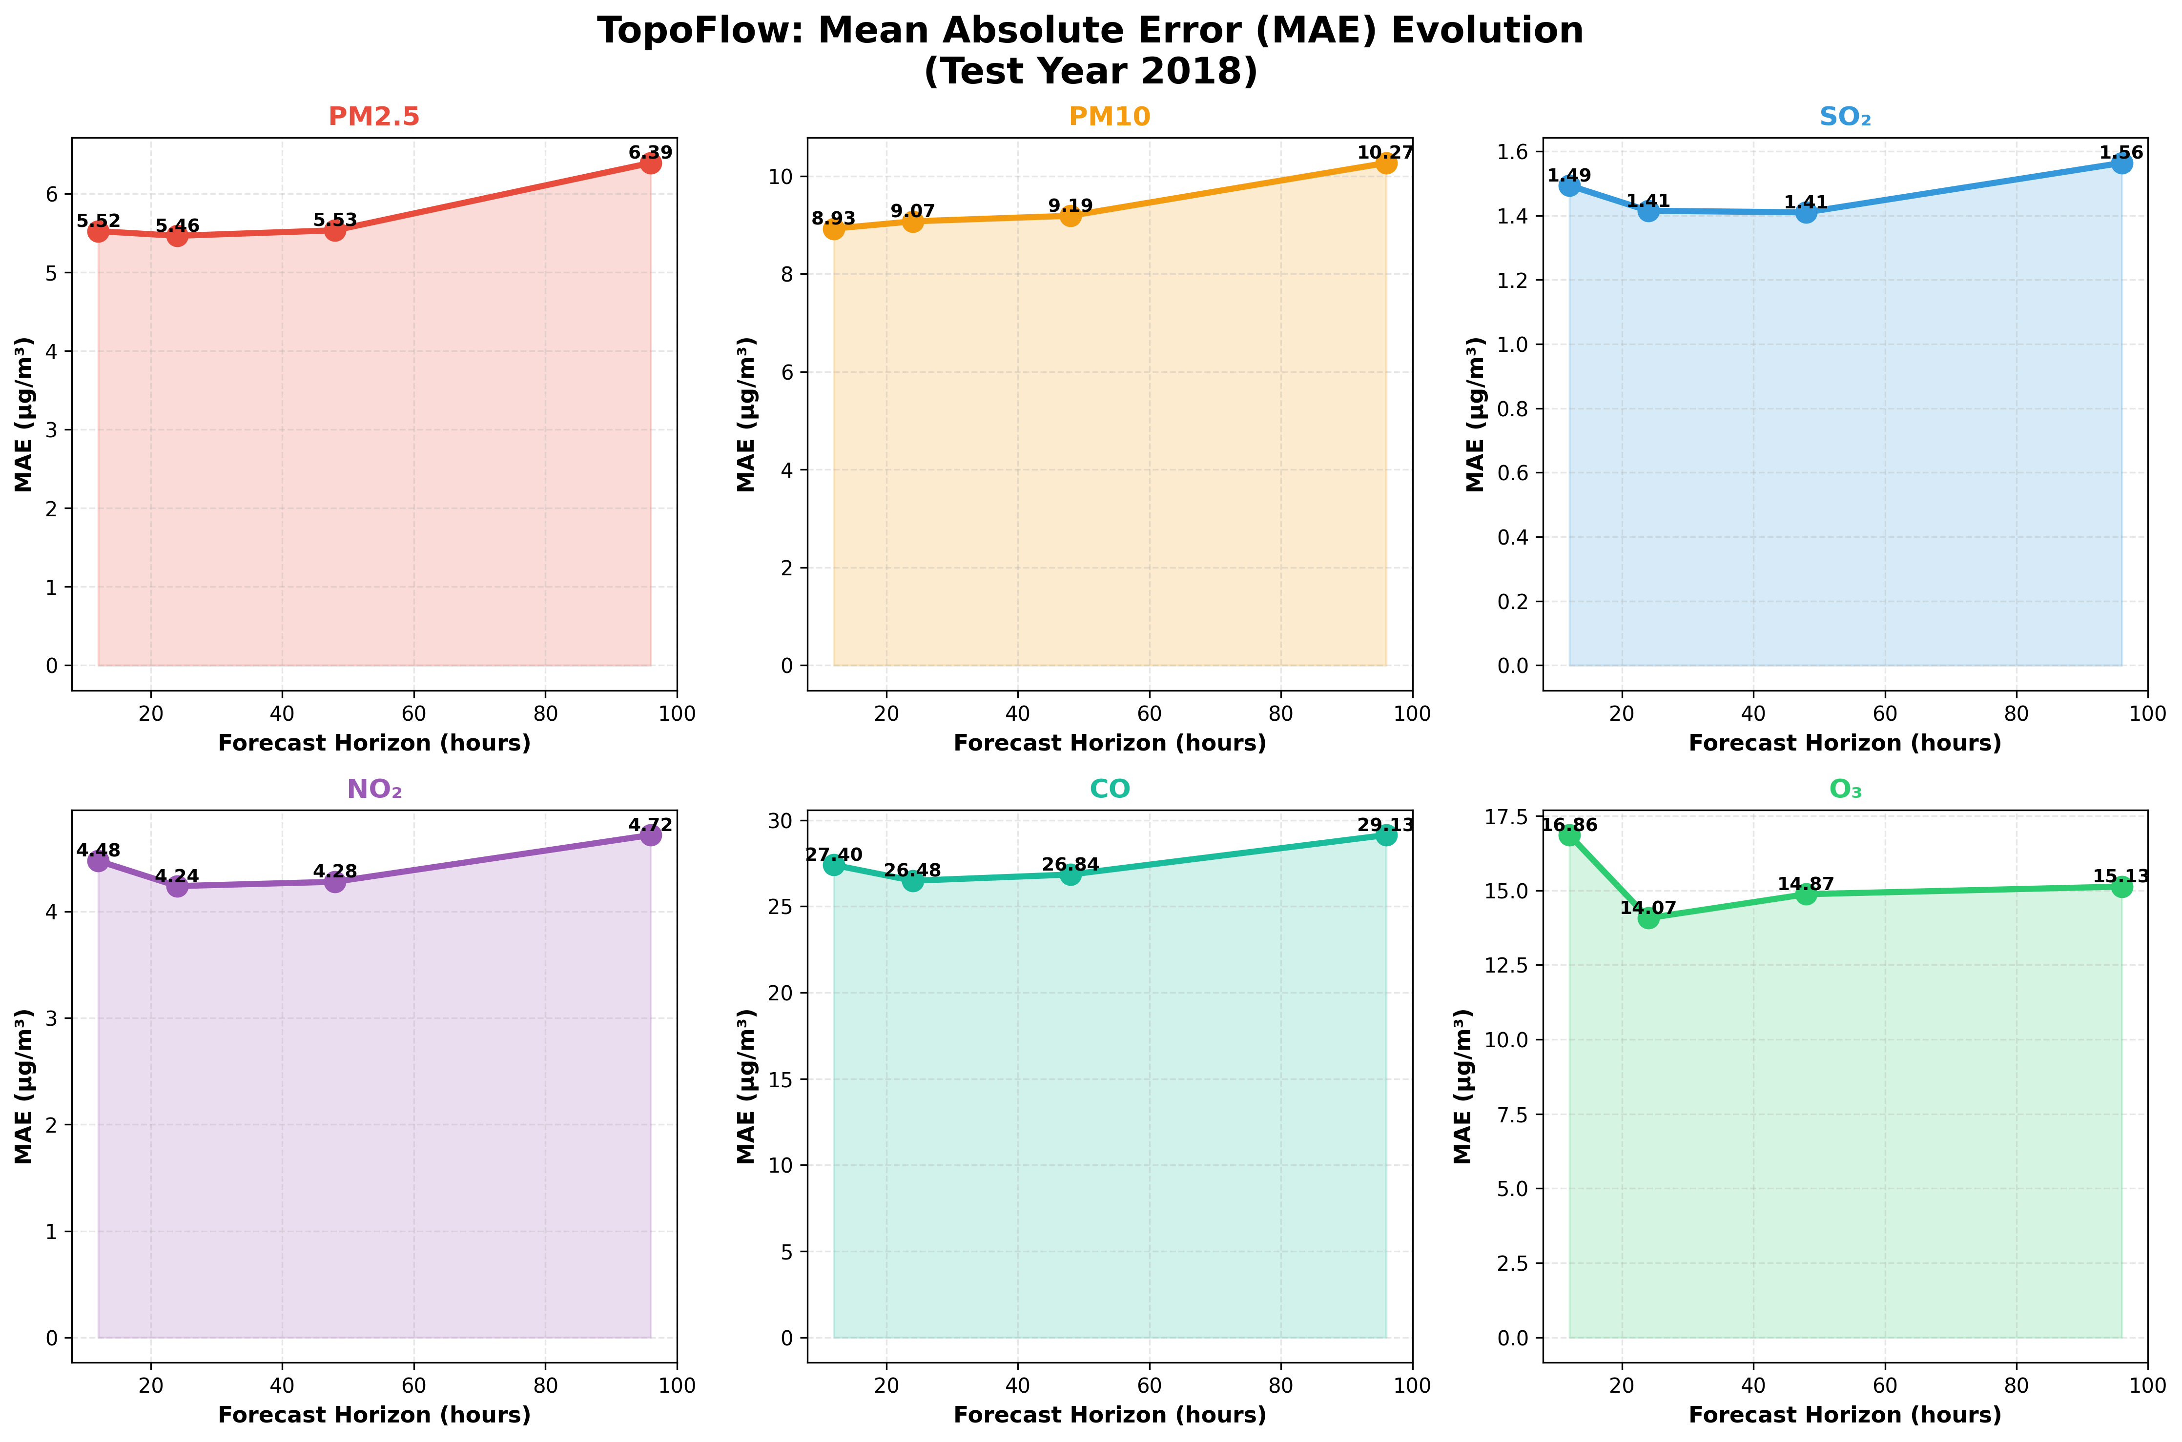
Mean Absolute Error (MAE) Evolution by Horizon

Slide 5
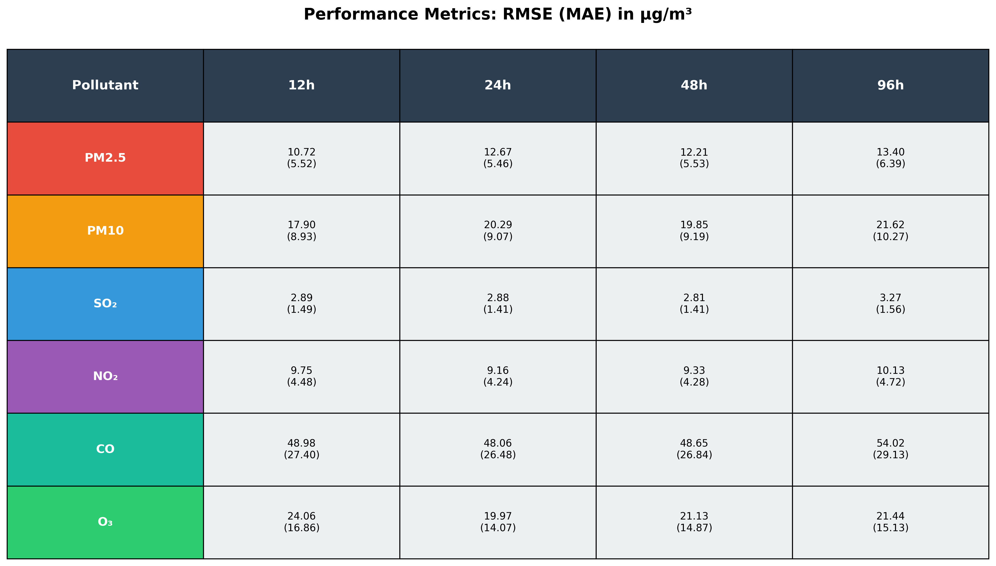
Detailed Performance: RMSE (MAE) Summary
📍 China Region: 11,317 active pixels (34.5%) | 128×256 grid | 4,000 test samples | Val Loss: 0.3557

Slide 6
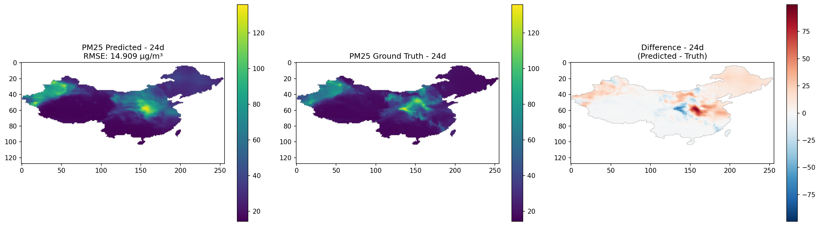
Spatial Distribution: PM2.5 Predictions (24h Horizon)

