Slide 1
Understanding Neural Network Architecture Using Evolutionary Algorithm Search
Ammar Mukadam

Slide 2
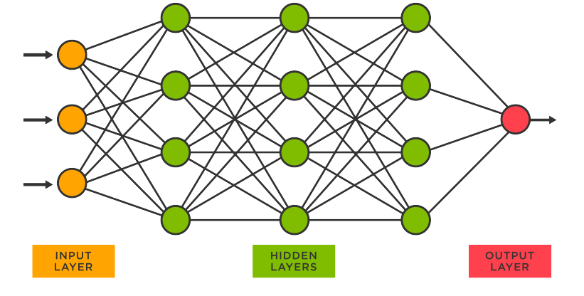
Neural Networks
Source: TIBCO

Slide 3
Weights and Biases
Focus on the connections between neurons:
Weights: value of each neural connection to the final output
Bias: threshold for a neuron to activate based on the input it receives.

Slide 4
Are we actually learning?
Loss function: understanding the network's progress towards consistently outputting the expected result.
How accurate is our neural network?

Slide 5
Back-propagation
Output
Input
Source: TIBCO

Slide 6
Investigating The Hidden Layers
How many layers are in the hidden layers?
How many neurons are in these layers?
Plus the many other hyperparameters

Slide 7
Network Hyperparameters
Number of layers & neurons per layer

Slide 8
Network Hyperparameters
Number of layers & neurons per layer
Activation function

Slide 9
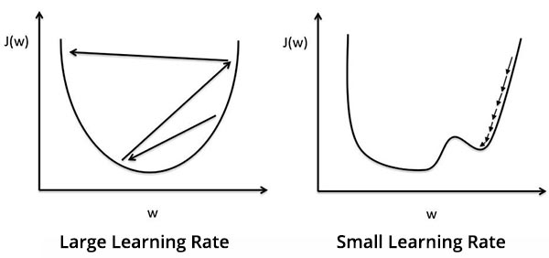
Network Hyperparameters
Number of layers & neurons per layer
Activation function
Learning rate
Source: SaugatBhattara

Slide 10
Network Hyperparameters
Number of layers & neurons per layer
Activation function
Learning rate
Dropout layers
Source: SaugatBhattara

Slide 11
Network Hyperparameters
Number of layers & neurons per layer
Activation function
Learning rate
Dropout layers
Cost Function
Source: SaugatBhattara

Slide 12
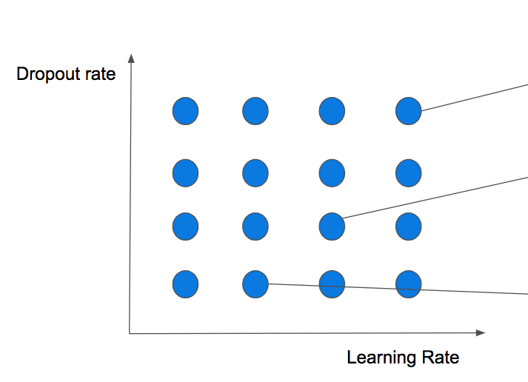
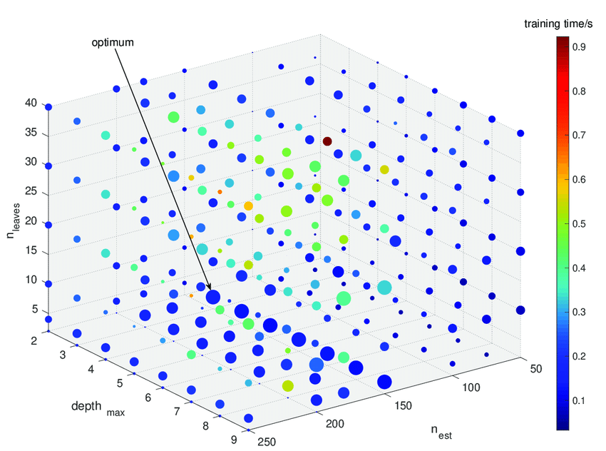
How do we find the optimal combination of hyperparameters?
Several methods, for example Grid Search
Source: FloydHub
Source: ResearchGate

Slide 13
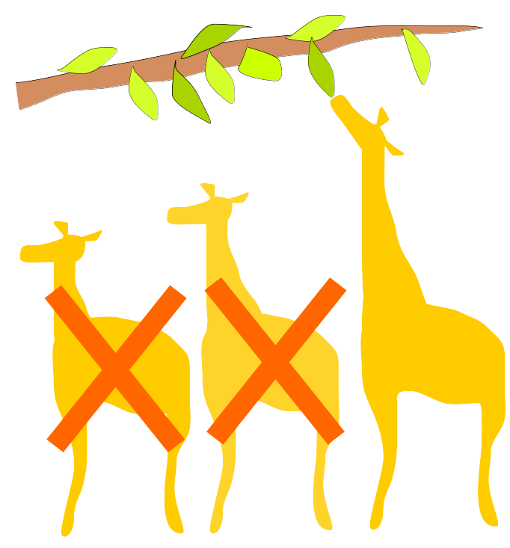
Evolutionary Algorithm Search
Evolution
Survival of the fittest
Source: Wikimedia Commons

Slide 14
Choosing the best individuals
Fitness function: Evaluated using TensorFlow
- Accuracy
- F1 Score
- Minimizing Loss
- Completion Time

Slide 15
How the search works
All of these hyperparameter combinations = individuals
Each individual made up of a chromosome that represents specific hyperparameters
These individuals make up the population

Slide 16
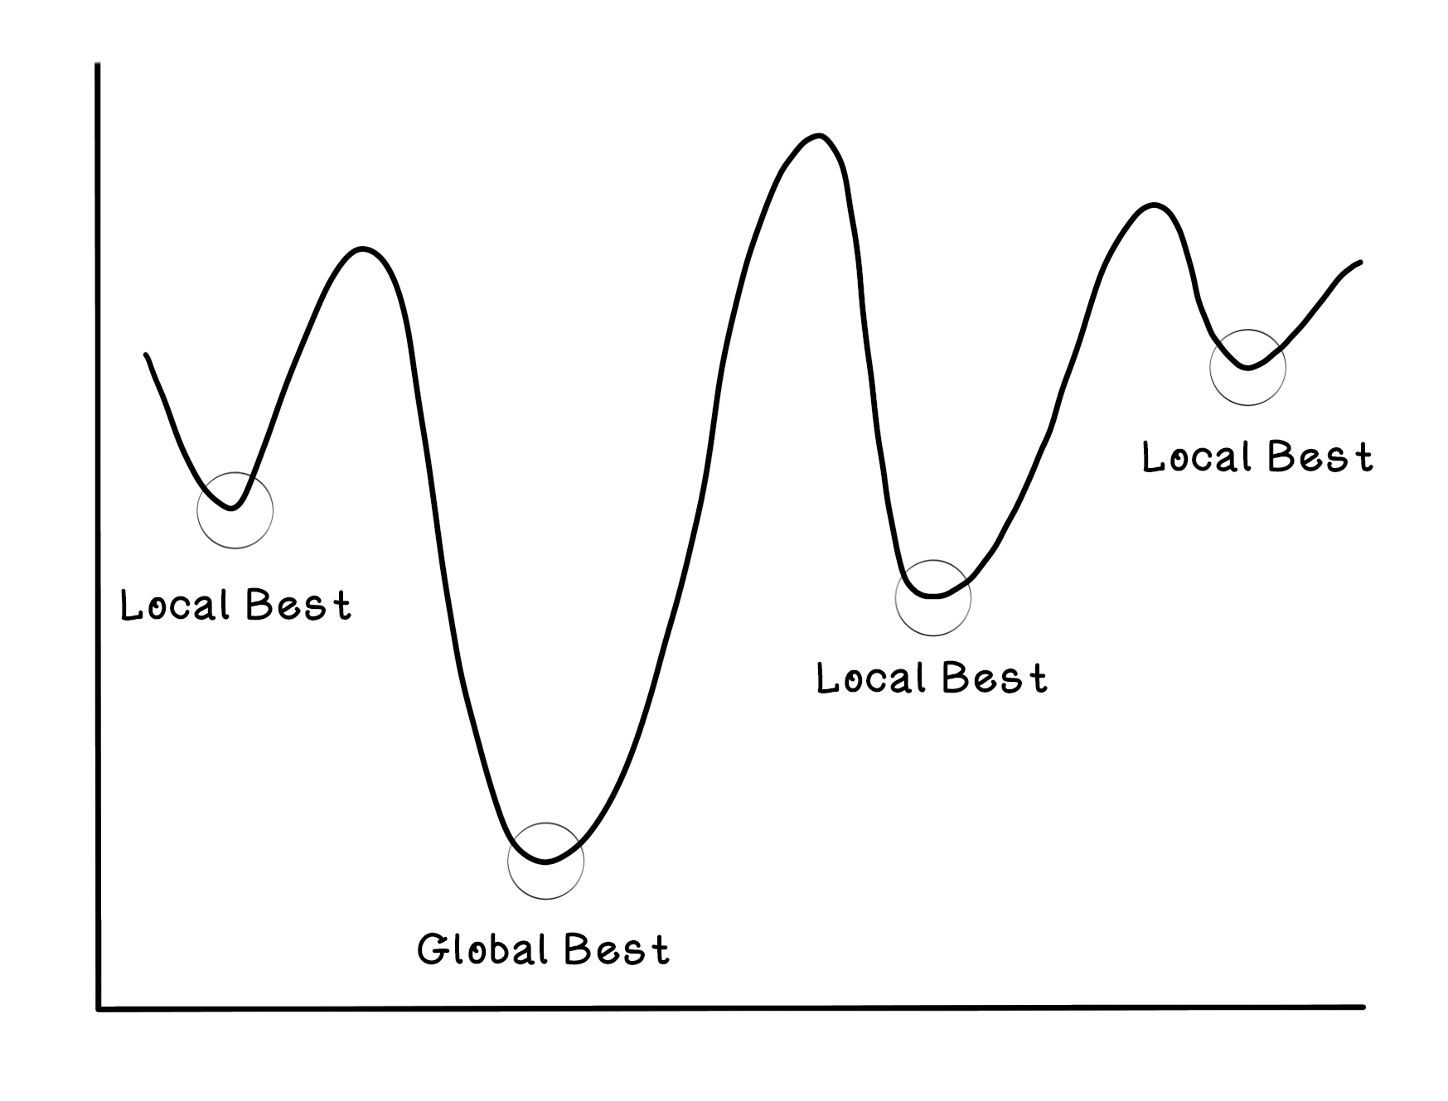
Following Evolution
Individuals are mated, chromosomes combined.
Variable chance of mutation to increase diversity
Source: Manning.com

Slide 17
The process as a whole
Initialization
1
Mutation
4
5
Termination
Selection
3
2
Mating, crossover of chromosomes
End

Slide 18
Wait a minute...
How many individuals do we start with?
How many generations do we run?
Plus the many other hyperparameters
We’ve been here before...

Slide 19
Genetic Search Hyperparameters
# of starting indiv. & # of generations
Mutation rate
Death %
# of parents mating
Current model is a proof of concept
Our chosen search hyperparameters have proven to be best for small datasets

Slide 20
For larger datasets with more hyperparameters:
# of generations
# of starting indiv.
Death rate%

Slide 21
Future Plans
Bayesian optimization: method that learns from its guesses to find the optimal hyperparameters for the search.

Slide 22
Overview
Hyperparamters of genetic search
Hyperparameters of neural network
Neural network best set up to learn

Slide 23
Thank you!

