Slide 1

Machine Learning Sab Kay Liey مشین لرنگ سب کے لیے
Muhammad Ammar Malik

Slide 2

Machine Learning

Slide 3


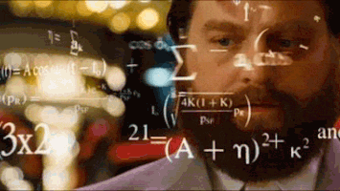
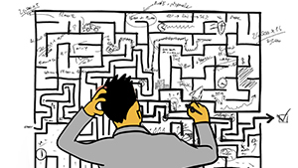
Some Common Myths!

Slide 4
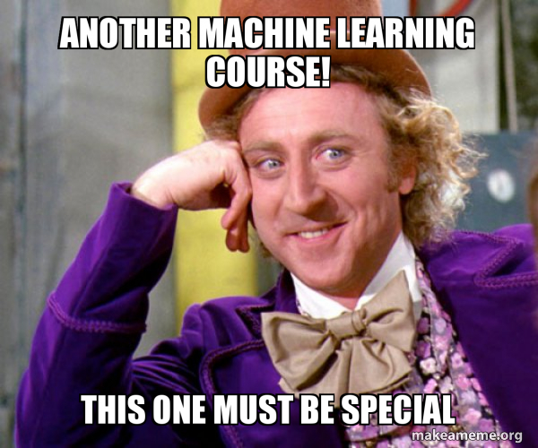

Slide 5

Tools required

Slide 6

Google Colab

Slide 7

Schedule

Slide 8


Follow & Subscribe
https://www.youtube.com/c/AmmarMalik93
https://www.facebook.com/Malik.Ammar.Official

