Slide 1
Machine Learning Sab Kay Liey مشین لرننگ سب کے لیے
Linear Regression

Slide 2
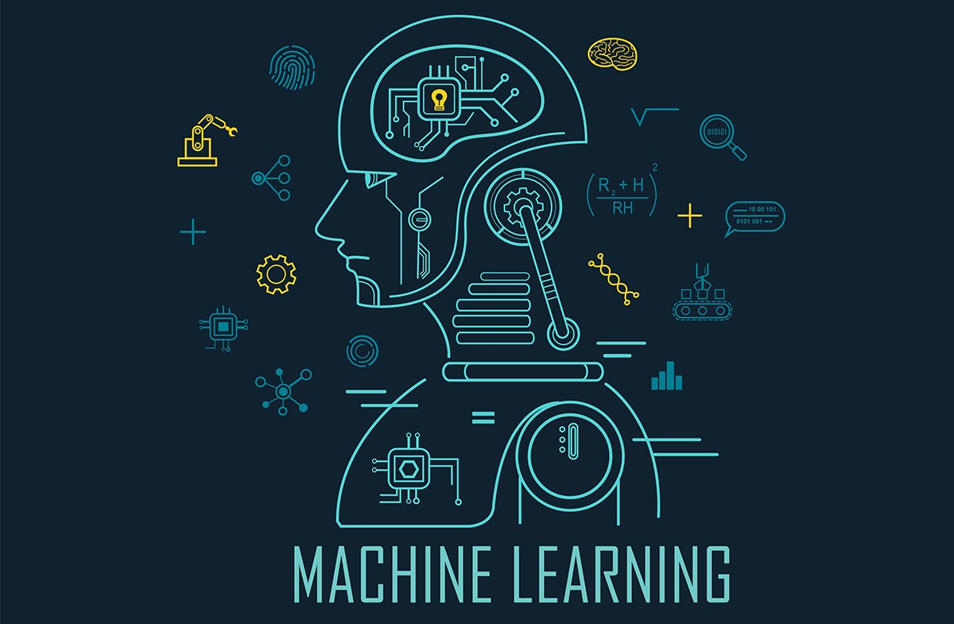
Machine Learning

Slide 3
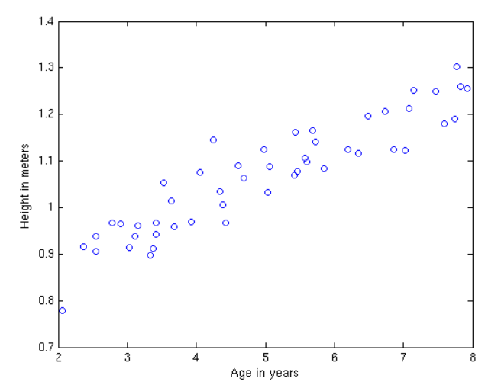

Slide 6
Equation of line y = mx + b
Random guess:
m = 0.05,
b = 0.7,
m = 0.08,
b = 1

Slide 7
The objective?
Learn values of ‘m’ and ‘b’
Also called ‘weights’
We will call ‘b’ as ‘w0’ and ‘m’ and ‘w1’.

