Slide 1
Aotunomous Mobile Robot ROS2
Graduation Project at MUST
Group #3

Slide 2
Welcome!!
Professors and Doctors
We are thrilled to extend a warm and hearty welcome to you

Slide 3
Introduction
In the past several years the mobile industrial robot expanded on many fields for example : goods stores, pharmacies, restaurants and military uses …. etc.
That’s reason for its reliability, low percentage error and saving money & money compared to manpower. For that many companies all around world compete to make their models are more synergetic.
So, we've been thinking about starting a project in this field to create a strong, cost-effective competitor with fast response times and independent decision-making, with minimal human intervention.

Slide 4
Agenda
01
Project Overview
Idea, Search, Challenges, Goals, Summary
02
Project Technicality
Majors, Elements, Summary
03
How to manage
Techniques, Notion, GitHub
04
Next Steps
What is next?

Slide 5
Overview
IDEA
Need#1
01
A customizable Robot serve in the midlevel warehouses
Need#2
02
A good price for this Robot
Need#3
03
Low percentage error
That’s led us to

Slide 6
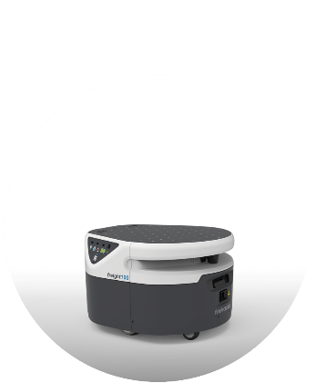
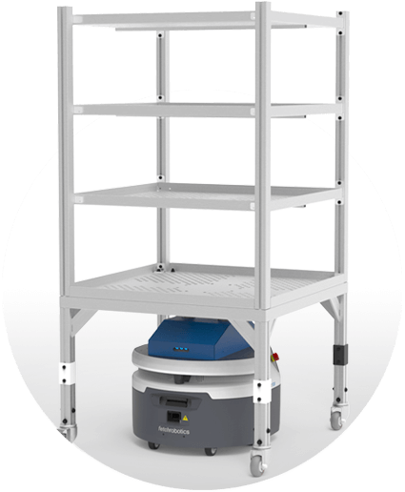
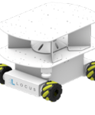
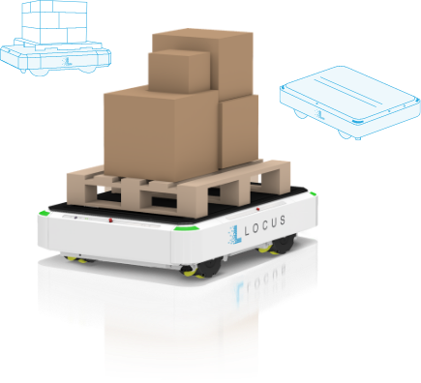
Search
Examples
We have studied multiple graduation projects to reach the most suitable solution that serves our goals.
Receiving and Putaway Robot
Fetch Robotics
Raw Material
Delivery
Fetch Robotics
Locus Vector
LOCUS Robotics
Raw Material
Delivery
LOCUS Robotics

Slide 7
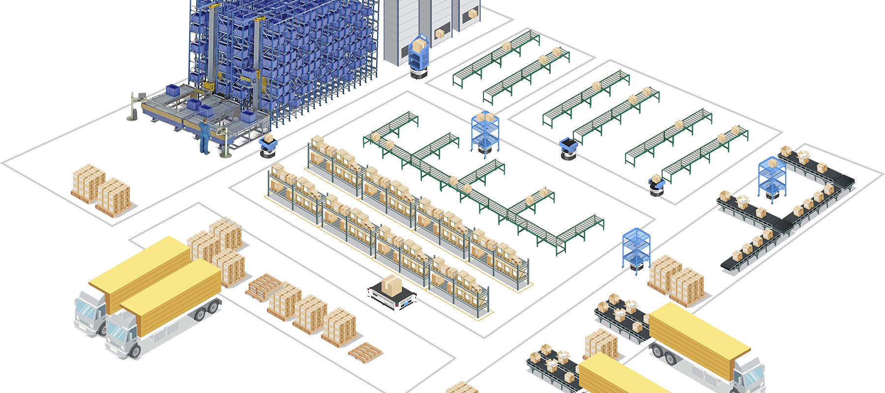

Slide 8
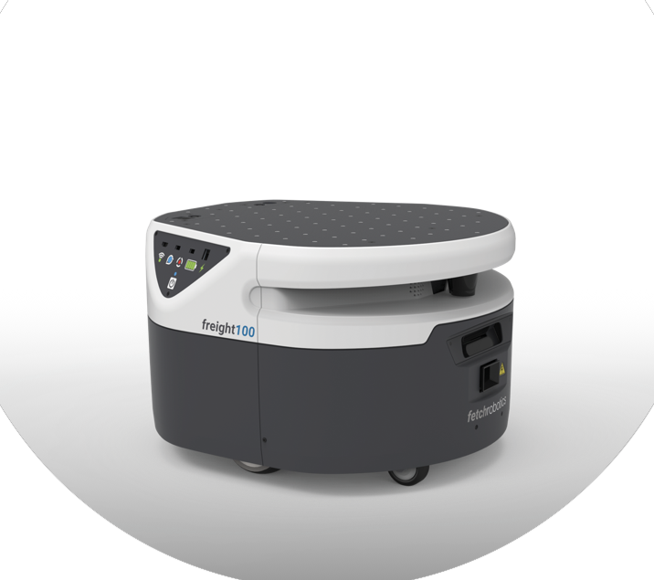
Challenges
Price
Quality
Dependability

Slide 9

GOALS
Manufacturing a robot that serves medium-sized shipping facilities, and medium-sized workshops, with the following features available
Suitable price
Dependability
Reliability
Adjustability

Slide 10
Project Technicality

Slide 11
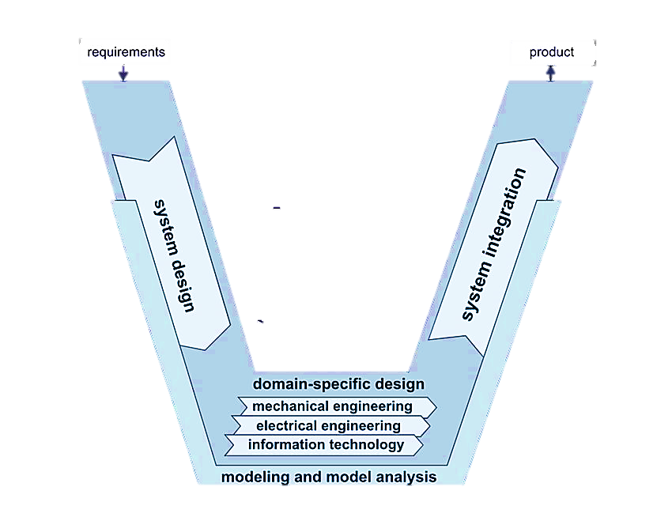
The project design
Organizational structuring within the team and assembly methodology
The scientific foundation of the design and its technical stages
is divided into two fund-amental elements
Modularization
Hierarchization

Slide 12
Majors
01
02
03
Mechanical
Electronics
Software
Design
Material selection
Motor selection
Load analysis
Power circuit
Controller
Sensors
Embedded system
ROS2
RTOS

Slide 13
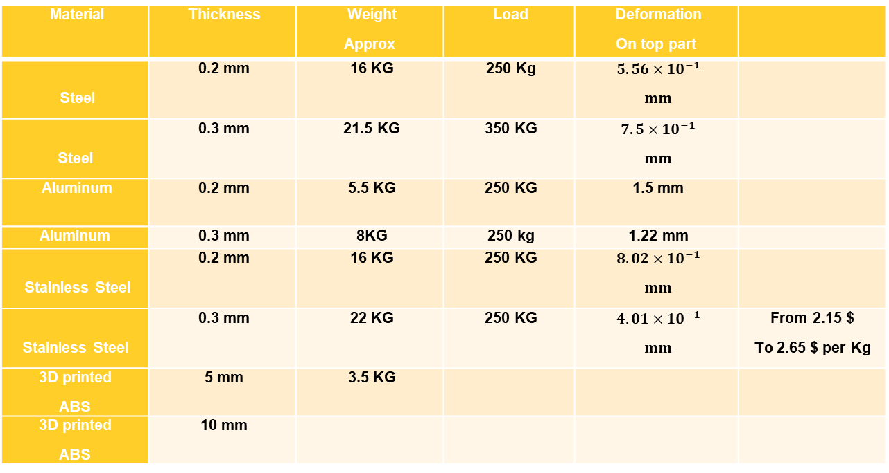
Material selection
Many different materials are used in the manufacture of autonomous mobile robot bodies, and the most commonly used materials nowadays are steel, aluminum,
and stainless steel.
The following table shows a simple comparison between these materials
Material | Thickness | Weight Approx | Load | Deformation On top part
Steel | 0.2 mm | 16 KG | 250 Kg | $5.56×{10}^{−1}$ $$mm$$
Steel | 0.3 mm | 21.5 KG | 350 KG | $7.5×{10}^{−1}$ $$mm$$
Aluminum | 0.2 mm | 5.5 KG | 250 KG | 1.5 mm
Aluminum | 0.3 mm | 8KG | 250 kg | 1.22 mm
Stainless Steel | 0.2 mm | 16 KG | 250 KG | $8.02×{10}^{−1}$ $$mm$$
Stainless Steel | 0.3 mm | 22 KG | 250 KG | $4.01×{10}^{−1}$ $$mm$$ | From 2.15 $ To 2.65 $ per Kg
3D printed ABS | 5 mm | 3.5 KG
3D printed ABS | 10 mm

Slide 14
AMR and Conveyor belt system and forklift
An Autonomous mobile robot is a moving robot that navigates the environment
around it, knows the paths and places where there are obstacles, and draws a
map of the environment around it. As for the conveyor belt, it is a fixed system
that is designed according to the area and shape of the warehouse or factory,
and if any change occurs in the environment, modification is necessary On the
system, meaning that it is not possible to take the same system and place it in
another factory that differs in area and design. Rather, this difference must be
taken into account, and the system must be modified. As for the Autonomous
mobile robot, this can be done as it scans and performs navigation of the enviro-nment around it. To obtain a map with which he can move in the new environme-nt, and as for the forklift, it needs a worker to drive it, and as for the Autonomous mobile robot, it works without the need for a worker and is flexible, as it can tran-sport goods to a different station each time, according to the order it receives,
and not transporting goods in a specific path as the conveyor belt

Slide 15
Basic Elements
Beagle-bone black rev c
I2C camera
Dc motors
Li-po battery
3d lidar
Encoders

Slide 16
Project Management

Slide 17



The project Management
Technique
Hybrid Approach
Tools
Techniques and Tools
Waterfall: Waterfall for the initial hardware design and manufacturing phases.
[requirements, design,
Implementation, testing,
deployment]
Agile: for the firmware and software development.
[Plan, Design, Develop,
Test,Deploy, Review]

Slide 18
Q&A

Slide 19
Thank you

Slide 20
Notes
Modularization: the process of
breaking down a complex system or project into
smaller, self-contained modules or
components. Each module serves a specific function or task and can
be developed or modified
independently. This approach
simplifies design, development,
and maintenance, making it more
efficient and adaptable.
Hierarchization: Hierarchization
involves structuring a project or
system in a hierarchical manner,
where components or modules are
organized in a clear and ordered
hierarchy.
This hierarchy defines the
relationships and dependencies
between different parts of the
system,
Allowing for better control,
communication
and management of the project’s
complexity.

