Slide 1
Aotunomouse Mobile Robot ROS2
Graduation Project at MUST

Slide 2
Welcome!!
Professors and Doctors
We are thrilled to extend a warm and hearty welcome to you

Slide 3
Introduction
In the past several years the mobile industrial robot expanded on many fields for example : goods stores, pharmacies, restaurants and military uses …. etc.
That’s reason for its reliability, low percentage error and saving money & money compared to manpower. For that many companies all around world compete to make their models are more synergetic.
So, we've been thinking about starting a project in this field to create a strong, cost-effective competitor with fast response times and independent decision-making, with minimal human intervention.

Slide 4
Agenda
01
Project Overview
Idea, Search, Challenges, Goals, Summary
02
Project Technicality
Majors, Elements, Summary
03
How to manage
Techniques, Notion, GitHub
04
Next Steps
What is next?

Slide 5
Overview
IDEA
Need#1
01
A customizable Robot serve in the midlevel warehouses
Need#2
02
A good price for this Robot
Need#3
03
Low percentage error
That’s led us to

Slide 6
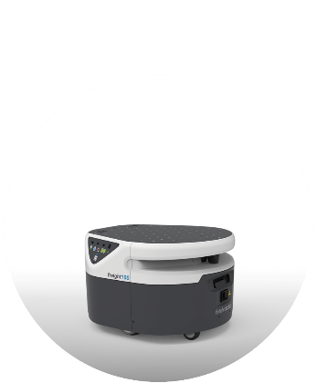
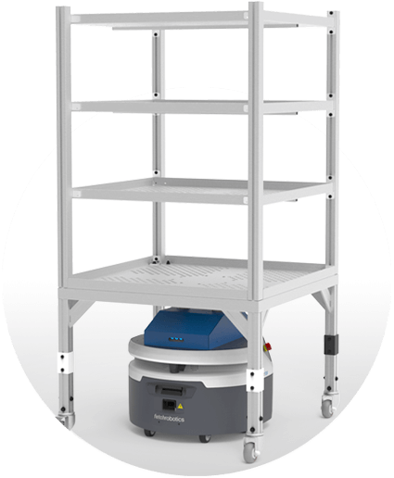
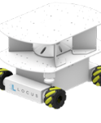
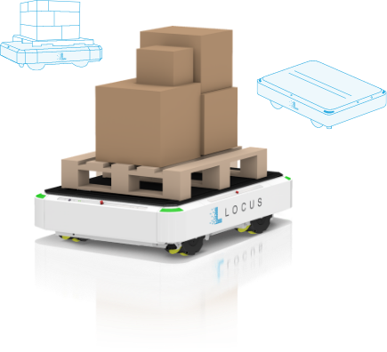
Search
Examples
We have studied multiple graduation projects to reach the most suitable solution that serves our goals.
Receiving and Putaway Robot
Fetch Robotics
Raw Material
Delivery
Fetch Robotics
Locus Vector
LOCUS Robotics
Raw Material
Delivery
LOCUS Robotics

Slide 7
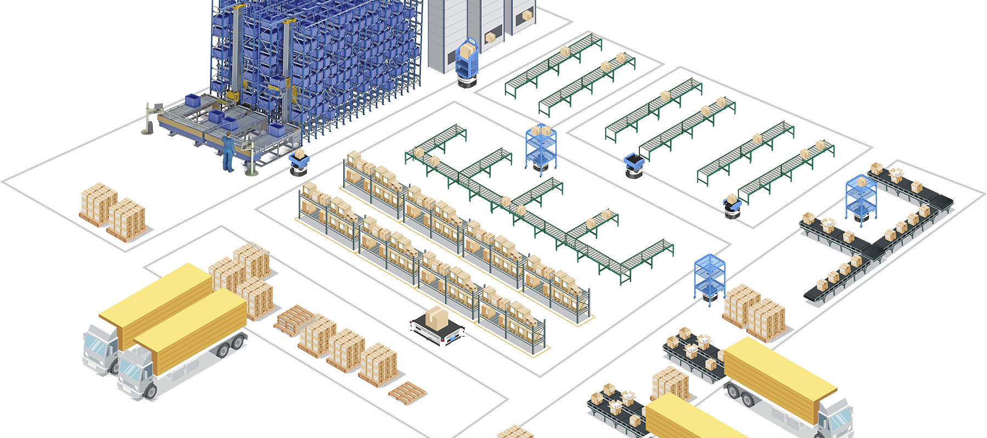

Slide 8
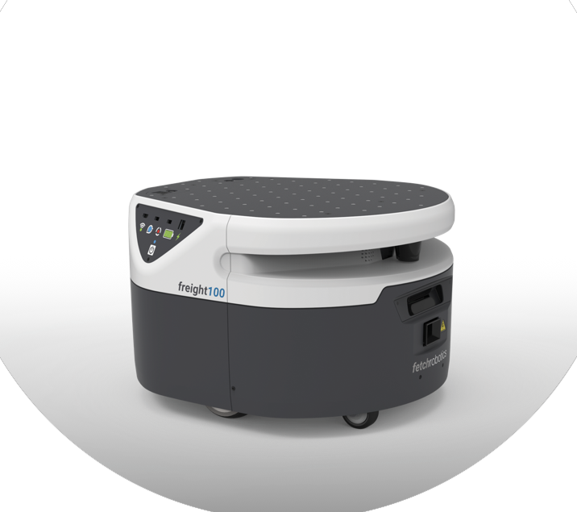
Challenges
Price
Quality
Dependability

Slide 9

GOALS
Manufacturing a robot that serves medium-sized shipping facilities, such as warehouses like Breadfast, and medium-sized workshops, with the following features available
Suitable price
Dependability
Reliability
Adjustability

Slide 10
Project Technicality

Slide 11
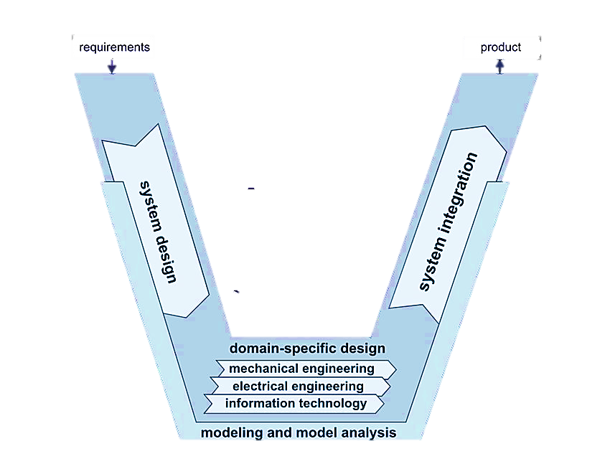
The project design
Organizational structuring within the team and assembly methodology
The scientific foundation of the design and its technical stages
is divided into two fund-amental elements
Modularization
Hierarchization

Slide 12
Majors
01
02
03
Mechanical
Electronics
Software
Design
Material selection
Motor selection
Load analysis
Power circuit
Controller
Sensors
Embedded system
ROS2
RTOS

Slide 13
Basic Elements
Beaglebone black rev c
I2C camera
Dc motors
Lipo battery
3d lidar
Encoders

Slide 14
Project Managment

Slide 15



The project Management
Technique
Hybrid Approach
Tools
Techniques and Tools
Waterfall: Waterfall for the initial hardware design and manufacturing phases.
[requirements, design,
Implementation, testing,
deployment]
Agile: for the firmware and software development.
[Plan, Design, Develop,
Test,Deploy, Review]

Slide 16
Q&A

Slide 17
Thank you

Slide 18
Notes
Modularization: the process of
breaking down a complex system or project into
smaller, self-contained modules or
components. Each module serves a specific function or task and can
be developed or modified
independently. This approach
simplifies design, development,
and maintenance, making it more
efficient and adaptable.
Hierarchization: Hierarchization
involves structuring a project or
system in a hierarchical manner,
where components or modules are
organized in a clear and ordered
hierarchy.
This hierarchy defines the
relationships and dependencies
between different parts of the
system,
Allowing for better control,
communication
and management of the project’s
complexity.

