Slide 1
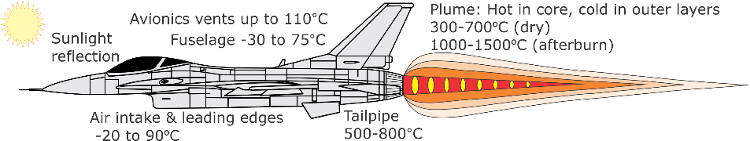
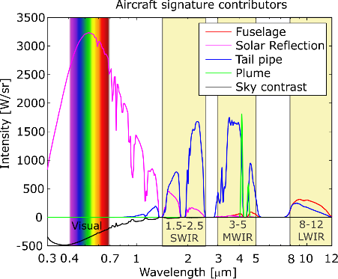
All parts contribute in different parts of the spectrum.
Signature exceeds background, except when viewed against the blue sky in visual –then darker than background.
Plume intensity varies depending on engine setting, from 100 W/sr for idle to 10 kW/sr for afterburner in 3-5 mm.
Notes:
Aircraft signature comprises radiation from the fuselage, the tailpipe and the plume, at the temperatures shown.
Contribution in different parts of the spectrum:
Fuselage thermal signature dominates in the longer wavelength region.
Fuselage reflection signature component contributes to the signature in SWIR band.
Tailpipe contributes in all wavelength bands, peaking in the SWIR and MWIR bands.
Plume signature varies depending on engine setting. For a non-afterburning aircraft the CO2 signature is mostly in the 3-5 um spectral band. The afterburning plume emits in all spectral bands.
In the visual spectral band, the aircraft may appear dark against the blue or overcast sky, when seen from below. This is a negative contrast, indicated in black on the graph.

Slide 2
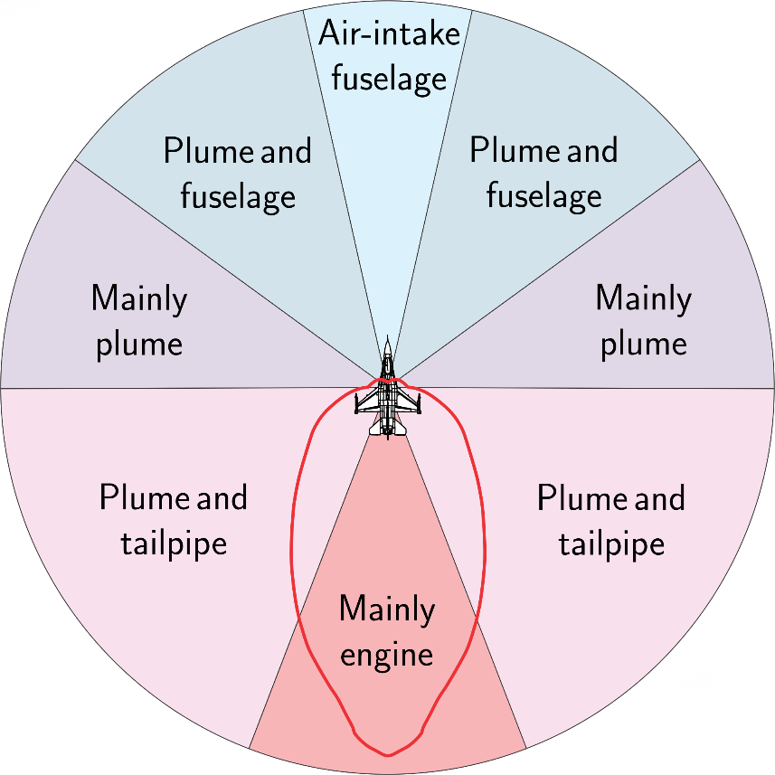
Notes:
Aircraft signature comprises radiation from the fuselage, the tailpipe and the plume, at the temperatures shown.
Contribution in different parts of the spectrum:
Fuselage thermal signature dominates in the longer wavelength region.
Fuselage reflection signature component contributes to the signature in SWIR band.
Tailpipe contributes in all wavelength bands, peaking in the SWIR and MWIR bands.
Plume signature varies depending on engine setting. For a non-afterburning aircraft the CO2 signature is mostly in the 3-5 um spectral band. The afterburning plume emits in all spectral bands.
In the visual spectral band, the aircraft may appear dark against the blue or overcast sky, when seen from below. This is a negative contrast, indicated in black on the graph.

