Slide 1

Genobolitics
Abdurrahman Aboudakila
Ammar Raşid

Slide 2
Outline
Genobolitics
Introduction
Problem definition
Novelty and Methods
Results and Discussion

Slide 3

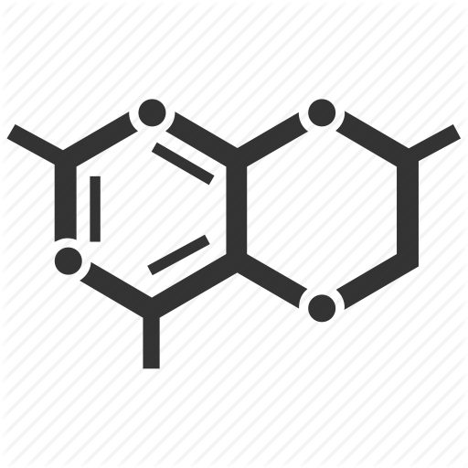

Body
1
Reactions
2
Genes
3
Genobolitics

Slide 4
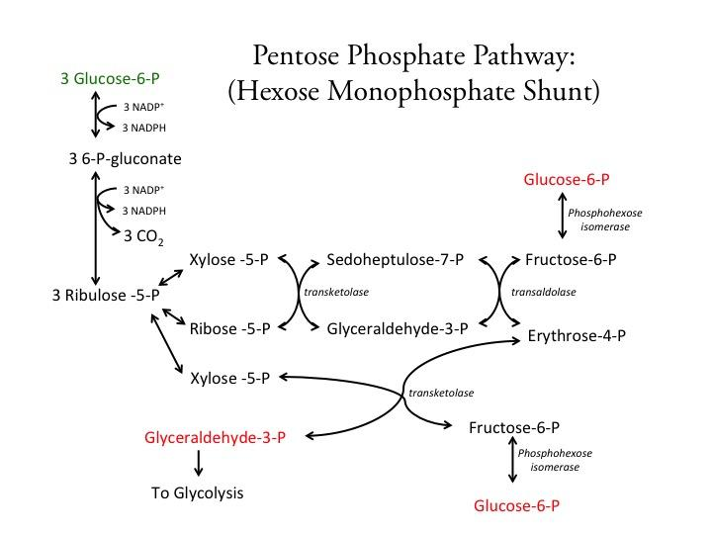
Pathways
Genobolitics

Slide 5
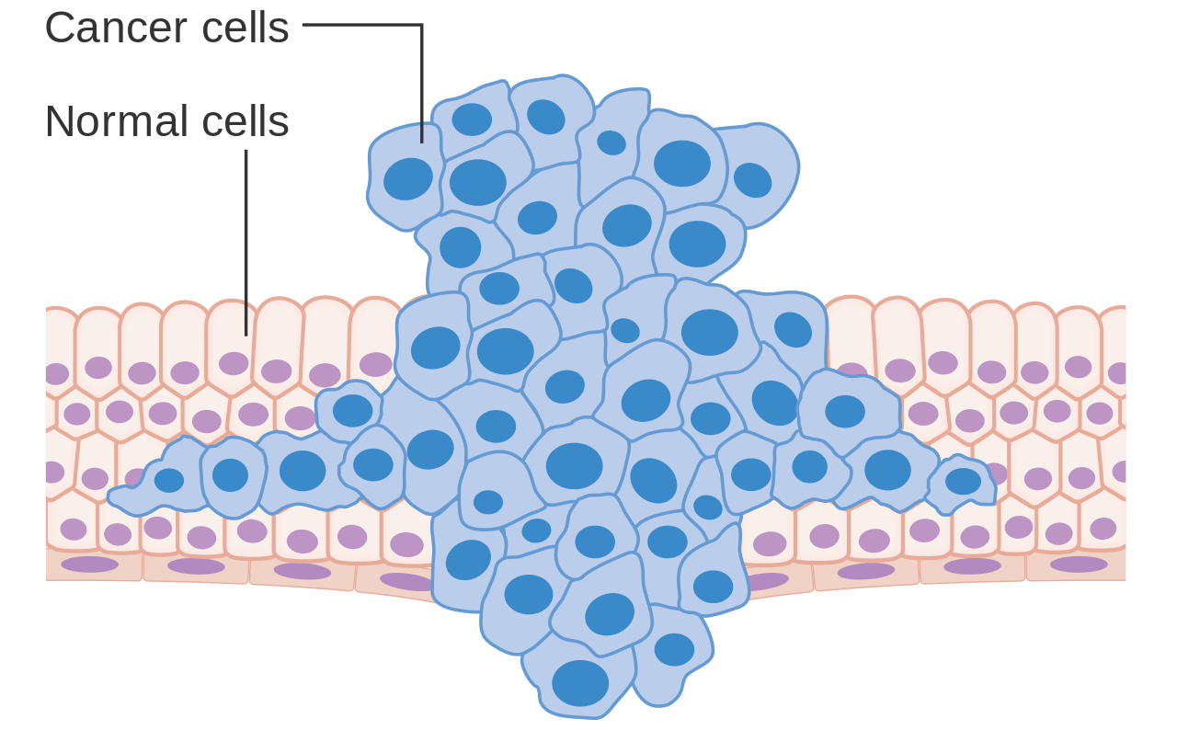
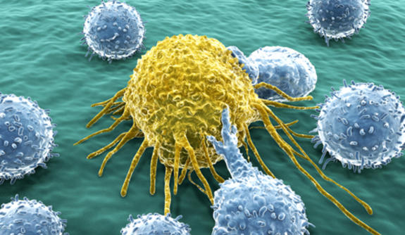
Cancer
Genobolitics

Slide 6
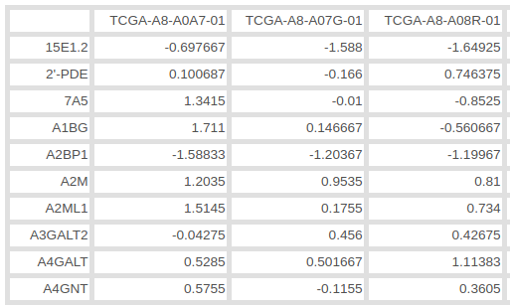
Problem Definition
Genobolitics
Inputs
Gene Expression Arrays of healthy and patient samples of various diseases
Goal
Train a disease classifier
Detect significant pathways in diseases
Construct disease-ontology

Slide 7
Methods
Dynamic Linear Programming
Flux Variability Analysis (FVA)
Computing Diff values (Features)
Machine Learning
Genobolitics

Slide 8
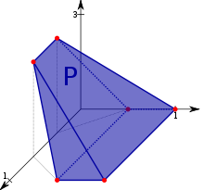
Dynamic Linear Programming
Genobolitics
Objective Coefficients = Fold Changes
Solve the objective function = C
Constrain ObjFun with C
Repeat for every reaction
Max+Min Reactions FCs

Slide 9
Compute Diff Values
Genobolitics
U_{ref} , L_{ref} = avg(U_{i}), avg(L_{i}) for i in healthy samples.
Diff = ((U -U_{ref}) + (L - L_{ref}))/2

Slide 10
Compute Diff Values
Genobolitics
U_{ref} , L_{ref} = avg(U_{i}), avg(L_{i}) for i in healthy samples.
Diff = ((U -U_{ref}) + (L - L_{ref}))/2

Slide 11
Disease Classification
Genobolitics
Genobolitics Pipeline
Nested Cross-Validation
10-Folds
10-Trials
Dimensionality Reduction | PCA 21 components
Classifier | SVC C = 4.641

Slide 12
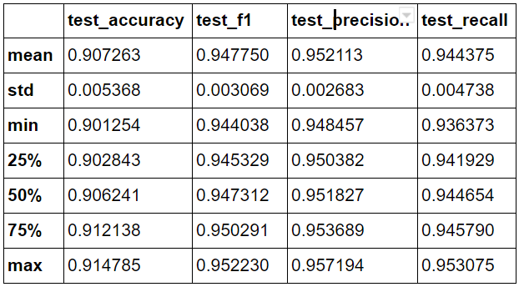
Breast-Cancer Case Study
Genobolitics
UCSC Xena Agilent G4502A
64 Healthy
534 PT & Metastatic
Using Diff Values

Slide 13
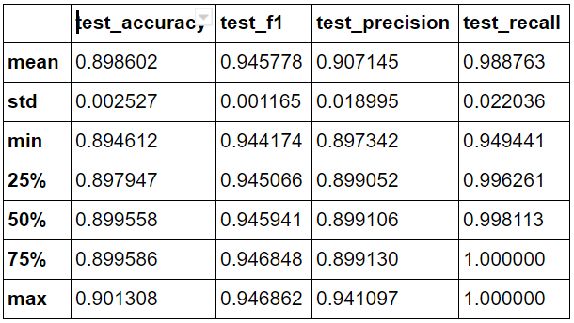
Breast-Cancer Case Study
Genobolitics
Using No Diff Values
Notes:
PT primary tumor

Slide 14
Breast-Cancer Case Study (cont.)
Genobolitics
Most significant pathways (based on Raw-values):
'Nucleotide interconversion', 'Purine synthesis', 'Pyrimidine synthesis', 'Vitamin A metabolism'
Notes:
PT primary tumor

Slide 15
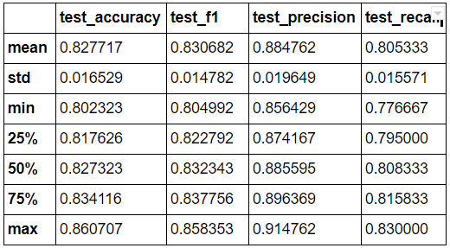
Lung-Cancer Case Study (GDS3257)
Genobolitics
A lung cancer dataset of 107 samples, consisting of 49 healthy, 58 unhealthy samples was used.
Same procedure used in previous study was applied here.

Slide 16
Lung-Cancer Case Study (GDS3257)
Genobolitics

Slide 17
Lung-Cancer Case Study (GDS3257)
Genobolitics
f1 score, precision and recall reported across 10-trials of nested cross-validation (Diff. scores)

Slide 18
Lung-Cancer Case Study (GDS3257)
Genobolitics
f1 score, precision and recall reported across 10-trials of nested cross-validation (Diff. scores)

Slide 19
Lung-Cancer Case Study (GDS3257)
Genobolitics
Most significant pathways:
'Blood group synthesis', 'Cholesterol metabolism', 'Eicosanoid metabolism', 'Fatty acid oxidation',
'Folate metabolism', 'Inositol phosphate metabolism',
'Nucleotide interconversion', 'Phosphatidylinositol phosphate metabolism',
'Pyrimidine synthesis', 'Steroid metabolism',
'Thiamine metabolism', 'Urea cycle'

Slide 20
Clustering
BC healthy | Light Pink
BC Patient | Dark magenta
CC Healthy | Green
CC Patient | Red
LG Healthy | Light Blue
LG Patient | Grey
PC Healthy | Yellow
PC Patient | Orange

Slide 21
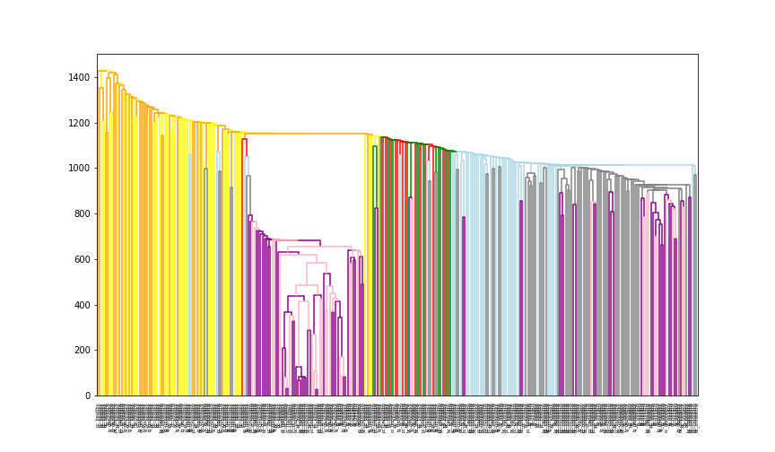
Hierarchical Clustering (Diff)

Slide 22
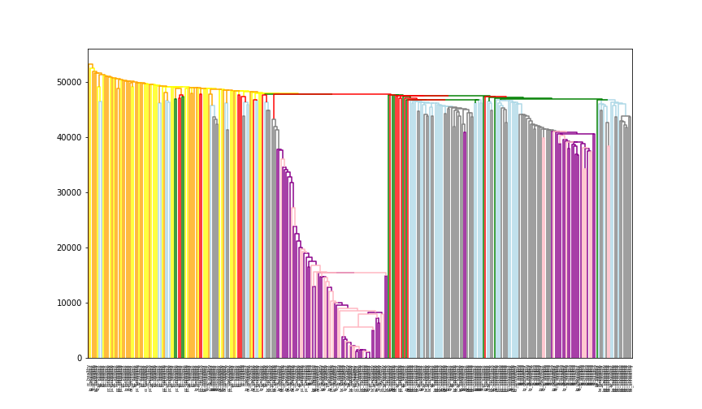
Hierarchical Clustering (Raw)

Slide 23
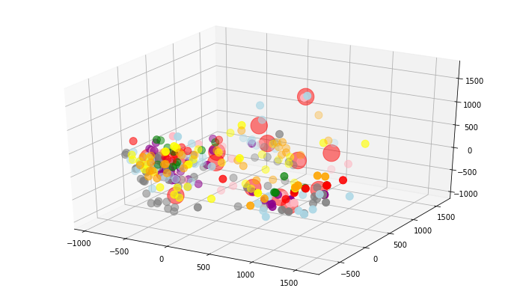
Clustering (PCA diff. score)

Slide 24
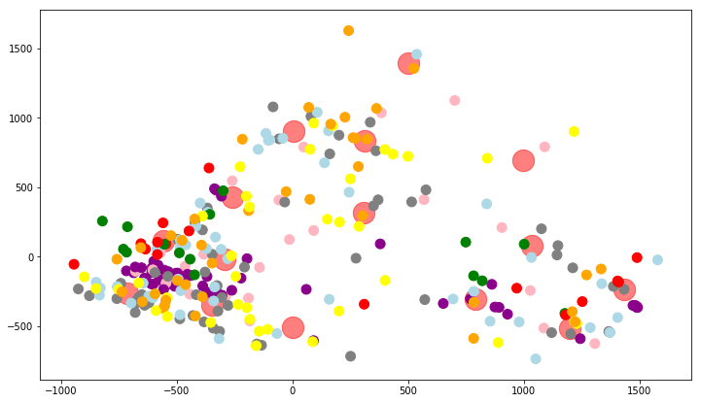
Clustering (PCA diff. score)

Slide 25
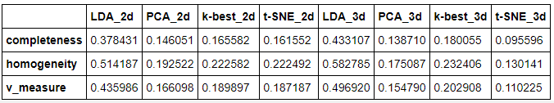
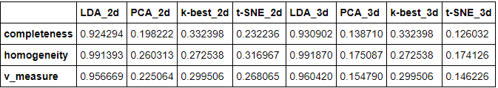
Clustering Metrics Results

Slide 26
Questions

