Slide 1
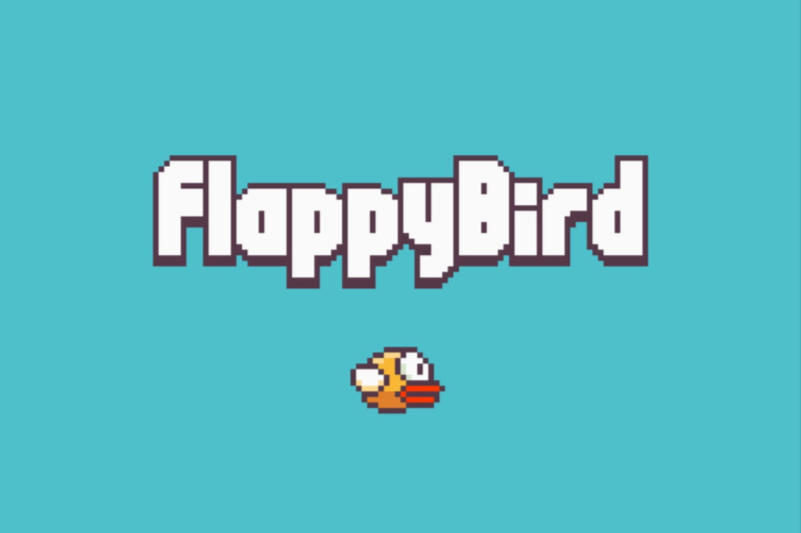
Flappy Bird game
Prepared by
Syed Ammar Zaidi

Slide 2
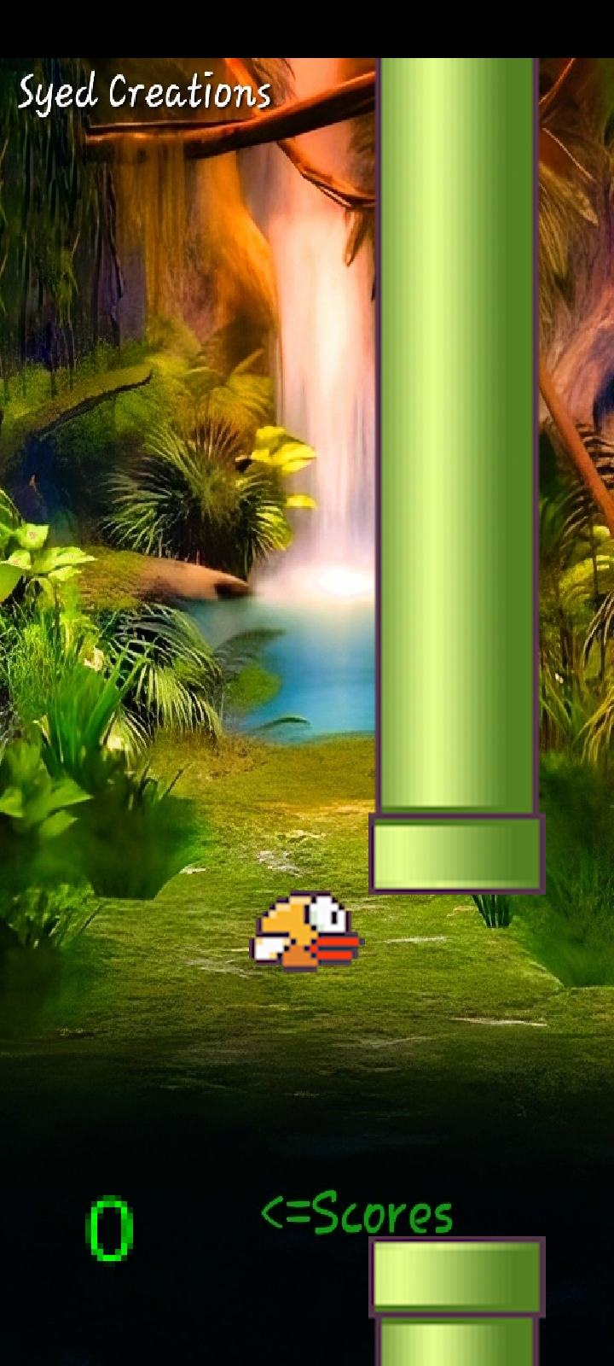
Overview: This Java project is a simple implementation of the popular mobile game Flappy Bird. The code uses the LibGdx library to handle the game's graphics and user input. The main goal of the game is for the player to navigate a bird through a series of pipes by tapping the screen to make the bird fly. The game ends if the bird collides with a pipe or the ground.

Slide 3

What is Android Studio?
Android Studio is an integrated development environment (IDE) for building Android applications. It is the official IDE for Android app development, developed by Google and based on the IntelliJ IDEA Java IDE. Android Studio includes a set of tools for developing and testing Android applications, such as a code editor, a debugger, and an emulator. It also provides support for integrating with other tools and frameworks, such as Git for version control, Gradle for build automation, and TestNG for testing. Android Studio makes it easy for developers to create and test Android apps, and it is a popular choice among developers for building Android apps.

Slide 4

What is libGdx?
LibGDX is a cross-platform game development framework written in Java. It allows developers to write their code once and deploy it to multiple platforms, including Android, iOS, desktop, and the web. LibGDX provides a set of APIs for creating games, including support for graphics, audio, input, and networking. It also includes a number of tools for building and testing games, making it a comprehensive solution for game development on multiple platforms.

Slide 5

Purpose
The purpose of the code you provided is to create a Flappy Bird-like game using the LibGDX library in Java. The game involves a player controlling a bird that flies through obstacles in the form of tubes. The player scores points by successfully navigating the bird through the tubes without colliding with them. The game ends when the bird collides with a tube or goes off the top or bottom of the screen.

Slide 6
Purpose (Continued)
The code sets up a number of variables and objects to store the necessary information for the game, such as the textures for the game elements, the position and movement of the bird, and the score. It also includes a number of methods for rendering and updating the game state, such as the create and render methods.

Slide 7
How code works?
The program consists of a single class called FlappyBird, which extends the ApplicationAdapter class from the LibGDX library. This class contains a number of methods that are responsible for different aspects of the game, such as rendering the graphics, handling user input, and updating the game state.
The main method that controls the gameplay is the render method, which is called repeatedly by the LibGDX game loop. This method handles user input, updates the game state, and renders the graphics for each frame.

Slide 8
How code works? (Continued)
The game state is controlled by the gameState variable, which can have one of three values: 0 for the start menu, 1 for the playing state, and 2 for the game over state. The render method uses this variable to determine which actions to take each frame.
In the playing state, the program uses the velocity variable to control the upward movement of the bird when the user taps the screen. The gravity variable is used to increase the bird's downward velocity over time, causing it to fall back down towards the ground.

Slide 9
How code works? (Continued)
The program uses arrays of Texture objects to store the images for the bird and the pipes, and a SpriteBatch object to draw these images to the screen. The program also uses a BitmapFont object to render the score to the screen.
The program uses a Circle object to represent the collision area for the bird, and Rectangle objects to represent the collision areas for the pipes. The program uses the Intersector class from the LibGDX library to detect collisions between these objects.

Slide 10
Structure:
The FlappyBird class contains several instance variables that store the state of the game, such as the gameState and score variables. It also contains a number of objects that are used for rendering and handling user input, such as the batch, font, and birdCircle objects.
The class has several methods that are called at different points in the game's lifecycle, such as the create and dispose methods, which are called when the game is first created and when it is closed, respectively.

Slide 11
Structure (Continued):
The main gameplay loop is implemented in the render method, which is called repeatedly by the LibGDX game loop. This method contains a number of conditional statements that determine which actions to take based on the current value of the gameState variable.
The updateGameState method is called by the render method to update the game state based on the current position of the bird and the pipes. If the bird collides with a pipe or the ground, the gameState is set to 2 and the game is over.

Slide 12
Structure (Continued):
The updateScore method is called by the updateGameState method to update the score whenever the bird passes through a pair of pipes.
The startGame method is called when the game is first started or when the player restarts after a game over. It resets all of the relevant game state variables to their starting values.

Slide 13
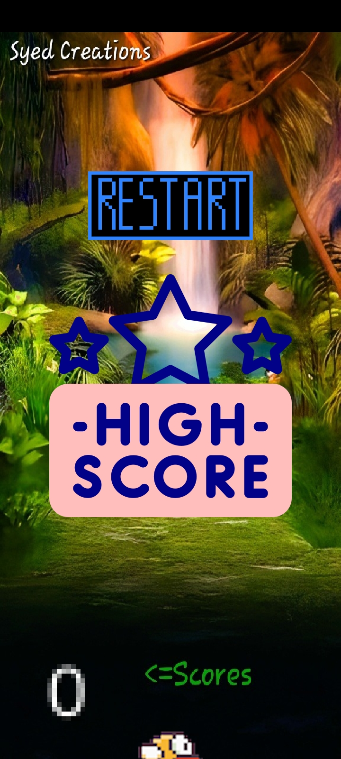
Detection of Collisions and Game Over:
The game is over when the bird collides with a tube or goes off the screen. The collision is detected by checking the intersection between the bird's collision circle and the tube collision boxes using the Intersector class. The game over image is displayed when the game is over.

Slide 14
Testing and Debugging
Testing the program involved playing through the game and verifying that the bird behaves as expected, the pipes are generated and move correctly,
Future Improvements:
To improve the game, some potential extensions could be to add more obstacles, such as moving walls or changing the gap size. The game could also be made more challenging by increasing the speed or adding more tubes. Other enhancements could include adding a main menu, leaderboards, and different game modes.

