Slide 1
Clock and Data Recovery over Optical Links and Networks
Ammar Shaqeel
Supervisor: Dr Georgios Zervas

Slide 2
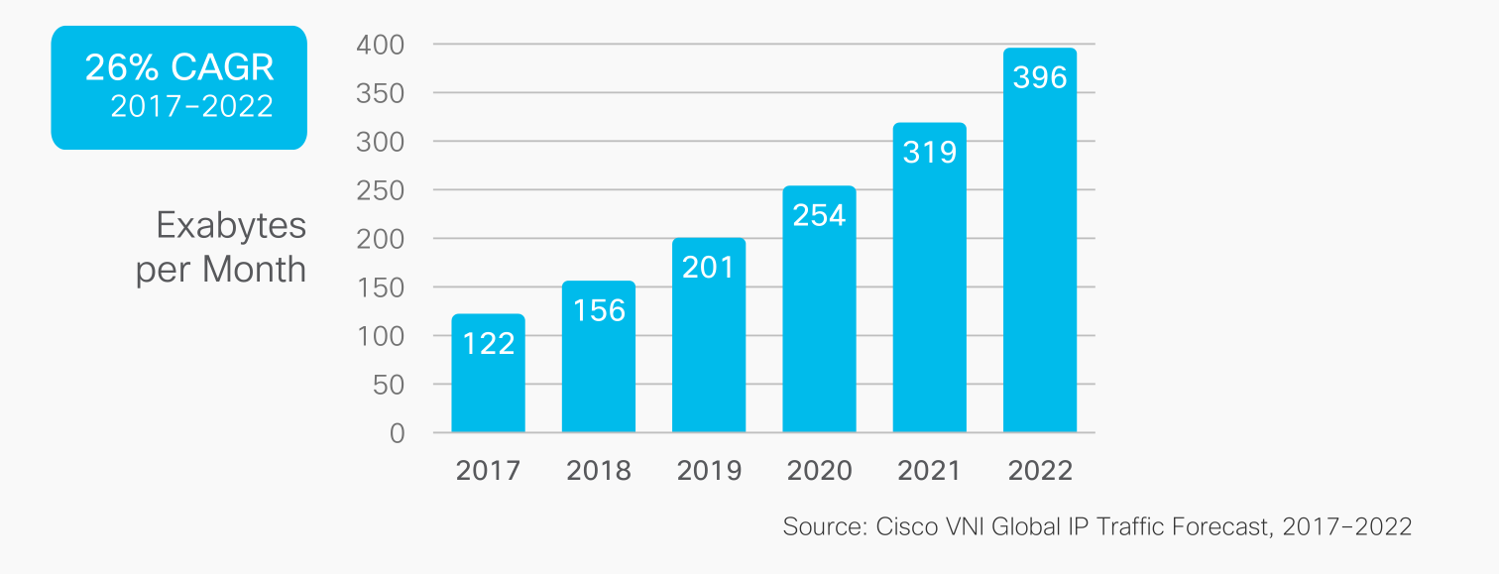
The Internet is Pretty Popular

Slide 3
Data Centres Must Keep Pace
Double bandwidth at the same price point.
Approaching Limits of Current Technologies.
Physical Limits
Optical Switching.
Higher throughput
Lower Latency
Cheaper

Slide 4
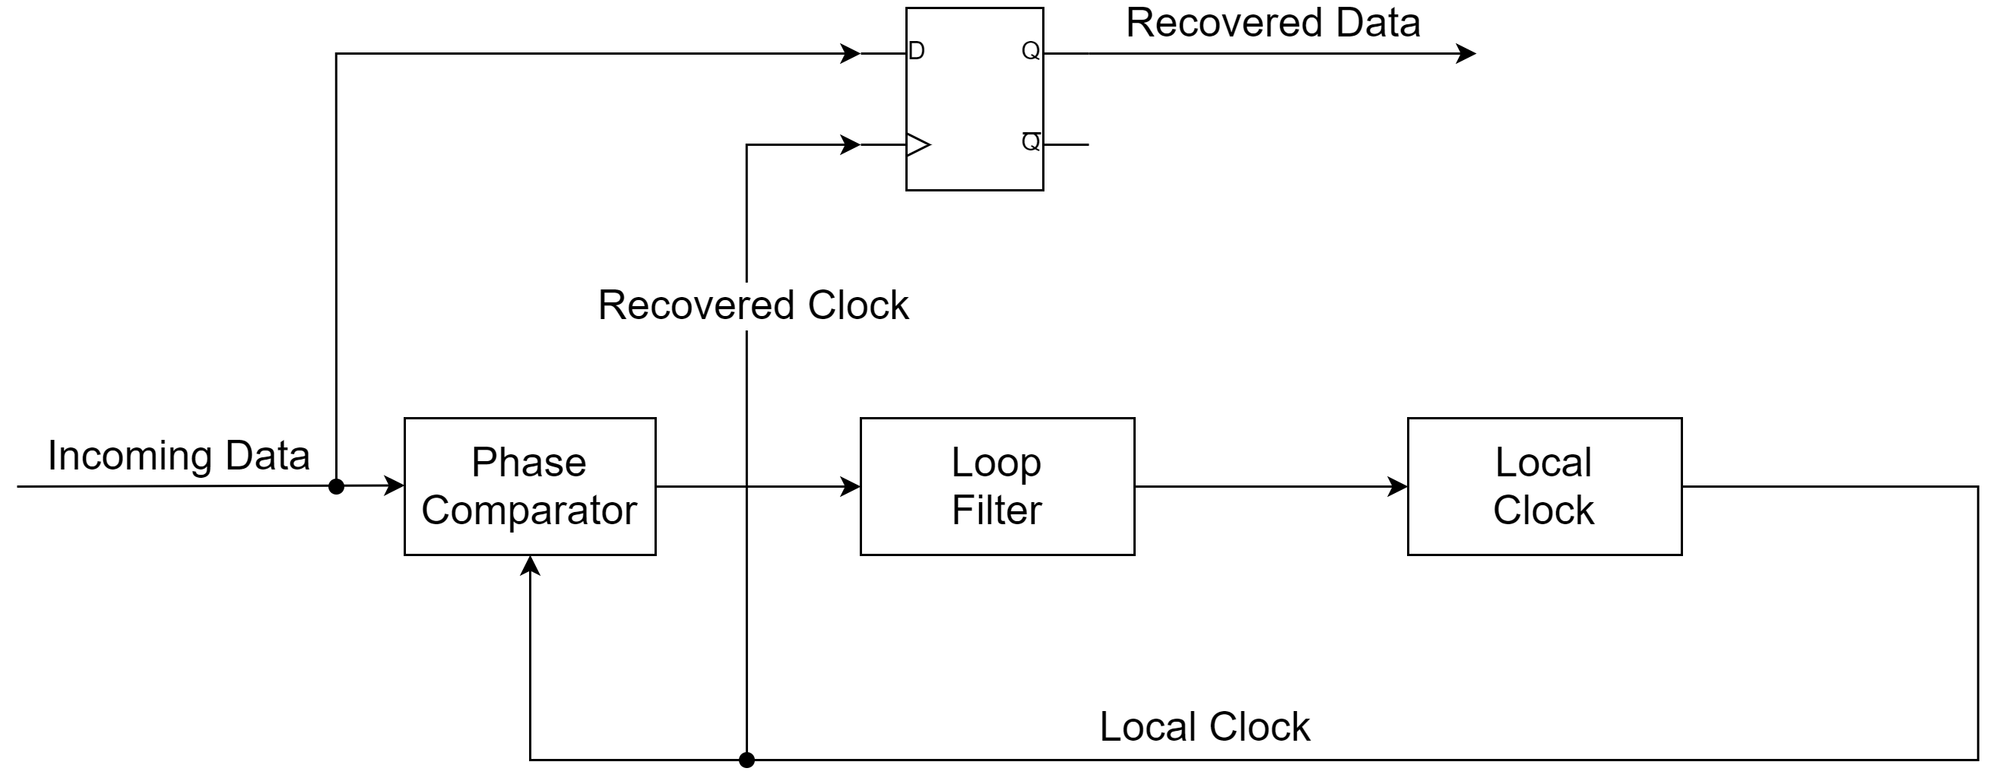
Clock and Data Recovery (CDR) Locking Time
CDR

Slide 5
Limiting Factor
Physical links between transmitter-receiver pairs.
New link formed on switch
CDR Must re-lock every time.
Tens – Hundreds ns.
The more you switch – the worse it becomes…
Exact performance depends on the parameters

Slide 6
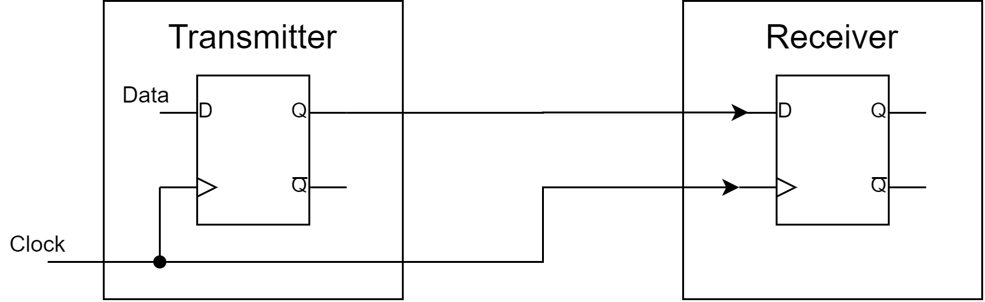
Source Synchronous Communication

Slide 7
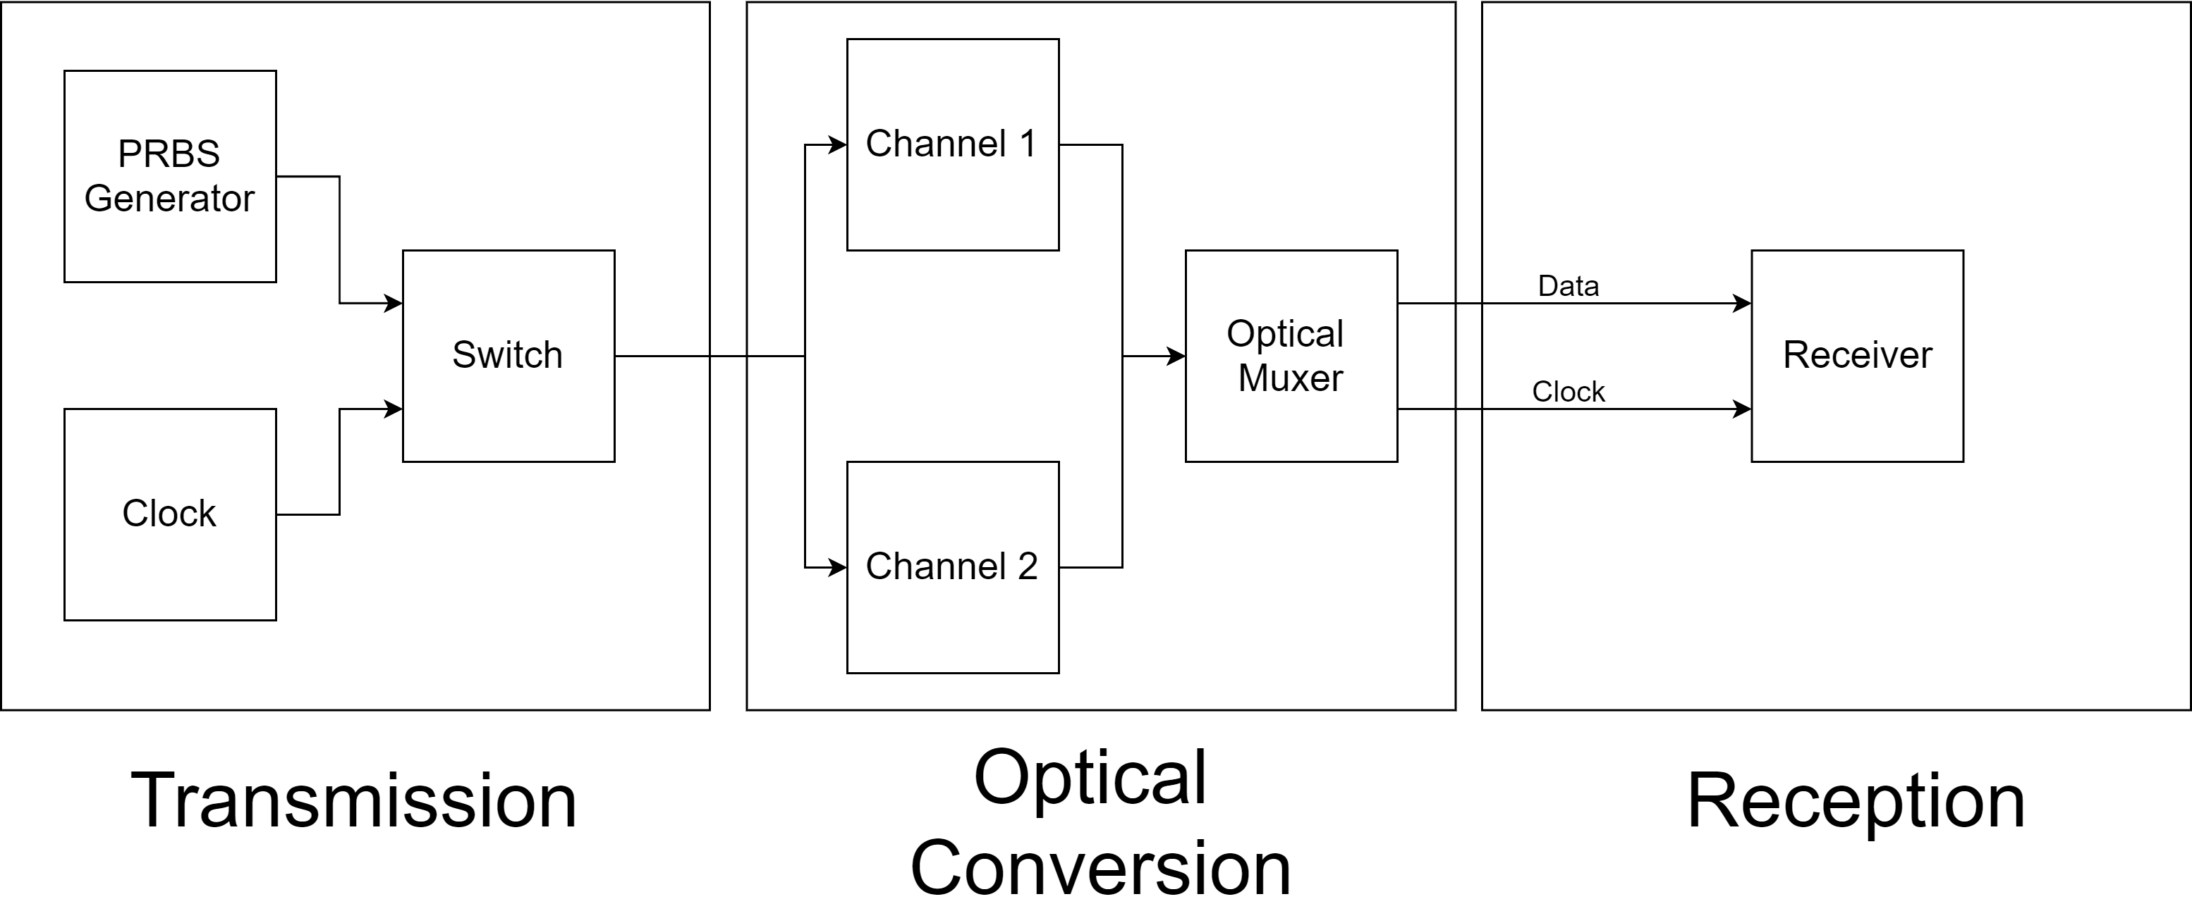
Proposed System

Slide 8
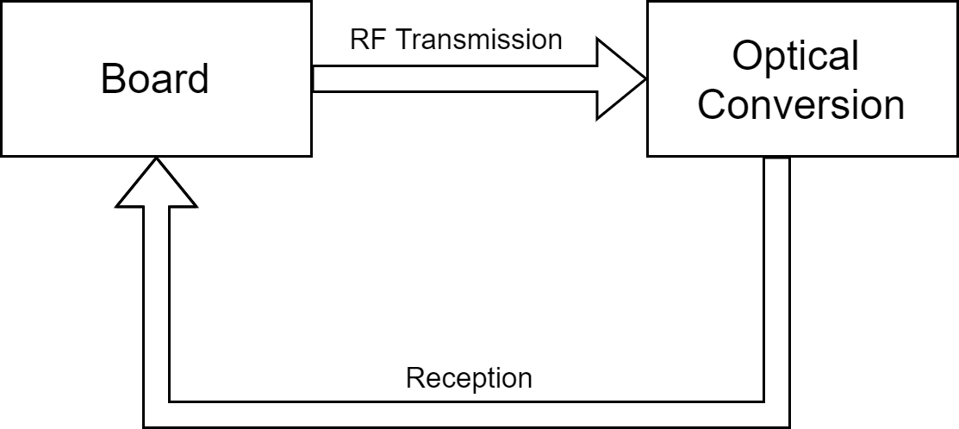
Proposed System

Slide 9
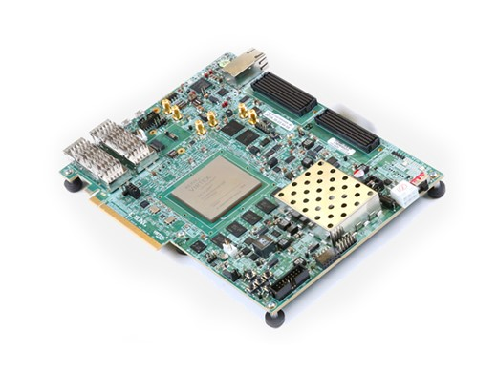
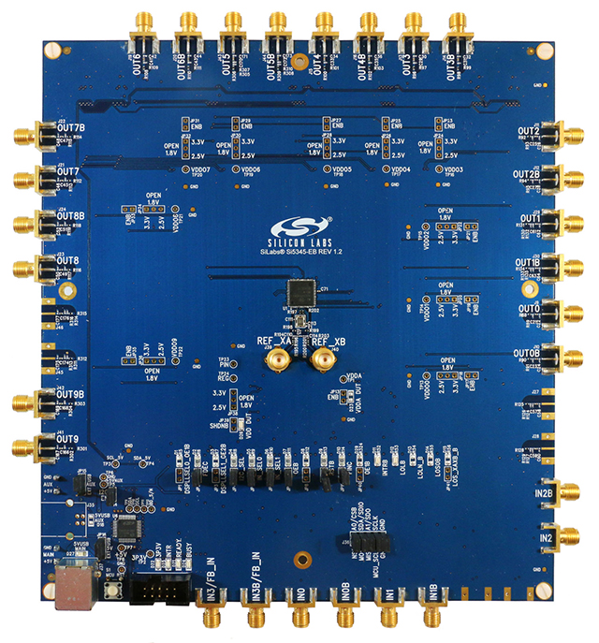
Transmission and Reception
Si5345 Clock
Xilinx VCU 118 Board

Slide 10
GTY Parallel To Serial Transceivers
A B C D E
A B C D E
A B C D E
TX
RX

Slide 11
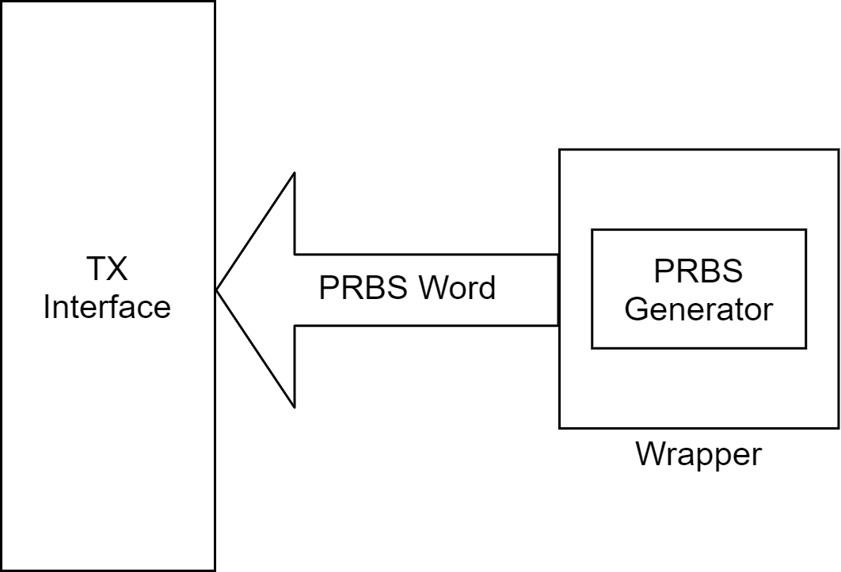
TX Interface

Slide 12
Two Channel Switching
A
B
C
D
E
Normal Channel:
A
C
E
Channel A:
B
D
Channel B:

Slide 13
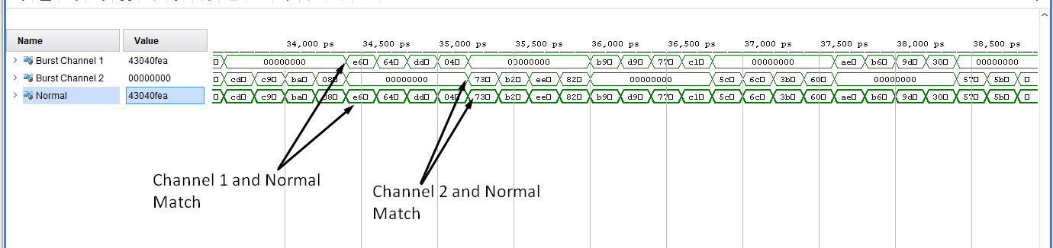
Two Channel Switching

Slide 14
One Channel Switching
A
B
C
D
E
Normal Channel:
A
B
C
Burst Channel:

Slide 15
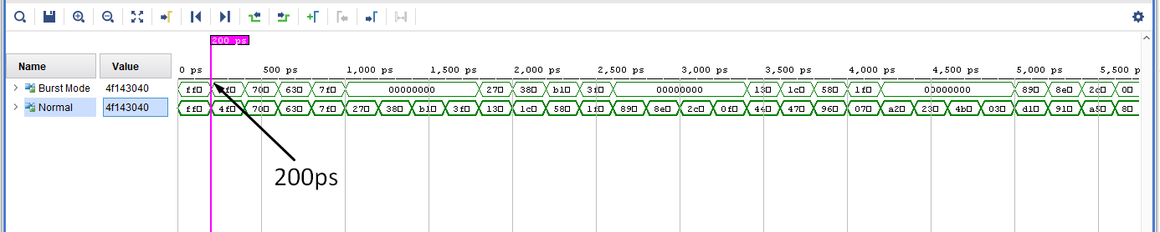
One Channel

Slide 16
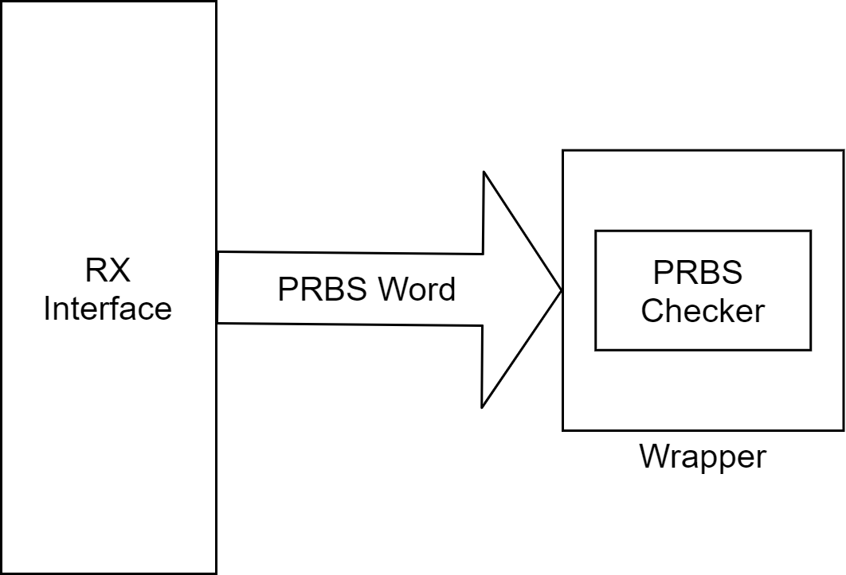
RX Interface

Slide 17
Checking
Two Channel Case: No Change.
(RX still receives full sequence)
Single Channel: Not working.
(Small errors)
In reality would probably do post-processing

Slide 18
Source Synchronous Reception
Disabled CDR.
RX locked to local clock
Becomes a shift register
BER becomes very large
Not able to read phase output.
Unsuccessful.
A lot of circuitry cannot be bypassed
Not much flexibility

Slide 19
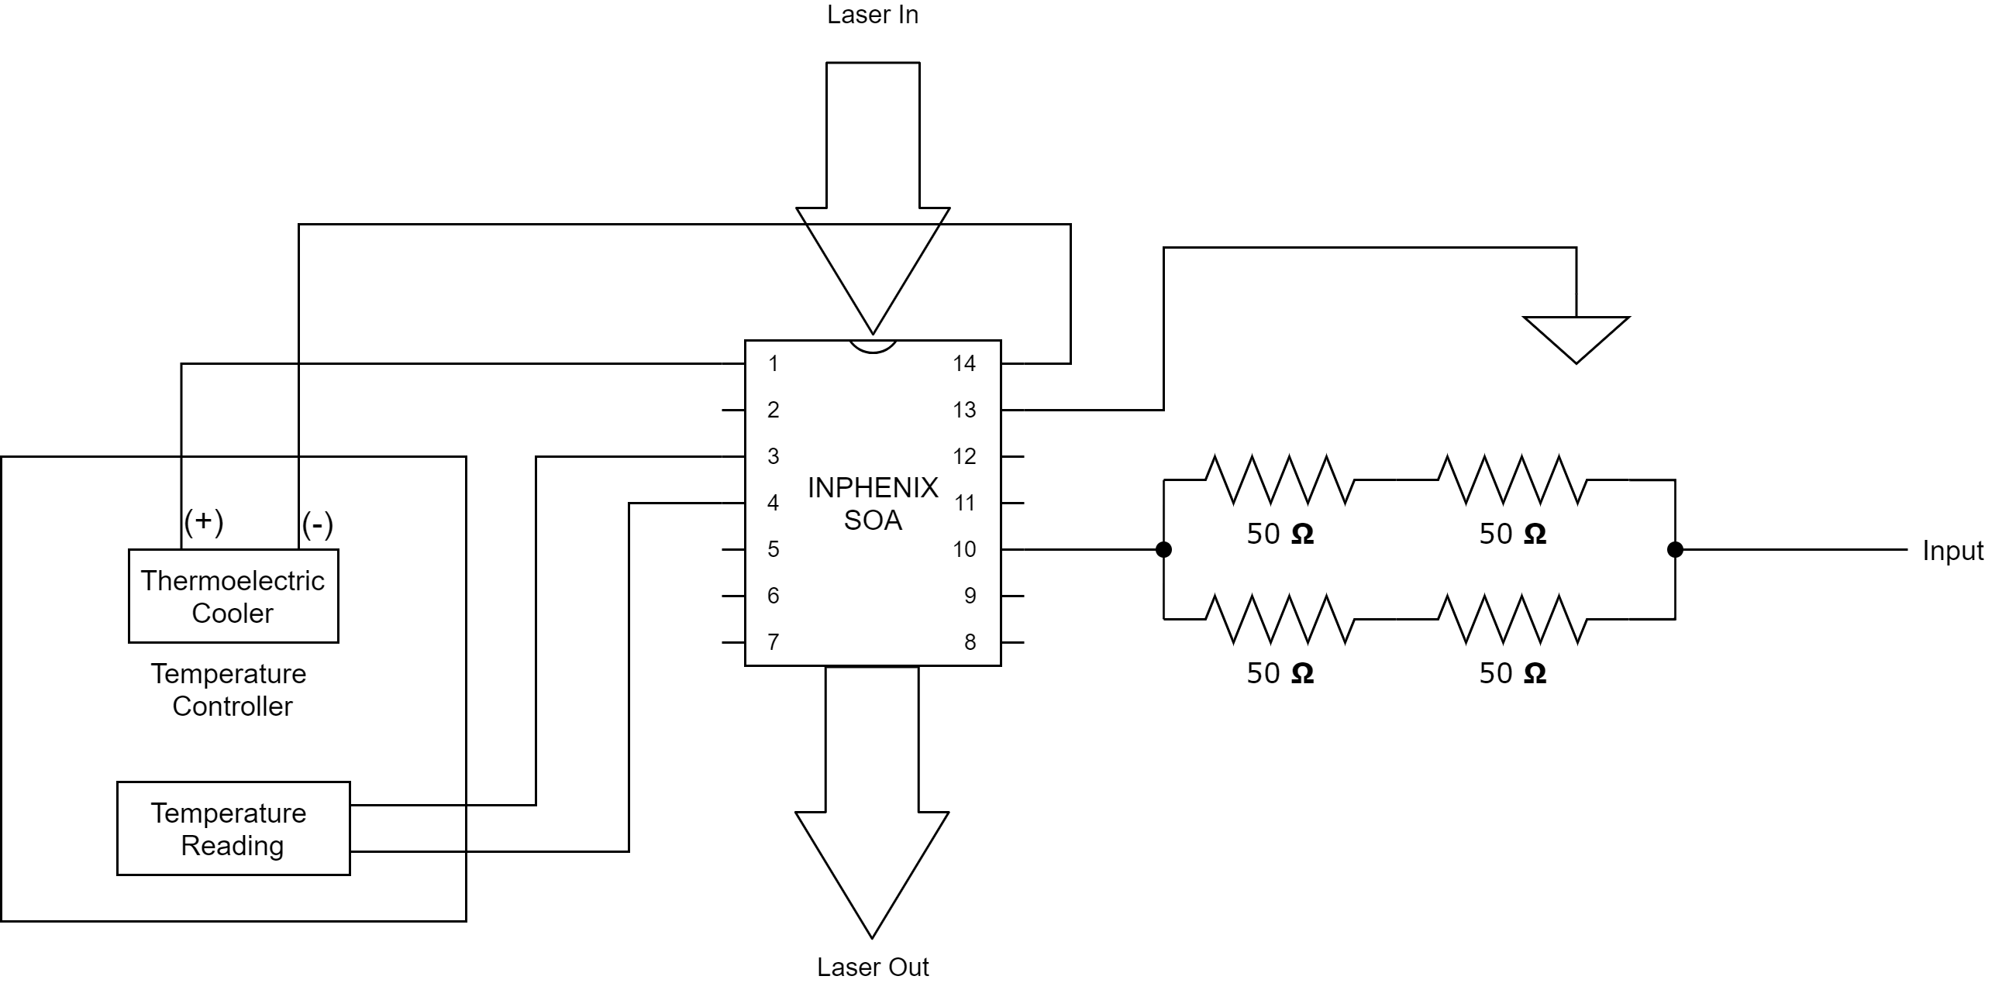
Optical Conversion

Slide 20
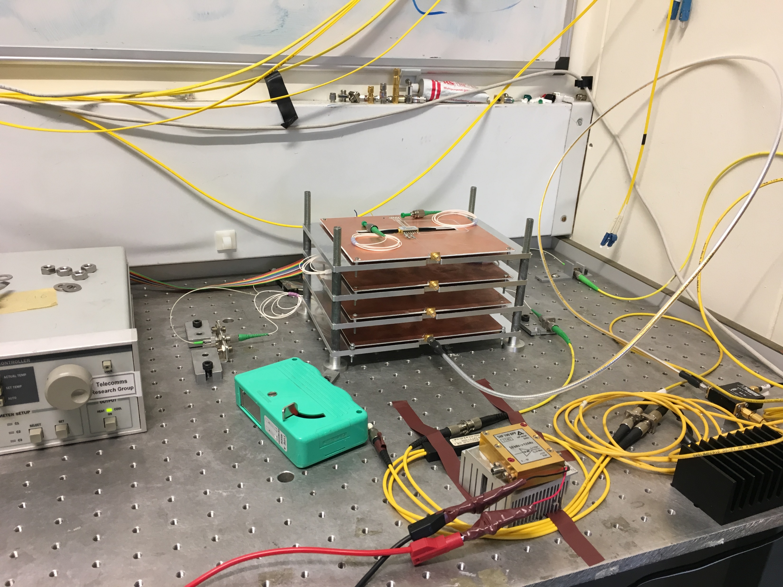
Full Setup

Slide 21
Summary
Overall incomplete.
Able to demonstrate burst transmission and reception (in simulation).
Not able to run receiver source synchronously.
Hardware for optical conversion was prepared.
In collaboration with other members of the group.
Was used in a recent paper.

Slide 22
Acknowledgments
Dr Georgios Zervas
Vaibhawa Mishra
Kari Clark

Slide 23
Questions?

