Slide 1

Instructor Kick-off
Analyze A/B Test Results
Ammar Yasser
© 2019 Udacity. All rights reserved.

Slide 2
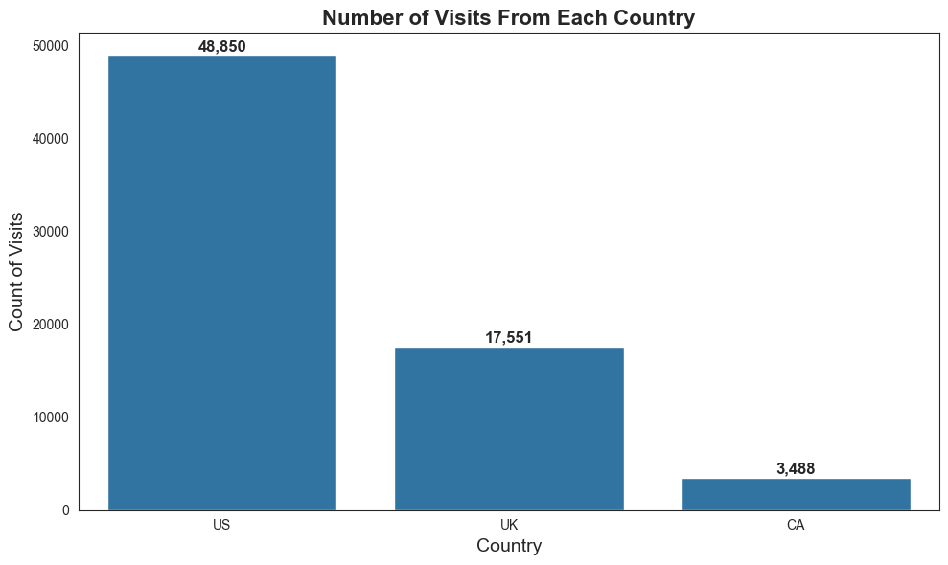
How Was The Experiment Implemented?​
Total Variant Visitors: 35211 Total Control Participants:​ 34678​

Slide 3
Conversion Rates
 | U.S. | U.K. | CA
Control | 10.7% | 10% | 9%
Treatment | 15.8% | 14% | 15%
The Treatment group generally had higher conversion rates than the Cntrol group across all countries. In the US, UK, and Canada, the Treatment group outperformed the Control group by a noticeable margin. This suggests that the new page (Treatment) leads to better conversion rates, though country differences may also play a role, which would require further testing to confirm.

Slide 4
Experiment Results
Treatment Conversion Rate: 15.53%
Control Conversion Rate:​ 10.53%
Delta in Treatment vs. Control Conversion Rate:​ 5.00%
p-value:​ 0.000
Conclusion:​ the new page (Treatment) has a statistically significant higher conversion rate than the old page (Control), with a p-value of 0.000, indicating that the difference is unlikely to be due to random chance. From a practical perspective, this suggests that the new page performs better in converting users, which could lead to increased user engagement or sales. Therefore, implementing the new page could be a beneficial step in improving overall conversion rates.

Slide 5
Country Results
Conclusion:​ there are noticeable differences in conversion rates between the treatment and Control groups across countries. In the US, the Treatment group has a higher conversion rate of 15.8%, compared to the Control group’s 10.7%. The Treatment group in the UK also performs slightly better with a 14% conversion rate versus 10% for the Control group, and in Canada, the Treatment group significantly outperforms with 15% compared to 9%. These results suggest that the new page (Treatment) generally leads to better performance across all countries, though further statistical testing is needed to confirm whether these differences are statistically significant.

