Slide 1
Back-propagation & Convolutional Neural Networks
Fei-Fei Li & Justin Johnson & Serena Yeung Stanford University

Slide 2
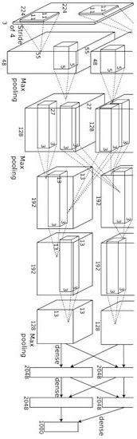
Convolutional network (AlexNet)
input image
weights loss
Figure copyright Alex Krizhevsky, Ilya Sutskever, and Geoffrey Hinton, 2012. Reproduced with permission.
Lecture 2 - 4

Slide 3
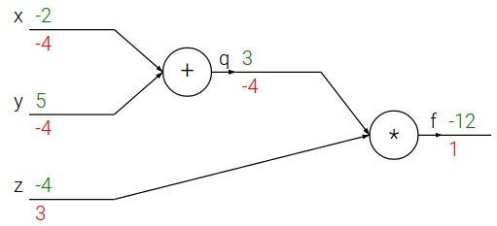

Backpropagation: a simple example
e.g. x = -2, y = 5, z = -4

Slide 4





Backpropagation: a simple example
e.g. x = -2, y = 5, z = -4
Want:

Slide 5

Backpropagation: a simple example
e.g. x = -2, y = 5, z = -4
Want:

Slide 6
Backpropagation: a simple example
e.g. x = -2, y = 5, z = -4
Want:

Slide 7

Backpropagation: a simple example
e.g. x = -2, y = 5, z = -4
Want:

Slide 8
Backpropagation: a simple example
e.g. x = -2, y = 5, z = -4
Want:

Slide 9

Backpropagation: a simple example
e.g. x = -2, y = 5, z = -4
Want:

Slide 10
Backpropagation: a simple example
e.g. x = -2, y = 5, z = -4
Want:

Slide 11

Backpropagation: a simple example
e.g. x = -2, y = 5, z = -4
Want:

Slide 12


Backpropagation: a simple example
e.g. x = -2, y = 5, z = -4
Chain rule:
Want:

Slide 13

Backpropagation: a simple example
e.g. x = -2, y = 5, z = -4
Want:

Slide 14
Backpropagation: a simple example
e.g. x = -2, y = 5, z = -4
Chain rule:
Want:

Slide 15

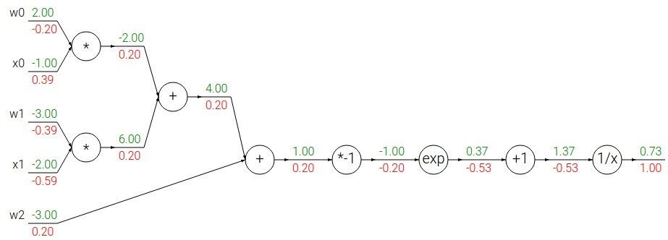
Another example:

Slide 16
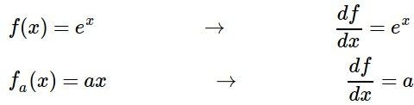
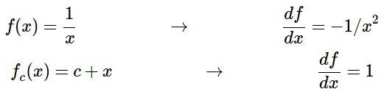
Another example:

Slide 17
Another example:

Slide 18

Another example:

Slide 19
Another example:

Slide 20

Another example:

Slide 21
Another example:

Slide 22

Another example:

Slide 23
Another example:

Slide 24
Another example:
(-1) * (-0.20) = 0.20

Slide 25
Another example:

Slide 26
Another example:
[local gradient] x [upstream gradient] [1] x [0.2] = 0.2
[1] x [0.2] = 0.2 (both inputs!)

Slide 27
Another example:

Slide 28
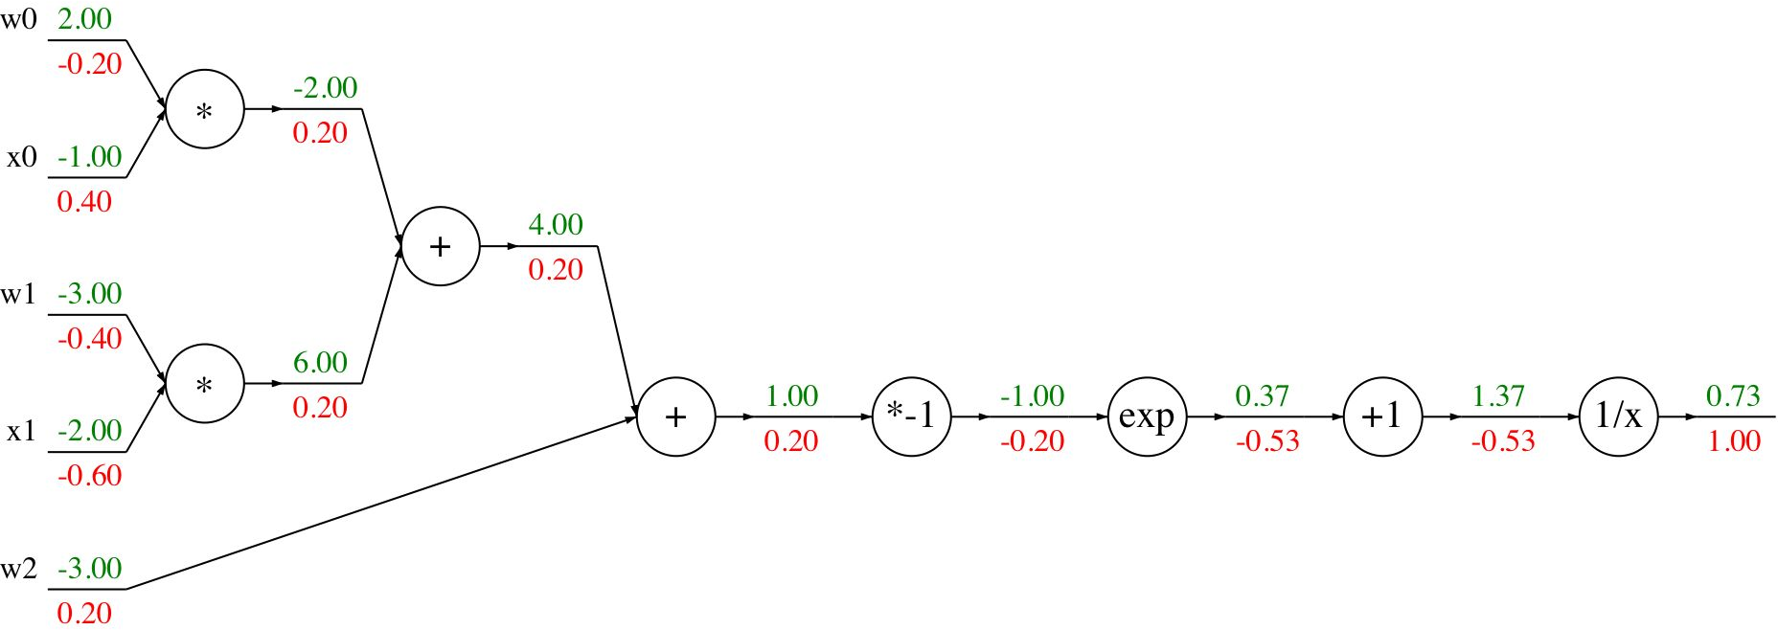
Another example:
[local gradient] x [upstream gradient] x0: [2] x [0.2] = 0.4
w0: [-1] x [0.2] = -0.2

Slide 29
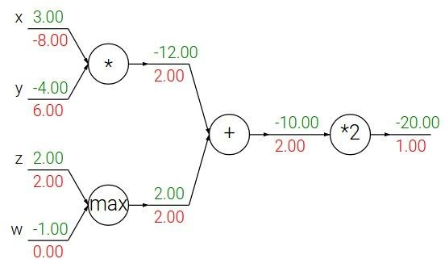
Patterns in backward flow
add gate: gradient distributor

Slide 30
Patterns in backward flow
add gate: gradient distributor Q: What is a max gate?

Slide 31
Patterns in backward flow
add gate: gradient distributor
max gate: gradient router

Slide 32
Patterns in backward flow
add gate: gradient distributor
max gate: gradient router Q: What is a mul gate?

Slide 33
Patterns in backward flow
add gate: gradient distributor max gate: gradient router mul gate: gradient switcher

Slide 34
Vectorized operations
f(x) = max(0,x) (elementwise)
4096-d
input vector
4096-d
output vector

Slide 35

Vectorized operations
f(x) = max(0,x) (elementwise)
Jacobian matrix
4096-d
input vector
4096-d
output vector

Slide 36
Vectorized operations
f(x) = max(0,x) (elementwise)
Jacobian matrix
4096-d
input vector
4096-d
output vector

Slide 37
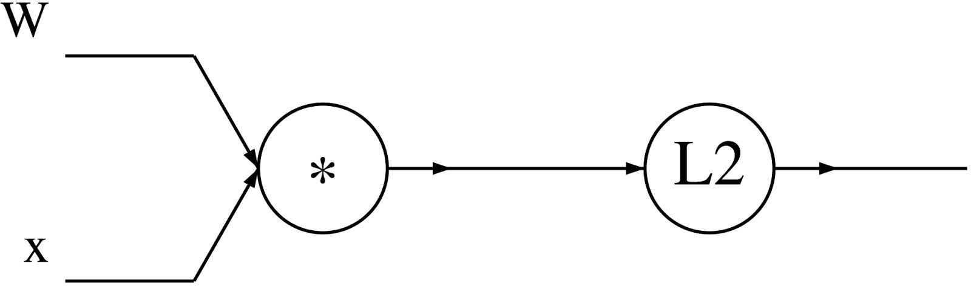
A vectorized example:

Slide 38


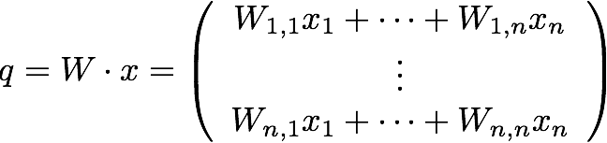
A vectorized example:

Slide 39

A vectorized example:

Slide 40
A vectorized example:

Slide 41


A vectorized example:

Slide 42

A vectorized example:

Slide 43


A vectorized example:

Slide 44
A vectorized example:

Slide 45
Convolutional Neural Networks

Slide 46

Fully Connected Layer
32x32x3 image -> stretch to 3072 x 1
input
activation
1
1
10 x 3072
weights
3072
10
Fei-Fei Li & Justin Johnson & Serena Yeung Lecture 5 - April 18, 2017

Slide 47
Convolution Layer
32x32x3 image -> preserve spatial structure
32
height
32
depth
width
3
Fei-Fei Li & Justin Johnson & Serena Yeung Lecture 5 - April 18, 2017

Slide 48
Convolution Layer
32x32x3 image
5x5x3 filter
32
Convolve the filter with the image
i.e. “slide over the image spatially, computing dot products”
32
3
Fei-Fei Li & Justin Johnson & Serena Yeung Lecture 5 - April 18, 2017

Slide 49
Convolution Layer
Filters always extend the full depth of the input volume
32x32x3 image
5x5x3 filter
32
Convolve the filter with the image
32
3
Fei-Fei Li & Justin Johnson & Serena Yeung Lecture 5 - April 18, 2017

Slide 50
Convolution Layer
activation map
32x32x3 image 5x5x3 filter
32
28
convolve (slide) over all spatial locations
32
28
3
1
Fei-Fei Li & Justin Johnson & Serena Yeung Lecture 5 - April 18, 2017

Slide 51
consider a second, green filter
Convolution Layer
32x32x3 image 5x5x3 filter
activation maps
32
28
convolve (slide) over all spatial locations
32
28
3
1
Lecture 5 - 33
Fei-Fei Li & Justin Johnson & Serena Yeung Lecture 5 - April 18, 2017

Slide 52
For example, if we had 6 5x5 filters, we’ll get 6 separate activation maps:
activation maps
32
28
Convolution Layer
32
28
3
6
We stack these up to get a “new image” of size 28x28x6!
Fei-Fei Li & Justin Johnson & Serena Yeung Lecture 5 - April 18, 2017

Slide 53
Preview: ConvNet is a sequence of Convolution Layers, interspersed with activation functions
32
28
CONV, ReLU
e.g. 6 5x5x3 filters
32
28
3
6
Fei-Fei Li & Justin Johnson & Serena Yeung Lecture 5 - April 18, 2017

Slide 54
Preview: ConvNet is a sequence of Convolutional Layers, interspersed with activation functions
32
28
24
….
CONV, ReLU
e.g. 6 5x5x3 filters
CONV, ReLU
e.g. 10 5x5x6 filters
CONV, ReLU
32
28
24
3
6
10
Fei-Fei Li & Justin Johnson & Serena Yeung Lecture 5 - April 18, 2017

Slide 55
A closer look at spatial dimensions:
7
7x7 input (spatially) assume 3x3 filter
7
Fei-Fei Li & Justin Johnson & Serena Yeung Lecture 5 - April 18, 2017

Slide 56
A closer look at spatial dimensions:
7
7x7 input (spatially) assume 3x3 filter
7
Fei-Fei Li & Justin Johnson & Serena Yeung Lecture 5 - April 18, 2017

Slide 57
A closer look at spatial dimensions:
7
7x7 input (spatially) assume 3x3 filter
7
Fei-Fei Li & Justin Johnson & Serena Yeung Lecture 5 - April 18, 2017

Slide 58
A closer look at spatial dimensions:
7
7x7 input (spatially) assume 3x3 filter
7
Fei-Fei Li & Justin Johnson & Serena Yeung Lecture 5 - April 18, 2017

Slide 59
A closer look at spatial dimensions:
7
7x7 input (spatially) assume 3x3 filter
=> 5x5 output
7
Fei-Fei Li & Justin Johnson & Serena Yeung Lecture 5 - April 18, 2017

Slide 60
A closer look at spatial dimensions:
7
7x7 input (spatially) assume 3x3 filter applied with stride 2
7
Fei-Fei Li & Justin Johnson & Serena Yeung Lecture 5 - April 18, 2017

Slide 61
A closer look at spatial dimensions:
7
7x7 input (spatially) assume 3x3 filter applied with stride 2
=> 3x3 output!
7
Fei-Fei Li & Justin Johnson & Serena Yeung Lecture 5 - April 18, 2017

Slide 62
A closer look at spatial dimensions:
7
7x7 input (spatially) assume 3x3 filter applied with stride 3?
7
Fei-Fei Li & Justin Johnson & Serena Yeung Lecture 5 - April 18, 2017

Slide 63
A closer look at spatial dimensions:
7
7x7 input (spatially) assume 3x3 filter applied with stride 3?
7
doesn’t fit!
cannot apply 3x3 filter on 7x7 input with stride 3.
Fei-Fei Li & Justin Johnson & Serena Yeung Lecture 5 - April 18, 2017

Slide 64
N
Output size:
(N - F) / stride + 1
 |  |  | F
 | F
e.g. N = 7, F = 3:
stride 1 => (7 - 3)/1 + 1 = 5
stride 2 => (7 - 3)/2 + 1 = 3
stride 3 => (7 - 3)/3 + 1 = 2.33 :\
N
Fei-Fei Li & Justin Johnson & Serena Yeung Lecture 5 - April 18, 2017

Slide 65
In practice: Common to zero pad the border
0 | 0 | 0 | 0 | 0 | 0
0
0
0
0
e.g. input 7x7
3x3 filter, applied with stride 1
pad with 1 pixel border => what is the output?
(recall:)
(N - F) / stride + 1
Fei-Fei Li & Justin Johnson & Serena Yeung Lecture 5 - April 18, 2017

Slide 66
In practice: Common to zero pad the border
0 | 0 | 0 | 0 | 0 | 0
0
0
0
0
e.g. input 7x7
3x3 filter, applied with stride 1
pad with 1 pixel border => what is the output?
7x7 output!
Fei-Fei Li & Justin Johnson & Serena Yeung Lecture 5 - April 18, 2017

Slide 67
In practice: Common to zero pad the border
0 | 0 | 0 | 0 | 0 | 0
0
0
0
0
e.g. input 7x7
3x3 filter, applied with stride 1
pad with 1 pixel border => what is the output?
7x7 output!
in general, common to see CONV layers with stride 1, filters of size FxF, and zero-padding with (F-1)/2. (will preserve size spatially)
e.g. F = 3 => zero pad with 1 F = 5 => zero pad with 2 F = 7 => zero pad with 3
Fei-Fei Li & Justin Johnson & Serena Yeung Lecture 5 - April 18, 2017

Slide 68
Remember back to…
E.g. 32x32 input convolved repeatedly with 5x5 filters shrinks volumes spatially! (32 -> 28 -> 24 ...). Shrinking too fast is not good, doesn’t work well.
32
28
24
….
CONV, ReLU
e.g. 6 5x5x3 filters
CONV, ReLU
e.g. 10 5x5x6 filters
CONV, ReLU
32
28
24
3
6
10
Fei-Fei Li & Justin Johnson & Serena Yeung Lecture 5 - April 18, 2017

Slide 69
Examples time:
Input volume: 32x32x3
10 5x5 filters with stride 1, pad 2
Output volume size: ?
Fei-Fei Li & Justin Johnson & Serena Yeung Lecture 5 - April 18, 2017

Slide 70
Examples time:
Input volume: 32x32x3
10 5x5 filters with stride 1, pad 2
Output volume size:
(32+2*2-5)/1+1 = 32 spatially, so
32x32x10
Fei-Fei Li & Justin Johnson & Serena Yeung Lecture 5 - April 18, 2017

Slide 71
Examples time:
Input volume: 32x32x3
10 5x5 filters with stride 1, pad 2
Number of parameters in this layer?
Fei-Fei Li & Justin Johnson & Serena Yeung Lecture 5 - April 18, 2017

Slide 72
Examples time:
Input volume: 32x32x3
10 5x5 filters with stride 1, pad 2
Number of parameters in this layer? each filter has 5*5*3 + 1 = 76 params
=> 76*10 = 760
(+1 for bias)
Fei-Fei Li & Justin Johnson & Serena Yeung Lecture 5 - April 18, 2017

Slide 73
MAX POOLING
Single depth slice
1 | 1 | 2 | 4
5 | 6 | 7 | 8
3 | 2 | 1 | 0
1 | 2 | 3 | 4
x
max pool with 2x2 filters and stride 2
6 | 8
3 | 4
y
Fei-Fei Li & Justin Johnson & Serena Yeung Lecture 5 - April 18, 2017

Slide 74
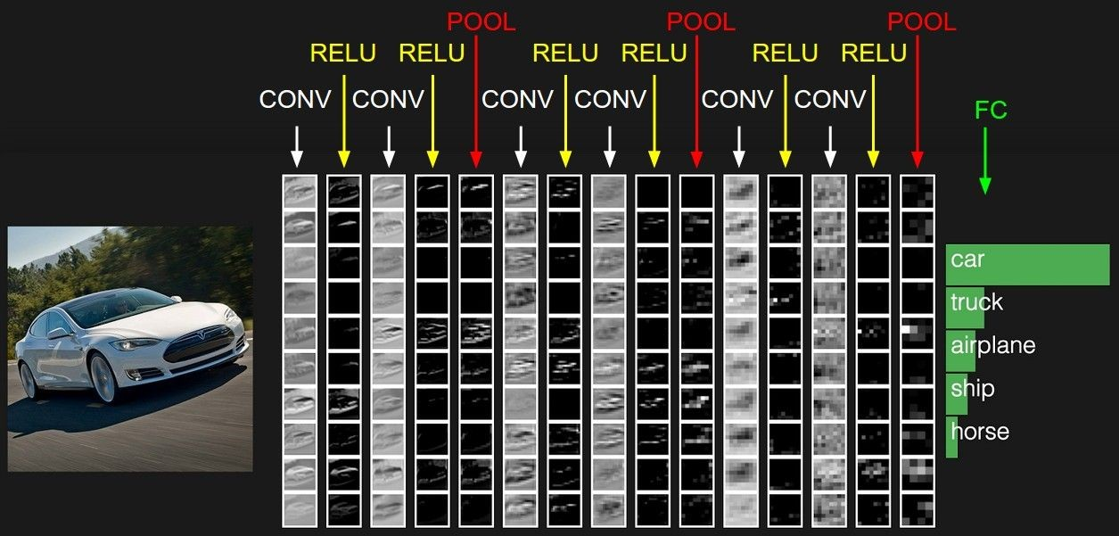
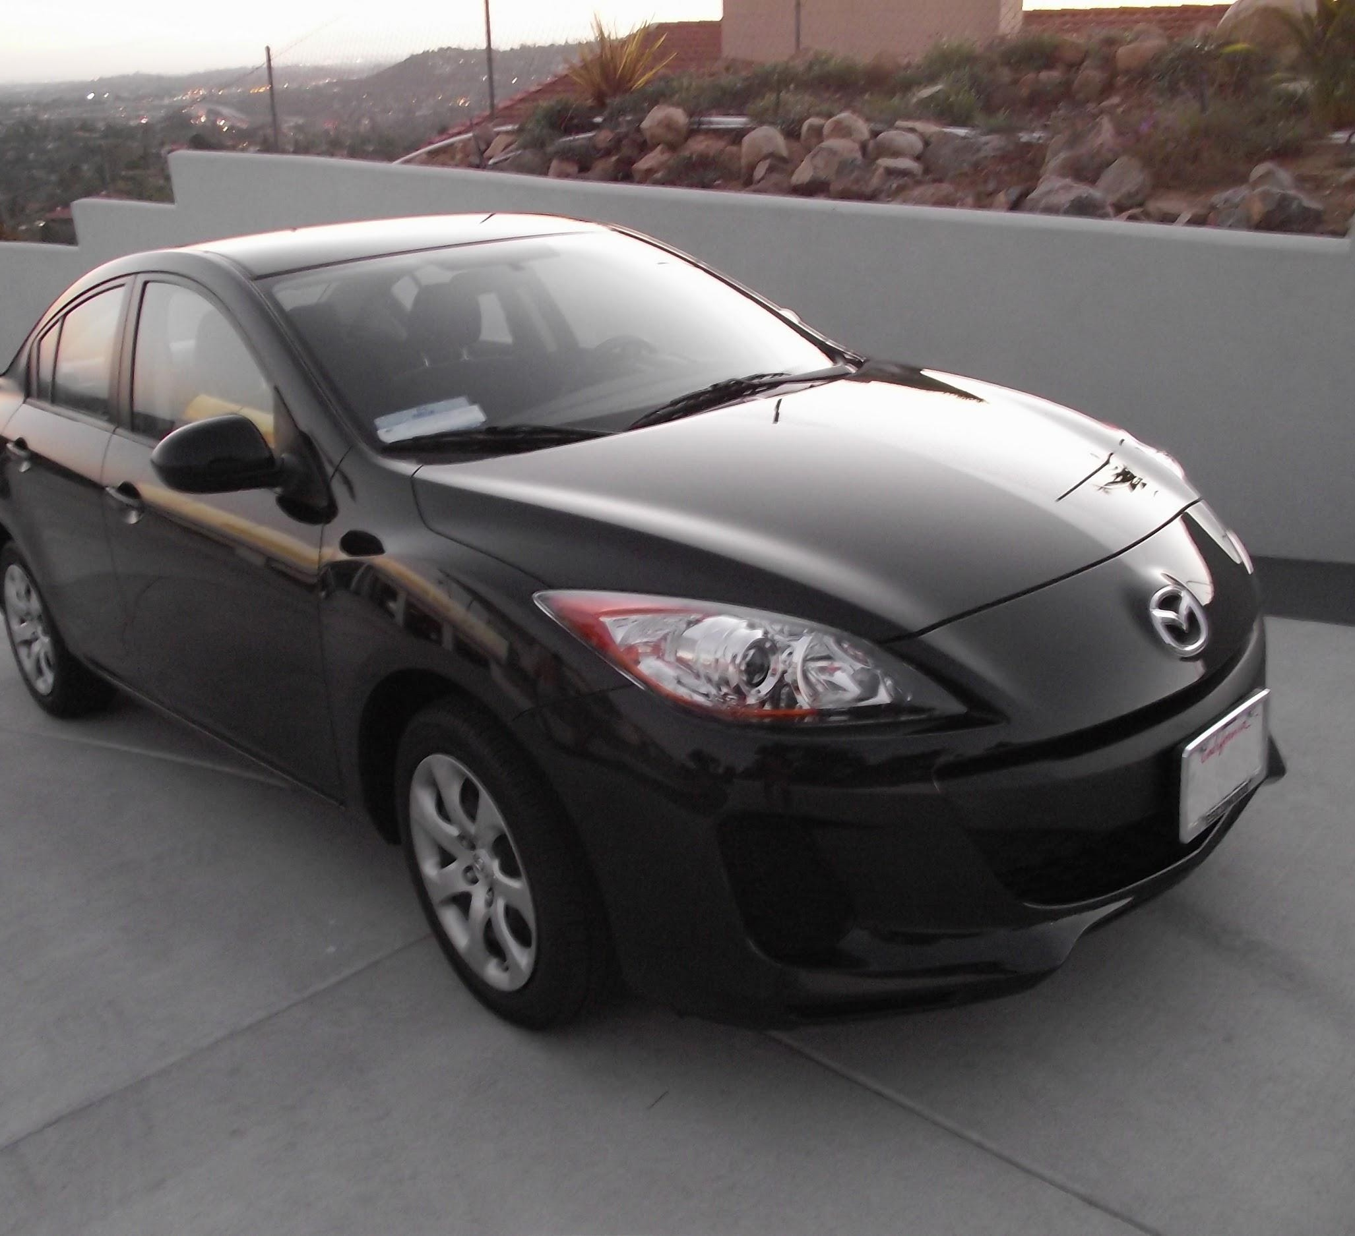
Fully Connected Layer (FC layer)
- Contains neurons that connect to the entire input volume, as in ordinary Neural Networks
Fei-Fei Li & Justin Johnson & Serena Yeung Lecture 5 - April 18, 2017

Slide 75
Activation Functions

Slide 76
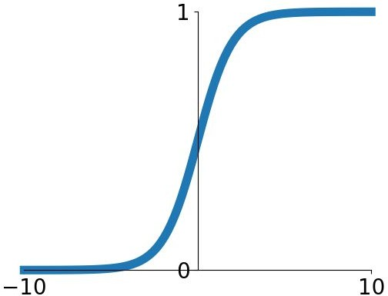
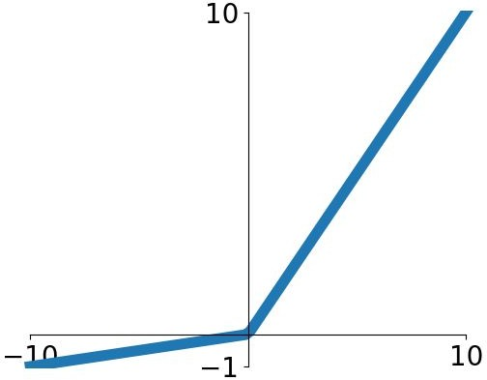


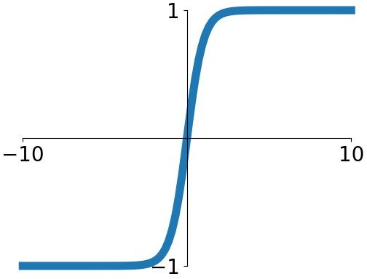


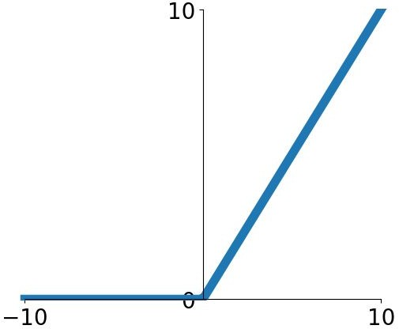
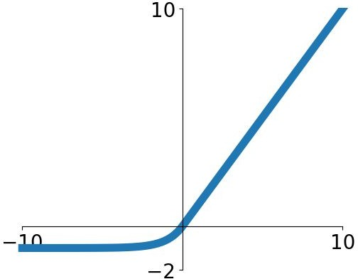
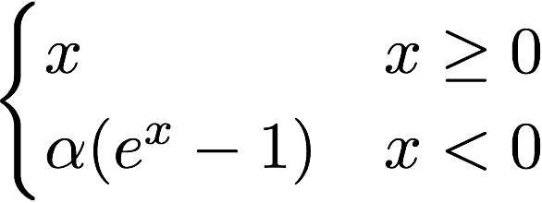

Activation Functions
Sigmoid
tanh
Leaky ReLU
Maxout
ReLU
ELU
Fei-Fei Li & Justin Johnson & Serena Yeung Lecture 6 - April 20, 2017

Slide 77

Activation Functions
Squashes numbers to range [0,1]
Sigmoid
Saturated neurons “kill” the gradients
Sigmoid outputs are not zero-centered
exp() is a bit compute expensive
Fei-Fei Li & Justin Johnson & Serena Yeung Lecture 6 - April 20, 2017

Slide 78
Activation Functions
Squashes numbers to range [-1,1]
zero centered (nice)
still kills gradients when saturated :(
tanh(x)
[LeCun et al., 1991]
Fei-Fei Li & Justin Johnson & Serena Yeung Lecture 6 - April 20, 2017

Slide 79
- Computes f(x) = max(0,x)
Activation Functions
Does not saturate (in +region)
Very computationally efficient
Converges much faster than sigmoid/tanh in practice (e.g. 6x)
Actually more biologically plausible than sigmoid
Not zero-centered output
An annoyance:
hint: what is the gradient when x < 0?
ReLU
(Rectified Linear Unit)
Fei-Fei Li & Justin Johnson & Serena Yeung Lecture 6 - April 20, 2017

Slide 80

Activation Functions
[Mass et al., 2013] [He et al., 2015]
Does not saturate
Computationally efficient
Converges much faster than sigmoid/tanh in practice! (e.g. 6x)
- will not “die”.
Leaky ReLU
Fei-Fei Li & Justin Johnson & Serena Yeung Lecture 6 - April 20, 2017

Slide 81

Activation Functions
[Clevert et al., 2015]
Exponential Linear Units (ELU)
- All benefits of ReLU
Closer to zero mean outputs
Negative saturation regime compared with Leaky ReLU adds some robustness to noise
Computation requires exp()
Fei-Fei Li & Justin Johnson & Serena Yeung Lecture 6 - April 20, 2017

Slide 82
Data Preprocessing
Fei-Fei Li & Justin Johnson & Serena Yeung Lecture 6 - April 20, 2017

Slide 83
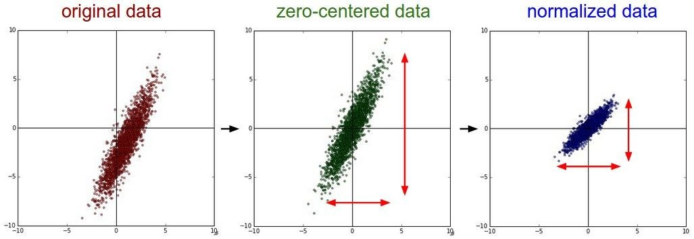
Step 1: Preprocess the data
Fei-Fei Li & Justin Johnson & Serena Yeung Lecture 6 - April 20, 2017

Slide 84
Step 1: Preprocess the data
Fei-Fei Li & Justin Johnson & Serena Yeung Lecture 6 - April 20, 2017

Slide 85
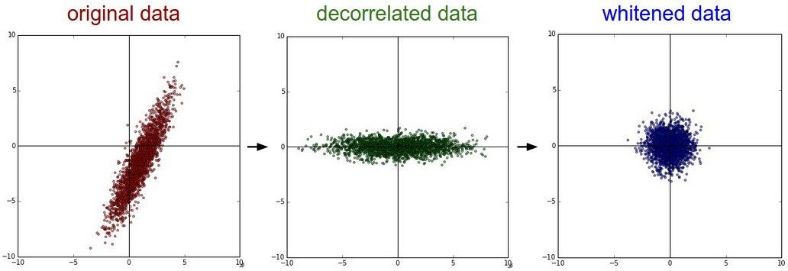
Step 1: Preprocess the data
In practice, you may also see PCA and Whitening of the data
(data has diagonal covariance matrix)
(covariance matrix is the identity matrix)
Lecture 6 - 38
Fei-Fei Li & Justin Johnson & Serena Yeung Lecture 6 - April 20, 2017

Slide 86
TLDR: In practice for Images: center only
e.g. consider CIFAR-10 example with [32,32,3] images
Subtract the mean image (e.g. AlexNet) (mean image = [32,32,3] array)
Subtract per-channel mean (e.g. VGGNet) (mean along each channel = 3 numbers)
Not common to normalize variance, to do PCA or whitening
Fei-Fei Li & Justin Johnson & Serena Yeung Lecture 6 - April 20, 2017

Slide 87
GoogleNet

Slide 88
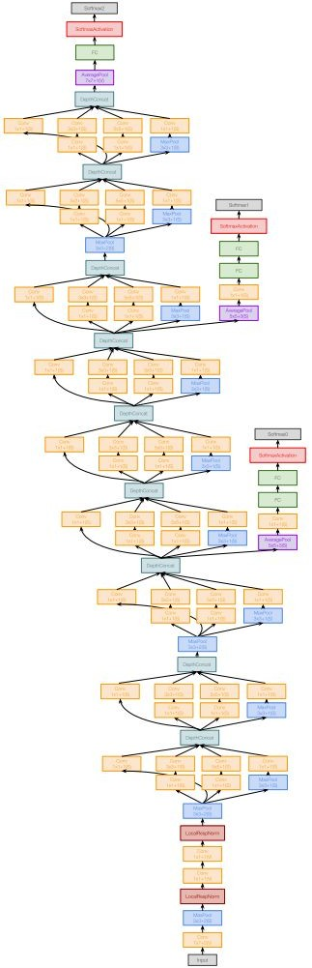
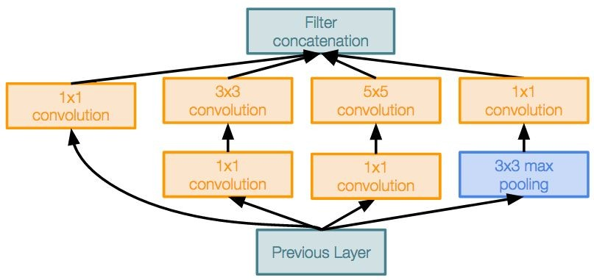
Case Study: GoogLeNet
[Szegedy et al., 2014]
Deeper networks, with computational efficiency
22 layers
Efficient “Inception” module
No FC layers
Only 5 million parameters!
12x less than AlexNet
ILSVRC’14 classification winner (6.7% top 5 error)
Inception module
Fei-Fei Li & Justin Johnson & Serena Yeung Lecture 9 - May 2, 2017

Slide 89
Case Study: GoogLeNet
[Szegedy et al., 2014]
“Inception module”: design a good local network topology (network within a network) and then stack these modules on top of each other
Inception module
Fei-Fei Li & Justin Johnson & Serena Yeung Lecture 9 - May 2, 2017

Slide 90
Apply parallel filter operations on the input from previous layer:
Filter concatenation
Multiple receptive field sizes for convolution (1x1, 3x3, 5x5)
Pooling operation (3x3)
1x1 convolution
3x3 convolution
5x5 convolution
3x3 max pooling
Previous Layer
Concatenate all filter outputs together depth-wise
Naive Inception module
Fei-Fei Li & Justin Johnson & Serena Yeung Lecture 9 - May 2, 2017

Slide 91
Case Study: GoogLeNet
Q: What is the problem with this? [Hint: Computational complexity]
[Szegedy et al., 2014]
Example:
Q3:What is output size after filter concatenation?
Conv Ops:
[1x1 conv, 128] 28x28x128x1x1x256 [3x3 conv, 192] 28x28x192x3x3x256 [5x5 conv, 96] 28x28x96x5x5x256 Total: 854M ops
28x28x(128+192+96+256) = 28x28x672
Filter concatenation
28x28x128
28x28x192 28x28x96
28x28x256
1x1 conv,
128
3x3 conv,
192
5x5 conv,
96
3x3 pool
Very expensive compute
Module input: 28x28x256
Input
Pooling layer also preserves feature depth, which means total depth after concatenation can only grow at every layer!
Naive Inception module
Fei-Fei Li & Justin Johnson & Serena Yeung Lecture 9 - May 2, 2017

Slide 92
Case Study: GoogLeNet
Q: What is the problem with this? [Hint: Computational complexity]
[Szegedy et al., 2014]
Example:
Q3:What is output size after filter concatenation?
28x28x(128+192+96+256) = 529k
Solution: “bottleneck” layers that use 1x1 convolutions to reduce feature depth
Filter concatenation
28x28x128
28x28x192 28x28x96
28x28x256
1x1 conv,
128
3x3 conv,
192
5x5 conv,
96
3x3 pool
Module input: 28x28x256
Input
Naive Inception module
Fei-Fei Li & Justin Johnson & Serena Yeung Lecture 9 - May 2, 2017

Slide 93
1x1 conv “bottleneck” layers
Filter concatenation
Filter concatenation
1x1 convolution
3x3 convolution
5x5 convolution
3x3 max pooling
1x1 convolution
3x3 convolution
5x5 convolution
1x1 convolution
1x1 convolution
1x1 convolution
3x3 max pooling
Previous Layer
Previous Layer
Naive Inception module
Inception module with dimension reduction
Fei-Fei Li & Justin Johnson & Serena Yeung Lecture 9 - May 2, 2017

Slide 94
Using same parallel layers as naive example, and adding “1x1 conv, 64 filter” bottlenecks:
28x28x480
Conv Ops:
[1x1 conv, 64] 28x28x64x1x1x256 [1x1 conv, 64] 28x28x64x1x1x256 [1x1 conv, 128] 28x28x128x1x1x256 [3x3 conv, 192] 28x28x192x3x3x64 [5x5 conv, 96] 28x28x96x5x5x64 [1x1 conv, 64] 28x28x64x1x1x256 Total: 358M ops
Filter concatenation
28x28x128
28x28x192 28x28x96
28x28x64
1x1 conv,
128
3x3 conv,
192
5x5 conv,
96
1x1 conv,
64
28x28x64
28x28x64
28x28x256
1x1 conv, 64
1x1 conv, 64
3x3 pool
Module input: 28x28x256
Previous Layer
Compared to 854M ops for naive version Bottleneck can also reduce depth after pooling layer
Inception module with dimension reduction
Fei-Fei Li & Justin Johnson & Serena Yeung Lecture 9 - May 2, 2017

Slide 95
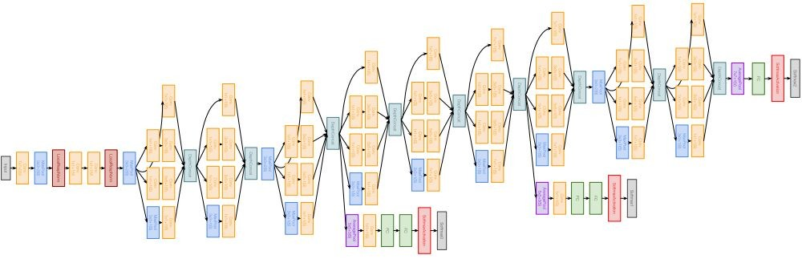
Full GoogLeNet architecture
Stem Network: Conv-Pool- 2x Conv-Pool
Fei-Fei Li & Justin Johnson & Serena Yeung Lecture 9 - May 2, 2017

Slide 96
Full GoogLeNet architecture
Stacked Inception Modules
Fei-Fei Li & Justin Johnson & Serena Yeung Lecture 9 - May 2, 2017

Slide 97
Full GoogLeNet architecture
Classifier output (removed expensive FC layers!)
Fei-Fei Li & Justin Johnson & Serena Yeung Lecture 9 - May 2, 2017

Slide 98
ResNet

Slide 99
Case Study: ResNet
[He et al., 2015]
Softmax
FC 1000
Pool
3x3 conv, 64
3x3 conv, 64
relu
3x3 conv, 64
Very deep networks using residual connections
3x3 conv, 64
F(x) + x
3x3 conv, 64
3x3 conv, 64
..
.
conv
152-layer model for ImageNet
ILSVRC’15 classification winner (3.57% top 5 error)
Swept all classification and detection competitions in ILSVRC’15 and COCO’15!
3x3 conv, 128
F(x)
X
identity
3x3 conv, 128
relu
3x3 conv, 128
conv
3x3 conv, 128
3x3 conv, 128
3x3 conv, 128 / 2
3x3 conv, 64
X
Residual block
3x3 conv, 64
3x3 conv, 64
3x3 conv, 64
3x3 conv, 64
3x3 conv, 64
Pool
7x7 conv, 64 / 2
Input
Fei-Fei Li & Justin Johnson & Serena Yeung Lecture 9 - May 2, 2017

Slide 100
Case Study: ResNet
[He et al., 2015]
Solution: Use network layers to fit a residual mapping instead of directly trying to fit a desired underlying mapping
relu
H(x)
F(x) + x
conv
conv
F(x)
X
identity
 | relu
conv
relu
conv
X
“Plain” layers
X
Residual block
Fei-Fei Li & Justin Johnson & Serena Yeung Lecture 9 - May 2, 2017

Slide 101
Solution: Use network layers to fit a residual mapping instead of directly trying to fit a desired underlying mapping
H(x) = F(x) + x
relu
H(x)
F(x) + x
Use layers to fit residual F(x) = H(x) - x
instead of H(x) directly
conv
conv
F(x)
X
identity
 | relu
conv
relu
conv
X
“Plain” layers
X
Residual block
Fei-Fei Li & Justin Johnson & Serena Yeung Lecture 9 - May 2, 2017

Slide 102
Case Study: ResNet
[He et al., 2015]
Softmax
FC 1000
Pool
3x3 conv, 512
3x3 conv, 512
Full ResNet architecture:
3x3 conv, 512
3x3 conv, 512
Stack residual blocks
Every residual block has two 3x3 conv layers
Periodically, double # of filters and downsample spatially using stride 2 (/2 in each dimension)
relu
3x3 conv, 512
F(x) + x
3x3 conv, 512, /2
..
.
3x3 conv
3x3 conv, 128
3x3 conv, 128
3x3 conv, 128 filters, /2 spatially with stride 2
F(x)
X
identity
3x3 conv, 128
relu
3x3 conv, 128
3x3 conv
3x3 conv, 128
3x3 conv, 128, / 2
3x3 conv, 64
3x3 conv, 64 filters
3x3 conv, 64
X
Residual block
3x3 conv, 64
3x3 conv, 64
3x3 conv, 64
3x3 conv, 64
Pool
7x7 conv, 64, / 2
Input
Fei-Fei Li & Justin Johnson & Serena Yeung Lecture 9 - May 2, 2017

Slide 103
Case Study: ResNet
[He et al., 2015]
Softmax
FC 1000
Pool
No FC layers
besides FC 1000 to output classes
3x3 conv, 512
3x3 conv, 512
Full ResNet architecture:
3x3 conv, 512
3x3 conv, 512
Global average pooling layer after last conv layer
Stack residual blocks
Every residual block has two 3x3 conv layers
Periodically, double # of filters and downsample spatially using stride 2 (/2 in each dimension)
Additional conv layer at the beginning
No FC layers at the end (only FC 1000 to output classes)
relu
3x3 conv, 512
F(x) + x
3x3 conv, 512, /2
..
.
3x3 conv
3x3 conv, 128
3x3 conv, 128
F(x)
X
identity
3x3 conv, 128
relu
3x3 conv, 128
3x3 conv
3x3 conv, 128
3x3 conv, 128, / 2
3x3 conv, 64
3x3 conv, 64
X
Residual block
3x3 conv, 64
3x3 conv, 64
3x3 conv, 64
3x3 conv, 64
Pool
7x7 conv, 64, / 2
Input
Fei-Fei Li & Justin Johnson & Serena Yeung Lecture 9 - May 2, 2017

Slide 104
Case Study: ResNet
[He et al., 2015]
Softmax
FC 1000
Pool
3x3 conv, 512
3x3 conv, 512
3x3 conv, 512
3x3 conv, 512
3x3 conv, 512
Total depths of 34, 50, 101, or 152 layers for ImageNet
3x3 conv, 512, /2
..
.
3x3 conv, 128
3x3 conv, 128
3x3 conv, 128
3x3 conv, 128
3x3 conv, 128
3x3 conv, 128, / 2
3x3 conv, 64
3x3 conv, 64
3x3 conv, 64
3x3 conv, 64
3x3 conv, 64
3x3 conv, 64
Pool
7x7 conv, 64, / 2
Input
Fei-Fei Li & Justin Johnson & Serena Yeung Lecture 9 - May 2, 2017

Slide 105

Case Study: ResNet
[He et al., 2015]
28x28x256
output
For deeper networks
(ResNet-50+), use “bottleneck” layer to improve efficiency (similar to GoogLeNet)
1x1 conv, 256
3x3 conv, 64
1x1 conv, 64
28x28x256
input
Fei-Fei Li & Justin Johnson & Serena Yeung Lecture 9 - May 2, 2017

Slide 106
Case Study: ResNet
[He et al., 2015]
28x28x256
output
1x1 conv, 256 filters projects
back to 256 feature maps (28x28x256)
For deeper networks
(ResNet-50+), use “bottleneck” layer to improve efficiency (similar to GoogLeNet)
1x1 conv, 256
3x3 conv operates over only 64 feature maps
3x3 conv, 64
1x1 conv, 64 filters to project to 28x28x64
1x1 conv, 64
28x28x256
input
Fei-Fei Li & Justin Johnson & Serena Yeung Lecture 9 - May 2, 2017

Slide 107
Reference:
Convolutional Neural Networks for Visual Recognition
University of Stanford
https://www.stanford.edu/
Instructor
Fei-Fei Li & Justin Johnson & Serena Yeung Stanford University
Thanks ☺

