Slide 1
Code for Convolutional Network

Slide 2
ConvNet Architecture
Three main types of layers to build ConvNet architecture.
Convolutional Layer
Pooling Layer
Fully Connected Layer

Slide 3
Convolutional Layer
To summarize the Convolutional layer
Accept volume of size W*H*D
Require 4 hyper-parameters
Number of filters K
Their spatial extent F
The stride S
The amount of zero padding P

Slide 4
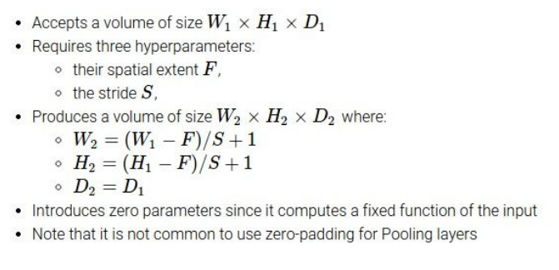
Max Pooling

Slide 5
ConNet code in torch
main.lua - loads all other files, starts training.
opts.lua - all the command-line options and description
data.lua - contains the logic to create K threads for parallel data-loading.
donkey.lua - contains the data-loading logic and details. It is run by each data-loader thread. random image cropping, generating 10-crops etc.
model.lua - creates AlexNet model and criterion.
train.lua - logic for training the network. we hard-code a learning rate + weight decay schedule that produces good results.
test.lua- logic for testing the network on validation set (including calculating top-1 and top-5 errors)
dataset.lua - a general purpose data loader

Slide 6
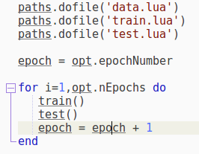
Main.lua

Slide 7
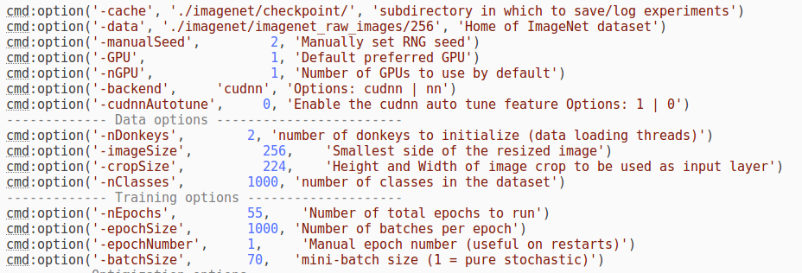
opts.lua

Slide 8
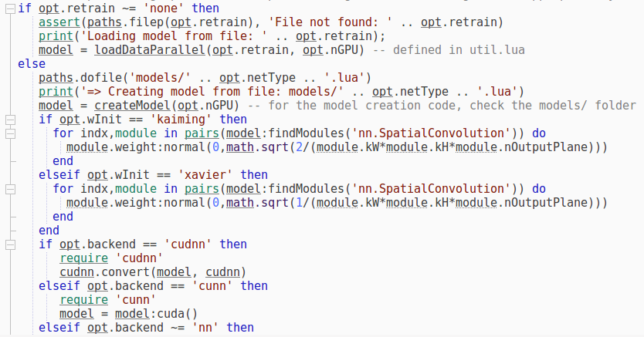
model.lua

Slide 9
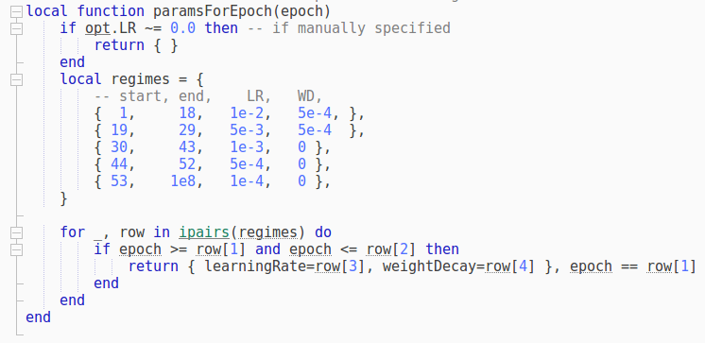

train.lua

Slide 10
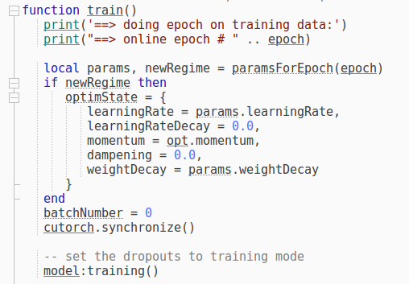
train.lua (cont.)

Slide 11
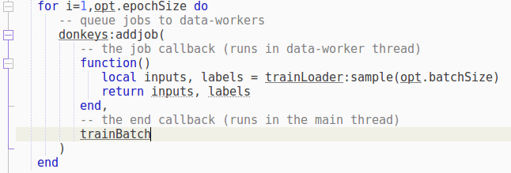
train.lua (cont.)

Slide 12
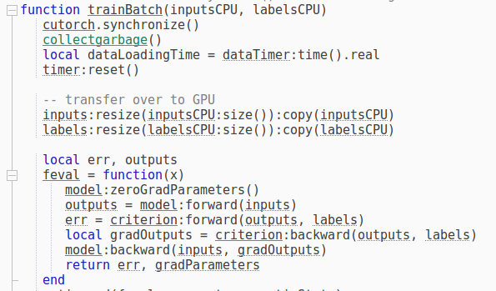
train.lua (cont.)

Slide 13
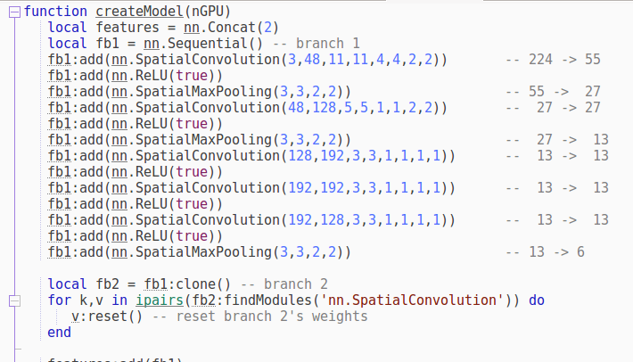
AlexNet Model File

Slide 14
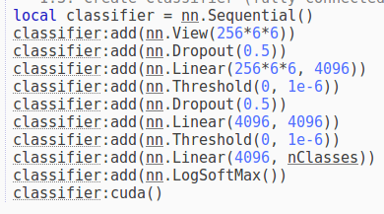
AlexNet Model File (cont.)

Slide 15
Other architectures to know...

Slide 16
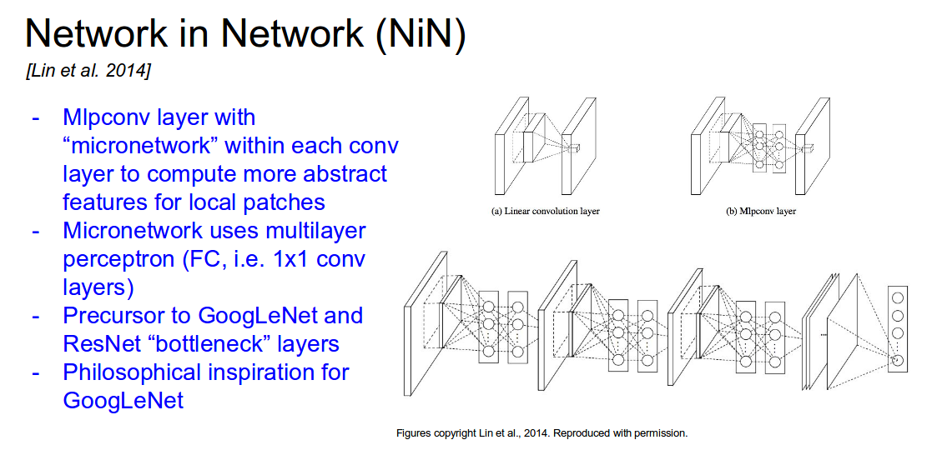

Slide 17
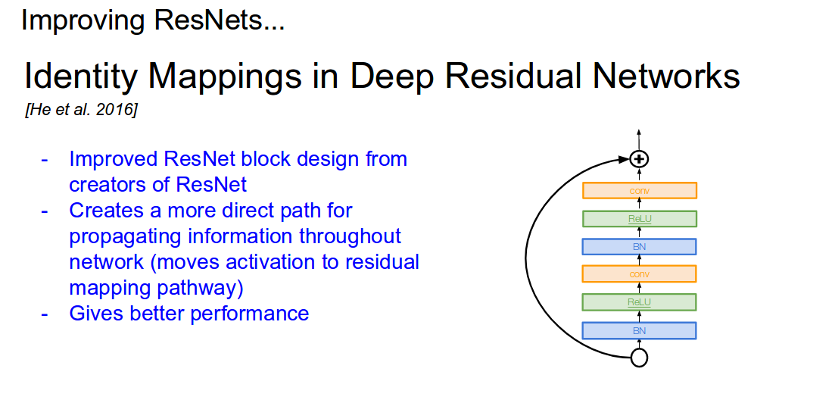

Slide 18
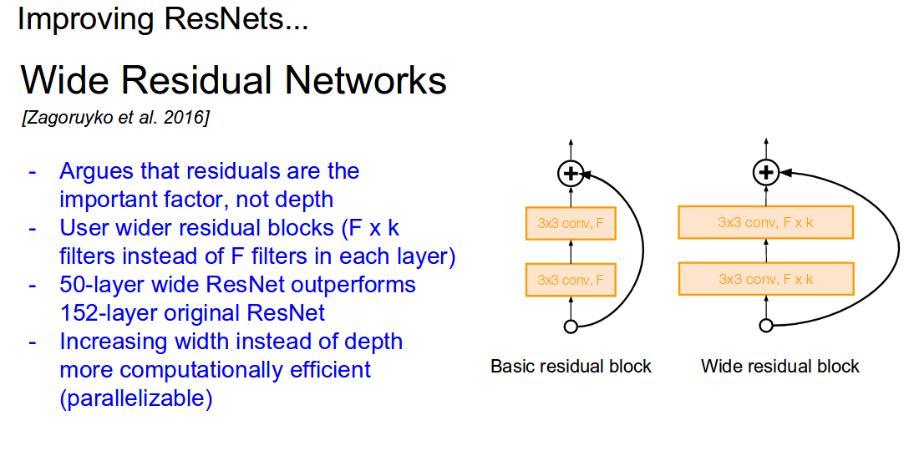

Slide 19
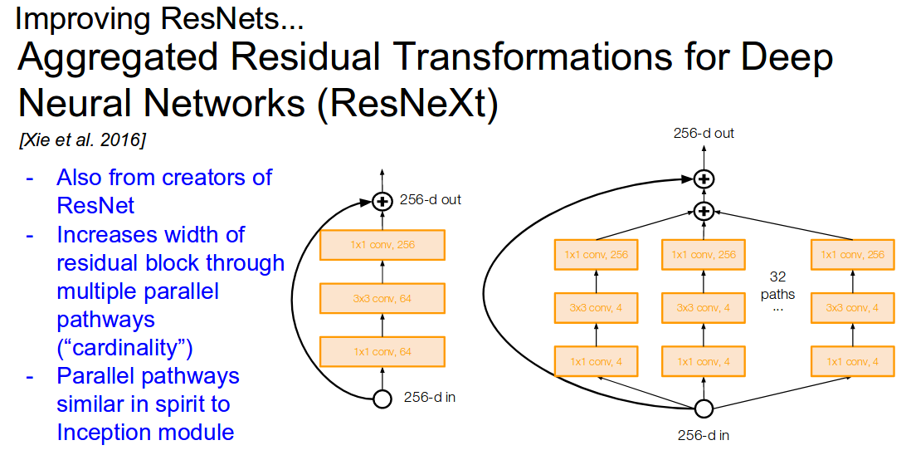

Slide 20
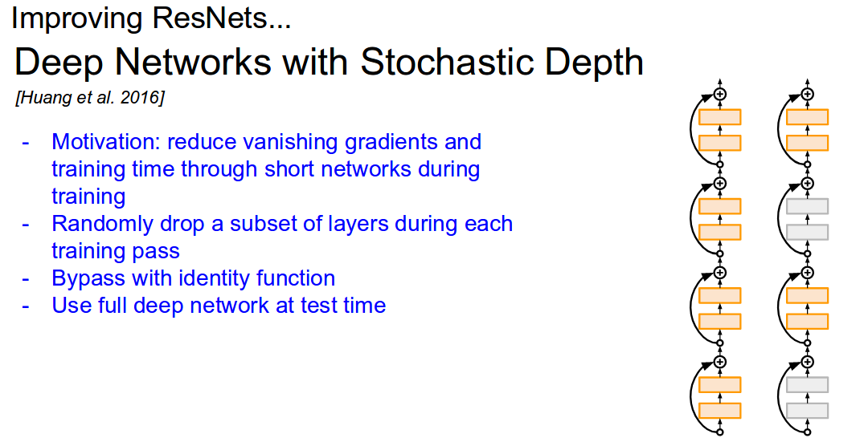

Slide 21
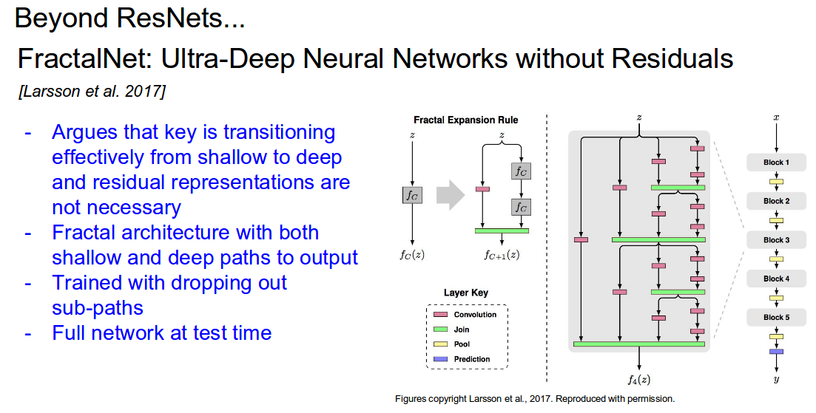

Slide 22
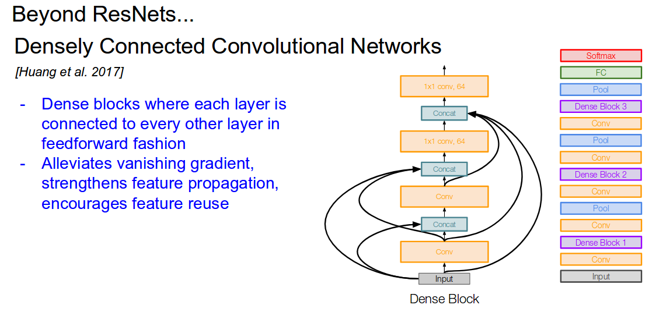

Slide 23
Weight Initialization

Slide 24
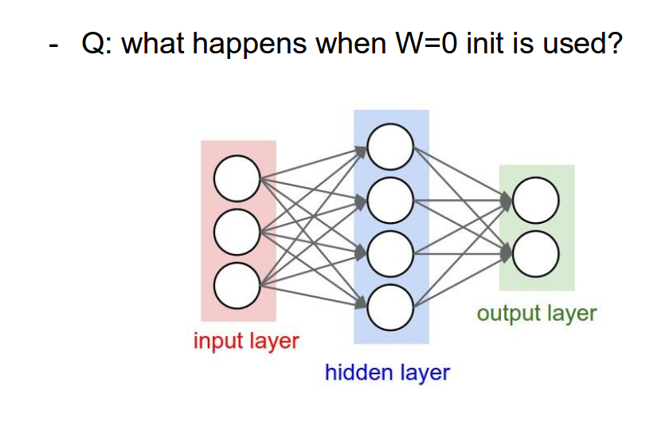

Slide 25

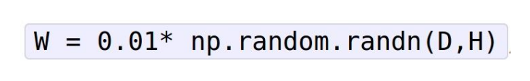


Slide 26
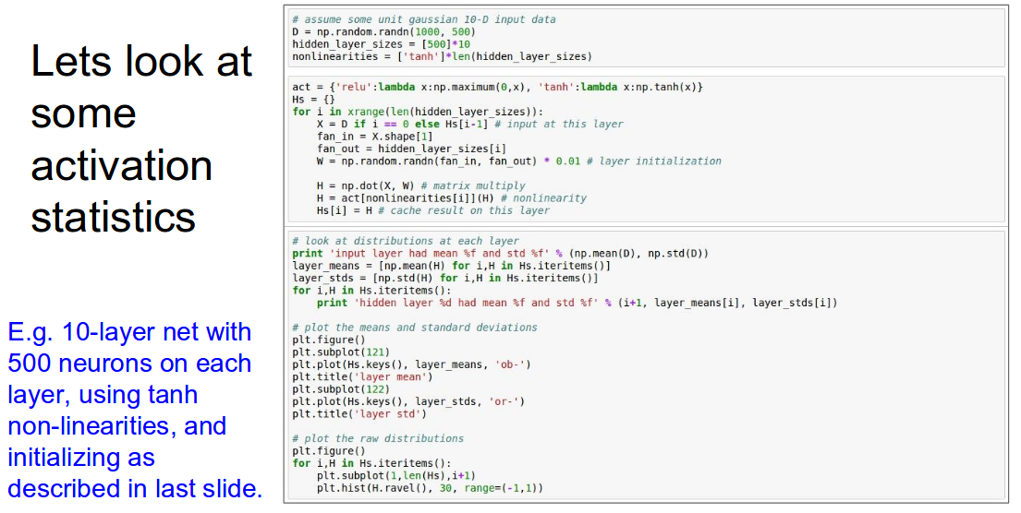

Slide 27
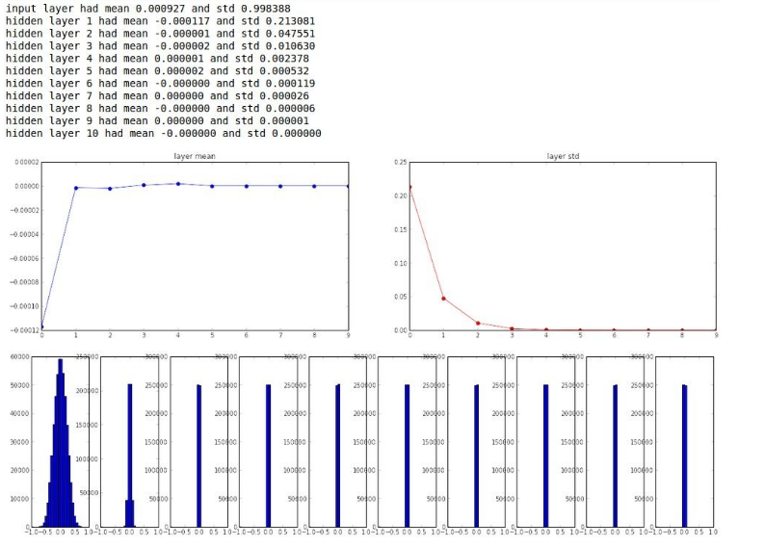

Slide 28
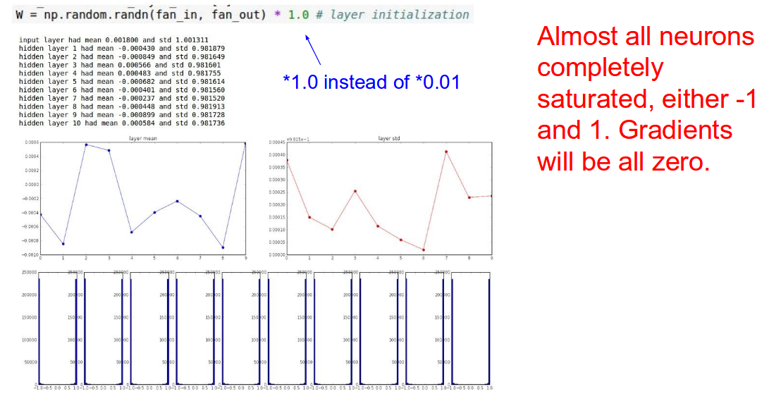

Slide 29
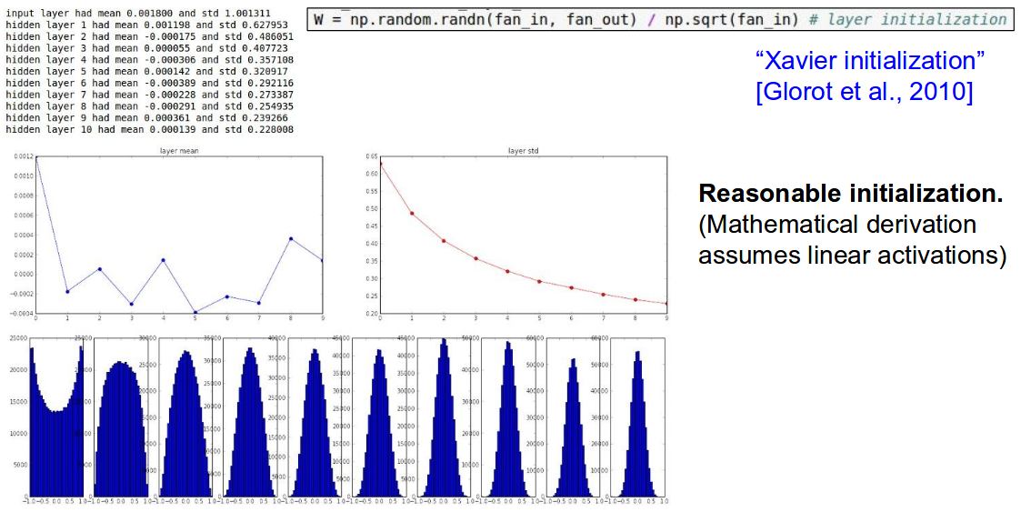

Slide 30
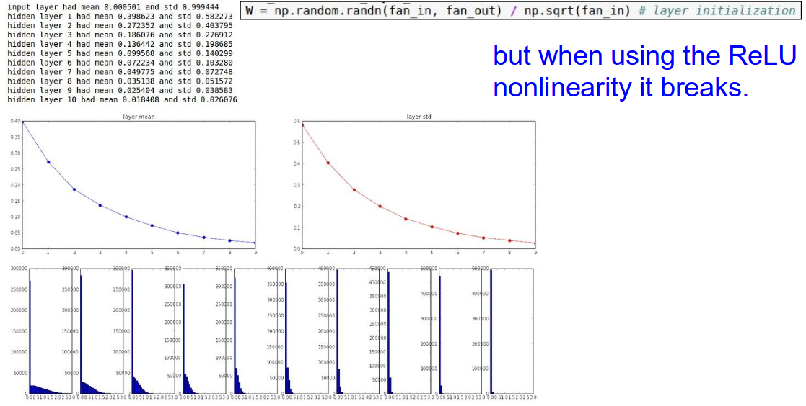

Slide 31
