Slide 1
Batch Normalization
Fei-Fei Li & Justin Johnson & Serena Yeung Lecture 6 - April 20, 2017

Slide 2

Batch Normalization
[Ioffe and Szegedy, 2015]
“you want unit gaussian activations? just make them so.”
consider a batch of activations at some layer. To make each dimension unit gaussian, apply:
Fei-Fei Li & Justin Johnson & Serena Yeung Lecture 6 - April 20, 2017

Slide 3


Batch Normalization
[Ioffe and Szegedy, 2015]
“you want unit gaussian activations? just make them so.”
1. compute the empirical mean and variance independently for each dimension.
X
N
2. Normalize
D
Fei-Fei Li & Justin Johnson & Serena Yeung Lecture 6 - April 20, 2017

Slide 4
Batch Normalization
[Ioffe and Szegedy, 2015]
FC
Usually inserted after Fully Connected or Convolutional layers, and before nonlinearity.
BN
tanh
FC
BN
tanh
...
Fei-Fei Li & Justin Johnson & Serena Yeung Lecture 6 - April 20, 2017

Slide 5
Batch Normalization
[Ioffe and Szegedy, 2015]
FC
Usually inserted after Fully Connected or Convolutional layers, and before nonlinearity.
BN
tanh
FC
BN
Problem: do we necessarily want a unit gaussian input to a tanh layer?
tanh
...
Fei-Fei Li & Justin Johnson & Serena Yeung Lecture 6 - April 20, 2017

Slide 6
Babysitting the Learning Process
Fei-Fei Li & Justin Johnson & Serena Yeung Lecture 6 - April 20, 2017

Slide 7
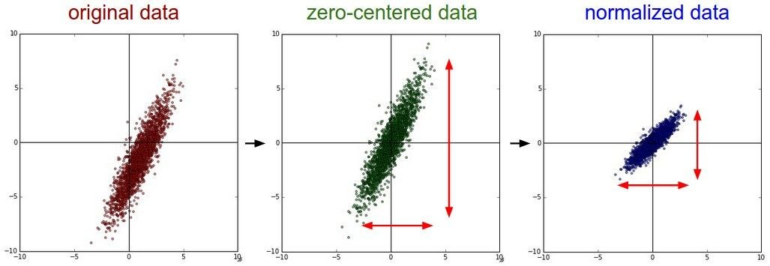


Step 1: Preprocess the data
(Assume X [NxD] is data matrix, each example in a row)
Fei-Fei Li & Justin Johnson & Serena Yeung Lecture 6 - April 20, 2017

Slide 8
Step 2: Choose the architecture:
say we start with one hidden layer of 50 neurons:
50 hidden neurons
10 output neurons, one per class
output layer
CIFAR-10
images, 3072
numbers
input layer
hidden layer
Fei-Fei Li & Justin Johnson & Serena Yeung Lecture 6 - April 20, 2017

Slide 9
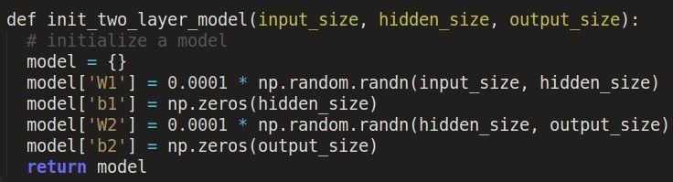

Double check that the loss is reasonable:
disable regularization
loss ~2.3. “correct “ for 10 classes
returns the loss and the gradient for all parameters
Fei-Fei Li & Justin Johnson & Serena Yeung Lecture 6 - April 20, 2017

Slide 10

Double check that the loss is reasonable:
crank up regularization
loss went up, good. (sanity check)
Fei-Fei Li & Justin Johnson & Serena Yeung Lecture 6 - April 20, 2017

Slide 11
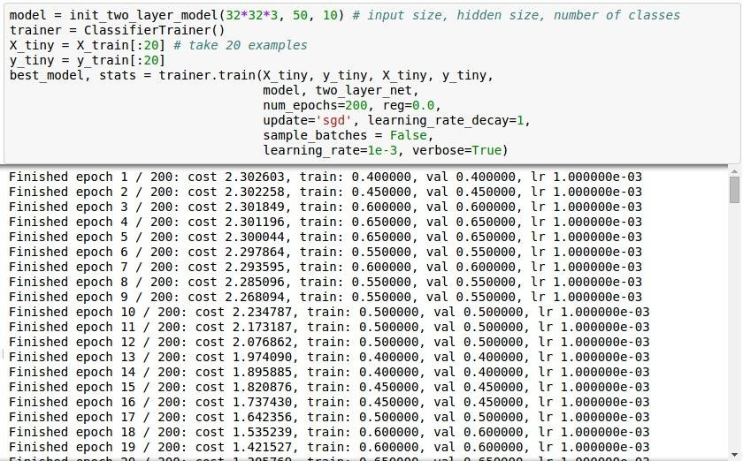
Lets try to train now…
Tip: Make sure that you can overfit very small portion of the training data
The above code:
take the first 20 examples from CIFAR-10
turn off regularization (reg = 0.0)
use simple vanilla ‘sgd’
Fei-Fei Li & Justin Johnson & Serena Yeung Lecture 6 - April 20, 2017

Slide 12
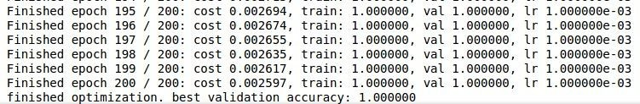

Lets try to train now…
Tip: Make sure that you can overfit very small portion of the training data
Very small loss, train accuracy 1.00, nice!
Fei-Fei Li & Justin Johnson & Serena Yeung Lecture 6 - April 20, 2017

Slide 13
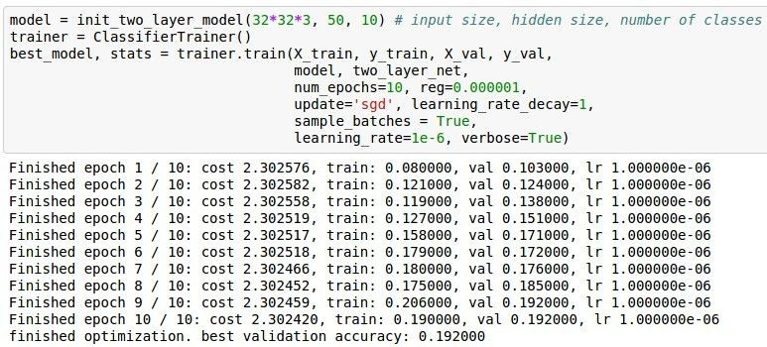
Lets try to train now…
Start with small regularization and find learning rate that makes the loss go down.
Fei-Fei Li & Justin Johnson & Serena Yeung Lecture 6 - April 20, 2017

Slide 14
Lets try to train now…
Start with small regularization and find learning rate that makes the loss go down.
Loss barely changing
Fei-Fei Li & Justin Johnson & Serena Yeung Lecture 6 - April 20, 2017

Slide 15
Lets try to train now…
Start with small regularization and find learning rate that makes the loss go down.
Loss barely changing: Learning rate is probably too low
loss not going down:
learning rate too low
Fei-Fei Li & Justin Johnson & Serena Yeung Lecture 6 - April 20, 2017

Slide 16
Lets try to train now…
Start with small regularization and find learning rate that makes the loss go down.
Loss barely changing: Learning rate is probably too low
loss not going down:
learning rate too low
Notice train/val accuracy goes to 20% though, what’s up with that? (remember this is softmax)
Fei-Fei Li & Justin Johnson & Serena Yeung Lecture 6 - April 20, 2017

Slide 17
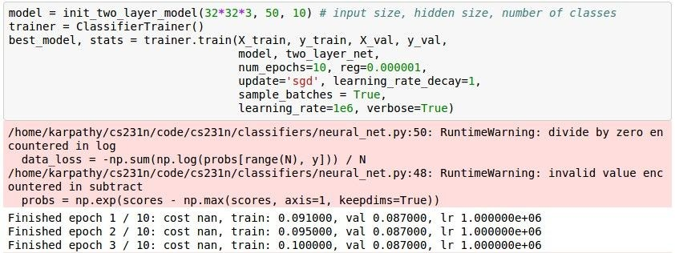
Lets try to train now…
Start with small regularization and find learning rate that makes the loss go down.
loss not going down:
learning rate too low
Now let’s try learning rate 1e6.
Fei-Fei Li & Justin Johnson & Serena Yeung Lecture 6 - April 20, 2017

Slide 18
Lets try to train now…
Start with small regularization and find learning rate that makes the loss go down.
cost: NaN almost always means high learning rate...
loss not going down: learning rate too low loss exploding: learning rate too high
Fei-Fei Li & Justin Johnson & Serena Yeung Lecture 6 - April 20, 2017

Slide 19
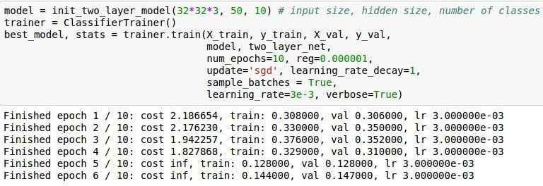
Lets try to train now…
Start with small regularization and find learning rate that makes the loss go down.
3e-3 is still too high. Cost explodes….
loss not going down: learning rate too low loss exploding: learning rate too high
=> Rough range for learning rate we should be cross-validating is somewhere [1e-3 … 1e-5]
Fei-Fei Li & Justin Johnson & Serena Yeung Lecture 6 - April 20, 2017

Slide 20
Hyperparameter Optimization
Fei-Fei Li & Justin Johnson & Serena Yeung Lecture 6 - April 20, 2017

Slide 21
Cross-validation strategy
coarse -> fine cross-validation in stages
First stage: only a few epochs to get rough idea of what params work
Second stage: longer running time, finer search
… (repeat as necessary)
Tip for detecting explosions in the solver:
If the cost is ever > 3 * original cost, break out early
Fei-Fei Li & Justin Johnson & Serena Yeung Lecture 6 - April 20, 2017

Slide 22
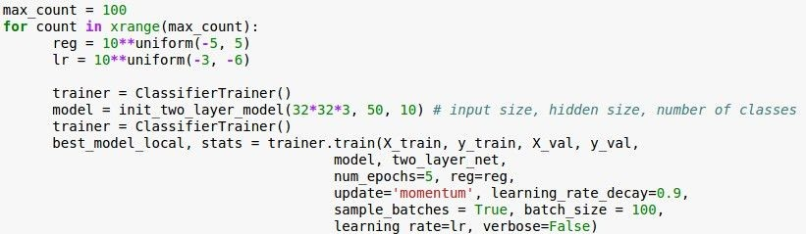
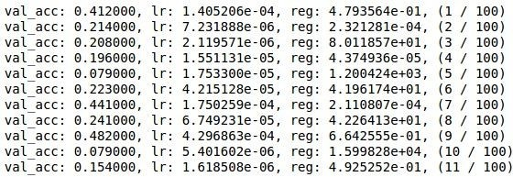
For example: run coarse search for 5 epochs
note it’s best to optimize
in log space!
nice
Fei-Fei Li & Justin Johnson & Serena Yeung Lecture 6 - April 20, 2017

Slide 23

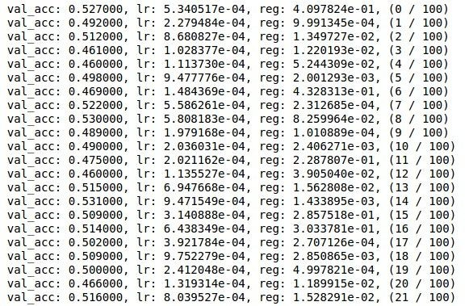
Now run finer search...
adjust range
53% - relatively good for a 2-layer neural net with 50 hidden neurons.
Fei-Fei Li & Justin Johnson & Serena Yeung Lecture 6 - April 20, 2017

Slide 24
Now run finer search...
adjust range
53% - relatively good for a 2-layer neural net with 50 hidden neurons.
But this best
cross-validation result is worrying. Why?
Fei-Fei Li & Justin Johnson & Serena Yeung Lecture 6 - April 20, 2017

Slide 25
Lecture 9: CNN Architectures
Lecture 9 -
1
Fei-Fei Li & Justin Johnson & Serena Yeung Lecture 9 - May 2, 2017

Slide 26
Today: CNN Architectures
Case Studies
AlexNet
VGG
GoogLeNet
ResNet
Also....
NiN (Network in Network)
Wide ResNet
ResNeXT
Stochastic Depth
DenseNet
FractalNet
SqueezeNet
Lecture 9 -
26

Slide 27
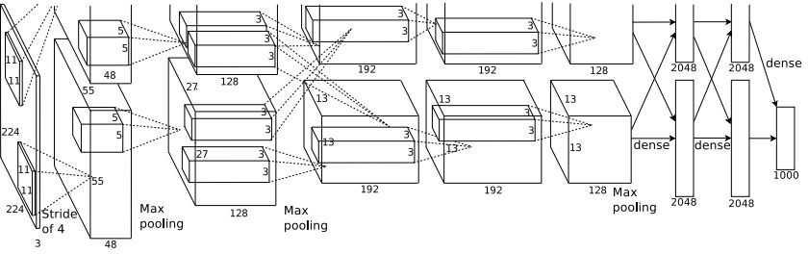
Case Study: AlexNet
[Krizhevsky et al. 2012]
Architecture:
CONV1 MAX POOL1 NORM1 CONV2 MAX POOL2 NORM2 CONV3 CONV4 CONV5
Max POOL3 FC6
FC7 FC8
Lecture 9 - 27
Fei-Fei Li & Justin Johnson & Serena Yeung Lecture 9 - May 2, 2017

Slide 28
Case Study: AlexNet
[Krizhevsky et al. 2012]
Input: 227x227x3 images
First layer (CONV1): 96 11x11 filters applied at stride 4
=>
Q: what is the output volume size? Hint: (227-11)/4+1 = 55
Lecture 9 - 28
Fei-Fei Li & Justin Johnson & Serena Yeung Lecture 9 - May 2, 2017

Slide 29
Case Study: AlexNet
[Krizhevsky et al. 2012]
Input: 227x227x3 images
First layer (CONV1): 96 11x11 filters applied at stride 4
=>
Output volume [55x55x96]
Q: What is the total number of parameters in this layer?
Lecture 9 - 29
Fei-Fei Li & Justin Johnson & Serena Yeung Lecture 9 - May 2, 2017

Slide 30
Case Study: AlexNet
[Krizhevsky et al. 2012]
Input: 227x227x3 images
First layer (CONV1): 96 11x11 filters applied at stride 4
=>
Output volume [55x55x96]
Parameters: (11*11*3)*96 = 35K
Lecture 9 - 30
Fei-Fei Li & Justin Johnson & Serena Yeung Lecture 9 - May 2, 2017

Slide 31
Case Study: AlexNet
[Krizhevsky et al. 2012]
Input: 227x227x3 images After CONV1: 55x55x96
Second layer (POOL1): 3x3 filters applied at stride 2 Q: what is the output volume size? Hint: (55-3)/2+1 = 27
Lecture 9 - 31
Fei-Fei Li & Justin Johnson & Serena Yeung Lecture 9 - May 2, 2017

Slide 32
Case Study: AlexNet
[Krizhevsky et al. 2012]
Input: 227x227x3 images After CONV1: 55x55x96
Second layer (POOL1): 3x3 filters applied at stride 2 Output volume: 27x27x96
Q: what is the number of parameters in this layer?
Lecture 9 - 32
Fei-Fei Li & Justin Johnson & Serena Yeung Lecture 9 - May 2, 2017

Slide 33
Case Study: AlexNet
[Krizhevsky et al. 2012]
Input: 227x227x3 images After CONV1: 55x55x96
Second layer (POOL1): 3x3 filters applied at stride 2 Output volume: 27x27x96
Parameters: 0!
Lecture 9 - 33
Fei-Fei Li & Justin Johnson & Serena Yeung Lecture 9 - May 2, 2017

Slide 34
Case Study: AlexNet
[Krizhevsky et al. 2012]
Input: 227x227x3 images After CONV1: 55x55x96 After POOL1: 27x27x96
...
Lecture 9 - 34
Fei-Fei Li & Justin Johnson & Serena Yeung Lecture 9 - May 2, 2017

Slide 35
Case Study: AlexNet
[Krizhevsky et al. 2012]
Full (simplified) AlexNet architecture: [227x227x3] INPUT
[55x55x96] CONV1: 96 11x11 filters at stride 4, pad 0 [27x27x96] MAX POOL1: 3x3 filters at stride 2 [27x27x96] NORM1: Normalization layer
[27x27x256] CONV2: 256 5x5 filters at stride 1, pad 2 [13x13x256] MAX POOL2: 3x3 filters at stride 2 [13x13x256] NORM2: Normalization layer [13x13x384] CONV3: 384 3x3 filters at stride 1, pad 1 [13x13x384] CONV4: 384 3x3 filters at stride 1, pad 1 [13x13x256] CONV5: 256 3x3 filters at stride 1, pad 1 [6x6x256] MAX POOL3: 3x3 filters at stride 2
[4096] FC6: 4096 neurons
[4096] FC7: 4096 neurons
[1000] FC8: 1000 neurons (class scores)
Lecture 9 - 35
Fei-Fei Li & Justin Johnson & Serena Yeung Lecture 9 - May 2, 2017

Slide 36
Case Study: AlexNet
[Krizhevsky et al. 2012]
Full (simplified) AlexNet architecture: [227x227x3] INPUT
[55x55x96] CONV1: 96 11x11 filters at stride 4, pad 0 [27x27x96] MAX POOL1: 3x3 filters at stride 2 [27x27x96] NORM1: Normalization layer
[27x27x256] CONV2: 256 5x5 filters at stride 1, pad 2 [13x13x256] MAX POOL2: 3x3 filters at stride 2 [13x13x256] NORM2: Normalization layer [13x13x384] CONV3: 384 3x3 filters at stride 1, pad 1 [13x13x384] CONV4: 384 3x3 filters at stride 1, pad 1 [13x13x256] CONV5: 256 3x3 filters at stride 1, pad 1 [6x6x256] MAX POOL3: 3x3 filters at stride 2
Details/Retrospectives:
first use of ReLU
used Norm layers (not common anymore)
heavy data augmentation
dropout 0.5
batch size 128
SGD Momentum 0.9
Learning rate 1e-2, reduced by 10 manually when val accuracy plateaus
L2 weight decay 5e-4
[4096] FC6: 4096 neurons
[4096] FC7: 4096 neurons
[1000] FC8: 1000 neurons (class scores)
- 7 CNN ensemble: 18.2% -> 15.4%
Fei-Fei Li & Justin Johnson & Serena Yeung Lecture 9 - May 2, 2017

Slide 37
Case Study: AlexNet
[Krizhevsky et al. 2012]
Full (simplified) AlexNet architecture: [227x227x3] INPUT
[55x55x96] CONV1: 96 11x11 filters at stride 4, pad 0 [27x27x96] MAX POOL1: 3x3 filters at stride 2
[55x55x48] x 2
[27x27x96] NORM1: Normalization layer
[27x27x256] CONV2: 256 5x5 filters at stride 1, pad 2 [13x13x256] MAX POOL2: 3x3 filters at stride 2 [13x13x256] NORM2: Normalization layer [13x13x384] CONV3: 384 3x3 filters at stride 1, pad 1 [13x13x384] CONV4: 384 3x3 filters at stride 1, pad 1 [13x13x256] CONV5: 256 3x3 filters at stride 1, pad 1
Historical note: Trained on GTX 580 GPU with only 3 GB of memory.
Network spread across 2 GPUs, half the neurons (feature maps) on each GPU.
[6x6x256] MAX POOL3: 3x3 filters at stride 2 [4096] FC6: 4096 neurons
[4096] FC7: 4096 neurons
[1000] FC8: 1000 neurons (class scores)
Fei-Fei Li & Justin Johnson & Serena Yeung Lecture 9 - May 2, 2017

Slide 38
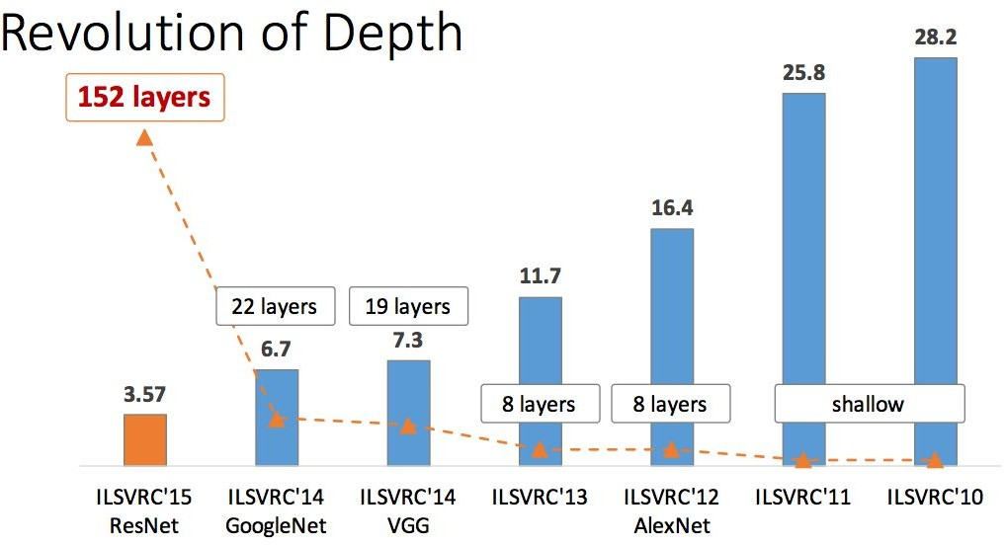
ImageNet Large Scale Visual Recognition Challenge (ILSVRC) winners
First CNN-based winner
Fei-Fei Li & Justin Johnson & Serena Yeung Lecture 9 - May 2, 2017

Slide 39
ImageNet Large Scale Visual Recognition Challenge (ILSVRC) winners
ZFNet: Improved hyperparameters over AlexNet
Fei-Fei Li & Justin Johnson & Serena Yeung Lecture 9 - May 2, 2017

Slide 40
Case Study: VGGNet
[Simonyan and Zisserman, 2014]
Softmax
FC 1000
FC 4096
FC 4096
Pool
3x3 conv, 512
3x3 conv, 512
3x3 conv, 512
3x3 conv, 512
Pool
3x3 conv, 512
3x3 conv, 512
3x3 conv, 512
3x3 conv, 512
Pool
3x3 conv, 256
3x3 conv, 256
Pool
3x3 conv, 128
3x3 conv, 128
Pool
3x3 conv, 64
3x3 conv, 64
Input
Softmax
FC 1000
FC 4096
FC 4096
Pool
3x3 conv, 512
3x3 conv, 512
3x3 conv, 512
Pool
3x3 conv, 512
3x3 conv, 512
Small filters, Deeper networks
8 layers (AlexNet)
-> 16 - 19 layers (VGG16Net)
Only 3x3 CONV stride 1, pad 1 and 2x2 MAX POOL stride 2
Softmax
FC 1000
FC 4096
FC 4096
Pool
3x3 conv, 256
3x3 conv, 384
Pool
3x3 conv, 384
Pool
5x5 conv, 256
11x11 conv, 96
Input
3x3 conv, 512
Pool
3x3 conv, 256
3x3 conv, 256
Pool
3x3 conv, 128
3x3 conv, 128
Pool
3x3 conv, 64
3x3 conv, 64
Input
AlexNet
VGG16
VGG19
Fei-Fei Li & Justin Johnson & Serena Yeung Lecture 9 - May 2, 2017

Slide 41
(not counting biases)
INPUT: [224x224x3] memory: 224*224*3=150K params: 0
CONV3-64: [224x224x64] memory: 224*224*64=3.2M params: (3*3*3)*64 = 1,728 CONV3-64: [224x224x64] memory: 224*224*64=3.2M params: (3*3*64)*64 = 36,864
POOL2: [112x112x64] memory: 112*112*64=800K params: 0
CONV3-128: [112x112x128] memory: 112*112*128=1.6M params: (3*3*64)*128 = 73,728 CONV3-128: [112x112x128] memory: 112*112*128=1.6M params: (3*3*128)*128 = 147,456
POOL2: [56x56x128] memory: 56*56*128=400K params: 0
CONV3-256: [56x56x256] memory: 56*56*256=800K params: (3*3*128)*256 = 294,912 CONV3-256: [56x56x256] memory: 56*56*256=800K params: (3*3*256)*256 = 589,824 CONV3-256: [56x56x256] memory: 56*56*256=800K params: (3*3*256)*256 = 589,824
POOL2: [28x28x256] memory: 28*28*256=200K params: 0
CONV3-512: [28x28x512] memory: 28*28*512=400K params: (3*3*256)*512 = 1,179,648 CONV3-512: [28x28x512] memory: 28*28*512=400K params: (3*3*512)*512 = 2,359,296 CONV3-512: [28x28x512] memory: 28*28*512=400K params: (3*3*512)*512 = 2,359,296
POOL2: [14x14x512] memory: 14*14*512=100K params: 0
CONV3-512: [14x14x512] memory: 14*14*512=100K params: (3*3*512)*512 = 2,359,296 CONV3-512: [14x14x512] memory: 14*14*512=100K params: (3*3*512)*512 = 2,359,296 CONV3-512: [14x14x512] memory: 14*14*512=100K params: (3*3*512)*512 = 2,359,296
POOL2: [7x7x512] memory: 7*7*512=25K params: 0
FC: [1x1x4096] memory: 4096 params: 7*7*512*4096 = 102,760,448 FC: [1x1x4096] memory: 4096 params: 4096*4096 = 16,777,216
FC: [1x1x1000] memory: 1000 params: 4096*1000 = 4,096,000
Softmax
FC 1000
FC 4096
FC 4096
Pool
3x3 conv, 512
3x3 conv, 512
3x3 conv, 512
Pool
3x3 conv, 512
3x3 conv, 512
3x3 conv, 512
Pool
3x3 conv, 256
3x3 conv, 256
Pool
3x3 conv, 128
3x3 conv, 128
Pool
3x3 conv, 64
3x3 conv, 64
Input
VGG16
Fei-Fei Li & Justin Johnson & Serena Yeung Lecture 9 - May 2, 2017

Slide 42
(not counting biases)
INPUT: [224x224x3] memory: 224*224*3=150K params: 0
CONV3-64: [224x224x64] memory: 224*224*64=3.2M params: (3*3*3)*64 = 1,728 CONV3-64: [224x224x64] memory: 224*224*64=3.2M params: (3*3*64)*64 = 36,864
POOL2: [112x112x64] memory: 112*112*64=800K params: 0
CONV3-128: [112x112x128] memory: 112*112*128=1.6M params: (3*3*64)*128 = 73,728 CONV3-128: [112x112x128] memory: 112*112*128=1.6M params: (3*3*128)*128 = 147,456
POOL2: [56x56x128] memory: 56*56*128=400K params: 0
CONV3-256: [56x56x256] memory: 56*56*256=800K params: (3*3*128)*256 = 294,912 CONV3-256: [56x56x256] memory: 56*56*256=800K params: (3*3*256)*256 = 589,824 CONV3-256: [56x56x256] memory: 56*56*256=800K params: (3*3*256)*256 = 589,824
POOL2: [28x28x256] memory: 28*28*256=200K params: 0
CONV3-512: [28x28x512] memory: 28*28*512=400K params: (3*3*256)*512 = 1,179,648 CONV3-512: [28x28x512] memory: 28*28*512=400K params: (3*3*512)*512 = 2,359,296 CONV3-512: [28x28x512] memory: 28*28*512=400K params: (3*3*512)*512 = 2,359,296
POOL2: [14x14x512] memory: 14*14*512=100K params: 0
CONV3-512: [14x14x512] memory: 14*14*512=100K params: (3*3*512)*512 = 2,359,296 CONV3-512: [14x14x512] memory: 14*14*512=100K params: (3*3*512)*512 = 2,359,296 CONV3-512: [14x14x512] memory: 14*14*512=100K params: (3*3*512)*512 = 2,359,296
POOL2: [7x7x512] memory: 7*7*512=25K params: 0
FC: [1x1x4096] memory: 4096 params: 7*7*512*4096 = 102,760,448 FC: [1x1x4096] memory: 4096 params: 4096*4096 = 16,777,216
FC: [1x1x1000] memory: 1000 params: 4096*1000 = 4,096,000
TOTAL memory: 24M * 4 bytes ~= 96MB / image (only forward! ~*2 for bwd) TOTAL params: 138M parameters
Softmax
FC 1000
FC 4096
FC 4096
Pool
3x3 conv, 512
3x3 conv, 512
3x3 conv, 512
Pool
3x3 conv, 512
3x3 conv, 512
3x3 conv, 512
Pool
3x3 conv, 256
3x3 conv, 256
Pool
3x3 conv, 128
3x3 conv, 128
Pool
3x3 conv, 64
3x3 conv, 64
Input
VGG16
Fei-Fei Li & Justin Johnson & Serena Yeung Lecture 9 - May 2, 2017

Slide 43
(not counting biases)
INPUT: [224x224x3] memory: 224*224*3=150K params: 0
CONV3-64: [224x224x64] memory: 224*224*64=3.2M params: (3*3*3)*64 = 1,728 CONV3-64: [224x224x64] memory: 224*224*64=3.2M params: (3*3*64)*64 = 36,864
POOL2: [112x112x64] memory: 112*112*64=800K params: 0
CONV3-128: [112x112x128] memory: 112*112*128=1.6M params: (3*3*64)*128 = 73,728 CONV3-128: [112x112x128] memory: 112*112*128=1.6M params: (3*3*128)*128 = 147,456
POOL2: [56x56x128] memory: 56*56*128=400K params: 0
CONV3-256: [56x56x256] memory: 56*56*256=800K params: (3*3*128)*256 = 294,912 CONV3-256: [56x56x256] memory: 56*56*256=800K params: (3*3*256)*256 = 589,824 CONV3-256: [56x56x256] memory: 56*56*256=800K params: (3*3*256)*256 = 589,824
POOL2: [28x28x256] memory: 28*28*256=200K params: 0
CONV3-512: [28x28x512] memory: 28*28*512=400K params: (3*3*256)*512 = 1,179,648 CONV3-512: [28x28x512] memory: 28*28*512=400K params: (3*3*512)*512 = 2,359,296 CONV3-512: [28x28x512] memory: 28*28*512=400K params: (3*3*512)*512 = 2,359,296
POOL2: [14x14x512] memory: 14*14*512=100K params: 0
CONV3-512: [14x14x512] memory: 14*14*512=100K params: (3*3*512)*512 = 2,359,296 CONV3-512: [14x14x512] memory: 14*14*512=100K params: (3*3*512)*512 = 2,359,296 CONV3-512: [14x14x512] memory: 14*14*512=100K params: (3*3*512)*512 = 2,359,296
POOL2: [7x7x512] memory: 7*7*512=25K params: 0
FC: [1x1x4096] memory: 4096 params: 7*7*512*4096 = 102,760,448
FC: [1x1x4096] memory: 4096 params: 4096*4096 = 16,777,216 FC: [1x1x1000] memory: 1000 params: 4096*1000 = 4,096,000
TOTAL memory: 24M * 4 bytes ~= 96MB / image (only forward! ~*2 for bwd)
Note:
Most memory is in early CONV
Most params are in late FC
TOTAL params: 138M parameters
Fei-Fei Li & Justin Johnson & Serena Yeung Lecture 9 - May 2, 2017

Slide 44
(not counting biases)
INPUT: [224x224x3] memory: 224*224*3=150K params: 0
CONV3-64: [224x224x64] memory: 224*224*64=3.2M params: (3*3*3)*64 = 1,728 CONV3-64: [224x224x64] memory: 224*224*64=3.2M params: (3*3*64)*64 = 36,864
POOL2: [112x112x64] memory: 112*112*64=800K params: 0
CONV3-128: [112x112x128] memory: 112*112*128=1.6M params: (3*3*64)*128 = 73,728 CONV3-128: [112x112x128] memory: 112*112*128=1.6M params: (3*3*128)*128 = 147,456
POOL2: [56x56x128] memory: 56*56*128=400K params: 0
CONV3-256: [56x56x256] memory: 56*56*256=800K params: (3*3*128)*256 = 294,912 CONV3-256: [56x56x256] memory: 56*56*256=800K params: (3*3*256)*256 = 589,824 CONV3-256: [56x56x256] memory: 56*56*256=800K params: (3*3*256)*256 = 589,824
POOL2: [28x28x256] memory: 28*28*256=200K params: 0
CONV3-512: [28x28x512] memory: 28*28*512=400K params: (3*3*256)*512 = 1,179,648 CONV3-512: [28x28x512] memory: 28*28*512=400K params: (3*3*512)*512 = 2,359,296 CONV3-512: [28x28x512] memory: 28*28*512=400K params: (3*3*512)*512 = 2,359,296
POOL2: [14x14x512] memory: 14*14*512=100K params: 0
Softmax
FC 1000
FC 4096
FC 4096
Pool
3x3 conv, 512
3x3 conv, 512
3x3 conv, 512
Pool
3x3 conv, 512
3x3 conv, 512
fc8 fc7 fc6
conv5-3 conv5-2 conv5-1
conv4-3 conv4-2 conv4-1
3x3 conv, 512
Pool
3x3 conv, 256
3x3 conv, 256
Pool
3x3 conv, 128
3x3 conv, 128
Pool
3x3 conv, 64
3x3 conv, 64
Input
conv3-2 conv3-1
CONV3-512: [14x14x512] memory: 14*14*512=100K CONV3-512: [14x14x512] memory: 14*14*512=100K CONV3-512: [14x14x512] memory: 14*14*512=100K
POOL2: [7x7x512] memory: 7*7*512=25K params: 0
params: (3*3*512)*512 = 2,359,296 params: (3*3*512)*512 = 2,359,296 params: (3*3*512)*512 = 2,359,296
conv2-2 conv2-1
conv1-2 conv1-1
FC: [1x1x4096] memory: 4096 params: 7*7*512*4096 = 102,760,448 FC: [1x1x4096] memory: 4096 params: 4096*4096 = 16,777,216
FC: [1x1x1000] memory: 1000 params: 4096*1000 = 4,096,000
TOTAL memory: 24M * 4 bytes ~= 96MB / image (only forward! ~*2 for bwd)
VGG16
Common names
TOTAL params: 138M parameters
Fei-Fei Li & Justin Johnson & Serena Yeung Lecture 9 - May 2, 2017

Slide 45
Case Study: VGGNet
[Simonyan and Zisserman, 2014]
Softmax
FC 1000
FC 4096
FC 4096
Pool
3x3 conv, 512
3x3 conv, 512
3x3 conv, 512
3x3 conv, 512
Pool
3x3 conv, 512
3x3 conv, 512
3x3 conv, 512
3x3 conv, 512
Pool
3x3 conv, 256
3x3 conv, 256
Pool
3x3 conv, 128
3x3 conv, 128
Pool
3x3 conv, 64
3x3 conv, 64
Input
Softmax
FC 1000
FC 4096
FC 4096
Pool
3x3 conv, 512
3x3 conv, 512
3x3 conv, 512
Pool
3x3 conv, 512
3x3 conv, 512
fc8 fc7 fc6
ILSVRC’14 2nd in classification, 1st in localization
Similar training procedure as Krizhevsky 2012
No Local Response Normalisation (LRN)
Use VGG16 or VGG19 (VGG19 only slightly better, more memory)
Use ensembles for best results
FC7 features generalize well to other tasks
Details:
conv5-3 conv5-2 conv5-1
Softmax
FC 1000
FC 4096
FC 4096
Pool
3x3 conv, 256
3x3 conv, 384
Pool
3x3 conv, 384
Pool
5x5 conv, 256
11x11 conv, 96
Input
conv4-3 conv4-2 conv4-1
fc7 fc6
3x3 conv, 512
Pool
3x3 conv, 256
3x3 conv, 256
Pool
3x3 conv, 128
3x3 conv, 128
Pool
3x3 conv, 64
3x3 conv, 64
Input
conv3-2 conv3-1
conv5 conv4
conv2-2 conv2-1
conv3
conv2 conv1
conv1-2 conv1-1
AlexNet
VGG16
VGG19
Fei-Fei Li & Justin Johnson & Serena Yeung Lecture 9 - May 2, 2017

Slide 46
ImageNet Large Scale Visual Recognition Challenge (ILSVRC) winners
Deeper Networks
Fei-Fei Li & Justin Johnson & Serena Yeung Lecture 9 - May 2, 2017

