Slide 1
Show, Attend and Tell: Natural Image Caption Generation with Visual Attention

Slide 2
Datasets used
Following datasets are used in the proposed methodology
Flickr8k
Flickr30k
MS COCO
Each image in the Flickr8k/30k dataset have 5 reference captions.
COCO dataset was pre-processed to maintain the same number of references between our datasets by discarding caption in excess of 5.
Basic tokenization was applied to MS COCO so that it is consistent with the tokenization present in Flickr8k and Flickr30k.

Slide 3
Evaluation Metrics BLEU
BLEU (bilingual evaluation understudy) is an algorithm for evaluating the quality of text which has been machine-translated from one natural-language to another
Quality is considered to be the correspondence between a machine's output and that of a human
Scores are calculated for individual translated segments(generally sentences)by comparing them with a set of good quality reference translations.
Those scores are then averaged over the whole corpus to reach an estimate of the translation's overall quality.

Slide 4
Contd.
Intelligibility or grammatical correctness are not taken into account.
BLEU is designed to approximate human judgement at a corpus level, and performs badly if used to evaluate the quality of individual sentences.
The BLEU metric scores a translation on a scale of 0 to 1, but is frequently displayed as a percentage value. The closer to 1, the more the translation correlates to a human translation.
Scores indicates how similar the candidate text is to the reference texts, with values closer to 1 representing more similar texts

Slide 5
METEOR
METEOR (Metric for Evaluation of Translation with Explicit ORdering)
It is a metric for the evaluation of machine translation output.
The metric is based on the harmonic mean of unigram precision and recall, with recall weighted higher than precision.
It also has some additional features that are not available in some other metrics such as stemming and synonymy matching, along with the standard exact word matching
The metric was designed to fix some of the problems found in the more popular BLEU metric

Slide 6
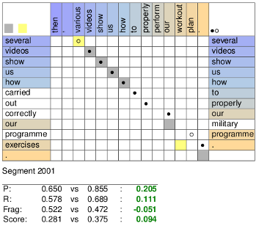
Contd.
METEOR also produce good correlation with human judgement at the sentence or segment level instead of corpus level as in BLEU metric
The Meteor automatic evaluation metric scores machine translation hypotheses by aligning them to one or more reference translations.
Alignments are based on exact, stem, synonym, and paraphrase matches between words and phrases

Slide 7
Methodology
An attention based approach was proposed to describe the contents of the given image
As claimed, quality of caption generation has improved using a combination of convolutional neural network to obtain vectorial representation of images and RNN was used to decode those representations into natural language sentences
Two attention-based image caption generators were used
“soft” deterministic attention mechanism trainable by standard back-propagation methods
“hard” stochastic attention mechanism trainable by maximizing an approximate variational lower bound or equivalently by REINFORCE

Slide 8
Model Details
Encoder : Convolutional Features
Convolutional neural network was used to extract a set of feature vectors, referred to as annotation vector here
The extractor produces L vectors, each of which is a D-dimensional representation corresponding to a part of the image.
To obtain a correspondence between the feature vectors and portion of 2-D image, features are extracted from lower convolutional layer
It allows the decoder to selectively focus on certain parts of the image by weighting a subset of all feature vectors.

Slide 9
Contd.
Decoder : Long Short-Term Memory Network (LSTM)
LSTM was used to produce a caption by generating one word at every time step conditioned on a context vector, previous hidden state and previously generated words
A deep output layer was used to compute the output word probability.
The inputs for the output layer are context vector, previously generated word and the decoder state.
Attention Models
Stochastic Hard
Deterministic Soft

Slide 10
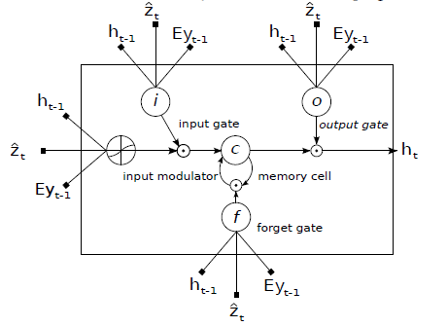
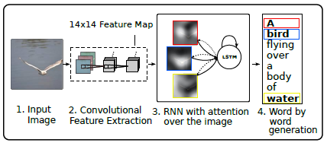
Diagrams
Methodology
Model

Slide 11
Training Procedure
Both variants of attention models were trained with stochastic gradient descent using adaptive learning rates
For the Flickr8k dataset, RMSProp worked best.
RMSProp is an optimizer that utilizes the magnitude of recent gradients to normalize the gradients.
For Flickr30k/MS COCO dataset, recently proposed Adam algorithm was quite effective.
It was found that training on a random group of captions to be computationally wasteful. To tackle with this issue, in pre-processing, a dictionary was built that maps the length of a sentence to the corresponding subset of captions.

Slide 12
Abstract
Inspired by recent work in machine translation and object detection, we introduce an attention based model that automatically learns to describe the content of images. We describe how we can train this model in a deterministic manner using standard backpropagation techniques and stochastically by maximizing a variational lower bound. We also show through visualization how the model is able to automatically learn to fix its gaze on salient objects while generating the corresponding words in the output sequence. We validate the use of attention with state-of-the art performance on three benchmark datasets: Flickr9k, Flickr30k and MS COCO.

