Slide 1
Using linking features in learning Non-parametric part models *
Ammar Kamal Hattab
ENGN2560 Final Project Presentation
May 17, 2013
* Leonid Karlinsky, Shimon Ullman, ECCV (3) 2012

Slide 2
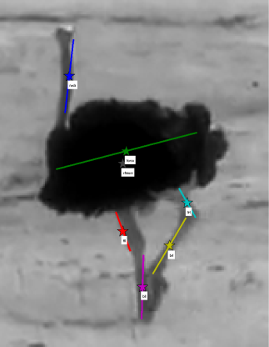
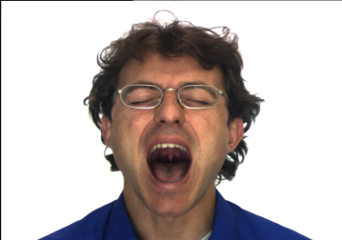
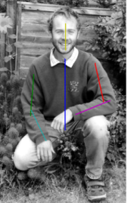
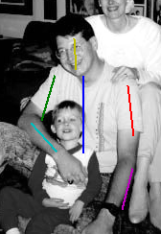
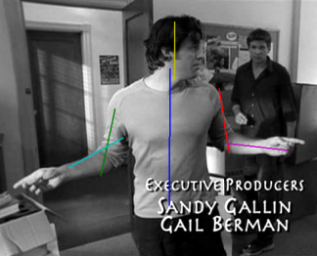
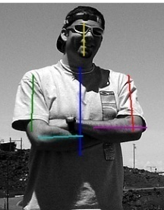
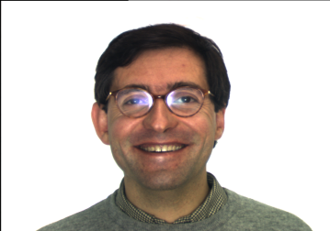
Project Goal
Project Goal: implement Linking Features Algorithm to detect a set of parts of a deformable object.
Examples:
detect human parts: head, torso, upper/lower limbs
detect facial landmarks: eyes, nose, mouth outlines, etc.
detect animal parts
…
Nk
Torso
tll
trl
bll
brl

Slide 3
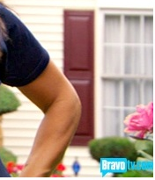
Linking Features Method
To use local features in strategic locations
To provide evidence on the connectivity of the part candidates
Features from the elbow are the “Linking Features” for the arm parts
How do we choose the right lower arm candidate?
The elbow appearance “links” the correct arm part candidates
Notes:
Features from the elbow that were learned to correspond to this particular arm configuration provide the evidence sufficient to choose the correct lower arm candidate. These features will be called the “linking features” for the arm parts.

Slide 4
Algorithm steps

Slide 5
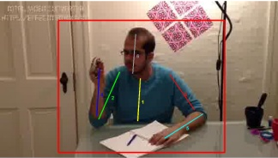
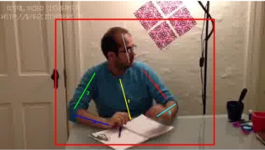
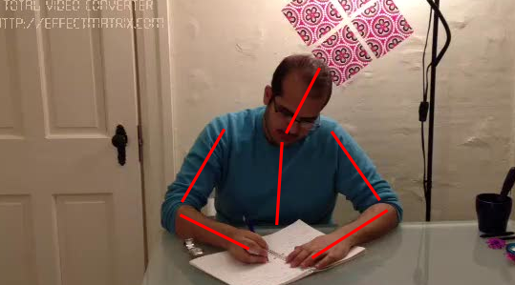

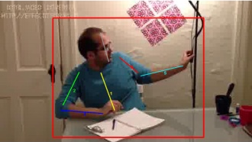
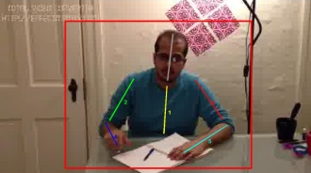
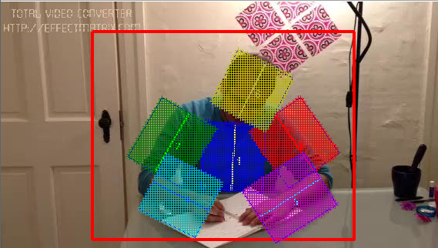
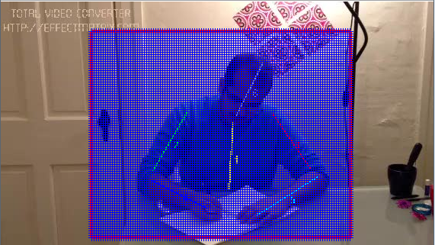
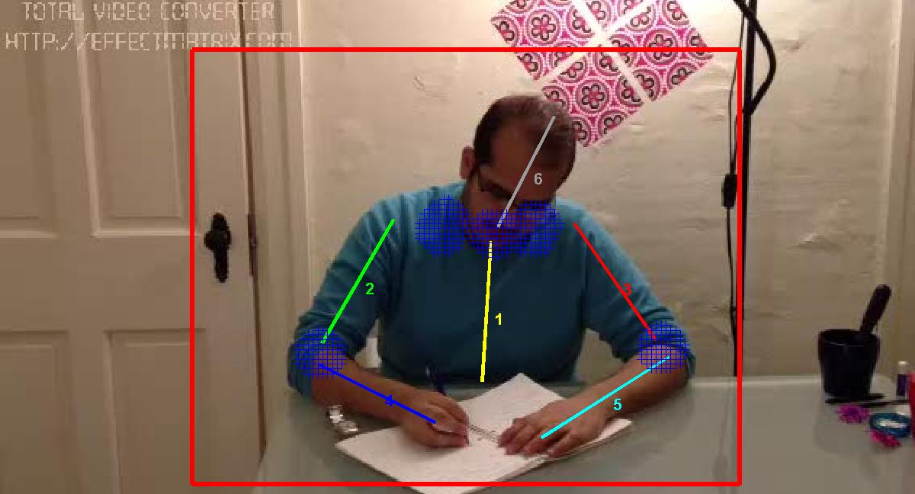
Training Steps
Extract
Annotate
Movie File
SIFT
Parts Features
Save
Training Model
Database
Linking Features

Slide 6

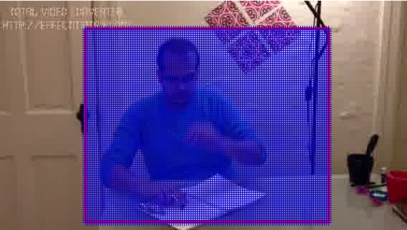
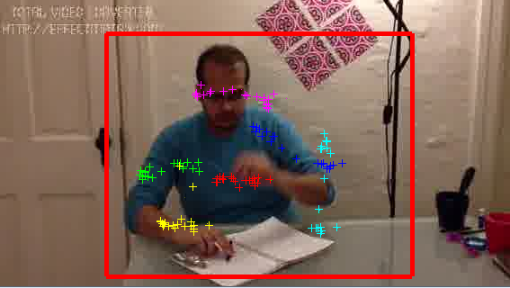
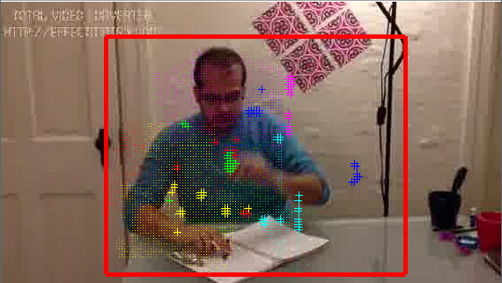
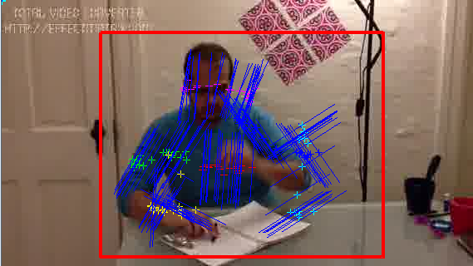
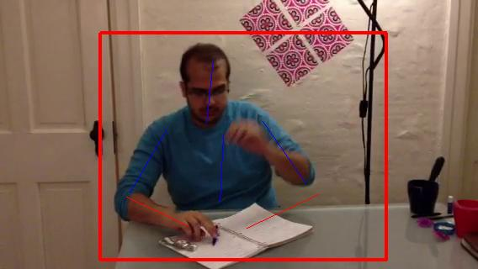
Testing Steps
SIFT
KDE
Training Model
Database
Max
With Orientations
Using Linking
Features

Slide 7
My Progress

Slide 8



Mid Presentation Status
I was able to generate parts candidates
I was able to use linking features to find the correct configuration of two part candidates
P = 0.0164
P =0.0868

Slide 9
Problems
Applying it to many images resulted in many errors:
In the detected center location of the parts
In the detected orientations of the parts
So to fix these errors :
Added two circles to the two ends of each part stick.
Fixed the voting locations (each feature votes for 25 locations)
Evaluated many different orientations

Slide 10

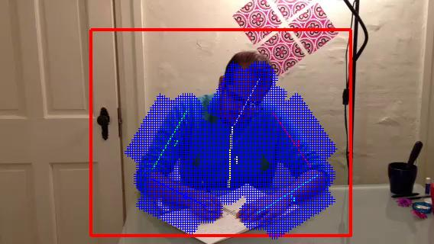
1- Adding Two Circles
Instead of using boxes only to collect features for different parts
Adding two circles to both ends enhances finding candidate part centers

Slide 11
2- Finding Correct Voting Locations
Each test image feature votes for candidate center locations (using Nearest Neighbors)
The correct candidate center locations could be found by adding
the offset between training Nearest Neighbors features and their center locations
to the feature location

Slide 12
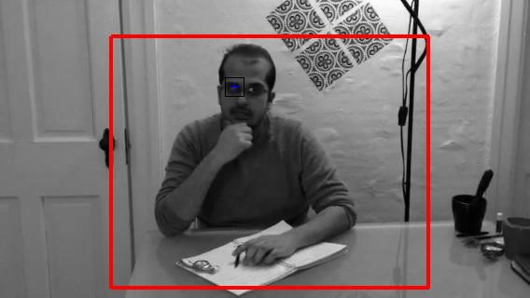
2- Finding Correct Voting Locations
Example: Eye Feature

Slide 13
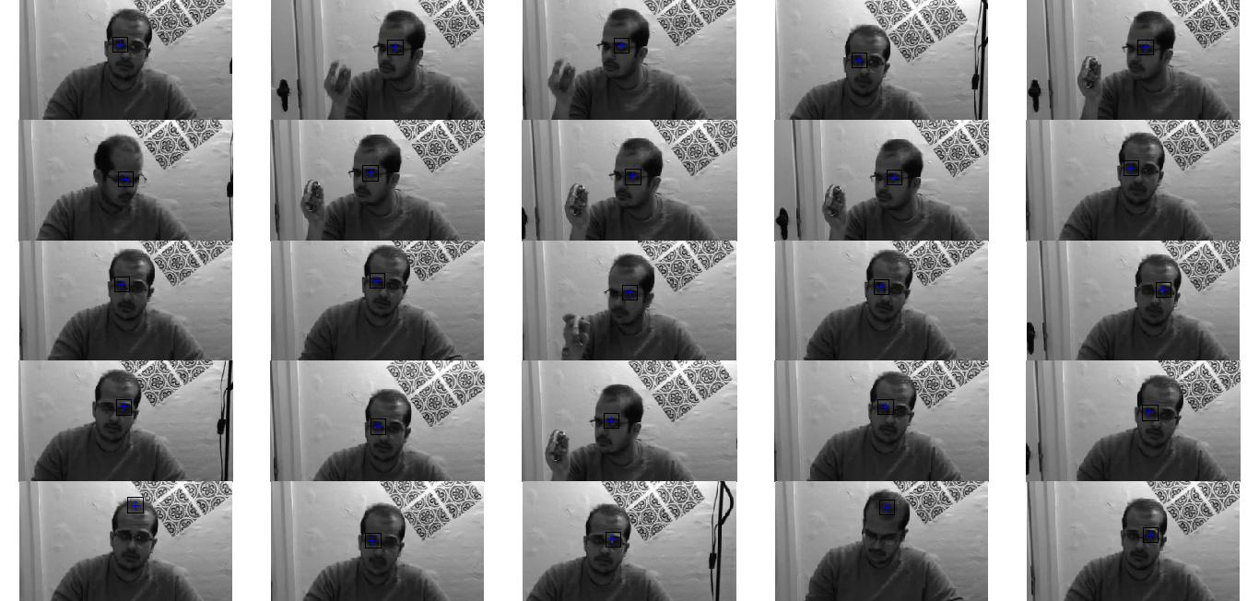
2- Finding Correct Voting Locations
Example: Eye Feature Nearest Neighbors

Slide 14
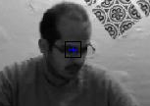
2- Finding Correct Voting Locations
Voting of the Head Center Location
Eye Feature (Test Image)
One of the Nearest Neighbors
(Training Image)
Using the offset
Candidate Center
Training Center

Slide 15
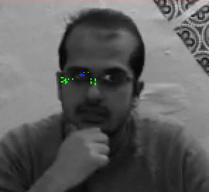
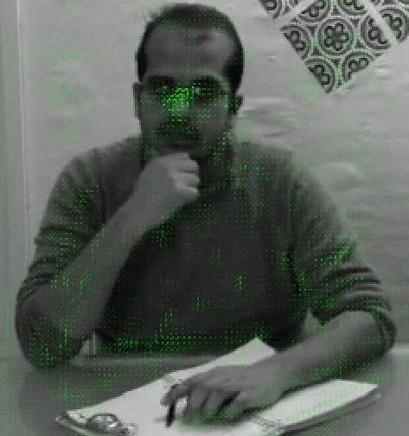
2- Finding Correct Voting Locations
Voting of the Head Center Location
Using the Eye Feature
Using All the Feature In the Image
25 voting locations

Slide 16
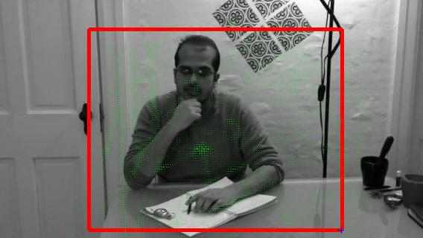
2- Finding Correct Voting Locations
Voting of the Torso Center Location

Slide 17
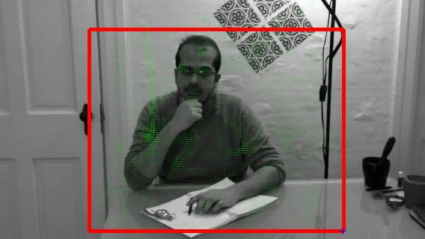
2- Finding Correct Voting Locations
Voting of the Upper Left Arm Center Location

Slide 18
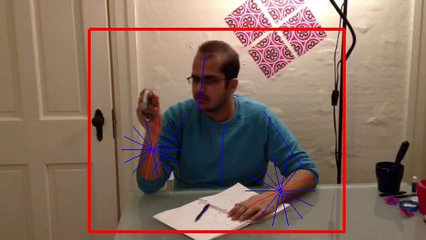
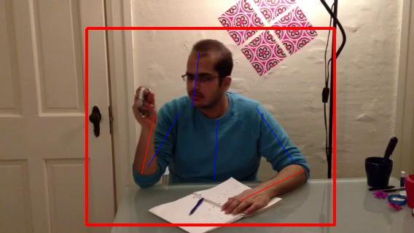
3- Using Many Orientations
To fix the problem of wrong orientations I used 7 orientations instead of three (as in the paper) to find the correct part orientation

Slide 19
Evaluation and Results

Slide 20
Dataset
I have tested the algorithm using a movie file,
32 frames for training
50 frames for testing
Running the algorithm on this file took around 10
hours

Slide 21
Evaluation Criterion
I used the standard PCP criterion (Percentage of Correctly Detected Body Parts) for parts detection which is used by the author of the paper.
PCP_{t} Criterion: both endpoints of the detected part should be within t ground-truth part length from the ground-truth part endpoints.
Detected Part
Ground Truth

Slide 22
Result
Result Detection:

Slide 23
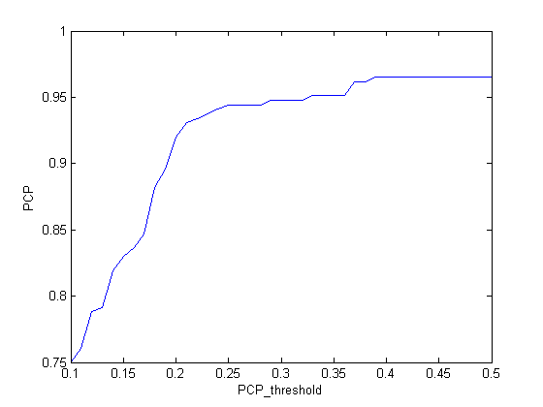
My Result
Result PCP Curve
Result PCP_{0.5} = 0.9653
96% of the parts are returned with 0.5 L from the ground truth

Slide 24
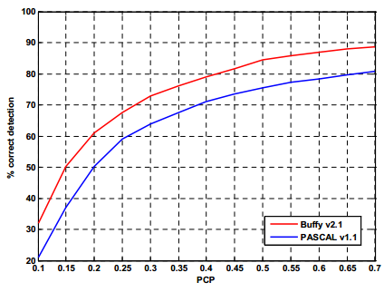


Paper Results
Paper Results PCP_{0.5}
Paper PCP Curve

Slide 25
Conclusion
My implementation gave higher PCP_{0.5}
due to the use of smaller dataset (50 images)
with fewer hard positions
Compared to the paper which applied it to large datasets with hundreds of images

Slide 26
Conclusion about Linking Features Algorithm
Provides high detection results comparable to state of the art methods.
Doesn’t need prior kinematic constrains
Linking Features add much values compared to part candidates scores alone
Could be combine with other methods to have better results.
Poor speed performance
Needs more clarification

Slide 27
END

Slide 28
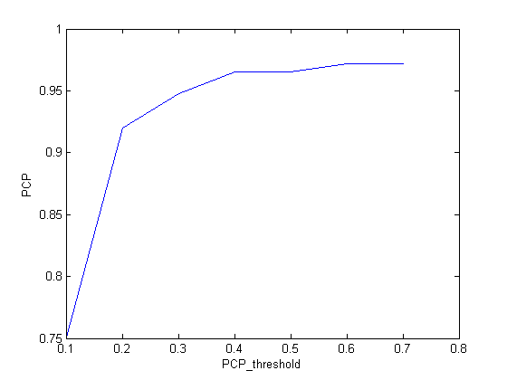
My Results

Slide 29

2- Finding Correct Voting Locations
Each test image feature votes for candidate center locations (using Nearest Neighbors) with voting weight proportional with :
d_{r} descriptors distance to r^{th} neighbor
o is the offset between feature and center

