Slide 1
MY REGIMEN

Slide 2
Introduction
Starting with the home page, which will take you to various places in the application. You can search what you see on our app, if you are a new user or an existing user, you will need to register on the app. you can log in/register on the app to perform skin care related improvement. For surveys, you can also read the blogs of our main contributors to learn more about products. Various options, such as Facebook, Google, Instagram, existing accounts or registration are available on signup page. On the product recommendation page, we can choose to search for a specific product category, which can be filtered and provide the name and price. You can also save any product as a favorite it for future use. Other product and ingredient images are displayed on the product overview page. This page also explains why the product is suitable for buyers. This page contains a list of websites. The website where we can purchase the selected products. This part of the page recommends products similar to your recent search. Customers can see each review and they can also like or dislike the reviews displayed on the screen. Therefore, the application is based to make the search for skincare products simple, easy, and worth it.

Slide 3
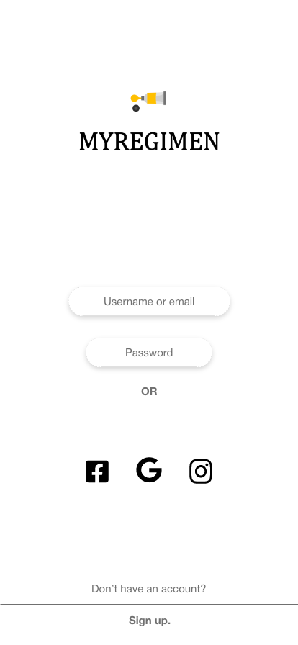
Login Page
What aspects of using prototype were problematic or confusing?
Everything was well in general, however I couldn't find the sign in button to continue when I entered my username and password.
Did you notice any features that you like?
The most useful aspect of the login page was the ability to log in using social media sites like Facebook, Google, or Instagram. It also helps you save time.
Did you notice any features that you dislike?
very feature on this page was beneficial in its own right and made the process move more smoothly.
Were any terms confusing?
I couldn't find the login button while entering an existing user id.
Which interface labels are confusing or require clarification?
Every interface on this page is well-designed and clearly defines its purpose.
Do you have any suggestions for improvement?
A support desk or a forget username and password tool, in my opinion, should also be included.

Slide 4
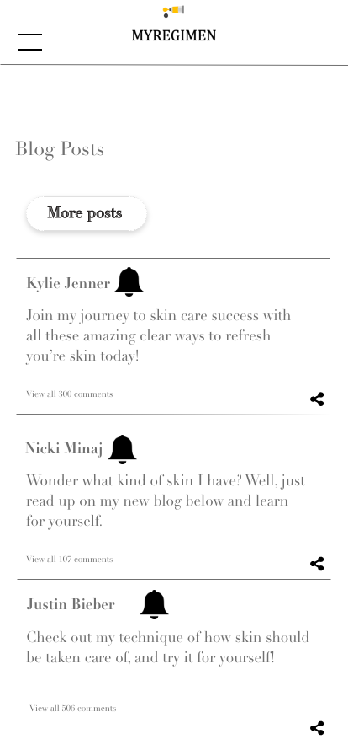
Blog Page
What aspects of using prototype were problematic or confusing?
Each prototype was meticulously crafted and easily navigable.
Did you notice any features that you like?
The ability to share a blog post is uncommon in these kind of apps, and it's something I've always wanted. So having this functionality on the page appealed to me.
Did you notice any features that you dislike?
I couldn't figure out where to click on the page to see the entire blog. Because Nicki Minaj wrote in her blog, "read the blog below and discover yourself," I struggled with that.
Were any terms confusing?
The most perplexing term I encountered was reading the entire blog.
Which interface labels are confusing or require clarification?
They can include a brief description of the blogger, such as whether he or she is a user or a specialist.
Do you have any suggestions for improvement?
They should also include a function that allows users to like or dislike individual blogs.

Slide 5
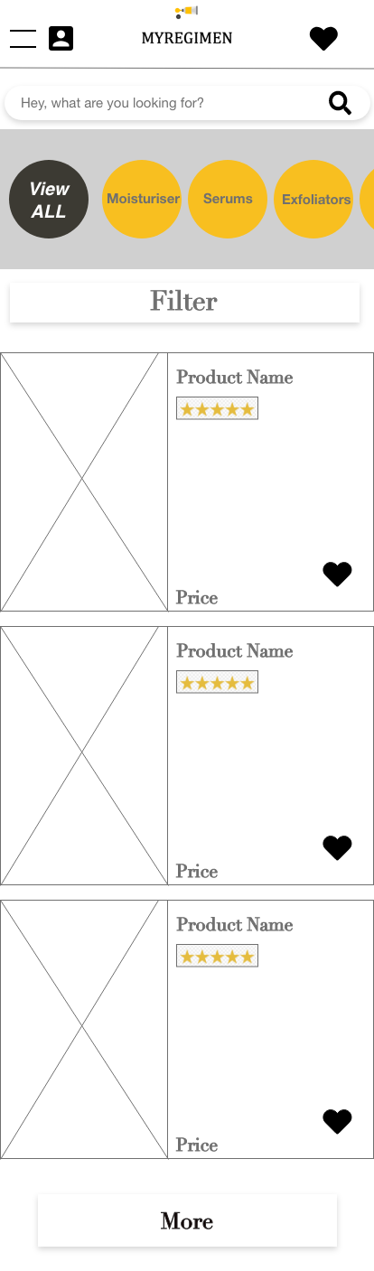
Product Recommendation
What aspects of using prototype were problematic or confusing?
None of the aspect here was confusing to me.
Did you notice any features that you like?
The ability to like the product is a standout feature.Did you notice any features that you dislike?
The tab in which we have the choice to select product type, in my opinion, should be replaced with product brand because brand is the most important factor in skin care.
Were any terms confusing?
No, each and every function was straightforward to use and navigate
Which interface labels are confusing or require clarification?
They can place a review underneath the stars to indicate how many reviews it has.
Do you have any suggestions for improvement?
The tab above the filter can be merged with the filter, and top company brand names can be added. Because we can leverage the filter tool after choosing a brand, which is more significant while looking at products for skin improvement.

Slide 6
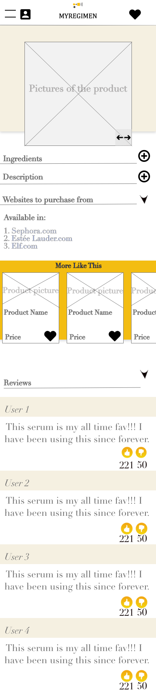
Product Review
What aspects of using prototype were problematic or confusing?
Got a difficulty in liking or saving and purchasing the product at the time of review from that specific page at that time?
Did you notice any features that you like?
Showing more products that are comparable to this one provides a large selection from which to choose.
Did you notice any features that you dislike?
No, the product review page is well-designed and includes all specifications.
Were any terms confusing?
No, everything went off without a hitch
.Which interface labels are confusing or require clarification?
Each interface on this page is adequately specified and explains how to use it.
Do you have any suggestions for improvement?
They can add a feature to like the product being reviewed at the time, or they can just add it to their cart or purchase it.

