Slide 1
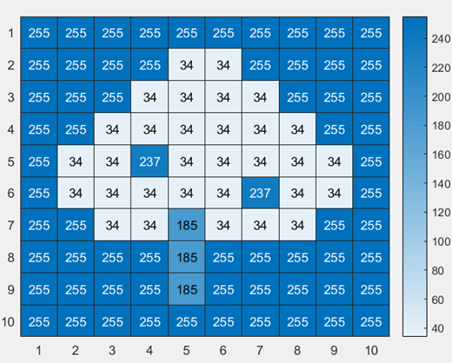
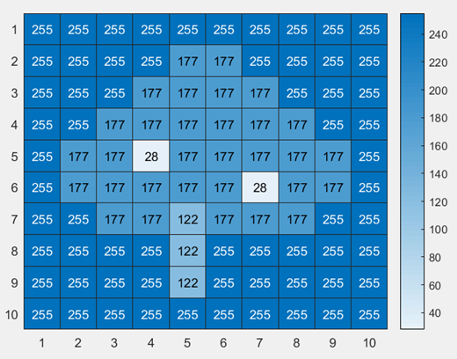
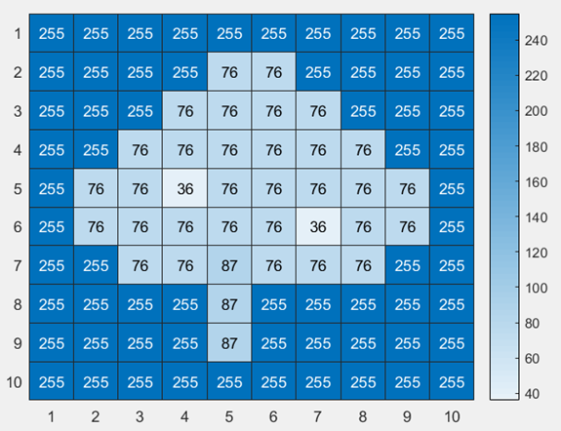
Color Channel Heat Maps
Red
Green
Blue

Slide 2
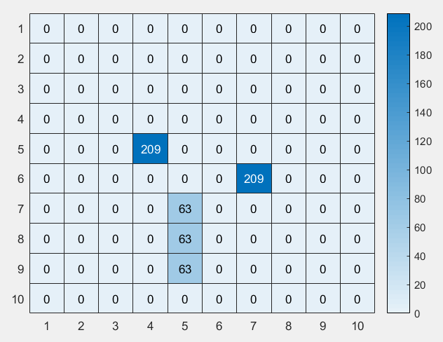
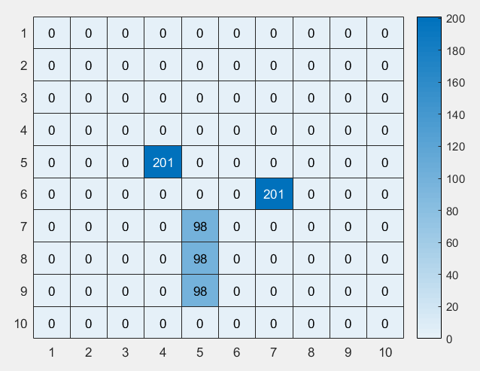
Red minus Green
Red Minus Blue

Slide 3
Problem 1
First the image is stored in a variable. Then the image is split into 3 color channels (red, green, blue). In order to remove the background blue and green color channels are subtracted from red color channel. A thresholding condition is then applied to the obtained matrixes, in order to filter out the cordinates that has significant difference between color channels. Among the filtered cordinates, apples are present at the pixels where intensity of red is greater than the sum of green and blue intensity.

