Slide 1
Problem 1
First the image is stored in a variable. Then the image is split into 3 color channels (red, green, blue). In order to remove the background blue and green color channels are subtracted from red color channel. A thresholding condition is then applied to the obtained matrixes, in order to filter out the cordinates that has significant difference between color channels. Among the filtered cordinates, apples are present at the pixels where intensity of red is greater than the sum of green and blue intensity.

Slide 2
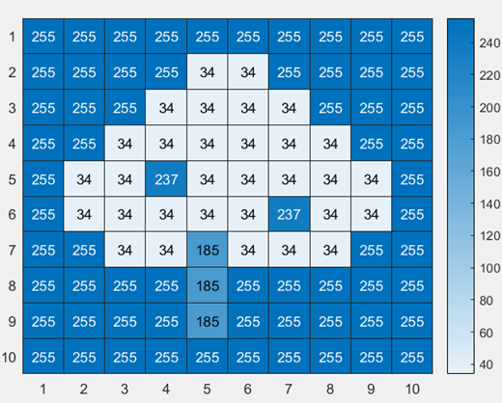
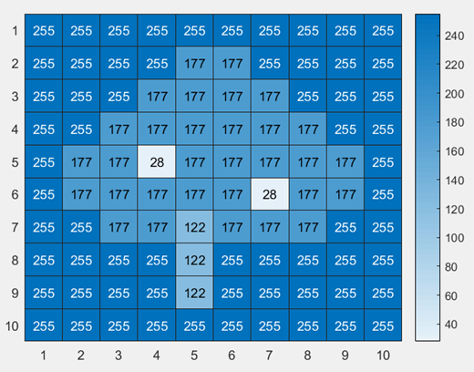
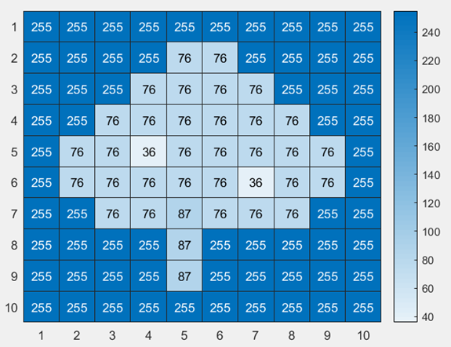
Color Channel Heat Maps
Red
Green
Blue

Slide 3
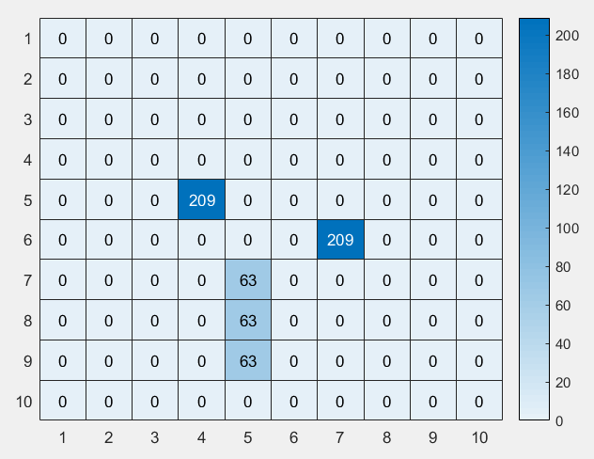
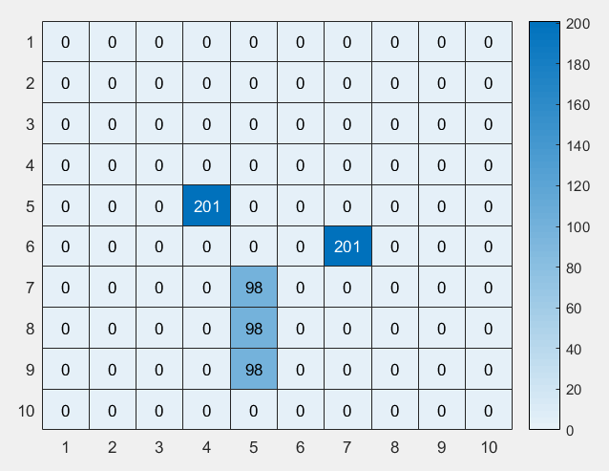
Red minus Green
Red Minus Blue

Slide 4
Problem 2
In order to rotate the image, first the centre of image is determined. A loop goes through all pixels of the image, and determines new position. The transformation is done in polar coordinates then mapped back to Cartesian coordinates.
In order to shrink and expand the image, first the linearly spaced vectors with half and double the dimensions of image are generated respectively. Then mesh-grids are generated from the vectors. At the end, 2D interpolation is performed on both the mesh-grids

Slide 5
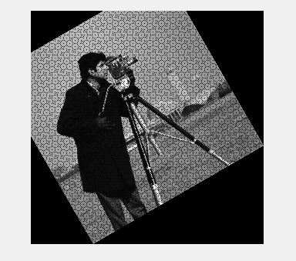
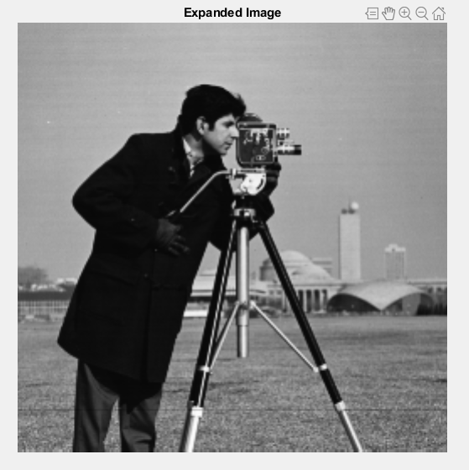
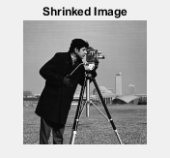

Slide 6
Problem 3
In order to detect the corners, first dimensions of the images are fixed then they are converted into grey scale images. After that Harris Feature detector function is used to detect corners of the given shape in the image. Then the corners are plotted on to the images.

Slide 7
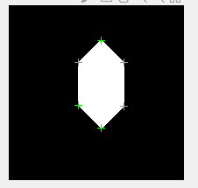
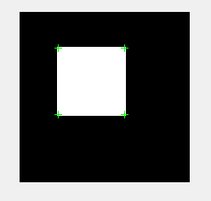
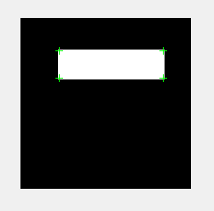

Slide 8
Problem 4
In order to obtain centeroid of a shape, firstly a progressive rectangular grid in fromed in x and y dimention. After filtering out the active pixels, mean is taken in both dimention, that gives out the centroid. Maximum and minimum of the grid in both dimentions is used to obtain the bounding box boundries.
Sobel filter is then manually applied to find the boundries of the shape. Parameter is fond by counting the number of pixels in the boundrz of the shape. Similarly area is determined by counting the number of pixels in the shape.

Slide 9
Major axis is determined by looking at all the parameter pixels and observing that which pairs are at the maximum distance and pass through the centroid.
Circularity is determined by the following formula:
Circularity = (4 * pi * area)./(parameter .^ 2)

Slide 10
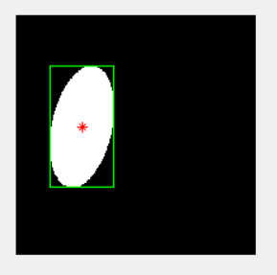
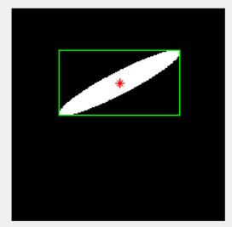
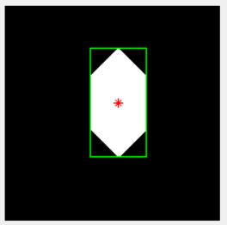
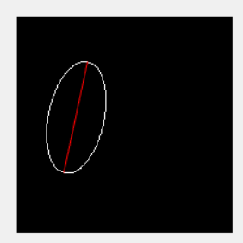
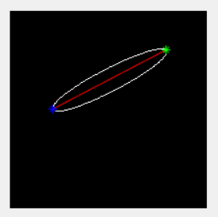
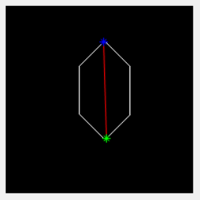

Slide 11
Problem 5
After reading and binarizing the image an image offset is defined. Global variables for image, empty labels and current label are defined. A recursive function the goes to each pixel observes its neighbours and once some active pixels are found they are replaced with ‘current label‘ variable. The variable is incremented once neighbours different than the current label are found.

Slide 12
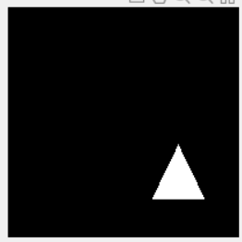

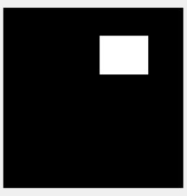
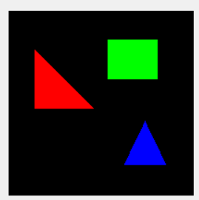

Slide 13
Problem 6
After reading and binarizing the image an image offset is defined. Global variables for image, empty labels and current label are defined. A recursive function the goes to each pixel observes its neighbours and once some active pixels are found they are replaced with ‘current label‘ variable. The variable is incremented once neighbours different than the current label are found.

Slide 14

