Slide 1



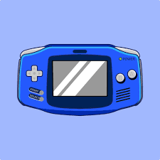
MINI PROJECT EVALUATION
Reverse Engineering and Emulation of
NES Hardware with
Integrated Debugger
Ojas Kumar - 23bcs059
Talatiya Mitraj - 23bcs092
Mentor/Guide - Dr. Sonika Gupta

Slide 2
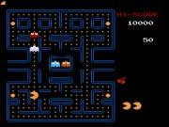
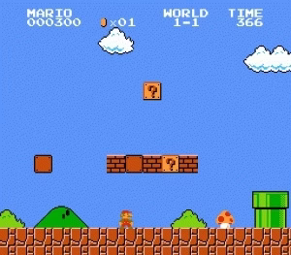
Problem Statement
Emulation is a core area of systems programming and reverse engineering , allowing legacy hardware to be replicated in software. The Nintendo Entertainment System (NES), launched in the 1980s, is one of the most studied consoles (CPU 6502) due to its influence on computer architecture and gaming history.
So, how can legacy hardware (NES) be reverse engineered and emulated in Rust while also providing modern debugging and profiling features to enhance usability for both learners and developers?

Slide 3

OBJECTIVES
  To study and reverse engineer the NES hardware architecture (CPU, PPU, APU, Memory Bus)
  To design and implement an emulator in Rust with modular and extensible architecture.
  To integrate a monitor/debugger supporting instruction tracing, breakpoints and profiling
  To analyze performance and correctness of the emulator against existing test ROMs.

Slide 4
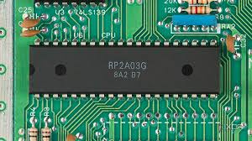
PROPOSED SOLUTION & METHODOLOGY
  Literature Survey & Reverse Engineering
    Study NES Architecture (6502 CPU, PPU, APU)
    Review existing emulators (FCEUX, Nestopia, Mesen) to identify strengths and limitations
  Design & Implementation
    Implement CPU instructions set and memory bus using Rust structs and enums
    Simulate PPU (video rendering) and APU (sound) subsystems
    Develop modular architecture seperating core emulation and debugging tools.
  Debugger & Monitoring System
    Build Step-Through execution engine with breakpoints
    Collect statistics (instruction frequency, CPU/GPU cycles, memory usage).
  Testing & Validation
    Run official NES test ROMs and compare behaviour with reference emulators.
THE 6502 CPU

Slide 5
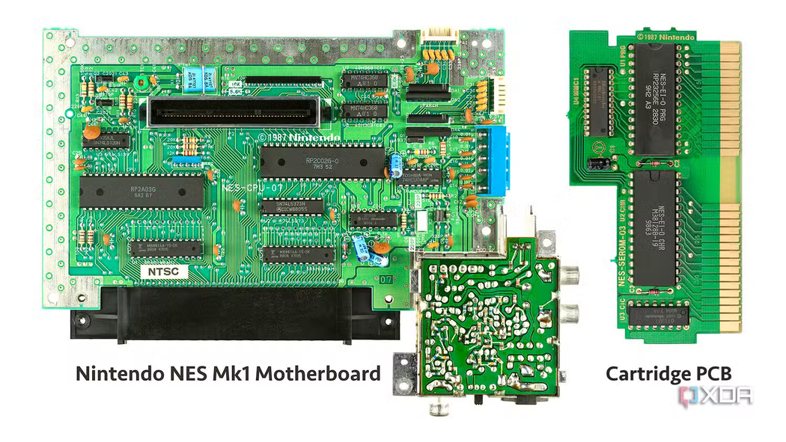
OUR PROGRESS TILL DATE
  CPU – Emulates the 6502 processor, running entirely in interpreted mode and lacking support for floating-point (BCD) operations.
  Bus – Acts as the communication backbone, connecting and synchronizing all NES components to operate in perfect cycle harmony.
  PPU (Picture Processing Unit) – Handles all graphical rendering for the NES, operating on a precise scanline-by-scanline basis.
  Cartridge – The game’s ROM module that loads the program data directly into the NES system.
  JoyPad – The iconic NES input controller, delivering classic and responsive player interaction.
  APU (Audio Processing Unit) – Generates system audio, though sound remains partially distorted as the DMCA channel emulation is still in progress.

Slide 6

CHALLENGES FACED & HOW WE ADDRESSED THEM
  Writing a Rust equivalent for every single 6502 CPU instruction was highly time-consuming and error-prone.
  The PPU (Picture Processing Unit) had complex addressing mechanisms, making accurate emulation difficult.
  Frequent program hangs occurred due to synchronization issues between CPU and PPU.
  Required a shift to a multithreaded architecture to maintain stability and responsiveness.
  Achieving cycle-accurate timing was essential to prevent graphical glitches and crashes.

Slide 7

FUTURE WORK & SCOPE
  Implement the DMC (Delta Modulation Channel) to complete NES audio emulation.Implement the DMC (Delta Modulation Channel) to complete NES audio emulation.
  Add support for multiple cartridge mappers beyond the currently supported NROM.
  Develop a more graphically enhanced debugger for better real-time analysis and visualization.
  Integrate a PPU tile viewer to inspect background and sprite rendering in detail.

Slide 8
REFERENCES
  Ricci, A., Programming the 6502, Sams Publishing, 1983
  NESDev Wiki: https://www.nesdev.org/
  Matt Godbolt, “6502 CPU Emulation in Practice,” IEEE Software, 2018
  FCEUX Emulator Documentation: http://www.fceux.com/
  NesDev Forums (community contributions on NES Architecture and emulation)
  Rust Programming Language Book: https”//doc.rust-lang.org/book/
WE THANK YOU FOR YOUR KIND ATTENTION
WE WISH YOU A HAPPY DAY !

