Slide 1
Online School Portal
0th Review
04/09/2026
Introduction & proposal
1st Review
18/09/2026
Background & literature
2nd Review
16/10/2026
Design and Implementation of an Online School Portal for Automation of Administrative and Student Processes
Forb Joseph Mufwambi · Reg. No 25233351032
Bachelor of Science in Computer Science · 351PJ01 Mini Project
DMI-St. Eugene University, Chipata Campus
System design diagrams
3rd Review
23/10/2026
Implementation & security
Notes:
Good morning. My mini project is an Online School Portal for DMI-St. Eugene University, Chipata Campus. It automates the administrative and student processes that are currently done on paper — admissions, fees, semester registration, coursework, results, and the No Due clearance that produces the exam hall ticket. This presentation is organised by the four review stages of the 351PJ01 review format shown on the right.

Slide 2




Presentation outline
0th Review
1st Review
2nd Review
3rd Review
04/09/2026
18/09/2026
16/10/2026
23/10/2026
Introduction
About the project
Problem statement
Aims & objectives
Scope & limitations
Development requirements
Justification
Background
Literature review of related systems
Why the proposed system is better
System architecture
Data flow diagrams
Use case diagram
Database design
Programming language & design
Evaluation & maintenance
Installation & operation
Security
Pages, features & code
Conclusion & summary
Notes:
The deck answers every bullet of the review format. The 0th review introduces the project and its proposal; the 1st review covers background and literature and justifies why the proposed system is better; the 2nd review presents the design diagrams; and the 3rd review covers implementation, evaluation, installation, security, the working pages and code, and the conclusion.

Slide 3

0th Review
04/09/2026 · Introduction, about the project, problem statement, aims & objectives, scope & limitations, development requirements and justification of the study
Notes:
The 0th review sets out what the project is, the problem it solves, what it aims to achieve, its boundaries, what was needed to build it, and why it is worth doing.

Slide 4
Introduction
0th Review
Universities run on processes: admitting students, billing and collecting fees, registering students each semester, teaching, examining and publishing results.
At DMISEU Chipata Campus most of these still depend on paper forms, notice boards and students walking from office to office for signatures.
This project replaces those steps with one secure web portal, where every student, lecturer and staff office works from the same live information.
5
19
Schools served
Diploma & Bachelor programmes
10
30
User roles, each with its own view
Database tables behind the portal
Notes:
Universities run on a set of core processes. At our campus most of them are still paper-based. The portal brings them into one web system. The figures on the right come from the system itself: it serves the campus's 5 schools and 19 programmes, supports 10 distinct user roles, and stores its data in 30 MySQL tables.

Slide 5








About the project
0th Review
A role-based web portal built with Node.js, Express and MySQL. Each module replaces a paper or manual process:
Online admissions
Role-based portals
Fees & payments
Semester registration
Apply for a programme online; registry reviews and accepts
Student, lecturer and staff dashboards with their own tabs
Fee ledger, billing and proof-of-payment verification
Register each semester; 5 offices approve in order
Notes & assignments
Results
Hall tickets
Notifications
Lecturers post Units 1–5 and assignments; students submit
CA and exam marks, automatic totals, grades and remarks
Digital No Due clearance, then a printable hall ticket
Announcements and alerts for every approval or hold
Notes:
The portal is organised into eight modules. The two highlighted in gold — semester registration and exam clearance with hall tickets — are the most automated: they replace multi-office signature forms with sequential digital approvals.

Slide 6




Problem statement
0th Review
Office-to-office signatures
The No Due Certificate needs Accounts, Class Advisor, Hostel, HOD, Dean of Students and Dean (Academic) to sign in person.
PROBLEM STATEMENT
Administrative and student processes at DMISEU Chipata Campus are manual and paper-based. This makes them slow, error-prone and hard to track, for students and staff alike. There is no single system where a student can apply, pay, register, learn, see results and get cleared for exams.
Paper records and manual checks
Fee balances, registrations and hall tickets are checked and prepared by hand, inviting errors and lost forms.
Queues and delays
Students lose class time queuing at offices; staff repeat the same checks every semester.
No real-time visibility
Students cannot see where their clearance is held up, or their balance, results and notices in one place.
Notes:
The biggest pain point is the No Due Certificate: before every mid-semester test a student walks to six offices to collect signatures, as shown on our actual paper form. The same pattern repeats for semester registration. Records are on paper, checks are manual, and nobody can see the status in real time.

Slide 7

Aims & objectives
0th Review
Aim To design and implement a secure online school portal that automates the administrative and student processes of DMISEU Chipata Campus.
1
Provide online admission applications and review by the registry
2
Give each role (student, lecturer, 8 staff roles) its own secure dashboard
3
Keep a fee ledger and verify uploaded proofs of payment
4
Automate semester registration with fee checks and five sequential approvals
5
Let lecturers publish notes, assignments and marks; compute grades automatically
6
Digitise the No Due Certificate and issue printable hall tickets
7
Support direct-entry students through semester exemptions
8
Notify users of every decision, hold and announcement
Notes:
The aim is a single secure portal automating the campus's administrative and student processes. The eight specific objectives map one-to-one to modules of the system, so each can be demonstrated and tested.

Slide 8


Scope & limitations of the study
0th Review
In scope
Limitations
DMISEU Chipata Campus: 5 schools, 19 Diploma & Bachelor programmes
Students, lecturers / class advisors and 8 staff roles
Admissions, fees, semester registration, notes, assignments, results
No Due clearance, exam timetables per programme & semester, hall tickets
Direct-entry exemptions, notifications and announcements
Web access from any modern browser, desktop or phone
No online payment gateway yet: students upload proof and Accounts verifies
No SMS or e-mail delivery; notifications are inside the portal
Single campus; other DMISEU campuses are not connected
Needs an internet connection; no offline mode
Grade scale is configurable and must be set to the official one
Not yet load-tested with the full student population
Notes:
The study covers the Chipata campus, all its programmes and every role involved in the processes. The main limitations are honest constraints of a mini project: payments are verified from uploaded proofs rather than an online gateway, notifications stay inside the portal, and the system has not yet been load-tested at full scale.

Slide 9


Development requirements
0th Review
Hardware
Software & tools
Libraries
Development laptop: dual-core CPU, 8 GB RAM, 256 GB storage
Server (deployment): 2 vCPU, 4 GB RAM, 40 GB SSD
Client: any PC or smartphone with a browser
Internet connection / campus LAN
Node.js runtime and npm
Express 5 web framework
MySQL 8 database (mysql2 driver)
VS Code editor, Git & GitHub
Google Chrome (testing), curl / Postman
bcrypt — password hashing
jsonwebtoken — login tokens
multer — file uploads
dotenv — configuration
nodemon — auto-restart in development
Notes:
Development needs only modest hardware. The software stack is entirely free and open source: Node.js with Express 5 on the server, MySQL for data, and a handful of well-known libraries for password hashing, tokens, uploads and configuration. The front end is plain HTML, CSS and JavaScript, so any browser works.

Slide 10






Justification of the study
0th Review
Saves time
Fewer errors
Transparency
Clearance and registration move between offices instantly instead of by foot.
Fee percentages, totals and grades are calculated by the system, not by hand.
Students see exactly which office has signed or put them on hold, and why.
Access anywhere
Less paper & cost
Better decisions
Available 24/7 from a phone or PC, on and off campus.
Forms, printed lists and typed hall tickets are replaced by digital records.
Live figures on fees, registrations and clearance for management.
Notes:
The study is justified by six benefits. The most visible to students are time saved and transparency — no more walking between offices or guessing who is holding a clearance. For the institution, automatic calculations reduce errors, paper costs drop, and management gets live figures.

Slide 11

1st Review
18/09/2026 · Background, literature review of systems related to the project idea, and why the proposed system is better than existing systems
Notes:
The 1st review places the project in context: the institution and its current process, what other universities and researchers have done, and how the proposed system improves on them.

Slide 12

Background
1st Review
DMI-St. Eugene University
A private university in Zambia with its main campus on Great North Road, Lusaka. The Chipata Campus offers Diploma and Bachelor programmes in five schools: Computing & IT, Business & Management, Social Sciences, Education, and Food & Nutrition Sciences.
The current process
Before each mid-semester test a student collects a paper No Due Certificate, then gets it signed office by office. The Controller of Examinations then issues a typed hall ticket. Semester registration follows a similar paper trail.
Universities across the region, including the University of Zambia, have moved these steps online, as the literature review shows.
Today: the paper No Due Certificate
Accounts office — dues in K
Class Advisor
Hostel
one walk and signature per office
Head of Department
Dean of Students
Dean (Academic)
Hall ticket typed and stamped by the Controller of Examinations
Notes:
Here is the background. The diagram on the right is our actual paper No Due Certificate: three departmental signatures — Accounts, Class Advisor and Hostel — then three officers: HOD, Dean of Students and Dean (Academic). Each is a separate trip. The portal reproduces exactly this chain, but digitally.

Slide 13
Literature review: related systems
1st Review
Lubanga, Majawa, Kapondera & Chawinga (2018)
Kaggwa (2010)
University of Zambia (n.d.)
Web-based student information management system — Mzuzu University, Malawi
Web-based students’ academic management system — Kampala International University, Uganda
Student Information System (SIS) — online course registration
Online registration and admissions cut the time students spend registering each semester. Problems: server overload at peak times, costly internet data, slow updates.
Replaced paper files that caused redundant, ambiguous data. Centralised notices, study materials, results and timetables; 60% of surveyed students supported it.
Student submits courses, HOD or Assistant Dean approves, then fees are paid. Status becomes "Registered" once a minimum share of fees (37.5% of tuition) is paid.
Lesson: Design for peak load and low data use; keep pages light.
Lesson: Centralise notes, assignments and results in one portal.
Lesson: Approval chain plus a minimum-fee rule; our portal uses 40% for registration.
Notes:
Three related systems. At Mzuzu University, Lubanga and colleagues found that a web-based student system shortened registration, but students suffered server overload and data costs. Kaggwa at Kampala International University replaced paper files with a central academic system that most students supported. Closest to home, the University of Zambia SIS uses an approval chain and registers a student once a minimum 37.5 percent of tuition is paid. Each gives a design lesson for our portal.

Slide 14



Literature review: theory & enterprise systems
1st Review
Technology Acceptance Model Davis (1989)
GAP IDENTIFIED
Users adopt a system when they find it useful and easy to use.
Applied: Clear tabs per role, plain-language status messages, one-click printing.
The systems reviewed handle registration, records and results. None of them documents a digital No Due clearance that ends in a hall ticket tailored to the student’s programme and semester, together with fee rules and direct-entry exemptions. This project fills that gap for DMISEU Chipata Campus.
IS Success Model DeLone & McLean (2003)
System, information and service quality drive use, user satisfaction and net benefits.
Applied: Accurate automatic calculations, live data and a clear audit of who signed what.
ERP in higher education Rabaa’i (2009)
University-wide ERP adoption is growing, but many implementations fail; critical success factors must be managed.
Applied: Built step by step around the campus’s own forms, one module at a time.
Notes:
Two theories guided the design. The Technology Acceptance Model says users adopt systems that are useful and easy to use, so each role sees only what it needs. DeLone and McLean's success model stresses system and information quality, so calculations are automatic and every signature is recorded. Rabaa'i warns that university ERP projects often fail, which is why the portal was built module by module around our own forms. The gap: none of the reviewed systems documents a digital No Due clearance ending in a programme-specific hall ticket.

Slide 15
Why the proposed system is better
1st Review
Capability | Current manual process | Typical SIS (e.g. UNZA SIS) | LMS only (e.g. Moodle) | Proposed portal
Online admission applications | ✗ | ✓ | ✗ | ✓
Semester registration with office approvals | ✗ | ✓ | ✗ | ✓
Fee ledger + proof-of-payment verification | ✗ | Fee view | ✗ | ✓
Digital No Due clearance (6 offices) | ✗ | Not documented | ✗ | ✓
Hall ticket per programme & semester | Typed by hand | Not documented | ✗ | ✓
Notes, assignments and results | Notice boards | Results | ✓ | ✓
Direct-entry semester exemptions | On paper | Not documented | ✗ | ✓
Built for DMISEU forms; free, open-source stack | — | ✗ | Generic | ✓
UNZA SIS capabilities from the University of Zambia’s published registration guide; "Not documented" means no public evidence was found, not that the feature is absent.
Notes:
This table justifies why the proposed system is better. Compared with our manual process it automates every row. A typical SIS such as UNZA's covers admissions and registration, but we found no public evidence of a digital No Due clearance or programme-specific hall tickets. An LMS such as Moodle handles teaching content but not administration. The proposed portal is the only option covering all rows, built around our own forms on a free stack.

Slide 16




What makes the proposed system better
1st Review
Follows our real approval chain
Rules applied automatically
Accounts → Class Advisor → Hostel → HOD → Dean of Students → Dean (Academic), enforced in order. No step can be skipped, and every signature is time-stamped.
Accounts clears a student the moment 40% (registration) or 75% (mid-semester exams) of fees are paid. No manual balance checks.
Hall ticket in one click
Handles real-world cases
Once all six approvals are in, the student prints an A4 hall ticket showing only their own programme and semester modules.
Direct-entry exemptions, hostel vs non-hostel students, and holds with reasons the student can read and fix.
Notes:
Four things make the proposed system better. It follows our real approval chain and enforces the order. It applies the fee rules automatically. It produces the hall ticket in one click, listing only that student's modules. And it handles the real cases staff deal with: direct-entry students, hostel residents and holds with reasons.

Slide 17

2nd Review
16/10/2026 · System architecture, data flow diagrams, use case diagram and database design
Notes:
The 2nd review presents the design of the system through four kinds of diagram: architecture, data flow, use cases and the database design.

Slide 18



System architecture
2nd Review
Presentation tier
Application tier
Data tier
Web browser · HTML, CSS, JavaScript
Node.js · Express 5 REST API
MySQL 8 · file storage
Public website & online application
Middleware: JSON, static files, verifyToken (JWT), checkRole
MySQL database dmiseu_chipata_campus — 30 tables
Student portal
Routes: auth, admissions, fees, registration, exams, results, notes, assignments, notifications…
uploads/ — photos, payment proofs, notes, submissions
Lecturer portal (Class Advisor)
HTTPS
REST · JSON
+ JWT
mysql2 pool
SQL with ?
parameters
Staff dashboard — 8 roles
Services: start-up migrations, notifications, fee-reminder scheduler
data/*.json — programmes, fees, grade scale
Printable A4 hall ticket
Notes:
The system uses a classic three-tier architecture. Browsers load static HTML, CSS and JavaScript pages and call a REST API with a JSON Web Token in each request. The application tier is Node.js with Express 5: middleware checks the token and the user's role before any route runs, and each business area — fees, registration, exams and so on — is a separate route module. The data tier is a MySQL database of 30 tables, plus a folder for uploaded files and JSON configuration such as the programme list and grade scale. Database changes are applied automatically when the server starts.

Slide 19
Data flow diagram: context (Level 0)
2nd Review
Applicant
Accounts office
→ application & documents
→ payments, verifications
← admission decision
← ledger, proofs to verify
0
Online School Portal
Student
→ registration, proofs, submissions
→ approvals or holds
HOD & Dean of Students
← statement, results, hall ticket
← approval queue
Lecturer / Class Advisor
→ notes, marks, approvals
→ sessions, timetables, roles
Registry, Dean (Academic) & Admin
← class lists, submissions
← reports, final approvals
Blue: data into the system · Gold: data out to the entity
Notes:
The context diagram shows the whole portal as one process and the six external entities that exchange data with it. Applicants send applications and receive decisions. Students send registrations, proofs of payment and assignment submissions, and receive statements, results and hall tickets. Lecturers send notes, marks and Class Advisor approvals. Accounts verifies payments. HOD and Dean of Students approve or hold. The registry, Dean (Academic) and administrator configure sessions, timetables, exemptions and user roles.

Slide 20
Data flow diagram: Level 1 processes
2nd Review
1.0
new student
2.0
% fees paid
3.0
Manage admissions & accounts
Manage fees & payments
Semester registration
D1
USERS, students, applications
D2
fee_entries, payment_proofs
D3
semester_registrations, exemptions
% fees paid
current semester
4.0
5.0
6.0
Teaching & results
Exam clearance & hall tickets
hold / ticket
Notify users
D4
course_notes, assignments, result_marks
D5
exam_sessions, timetable, clearances
D6
notifications, announcements
Notes:
Level 1 breaks the portal into six processes, each with its main data store. Admissions creates the student account, which triggers billing in process 2. Fee data feeds both semester registration and exam clearance, because both check the percentage of fees paid. Registration sets the student's current semester, which exam clearance uses to pick the right modules for the hall ticket. Every hold or issued ticket flows to the notification process.

Slide 21
Data flow diagram: Level 2, exam clearance
2nd Review
Departments (any order)
5.1 Accounts: auto-check fees ≥ 75%
All three cleared?
5.4
HOD approves
5.5
Dean of Students approves
5.6
Dean (Academic) approves
5.7
Issue hall ticket no.
yes
5.2 Class Advisor clears
5.3 Hostel clears (residents only)
Hold with a reason → notify student → later approvals reset
Student prints ticket
D2
fee_entries (paid vs billed)
D5
exam_clearances (signatures, ticket_no)
D5
exam_timetable (programme + semester)
Notes:
Level 2 expands process 5, exam clearance. Accounts is checked automatically against the fee data: 75 percent paid for the mid-semester test. The Class Advisor and Hostel — for hostel residents only — clear in any order. Only when all three departments have cleared can the HOD approve, then the Dean of Students, then the Dean (Academic), whose approval issues a hall ticket number. Any officer can instead hold the student with a reason: the student is notified and every later approval is reset. The ticket lists only the papers on the timetable for the student's own programme and semester.

Slide 22


Use case diagram
2nd Review
Online School Portal
Apply for admission
Verify payments & bill fees
Lecturer / Class Advisor
Applicant
Approve or hold exam clearance
Register for semester
Accountant
Approve semester registration
Upload proof of payment
Post notes, assignments & marks
HOD / Dean of Students
View results & notes
Student
Manage exam sessions & timetables
Submit assignment
Dean (Academic) / Registrar
Grant direct-entry exemptions
Print hall ticket
Manage users & roles
Administrator
Notes:
Two actors use the student-facing use cases on the left: applicants apply for admission, and students register for each semester, upload proofs of payment, view results and notes, submit assignments and print their hall ticket. Five staff actors on the right use the administrative use cases. Lecturers acting as Class Advisor post coursework and approve clearances and registrations; the accountant verifies payments; the HOD and Dean of Students approve; the Dean (Academic) and Registrar manage exam sessions, timetables and exemptions and give the final approval; the administrator manages users and roles. Every actor logs in first, and the role decides what they can see.

Slide 23
Database design: entity relationship diagram
2nd Review
LECTURERS
USERS
fee_entries
payment_proofs
lecturer_id PK
user_id FK
school
1:1
user_id PK
name, email
password (bcrypt hash)
role, status
entry_id PK
student_id FK
entry_type, amount
entry_date
1:0..1
proof_id PK
student_id FK
amount, reference
status, entry_id FK
1
1
1
N
student_exemptions
students
semester_registrations
registration_periods
exemption_id PK
student_id FK
from / to_semester
reason
N:1
student_id PK
user_id FK
programme, school
current_semester, reg_no
entry_type
1:N
reg_id PK
period_id FK, student_id FK
semester, status
5 step signatures
N:1
period_id PK
name, min_paid_pct
is_open
1
N
programme_modules
exam_timetable
exam_sessions
exam_clearances
module_id PK
programme, semester
module_code, name
1:N
row_id PK
session_id FK
programme, semester
module_code, exam_date
N:1
session_id PK
name, exam_type
min_paid_pct, centre
1:N
session_id PK FK
student_id PK FK
6 step signatures
ticket_no
Notes:
This is the core of the database design. USERS holds every login with a bcrypt password hash and a role; students and LECTURERS extend it one-to-one. A student has many fee entries, payment proofs, semester registrations, exemptions and exam clearances. A registration period has many registrations; an exam session has many timetable rows and clearances. Timetable rows are taken from programme_modules, so each programme and semester only gets its own modules. Clearance and registration rows hold one signature — who, when and any note — per approval step. The full database has 30 tables, including departments, courses, results, notes, assignments and notifications not shown here.

Slide 24

3rd Review
23/10/2026 · Programming language & program design, evaluation & maintenance, installation & operation, security, system pages, features & code, conclusion & summary
Notes:
The 3rd review covers how the system was implemented, how it was evaluated and will be maintained, how it is installed, operated and secured, the working pages and code, and the conclusion.

Slide 25


Programming language & tools
3rd Review
JavaScript on Node.js
≈ 10,500
19
One language for both server and browser; fast, event-driven I/O suits many simultaneous users.
lines of JavaScript (routes + front end)
API route modules
Express 5
Lightweight web framework for the REST API, middleware and serving the pages.
MySQL 8 (SQL)
9
30
Relational data with keys and joins fits students, fees and approvals; free and widely hosted.
web pages
database tables
HTML5, CSS3 & plain JavaScript
No framework needed: fast pages, low data use, works on phones and old PCs.
Notes:
The system is written in JavaScript end to end: Node.js and Express 5 on the server, plain HTML, CSS and JavaScript in the browser, and MySQL for data. I chose these because they are free, widely hosted and light enough for low-bandwidth users. The figures on the right were counted from the project: about 10,500 lines of JavaScript across 19 route modules, 9 pages and 30 tables.

Slide 26



Program design: project structure
3rd Review
mini_project/
|-- server.js start-up, routes, pages
|-- db.js MySQL connection pool
|-- middleware/auth.js verifyToken + checkRole
|-- routes/ 19 REST modules
| auth, applications, fees, registration,
| exams, results, assignments, notes, ...
|-- utils/ migrate, roles, notify,
| feeReminders, ensureColumn
|-- data/ programmes, modules, grades
|-- public/ 9 HTML pages, css/, js/
`-- uploads/ photos, proofs, notes
Layered design
Pages (public/) only call the API; routes hold the business rules; the database stores the data.
One module per process
Fees, registration, exams and results are separate route files that can change independently.
Roles in one place
utils/roles.js lists what each role may do; every route checks it on the server.
Self-updating database
utils/migrate.js creates and updates tables safely each time the server starts.
Notes:
The program follows a layered design. The pages in the public folder never touch the database; they call the REST API. Each business process has its own route module, roles are defined in one file and enforced on the server, and the migration file creates or updates every table automatically when the server starts, so installation needs no manual SQL.

Slide 27



Program design: how a request is processed
3rd Review
Browser
verifyToken
checkRole
Route handler
MySQL
JSON response
Page sends request with JWT
Is the token valid and not expired?
May this role use this route?
Business rules: fees %, approval order
Parameterised SQL query
Page updates; notification sent
One approval engine, reused
Accounts
Exam clearance and semester registration share the same design: an ordered list of steps, each with allowed roles; a step can only be signed once the steps before it are cleared; and holding a step resets the later ones. The same clearance-board component serves both on the staff and lecturer dashboards.
Class Advisor
HOD
Registration steps
(exam clearance adds Hostel)
Dean of Students
Dean (Academic)
Notes:
Every request follows the same path. The page sends the request with its token; verifyToken checks the token; checkRole checks the user's role; the route applies the business rules; MySQL is queried with parameters, never string-building; and a JSON response comes back, often with a notification created. Exam clearance and registration reuse one approval engine: an ordered list of steps with allowed roles, so adding or reordering an office is a one-line change.

Slide 28
System evaluation
3rd Review
Test | What was checked | Result
Clearance logic unit tests | Fee % thresholds, approval order, school scoping, hostel rules, locking after issue | All pass
API flow tests: exams | Session → modules → timetable → holds → approvals → ticket issued → student prints | All pass
API flow tests: registration | Windows, 40% rule, 5 ordered approvals, revoke, final-semester cap, exemptions | All pass
Browser render tests | Student, lecturer, staff pages and hall ticket on desktop and phone widths | Pass, layout fixes made
Integration on real MySQL | Approving a Dean (Academic) failed: role ENUM lacked the new value | Defect found & fixed
User acceptance test | Staff and students try real tasks; measured against usefulness and ease of use (TAM) | Planned
Evaluation criteria (DeLone & McLean): system quality (correct rules, no crashes), information quality (accurate balances, modules and approvals), user satisfaction and time saved per clearance.
Notes:
The system was evaluated in layers. Automated unit tests check the clearance rules. API flow tests run the full exam clearance and registration journeys through the real routes. Pages were rendered in a browser at desktop and phone widths. Running on the real MySQL database exposed one defect — the role column did not accept the new Dean Academic role — which was fixed with an automatic migration. A user acceptance test with staff and students is the next step.

Slide 29




System maintenance
3rd Review
Corrective maintenance
Adaptive maintenance
Fix defects reported by users or found in testing, e.g. the role ENUM fix applied by an automatic migration.
Adapt to change without code: new programmes and modules from the dashboard; fee rules and grade scale in JSON config.
Perfective maintenance
Preventive maintenance
Add features users ask for: payment gateway, SMS alerts, reports, a mobile app.
Daily database backups, dependency updates (npm audit), log review, keep secrets out of Git.
Notes:
Maintenance falls into four types. Corrective: fixing defects, as we already did with the role column. Adaptive: most changes — a new programme, new modules, a different fee percentage or grade scale — are made from the dashboard or JSON configuration without touching code. Perfective: future features such as online payments and SMS. Preventive: backups, dependency updates and keeping secrets out of version control.

Slide 30
Installation considerations
3rd Review
1
Install Node.js (v18 or later) and MySQL 8
# .env
DB_HOST=localhost
DB_PORT=3306
DB_USER=portal
DB_PASSWORD=********
DB_NAME=dmiseu_chipata_campus
SECRET=<long random string>
PORT=3000
$ npm install
$ node seeAdmin.js
$ npm start
Database ready.
Server running on port 3000
2
Create the database, e.g. dmiseu_chipata_campus
3
Copy the project and run npm install
4
Create .env with database details and a long random SECRET
5
Run node seeAdmin.js once to create the first admin, then change its password
6
Start with npm start / npm run dev; tables are created automatically
Production: run under a process manager (e.g. pm2) behind a reverse proxy with HTTPS; schedule mysqldump backups.
Notes:
Installation is deliberately simple. Install Node.js and MySQL, create an empty database, run npm install, and fill in the .env file. Running seeAdmin.js once creates the first administrator account. On start-up the server creates every table it needs and prints Database ready. For production it should run under a process manager behind HTTPS, with scheduled backups.

Slide 31






Operation considerations
3rd Review
A semester on the portal
Open registration
Approve
Set exams
Clear & print
Results
Registrar opens a window (40% fees)
Accounts → Advisor → HOD → DoS → Dean
Session + timetable per programme & semester
75% fees + 6 approvals → hall ticket
Lecturers publish marks; grades computed
People & roles
Training
Connectivity
Data care
Approve staff accounts with the right role; assign HODs and lecturers to their school.
Short sessions per office; students need only the Registration, Fees and Exams tabs.
Light pages keep data use low; host on a reliable server or campus LAN.
Back up the database and uploads folder daily; close old windows each semester.
Notes:
Operationally the portal follows the semester. The registrar opens a registration window; five offices approve; exam sessions and timetables are set per programme and semester; students are cleared and print hall tickets; then lecturers publish results. To run well it needs correct role assignment, brief training per office, a reliable host, and daily backups.

Slide 32



System security considerations
3rd Review
Implemented
Recommended before going live
Passwords hashed with bcrypt; never stored in plain text
Serve only over HTTPS (TLS certificate)
Keep .env and node_modules out of Git; rotate any secret that was ever committed
Limit repeated login attempts (rate limiting)
Move tokens from localStorage to secure, httpOnly cookies
Keep an audit log of approvals and role changes
Change the seeded admin password on first login
Signed JWT login tokens that expire after 1 hour
Role checks on every API route, enforced on the server
HODs and lecturers see only students in their own school
Parameterised SQL queries prevent SQL injection
Uploads limited by file type and 5 MB size
New accounts wait for admin approval; public sign-up is student-only
Notes:
Security was designed in from the start. Passwords are hashed with bcrypt, logins use signed tokens that expire after an hour, every route checks the user's role on the server, school-scoped roles only see their own students, all SQL is parameterised, uploads are restricted, and new accounts need approval. Before going live, the portal should run over HTTPS, keep secrets out of Git, rate-limit logins, store tokens in httpOnly cookies, and keep an audit log.

Slide 33
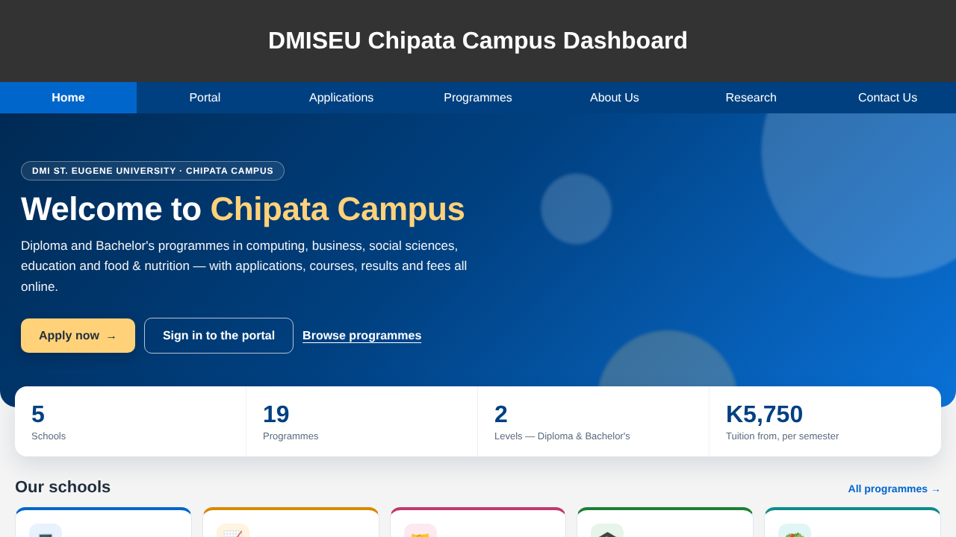
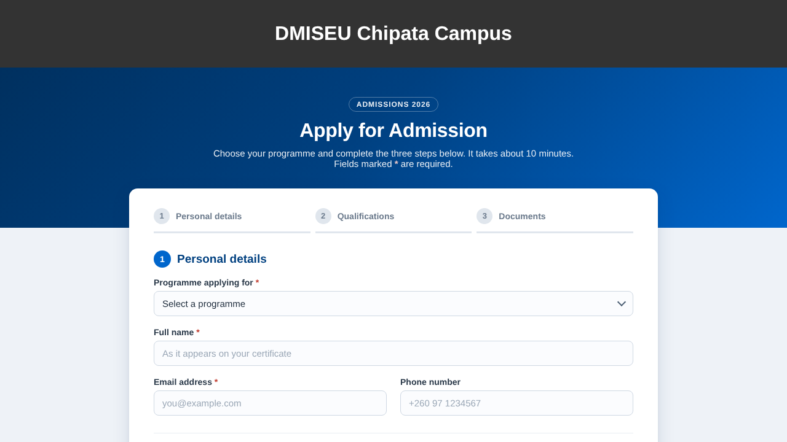
System pages: public website & admissions
3rd Review
Home page
Apply for admission
Schools, programmes and fees, with links to apply or sign in to the student, lecturer or staff portal.
Three-step online application: personal details, qualifications and documents. The registry reviews, adds notes and accepts or rejects.
Notes:
These are the public pages. The home page presents the campus's schools and programmes with their fees and links into each portal. The application page lets a prospective student apply online in three steps; the registry reviews applications on the staff dashboard.

Slide 34
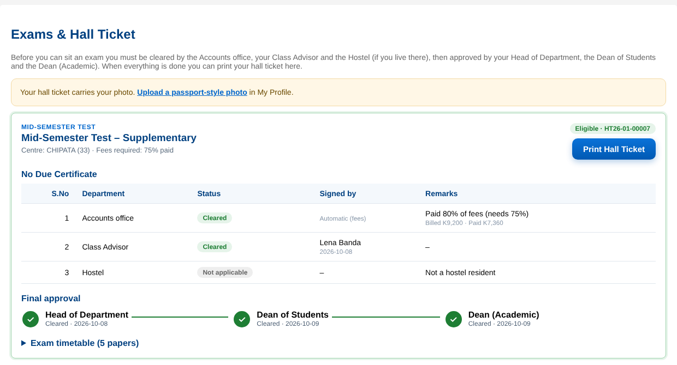
System pages: student exam clearance
3rd Review
Digital No Due Certificate: Accounts, Class Advisor and Hostel, with who signed and when
Accounts shows % paid and how much more is needed
Final approvals shown as a progress tracker
Holds show the officer’s reason
Print Hall Ticket unlocks only when every step is done
Screenshot with sample data
Notes:
This is the student's Exams tab. It is the paper No Due Certificate made digital: each department row shows its status, who signed and when; Accounts shows the percentage paid. Below, the final approvals appear as a progress tracker. The Print Hall Ticket button stays disabled until every step is complete.

Slide 35
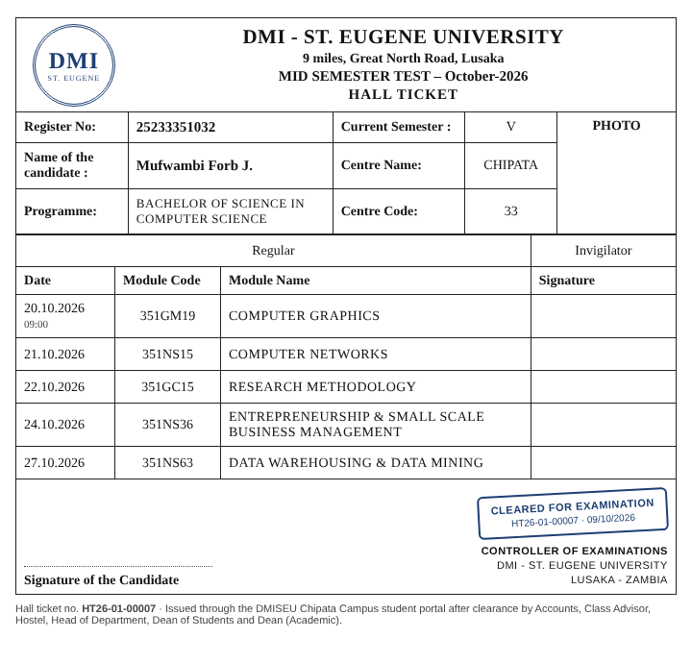
System pages: printable hall ticket
3rd Review
Same layout as the official paper hall ticket
Register no., name, programme, semester, centre name & code, photo
Only the student’s own programme and semester modules
Unique hall ticket number and "cleared for examination" stamp
Instructions to candidates on page 2
Print or save as PDF straight from the browser
Notes:
When all six approvals are in, the student opens and prints this A4 hall ticket. It reproduces the official layout: register number, name, programme, current semester, centre, photo, and the timetable of only their own modules, with a unique ticket number. Page two carries the ten instructions to candidates.

Slide 36
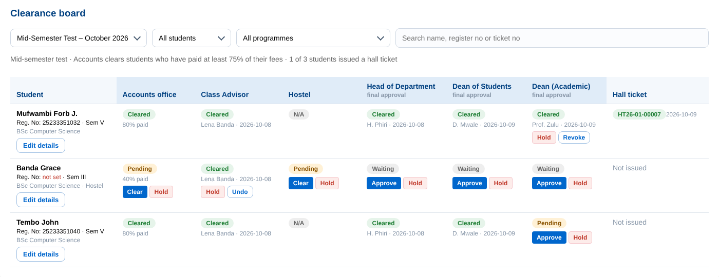
System pages: staff clearance board
3rd Review
One row per student, one column per office
Officers see Clear / Hold only on their own step
"Waiting for me" filter and bulk "Clear all"
Hold asks for a reason, sent to the student
Registry edits register no. and semester
Also on the staff dashboard: exam sessions, programme modules and timetables; semester registration windows and approvals; direct-entry exemptions; fees and payment-proof verification; applications; reports; announcements; users and roles.
Notes:
Staff use this clearance board. Each office sees Clear and Hold buttons only on the step it signs, and the Waiting for me filter shows only students it needs to act on. Holding requires a reason that the student sees. The same dashboard holds the exam session and timetable setup, registration windows, exemptions, fees and the other administrative tools.

Slide 37
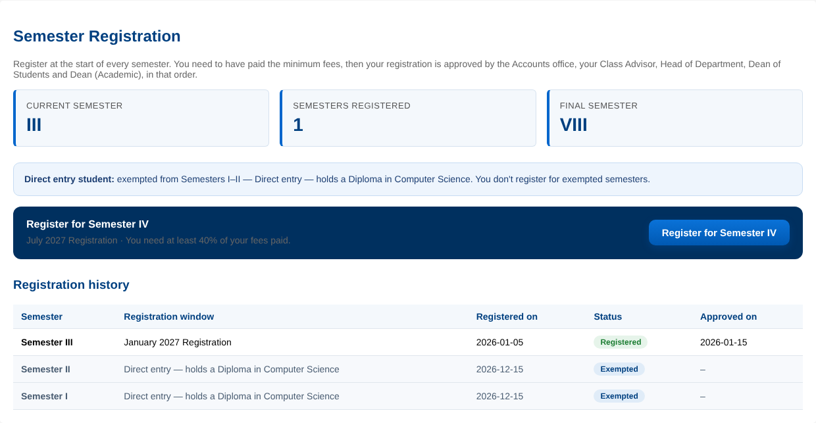
System pages: semester registration & direct entry
3rd Review
New students start in Semester I
Register button for the next semester; 40% fees required
Accounts → Class Advisor → HOD → Dean of Students → Dean (Academic)
Dean (Academic) approval moves the student up a semester
Direct-entry exemptions skip semesters (e.g. I–II → start in III)
Full registration history, including exempted semesters
Screenshot with sample data: a direct-entry student exempted from Semesters I–II
Notes:
This is the Registration tab for a direct-entry student. New students start in Semester One; this student was exempted from Semesters One and Two, so they started in Semester Three. Each semester they press Register; once 40 percent of fees is paid, the five offices approve in order and the Dean Academic's approval moves them up. The history lists every semester, including exempted ones.

Slide 38
Code: authentication & role checks
3rd Review
// middleware/auth.js
function verifyToken(req, res, next) {
const token = (req.headers['authorization'] || '').split(' ')[1];
if (!token) return res.status(401).send('Access token required.');
try {
req.user = jwt.verify(token, process.env.SECRET); // { id, role }
next();
} catch (err) {
return res.status(403).send('Invalid or expired token.');
}
}
function checkRole(...allowedRoles) {
return (req, res, next) => allowedRoles.includes(req.user?.role)
? next() : res.status(403).send('You do not have permission.');
}
// routes/exams.js — only exam managers may create sessions
router.post('/sessions', verifyToken,
checkRole(...ROLES.EXAM_MANAGE), createSession);
Every protected route runs verifyToken, then checkRole
The token carries the user’s id and role, signed with the server SECRET
Expired or altered tokens are rejected
Roles come from one file, utils/roles.js
Notes:
This is the security core. verifyToken reads the Bearer token, verifies its signature with the server secret and attaches the user's id and role to the request. checkRole then allows only the listed roles. Every protected route chains the two, as in the exam-session example at the bottom.

Slide 39
Code: fee rule & ordered approvals
3rd Review
// routes/registration.js (simplified)
const ORDER = ['accounts', 'advisor', 'hod', 'dos', 'academic'];
// Accounts clears automatically once enough fees are paid
const pct = charged > 0 ? Math.floor(paid / charged * 100) : 100;
steps.accounts.status = pct >= period.min_paid_pct // 40%
? 'cleared' : 'pending';
// A step can be signed only after every earlier step
function canAct(user, step, reg, ev) {
if (!STEPS[step].roles.includes(user.role)) return false;
if (user.scoped && user.school !== reg.school) return false;
const before = ORDER.slice(0, ORDER.indexOf(step));
return before.every(k => ev.steps[k].status === 'cleared');
}
// Final approval moves the student to the new semester
UPDATE students SET current_semester = ? WHERE student_id = ?
The 40% fee rule is checked live from the fee ledger
Offices can only sign in order; HODs and lecturers only for their own school
Holding a step resets every later step
Exam clearance uses the same design with 75% and a Hostel step
Notes:
This simplified excerpt shows the registration rules. Accounts status is calculated live from paid versus billed fees against the window's minimum, 40 percent. canAct allows a user to sign a step only if their role matches, the student is in their school where that applies, and every earlier step is cleared. The final approval updates the student's current semester.

Slide 40


Conclusion & summary
3rd Review
The Online School Portal turns DMISEU Chipata Campus’s paper processes into one secure web system. Students can apply, pay, register, learn, see results and print hall tickets; staff approve in the correct order from anywhere.
Objectives met
Real process, digitised
Secure by design
Tested
Admissions, role-based portals, fees, registration, coursework, results, clearance, hall tickets, exemptions and notifications are all working.
The six-office No Due Certificate and five-step registration run as ordered digital approvals.
Hashed passwords, expiring tokens, server-side role checks and parameterised SQL.
Logic, API flow and page tests pass; a defect found on the real database was fixed.
Future work Mobile-money and bank payment integration · SMS and e-mail alerts · management analytics · user acceptance testing and roll-out to other DMISEU campuses
Notes:
In conclusion, the portal meets its objectives: every planned module works, the real paper approval chains now run digitally in the correct order, security is built in, and the system has been tested. Future work includes online payment integration, SMS and e-mail alerts, analytics for management, user acceptance testing and extension to other campuses. Thank you.

Slide 41
References
Davis, F. D. (1989). Perceived usefulness, perceived ease of use, and user acceptance of information technology. MIS Quarterly, 13(3), 319–340.
DeLone, W. H., & McLean, E. R. (2003). The DeLone and McLean model of information systems success: A ten-year update. Journal of Management Information Systems, 19(4), 9–30.
Kaggwa, J. L. (2010). Web-based students’ academic management system: A case of School of Computer Studies, Kampala International University [Bachelor’s report]. Kampala International University.
Lubanga, S., Majawa, F., Kapondera, S., & Chawinga, W. D. (2018). Web based student information management system in universities: Experience from Mzuzu University. Proceedings of SCECSAL XXIII, Entebbe, Uganda.
Rabaa’i, A. A. (2009). Identifying critical success factors of ERP systems at the higher education sector [Conference paper]. CORE. https://core.ac.uk/display/10895619
University of Zambia. (n.d.). Course registration on the Student Information System. https://www.unza.zm/sites/default/files/article_files/2020-01/Course%20Registration.pdf
Notes:
These are the sources cited in the literature review and the comparison.

Slide 42

Thank you
Questions & discussion
Forb Joseph Mufwambi · 351PJ01 Mini Project · DMI-St. Eugene University, Chipata Campus
Notes:
Thank you. I welcome your questions.

