Slide 1

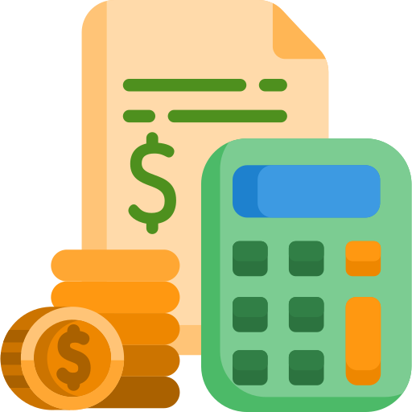
CS50 Final Project
16-Aug-2024
Yangon, Myanmar
BUDGETARY
By:
Aung Myin Moe
GitHub:
Ammmoe
edX:
AungMyinMoe

