Slide 1
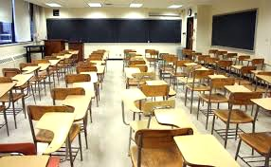
C
Classly

Slide 2
Problem Statement
It’s the end of your first day of school and you now have a syllabus for your Calculus Class
Imagine Highlighting 15 dates in a class syllabus
Manually flipping through pages and writing each date and assignment in your agenda
Or even manually typing each date in your digital calendar
Keep in this mind this is just for one class

Slide 3
Product Process
Upload syllabus into the web application portal
It will parse to identify dates and keywords in the document
Add those dates into your google calendar
Unique: The next best digital alternative is Blackboard.
Log into Blackboard
Select Your Class
Select announcements
Scroll through assignments
Press Control F

Slide 4
Resources Required to Implement Product
Content Management System
Front-End Developer
Back-End Developer
Google Calendar API

Slide 5
Use Case Scenario
Name: Garret Williams
Age: 21
Major: Chemical Engineering
Description of Use:
Garret Williams is taking 21 credits and is a student at Howard University. He is also Mr. Howard, and is involved in several extra-curricular activities.
He will use Classly to optimize scheduling his classes because he does not have time to manually input the data

Slide 6
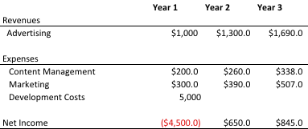
Business Model and Financials
Break Even Point of 2 years
Acquisition Strategy: We plan on leveraging partnerships with professors to offer extra credit

